Slide 1
Disruptive Library Landscape
April 12, 2013
Susan Gibbons,
Yale University Librarian

Slide 2
Disruptive Forces
Return on Investment (ROI)
Legal Challenges
MOOCs
Digital Preservation

Slide 3
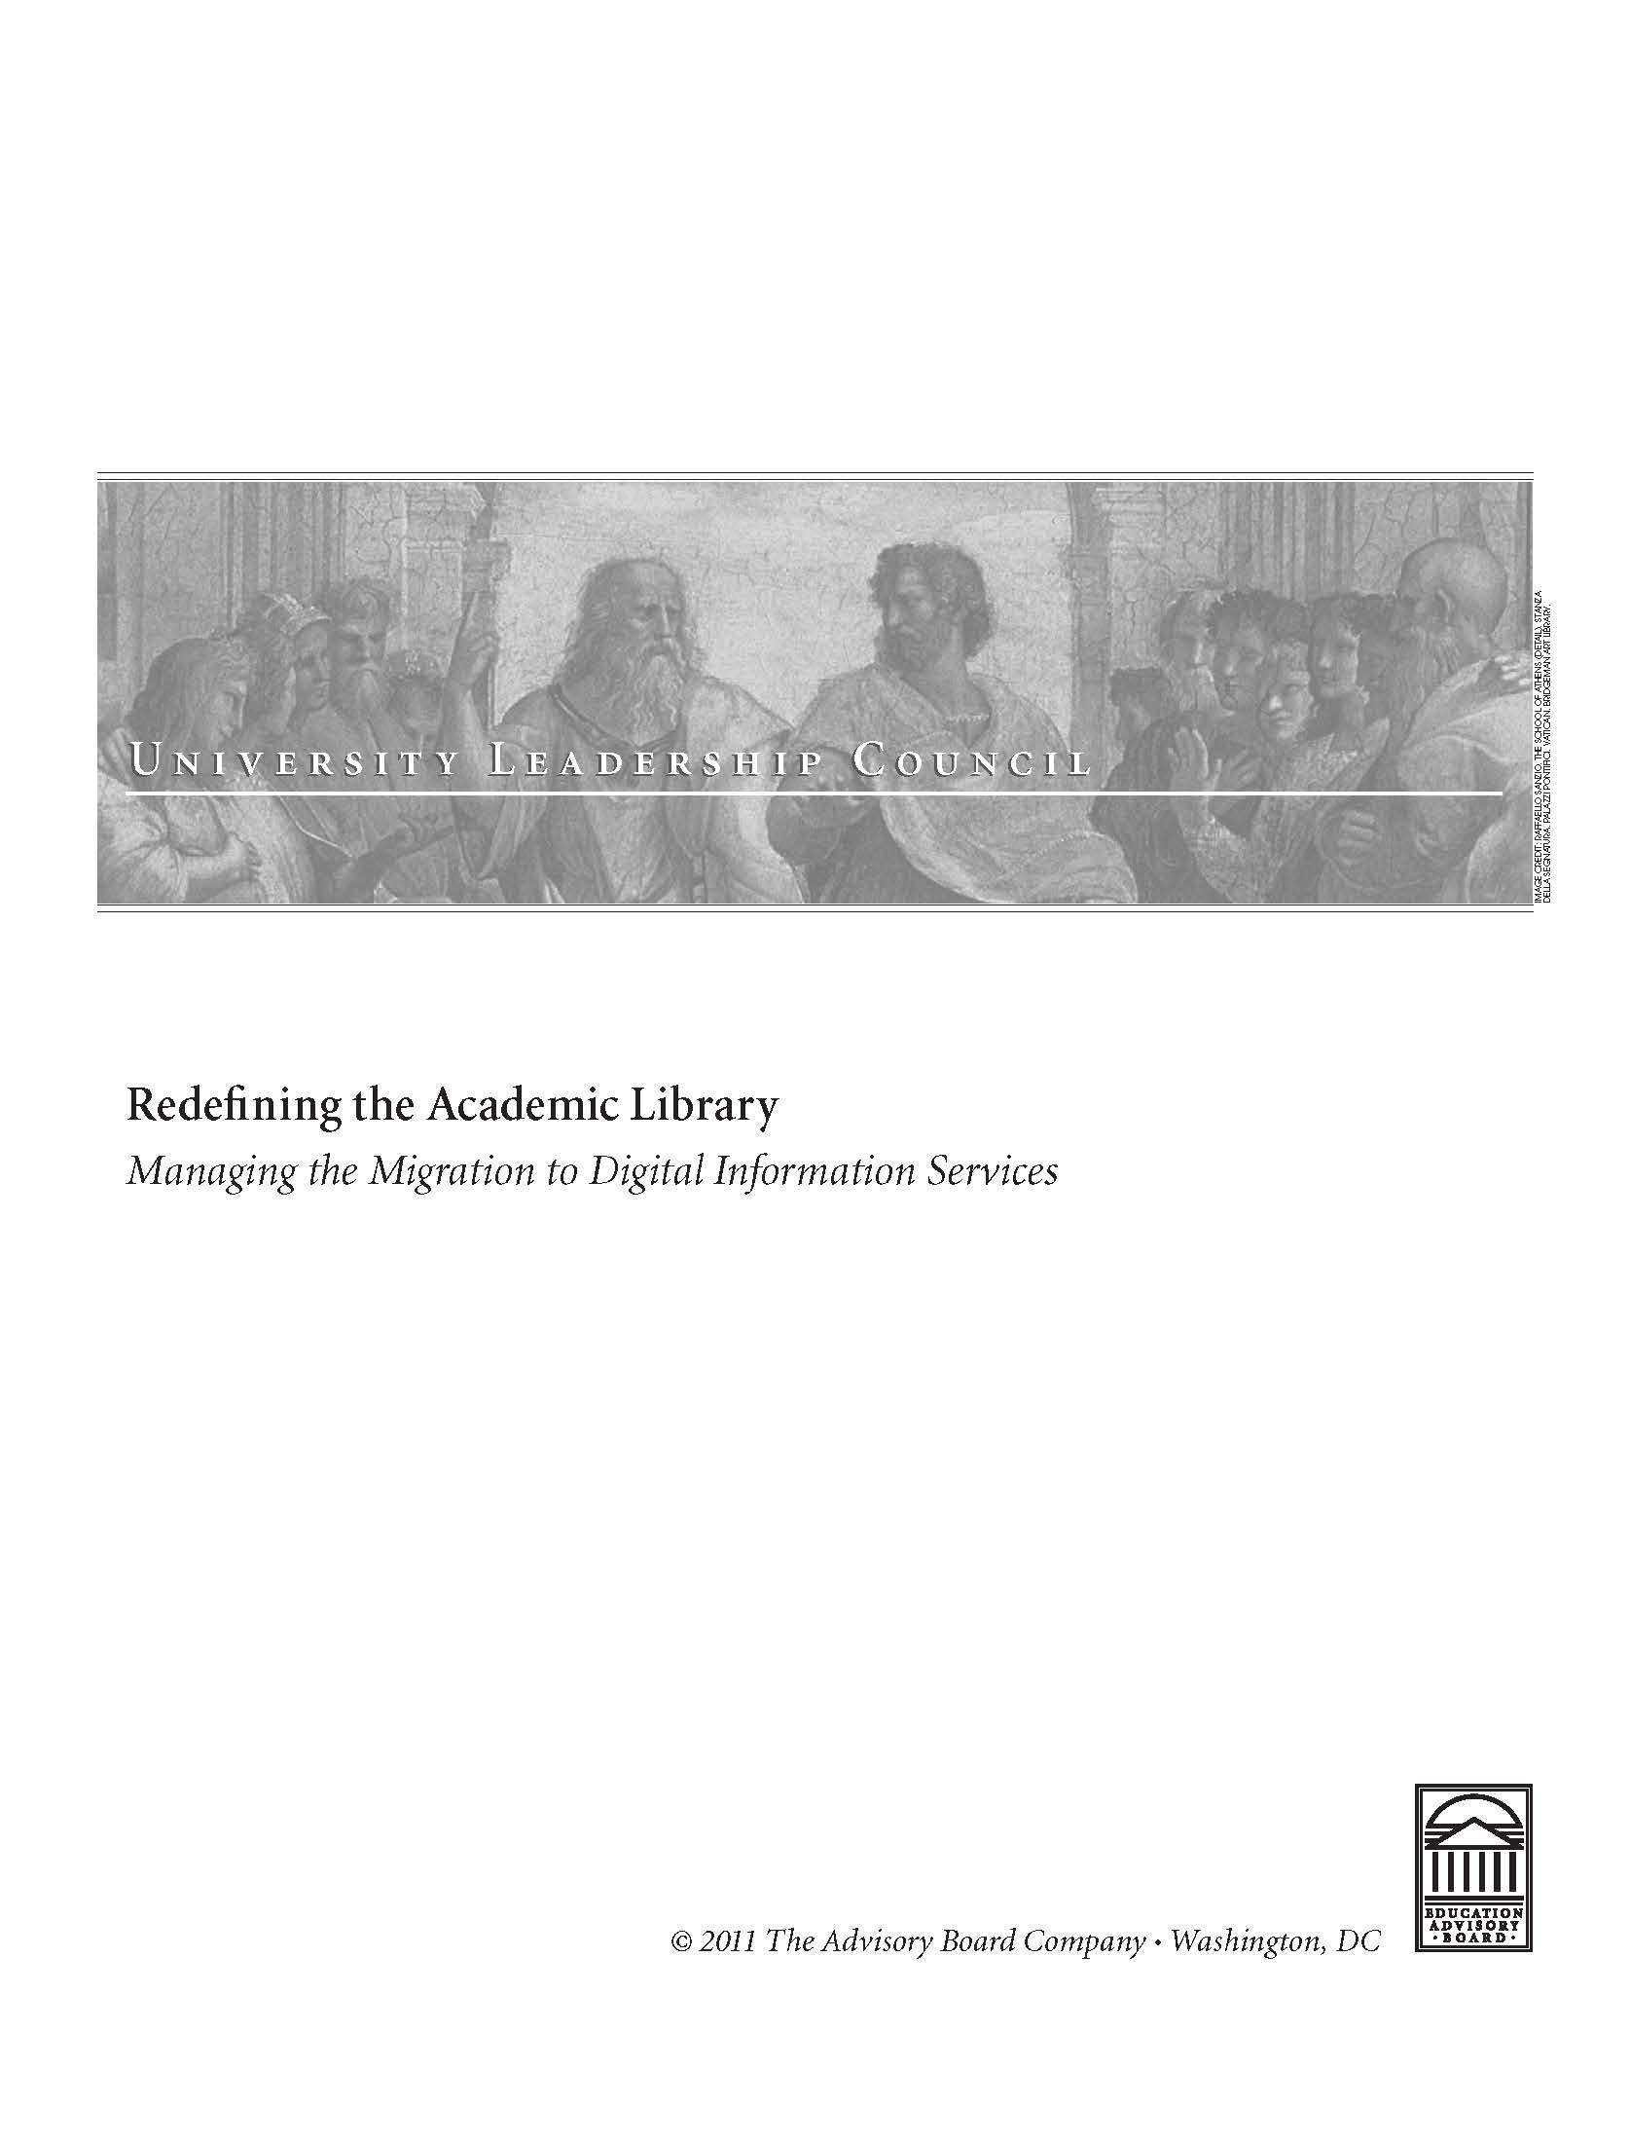
How do Presidents/Provosts Think about Libraries?
Education Advisory Board’s Redefining the Academic Library: Managing the Migration to Digital Information Services. 2011.

Slide 4
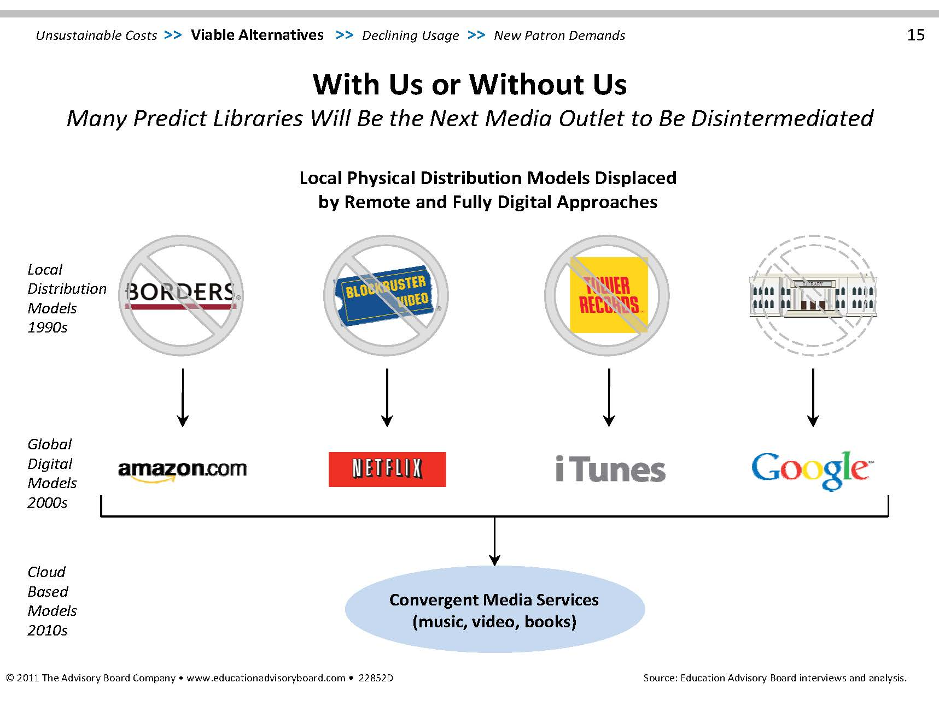

Slide 5
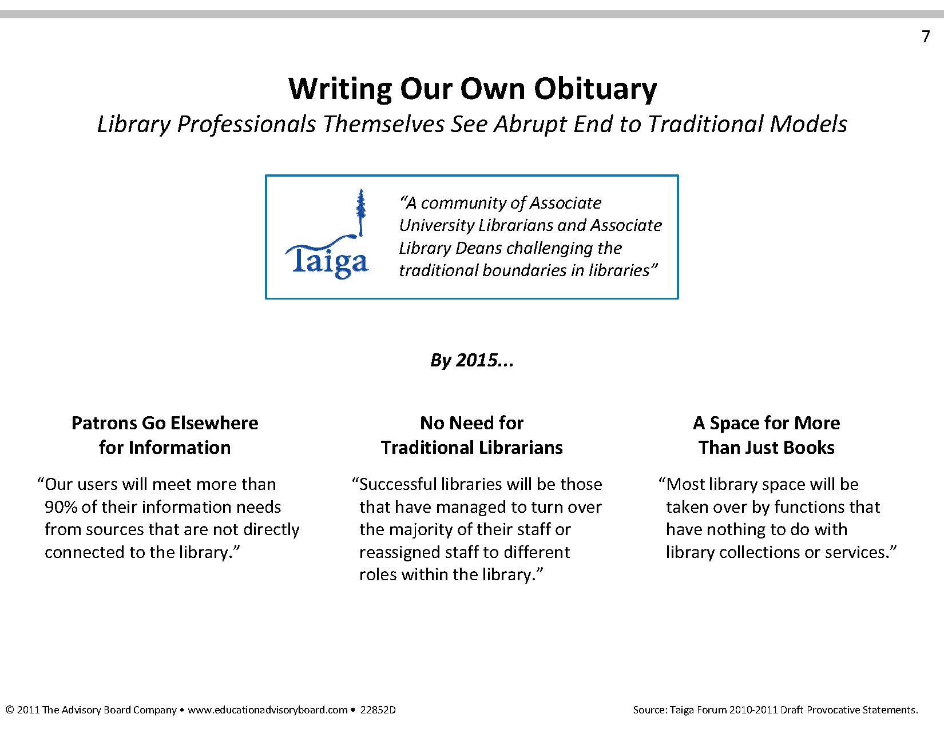

Slide 6
Return on Investment Metrics
Size of collection

Slide 7
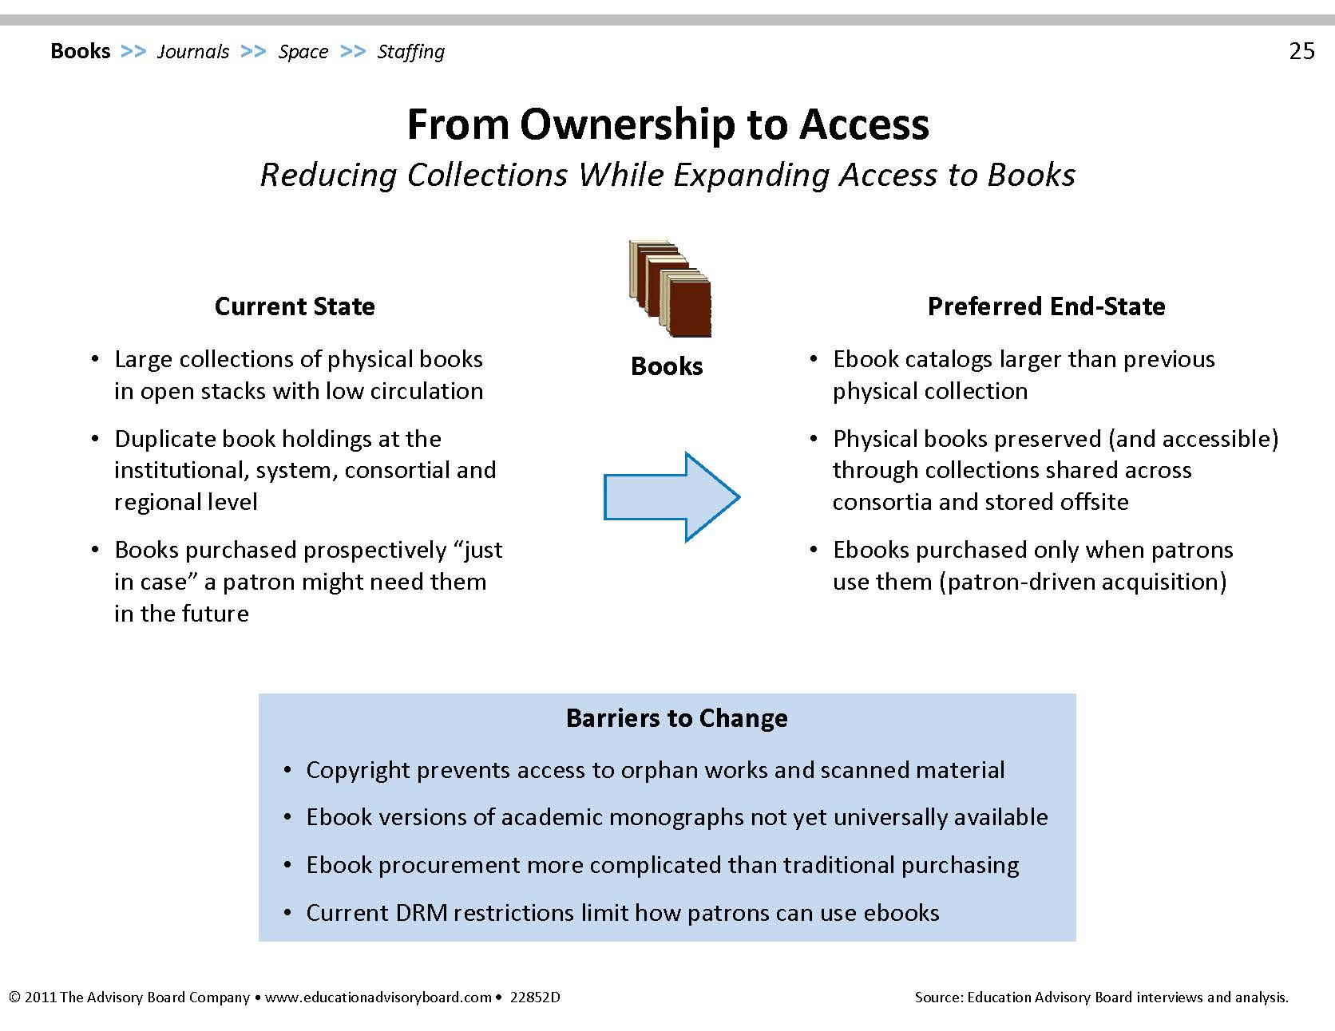

Slide 8
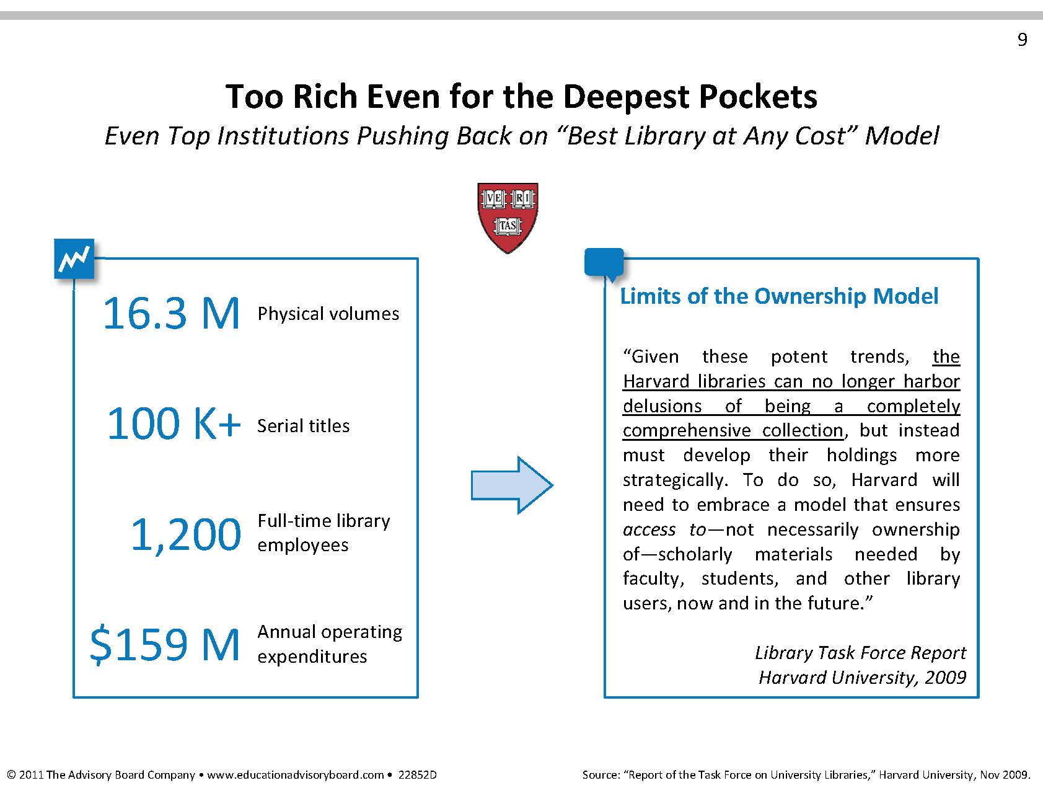

Slide 9
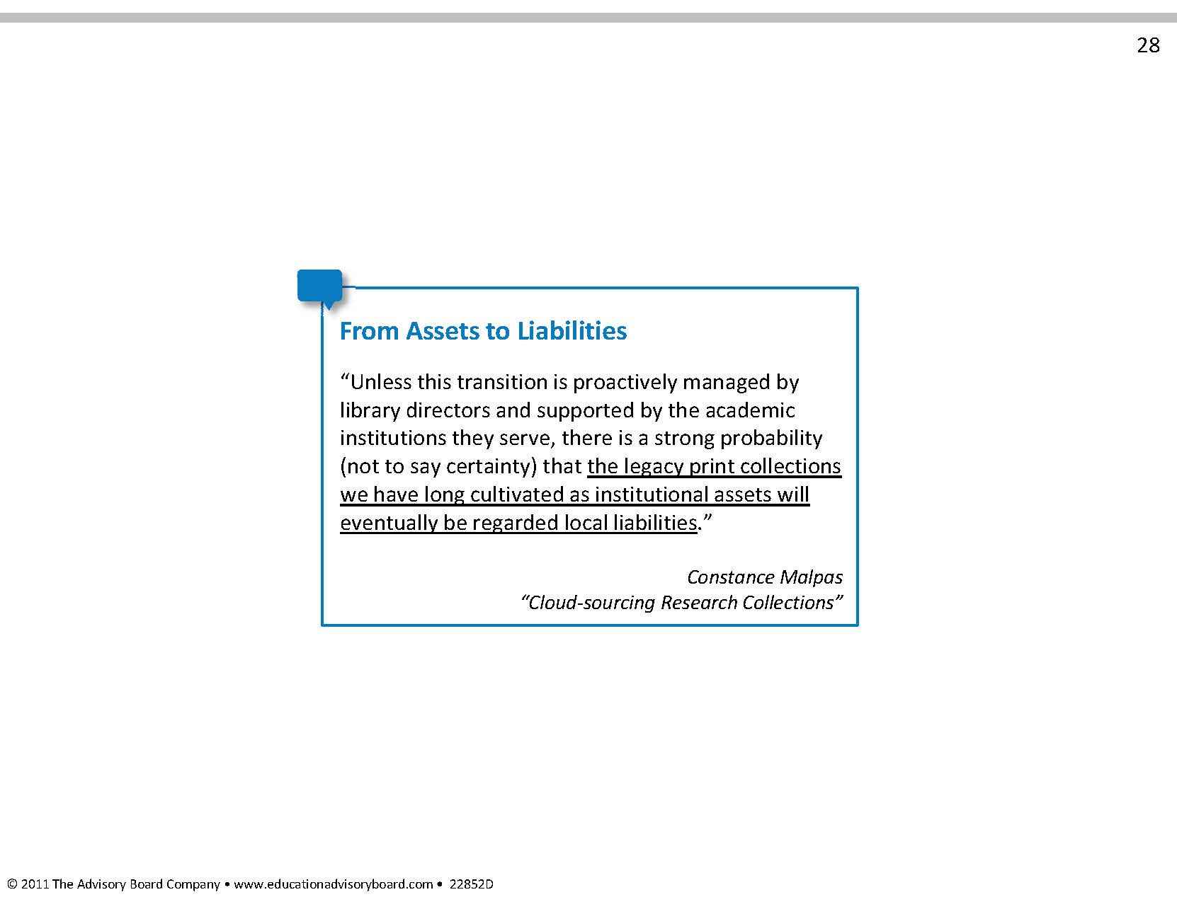

Slide 10
Cooperative Collection Development
Delivery mechanisms of collections & expertise
Robust, real-time collection analysis tools
Trust beyond a handshake
Response of scholars

Slide 11
Return on Investment Metrics
Size of collection
Circulation

Slide 12
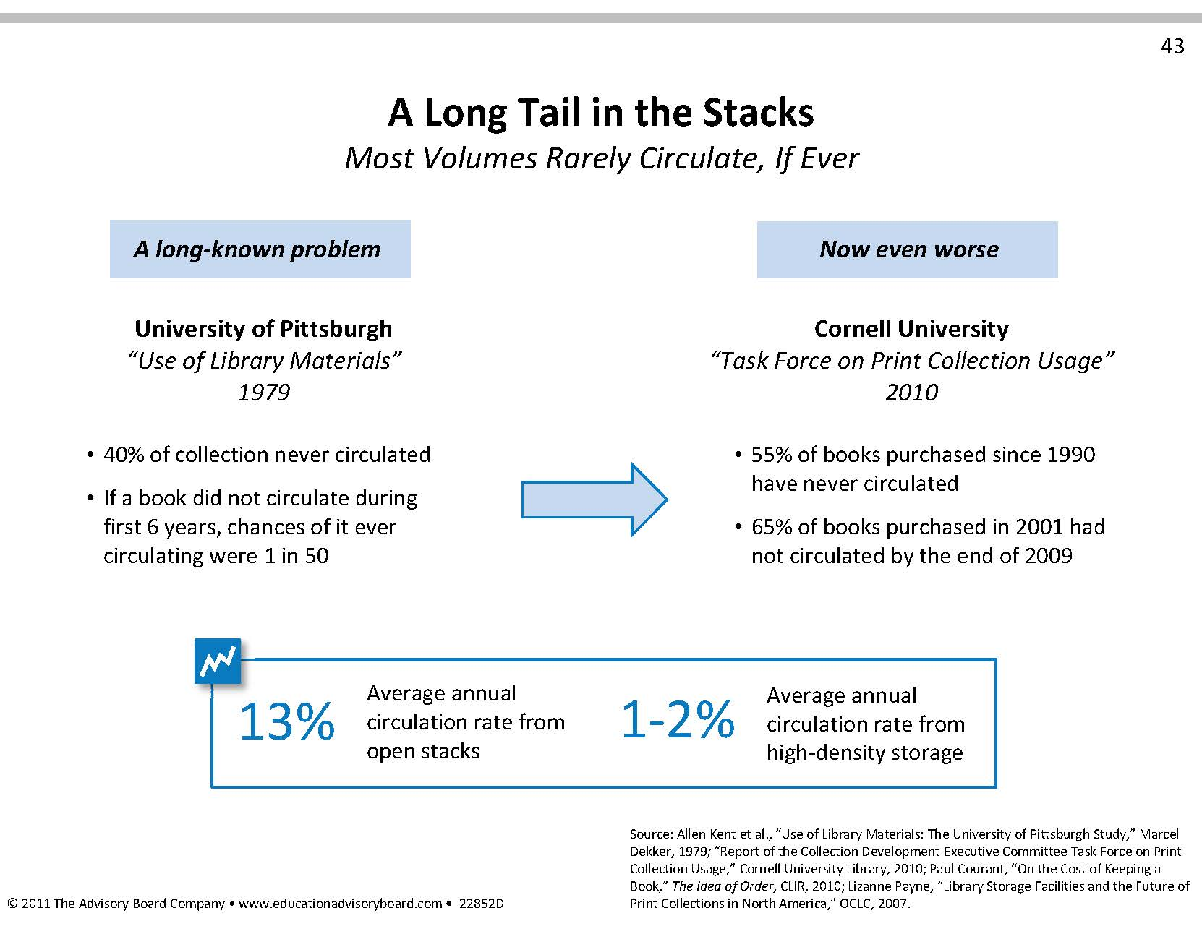

Slide 13
Patron-Driven Acquisitions
Discovery mechanisms for what’s available
Buy or Borrow?
Response time
  Print on demand- Espresso Machines
Long-term impact on collections

Slide 14
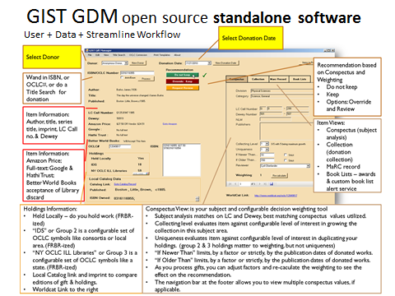

Slide 15
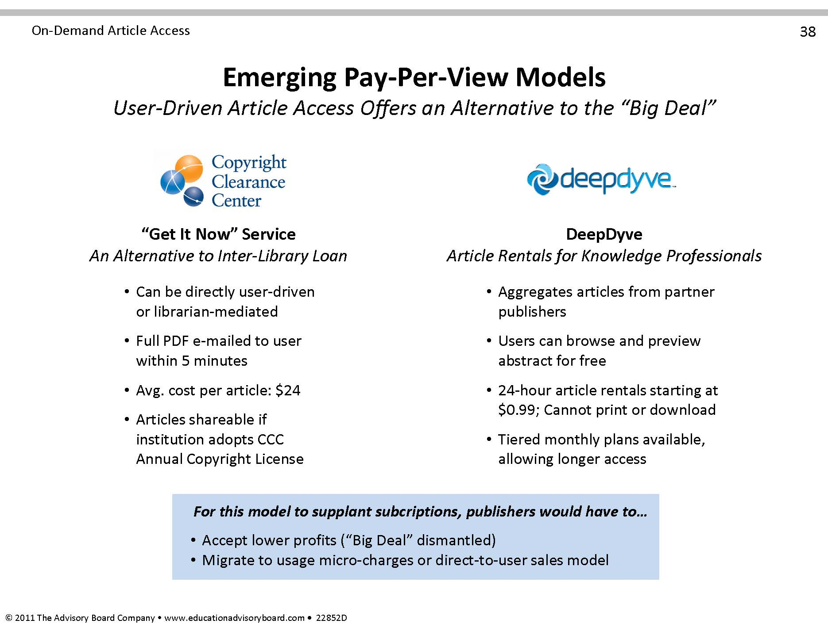

Slide 16
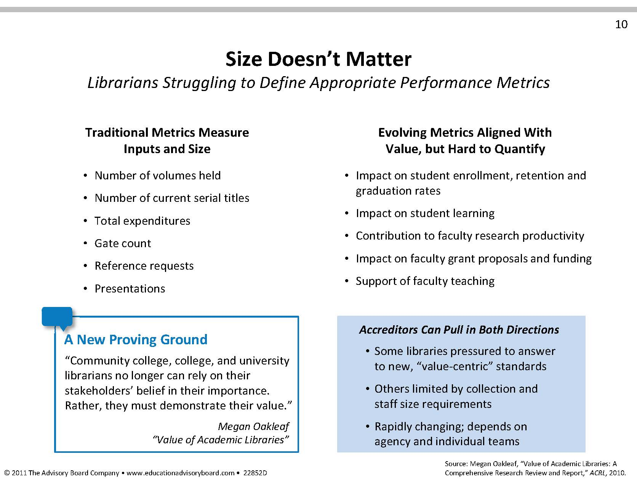

Slide 17

University of Rochester
“Rochester Method”: Adopting methods from anthropology & ethnography to study library users
What are the barriers to dissertation completion?
What steps do undergraduate take in completing a research paper?
Why are the faculty not using the institutional repository?
Why do students continue to use the physical science library facility when so much of the science literature is now available online?

Slide 18
Legal Challenges
Section 108- copyright exceptions for libraries and museums.
Georgia State University- electronic reserves. “Reasonably priced, readily available license for digital excerpts”

Slide 19


MOOCs

Slide 20
LOCKSS and Portico Coverage
Cornell data
LOCKSS only: 3.9%
Portico only: 14.5%
LOCKSS and Portico: 7.6%
  Not necessarily same holdings
Total coverage: 26.1% of titles
Notes:
Early in 2011, the list of Cornell e-journals was compared to the titles preserved in both LOCKSS and Portico as of that date, with the results shown here. A similar analysis of Columbia’s data in April showed slightly greater coverage, but not a significant difference.
The differences in coverage between LOCKSS and Portico were large enough to suggest that on these grounds alone there are good reasons to invest in both strategies, but we were struck by the low percentage of all e-journals covered by either system, leading us to take a closer look at the results.

Slide 21
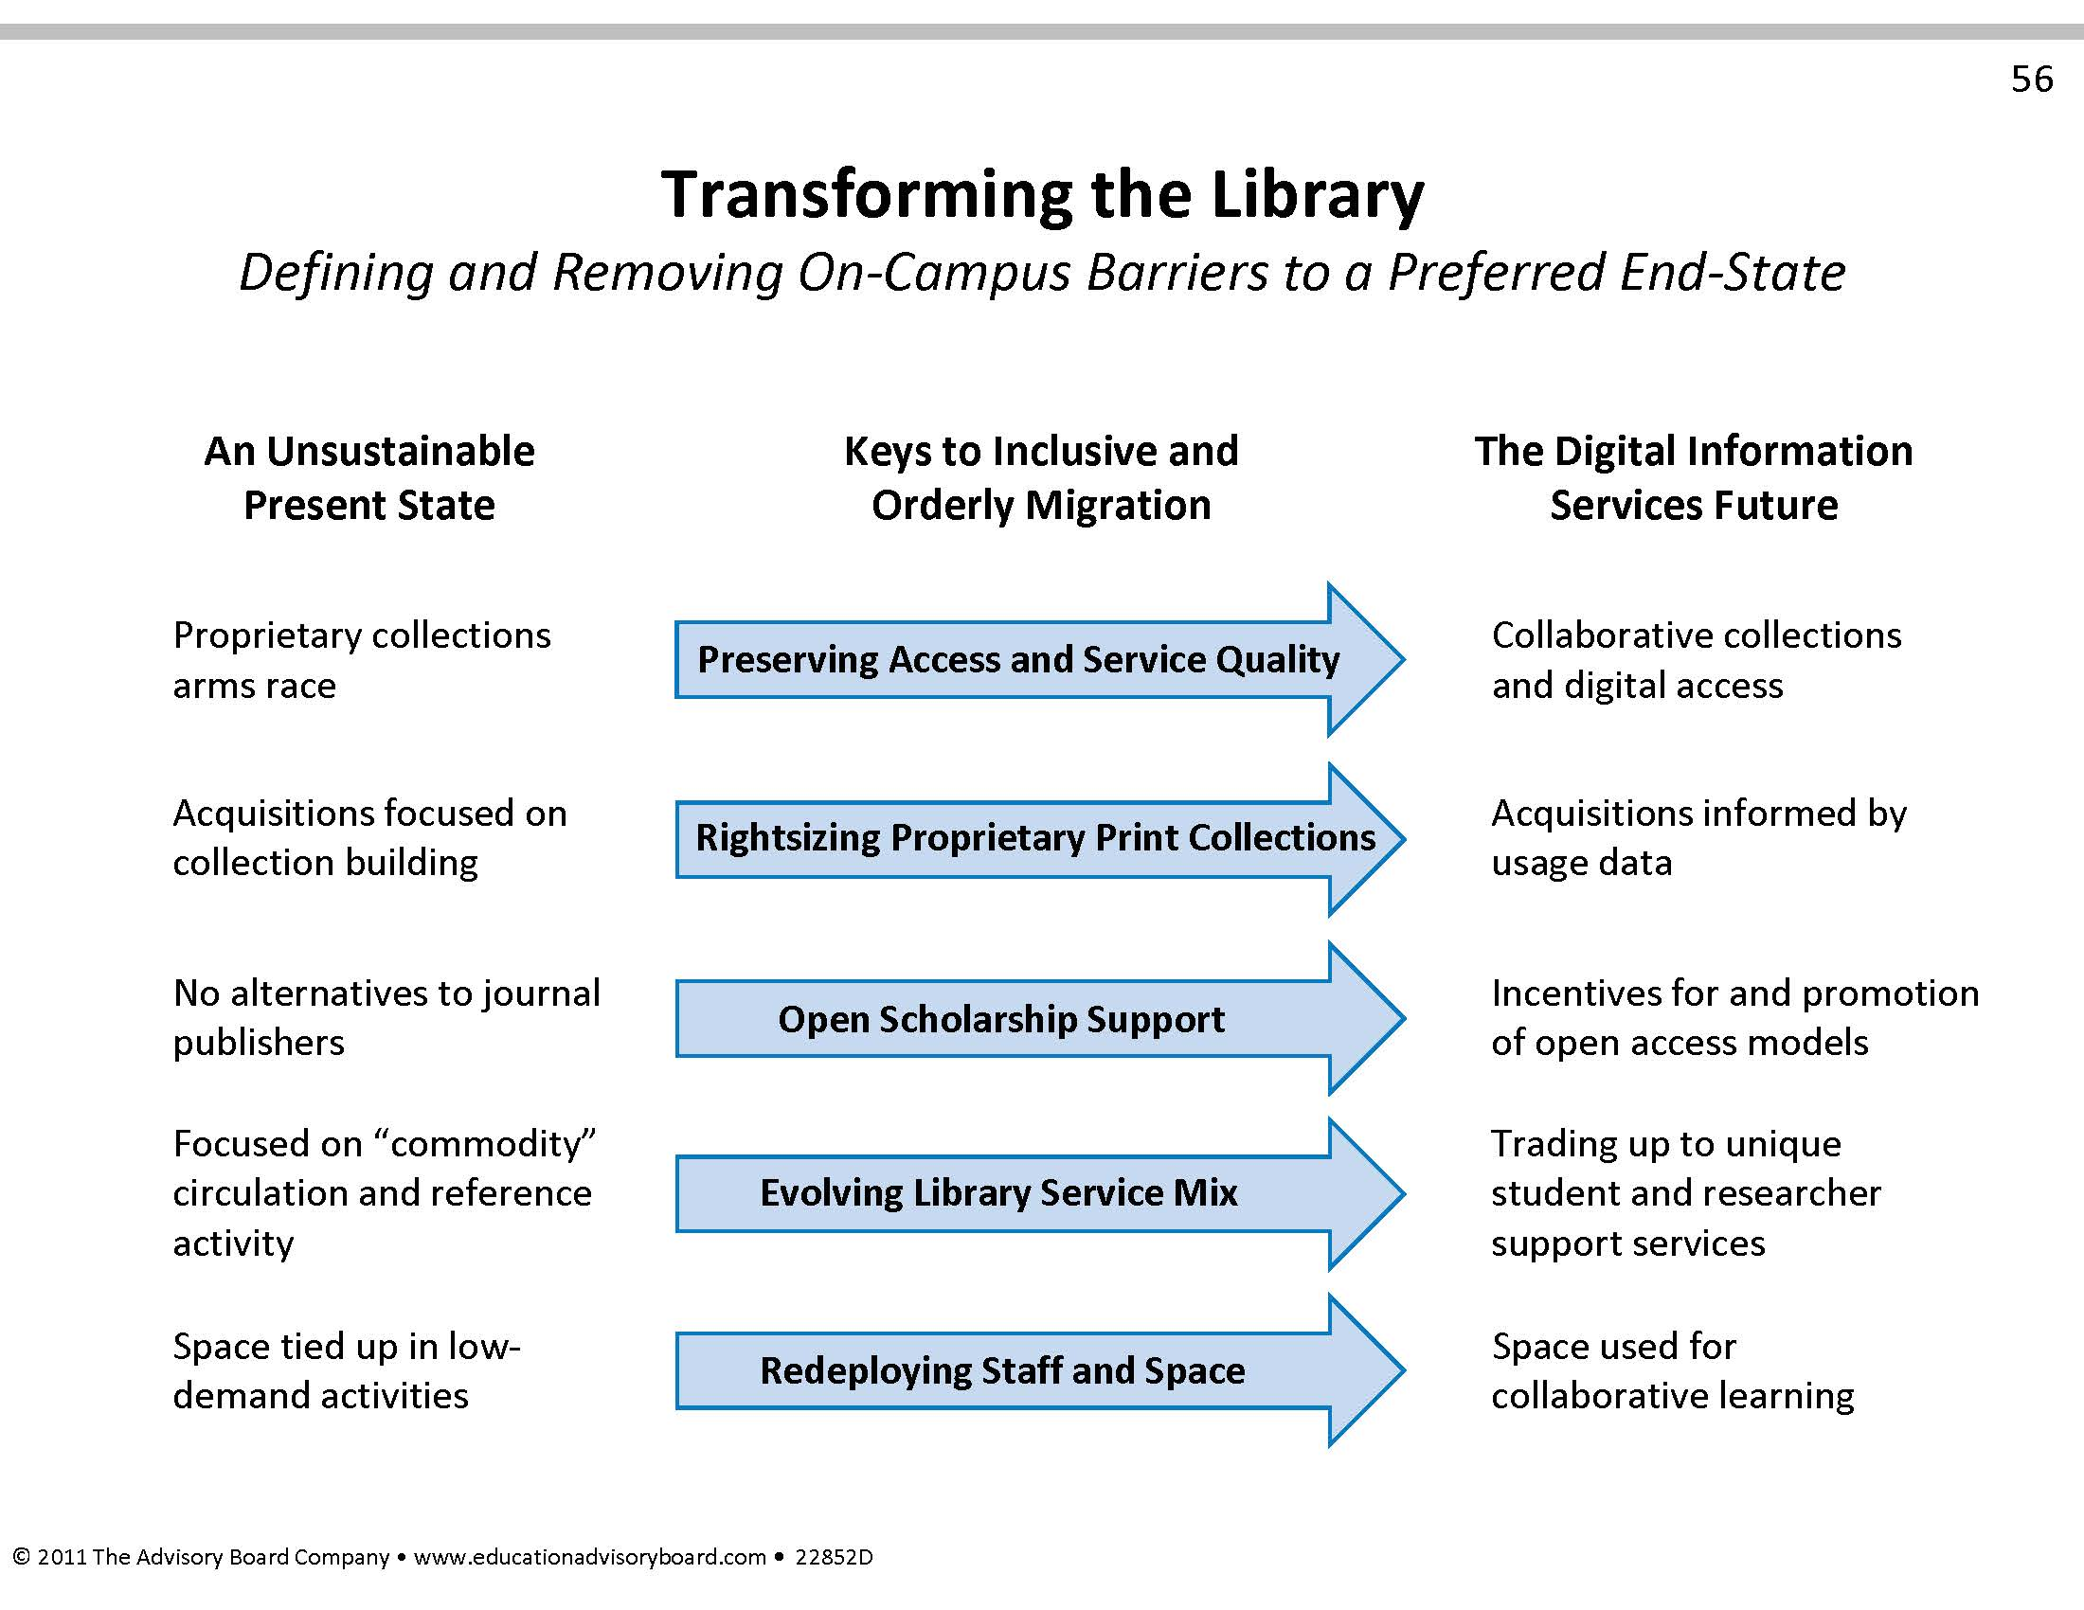

Slide 22


