Slide 1
Getting Started with MarcEdit
New England Library Association Fall 2013 Conference
Oct. 22nd, 2013
Ben Abrahamse
Cataloging Coordinator,
Acquisitions and Discovery Enhancement,
MIT Libraries

Slide 2
Dumb questions about MarcEdit that you'd like to ask but won't because you're afraid if you did then people might think you're dumb.
Part One

Slide 3
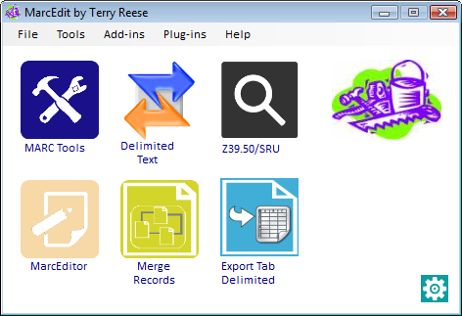
Q:
What is MARC Edit?

Slide 4

Q:
How much does MarcEdit cost?
$0

Slide 5

Q: How do I get MarcEdit?
http://marcedit.reeset.net

Slide 6



Q: What platforms does
MarcEdit run on?

Slide 7
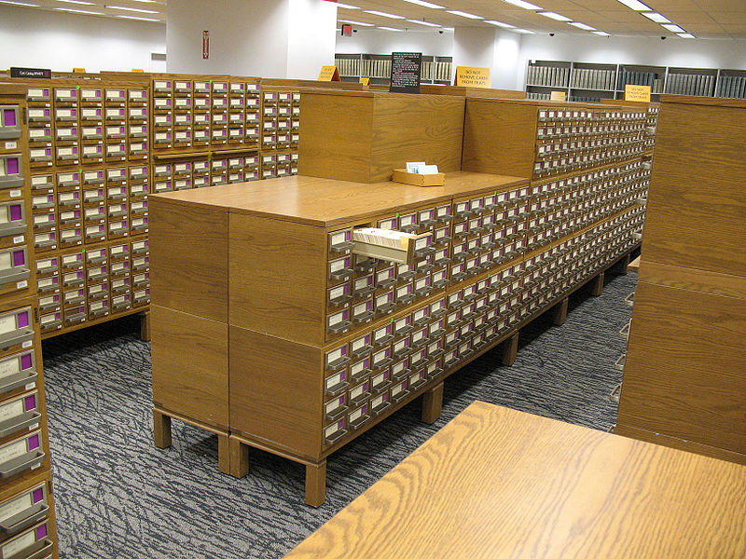
Q: How will MarcEdit replace my existing cataloging tools?

Slide 8



Q: What are MarcEdit's basic functions?
1. Acquire metadata

Slide 9

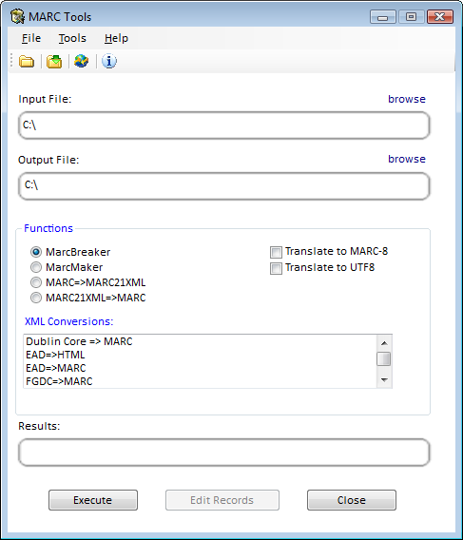

Q: What are MarcEdit's basic functions?
2. Import MARC (and other) metadata and convert it into plain text
MarcBreaker
Converts raw MARC (*.mrc) files to editable plain-text format (*.mrk).
Import comma- or tab-delimited text (from a spreadsheet, for example)
MARC ←→ XML
Converts raw MARC (*.mrc) to MARC21XML (*.xml).

Slide 10

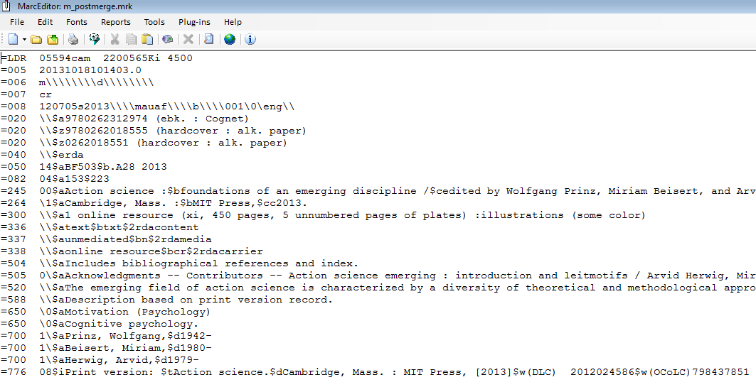
Q: What are MarcEdit's basic functions?
3. Edit MARC metadata as plain text
in a text editor that has MARC-specific tools.

Slide 11

Q: What are MarcEdit's basic functions?
4. Export plain text as MARC (and other metadata schemes)
MarcMaker
Converts edited plain-text back into raw MARC.
Export into tab- or comma-delimited (for spreadsheets)
Other XML
Converts MARC21XML to other XML format (EAD, DC, etc.)

Slide 12
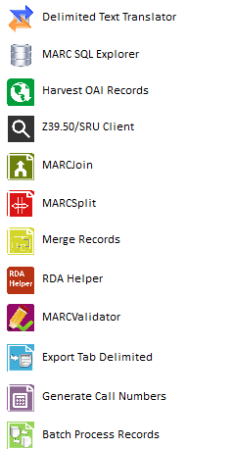
Q: What are MarcEdit's basic functions?
5. A bunch of other useful stuff

Slide 13

Q: Does MarcEdit work with MARC-8, with Unicode, or both?
é
Unicode
e ´
MARC-8
Raw MARC
{acute}e
In MARC Editor
é
Unicode
e ´
MARC-8

Slide 14
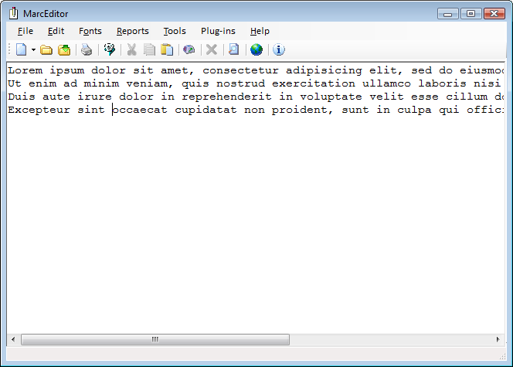
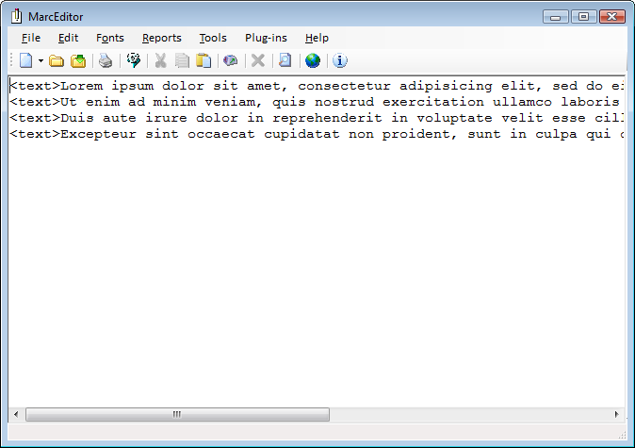
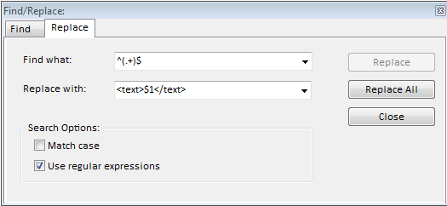
Q: Can MARC Edit be used on non-MARC metadata?

Slide 15

Q: What kind of support is available for people learning to use MarcEdit?
MarcEdit email list:
MARCEDIT-L@metis3.gmu.edu
To subscribe, send to the email address above a message with the text in the body (not the subject line):
SUBSCRIBE MARCEDIT-L
MarcEdit wiki:
http://marcedit.reeset.net/wiki/

Slide 16
A closer look at the MARC Editor:
"Itirative" editing tools
Part Two

Slide 17
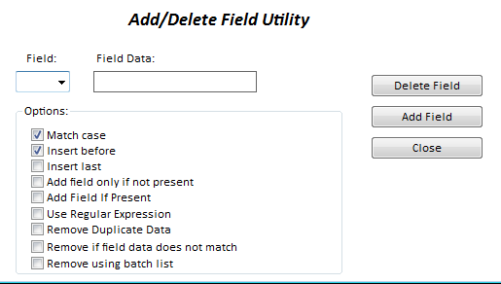
(MARC) Tools of the Trade
1. Adding/deleting entire fields

Slide 18
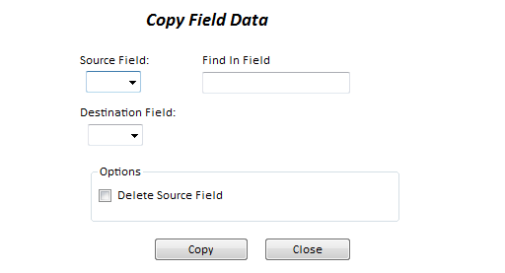
(MARC) Tools of the Trade
2. Copying entire fields

Slide 19
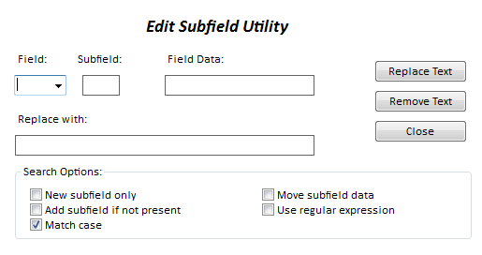
(MARC) Tools of the Trade
3. Adding/deleting/modifying subfields

Slide 20
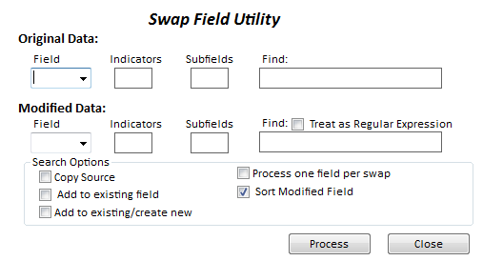
(MARC) Tools of the Trade
4. "Swapping" subfield data

Slide 21
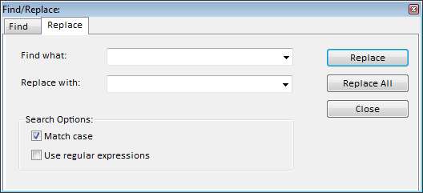
(MARC) Tools of the Trade
5. RegEx find and replace

Slide 22
An example of using MarcEdit to complete a painful project, less painfully...
Part Three

Slide 23
The project:
Provide records for MIT Press e-books
Already cataloged as print
Convert AACR2 to RDA (when necessary)

Slide 24
Publisher-supplied metadata (pub list)
Provided as spreadsheet, including title, publication date, and ISBNs (for print and electronic).
Wants to supply MARC records for online version in both MARC-8 and UTF.
MARC records

Slide 25
Publisher-supplied metadata (pub list)
Use MarcEdit's Z39.50 client to search OCLC (or LC, etc.) for existing records.
As a match-point, use publisher-supplied ISBNs.
Easiest to find all relevant records then "winnow out" bad records.
Search for existing MARC records
MARC records

Slide 26
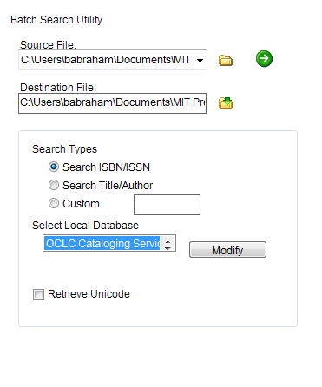
Z39.50 client in "Batch mode"

Slide 27
Publisher-supplied metadata (pub list)
Using MARC Edit's "Export tab-delimited" tool, import selected field values into a spreadsheet.
Useful data:
Encoding level (LDR/17)
Form of item ff (006/06)
PCC/LC (042 $a)
Title (245 $a)
Edition (250 $a)
Pub. date (260 $c)
Remember also always to include the system number (e.g. OCLC number 035 $a) as a unique identifier for each record!
Search for existing MARC records
Winnow out "bad" MARC records
MARC records

Slide 28
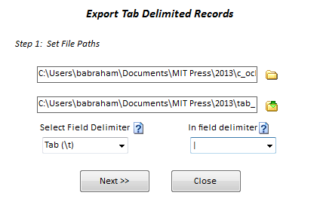
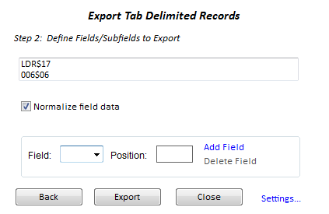
Exporting tab-delimited

Slide 29
Publisher-supplied metadata (pub list)
Now import the tab-delimited file into a spreadsheet. Sorting and filtering the data will enable you to see what kind of records exist for each title.
You can then go about easily selecting the best records to use as a basis from which to derive new records.
Search for existing MARC records
Winnow out "bad" MARC records
Once you've identified the records you want to keep, you can requery OCLC (etc.) by the system numbers of the "keepers" only.
MARC records

Slide 30
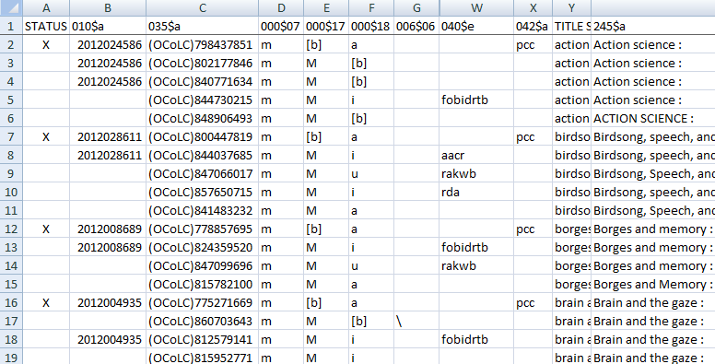
Using a spreadsheet to identify the best records

Slide 31
Publisher-supplied metadata (pub list)
Convert the MARC records to MarcEdit format and open it with the editor.
Use the "Add/Remove Fields" to remove junk fields.
You can remove a range of fields by just inserting the first digit in the "Find" box.
Search for existing MARC records
Winnow out "bad" MARC records
Remove non-relevant MARC data (9xx, etc.)
MARC records

Slide 32
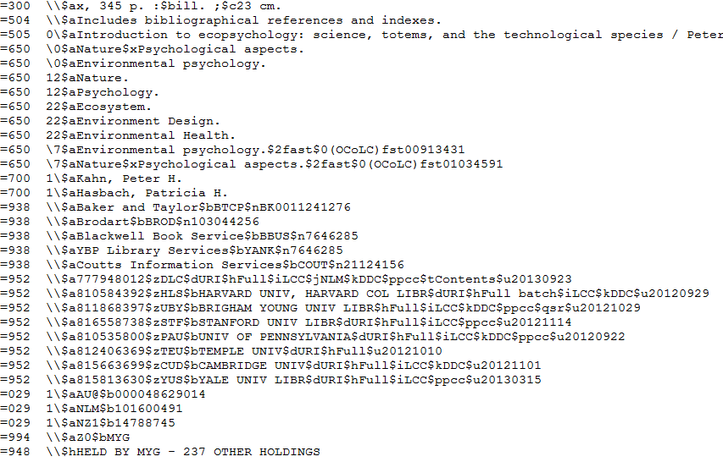
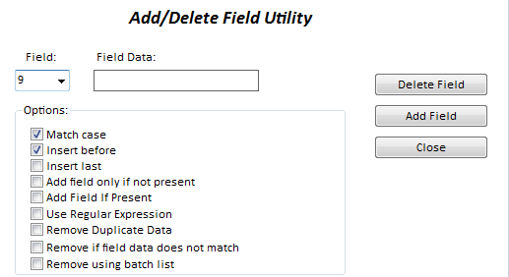
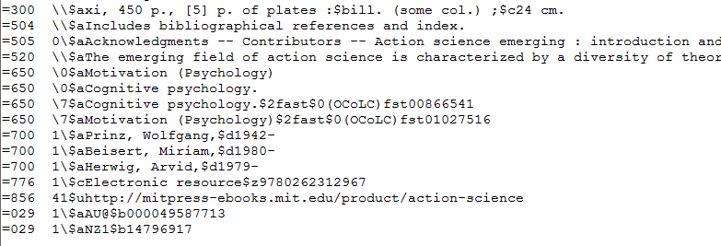
Removing junk fields

Slide 33
Publisher-supplied metadata (pub list)
You can save the file in MarcEdit format then use the "RDA Helper" tool to perform various basic AACR2-RDA conversions.
There is also a tool in the MARC Editor which will do it on the fly.
Search for existing MARC records
Winnow out "bad" MARC records
Remove non-relevant MARC data (9xx, etc.)
Convert to RDA
NOTE the "RDA Helper" only does basic RDA conversions like updating fixed fields, spelling out abbreviations and adding 33x fields.
Depending on how correct you need the records to be you may still need to look at them individually to find errors.
MARC records

Slide 34
Here we get down into the nitty-gritty of the editor. Converting print to e requires several changes:
--changing appropriate fixed fields
--adding 007's
--updating 300 $a
--adding URLs if necessary
--adding 776 that references print version record
Publisher-supplied metadata (pub list)
Search for existing MARC records
Select best existing MARC records
Remove non-relevant MARC data (9xx, etc.)
Convert to RDA
Convert from record for print manifestation to record for online manifestation
These changes can be implemented using a combination of MARC tools and Regex find-replace.
MARC records

Slide 35
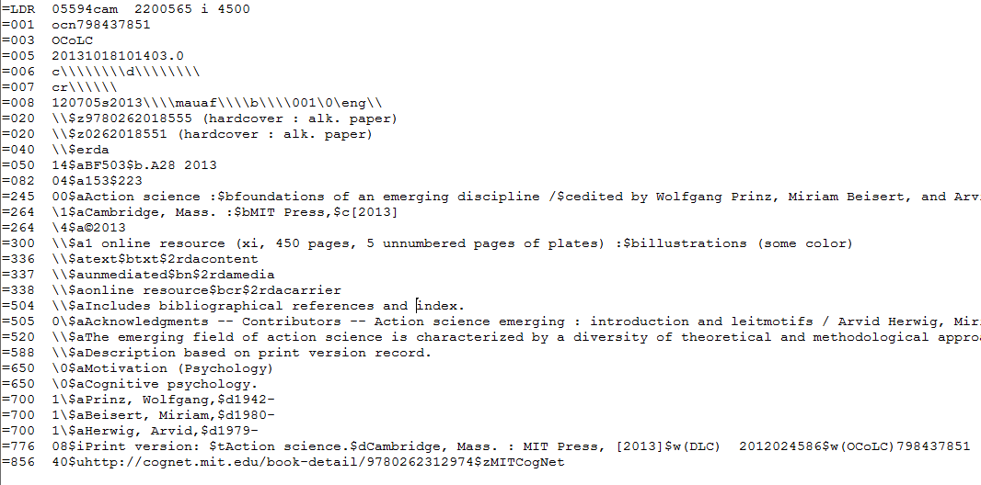
Finished* Product
* As all catalogers know a record is never really finished.

Slide 36
Thanks for your attention... any questions?

