Slide 1
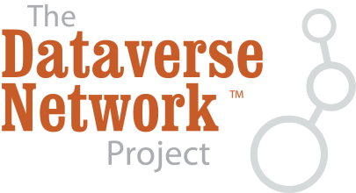


Helping Journals to Upgrade Data Publications for Reusable Research
Sonia Barbosa (Project Manager)
Eleni Castro (Project Coordinator)
Institute for Quantitative Social Science (IQSS)
Harvard University
@thedataorg

Slide 2
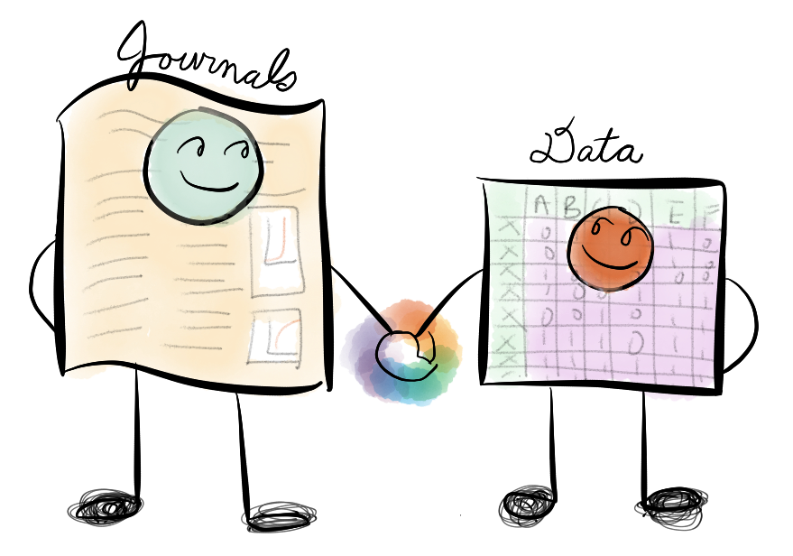
Purpose
Photo: Jean Liu

Slide 3
We propose to enable journals to:
  Seamlessly manage the submission, review, and publication of data associated with published articles
  The project addresses the needs of journal publishers and editors rather than focusing exclusively on researchers and archivists.
  The project focuses on the integration of data into the journal submission and publishing process, rather than on earlier stages of data creation and use.
  We plan to do this by integrating two well-established open-source systems:
    The Dataverse Network [King 2007; Crosas 2011]
    Open Journal Systems (OJS) [Willinsky 2005]
    The result will be to increase the replicability and reusability of published work in social science by improving the infrastructure for, practice of, and incentives related to data publication and citation.

Slide 4
The Dataverse Network

Slide 5
DATAVERSE
NETWORK
A Dataverse is
a virtual data archive with its own branding
Dataverse
Dataverse
Dataverse
Dataverse
Collections
Study
A Study describes and holds the Data
Study
Study
Metadata
Data Files

Slide 6
The Dataverse Network is a repository for research data that takes care of long term preservation and good archival practices, while the researchers and data producers keeps control of and get recognition for their data.

Slide 7

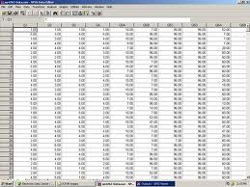
Why Connect Published Work to Data
Published
Results
+
Data + Metadata + Supporting Files (documentation, code)
=
A third party can replicate or reuse, thus validate and advance science

Slide 8
The Centralized Data Repository Provides:
Backups and replication of data in different locations (LOCKSS) so data is never lost
Re-format for long term accessibility so data never become obsolete
Extract Variable Metadata from data sets
Universal Metadata standards (DDI, Dublin Core)
Inter-operability with other systems through standard protocols (such as OAI-PMH, APIs)
The Dataverse takes care of the archival infrastructure (“plumbing”) for you!

Slide 9
Open Journal Systems (OJS)
Open Journal Systems is an open-source software for the management of peer-reviewed academic journals, created by the Public Knowledge Project (PKP), released under the GNU General Public License.
The Public Knowledge Project is a non-profit research initiative of the Faculty of Education at the University of British Columbia, the Canadian Centre for Studies in Publishing at Simon Fraser University, the Simon Fraser University Library, and Stanford University.
focused on the importance of making the results of publicly funded research freely available through open access policies, and on developing strategies for making this possible. It seeks to improve the scholarly and public quality of academic research through
the development of innovative online environments.

Slide 10
Open Journal Systems
Provides the technical infrastructure not only for the online presentation of journal articles, but also an entire editorial management workflow, including article submission, multiple rounds of peer-review, and indexing.
Relies upon individuals fulfilling different roles, such as the Journal manager, editor, reviewer, author, reader, etc. It has a module that supports subscription journals.
Has a 'plugin' architecture, similar to other community-based projects such as WordPress, allowing new features to be easily integrated without the need to change the entire core code base.
Open Journal Systems is also LOCKSS-compliant, helping
to ensure permanent archiving for ongoing access to the content of the journal.

Slide 11
Progress to-date
Compiled a list of potential journals (~100) that we can work with. Contacted a small handful to be our 1st round of pilot testers. Including:
Medical, Science & Social Science Publishers
Academic Publishers
Three publishers reviewed our plugin workflow and mockups to provide feedback prior to us beginning development on the technology.

Slide 12
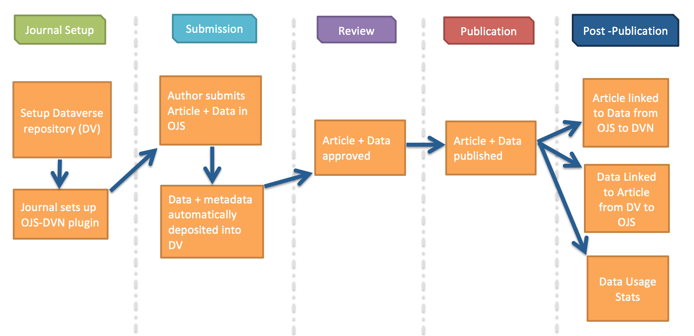
High-level Plugin Workflow
Flexible on this workflow

Slide 13
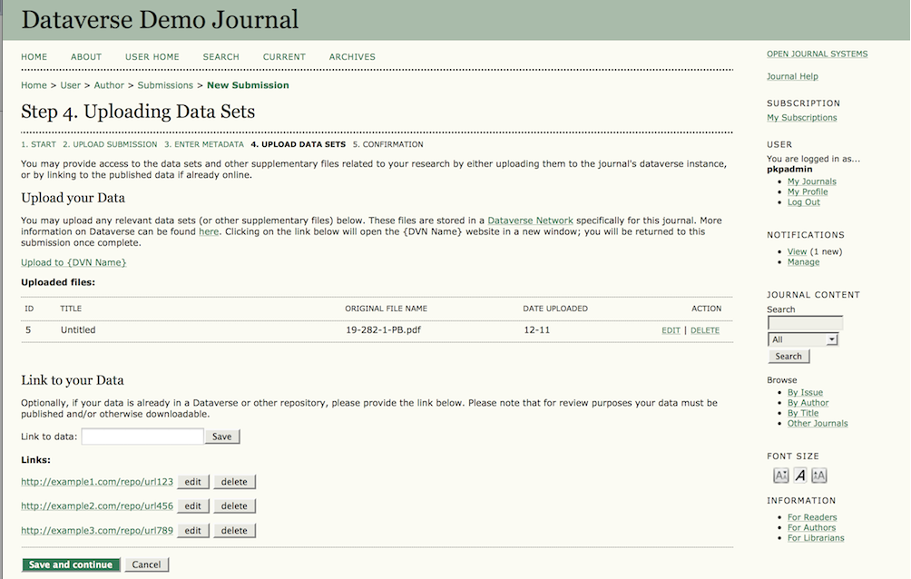
Mockup of Data Deposit (in OJS)

Slide 14
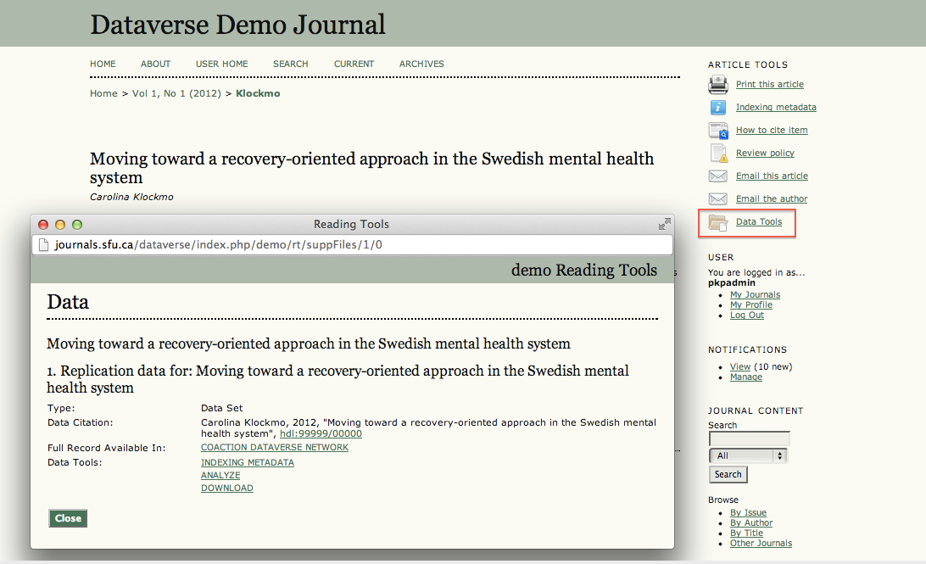
Published Article + Link to Data

Slide 15
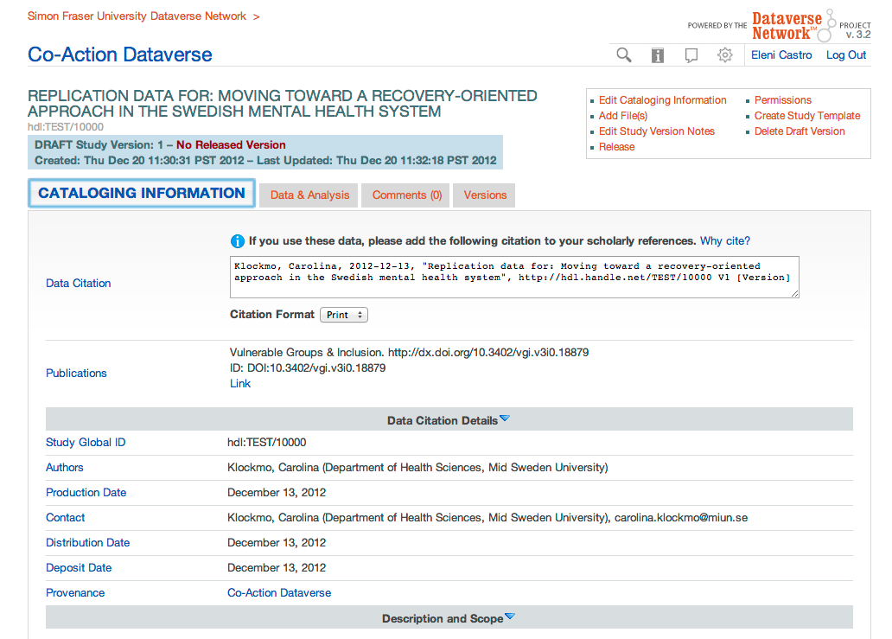
Data in the Dataverse

Slide 16
What’s next?
Beginning development of plugin and API (SWORD2-compliant) this April.
Testers (+4) will provide feedback during Summer 2013.
OJS+Dataverse teams: Provide guidance on best practices for Data Sharing Policies and Data Citation.

Slide 17
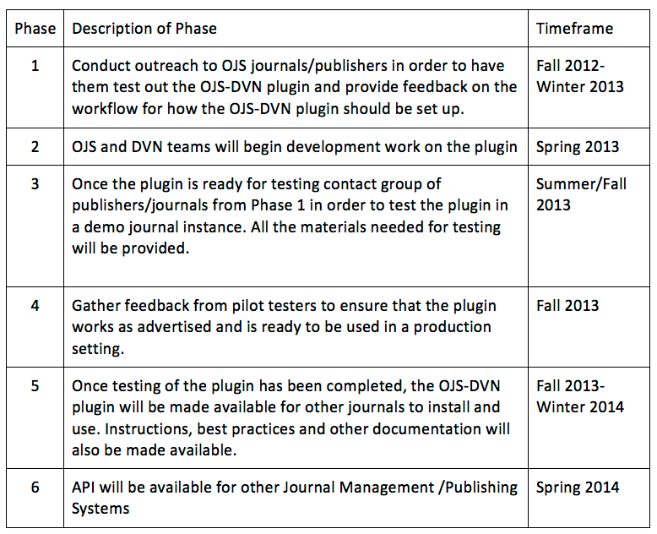
Project Roadmap

Slide 18
Sonia Barbosa, sbarbosa@hmdc.harvard.edu
Eleni Castro, ecastro@fas.harvard.edu
Contact for issues/questions on Dataverse: dvn_support@help.hmdc.harvard.edu
Web sites: http://thedata.org http://projects.iq.harvard.edu/ojs-dvn (Project specific)
Contacts and Sites

Slide 19

Thank you!
Alfred P. Sloan Foundation: for generous grant support on this project
Jean Liu: from the Altmetric blog for the “Journal and Data” illustration

