Slide 1
Why E-Books Suck
(unless your name is “Amazon”)
Alan Wexelblat
April 2013
New England Technical Service Librarians Conference

Slide 2
This Talk is a Set of Anecdotes
Around e-books; not “about” ebooks
E-book – the thing – is pretty well-understood
E-book – the cultural/social/technological phenomenon – is not.

Slide 3
What is Innovation?
Is it the invention (patents, etc)?
When was GPS “invented”?
  Engineering design studies:1960s
  First launch: 1973
  Fully operational: 1994
When was the last time you got lost?
  I bet it was sometime after 1994.
The “innovation” of GPS is only recently felt.
E-books are in the position of GPS in 1994.

Slide 4
Why Should You Listen to Me?
No particular reason, actually
  Not a lawyer nor publisher nor librarian
But I’m probably a good bit like you
  Politically little-l liberal
  First Amendment fundamentalist
  Crazy book- and knowledge-lover

Slide 5
I’ve been doing this a long time
Early ’00s I started a blog
  http://blogbook.org/tech_ip/
    The net never forgets
Mostly an excuse for me to spout off

Slide 6
Ranty McRant-Pants Gets Drafted
Invited to play in the (slightly bigger) leagues
Copyfight blog (http://copyfight.corante.com/)
  My last post for tech-ip (Feb 2005) was titled
  “Librarians get it”
  My first post for Copyfight was on pornography
  I claim that’s a coincidence
  At that time Copyfight a 7-person collaborative
    Headed by Donna Wentworth
  Last few years, just me
This talk based off work done for Copyfight
  But please don’t blame them for anything I say

Slide 7
E-book Ancient History
Descendants of hypertext
  A.K.A. electronic fiction
  Hypercard/interactive fiction
  And arguably the World Wide Web
1970s: Dynabook (Xerox)
1992: Data Discman (Sony, CD book player)
1993: PDF (Adobe, open format)
  competes & replaces SGML

Slide 8
Modern History
1998: (disputed) first ISBN issued for an e-book
1999: Open eBook (WWW working group/standard)
2011: First private (class-action) e-book lawsuit
2012: First government anti-trust action against (e)book sellers
Well that was fast
40 years to maturity
4 years to lawsuits

Slide 9
Terms of Art
Monopoly: exclusive possession and control, particularly from the selling side
  Monopoly isn’t per se illegal; e. g. government-granted monopolies we call “patents” and “copyrights”.
Monopsony: exclusive buyership; kind of the inverse of monopoly
  Also not particularly illegal, but highly problematic (from the sellers’ perspective at least)

Slide 10
More Terms
Agency Pricing: system in which producers (publishers) set minimum prices and forbid discounting
  Related “most favored nation” agreements
  Also not particularly illegal
Collusion: coordinated action, coordinated planning
  Collusion can make a legal act (e.g. political advertising, agency pricing) into an illegal act.

Slide 11
Amazon vs. The World
Amazon is a monopsony
  Especially for e-books
    That’s bad news for everyone else
    Book publishers hate this
  Buyers (readers) go to Amazon to get things, by a wide margin
  Earliest online affiliate program
    Link to Amazon, get some bucks
      What could possibly go wrong with that?

Slide 12
Amazon is Ubiquitous
Not just books, not just e-books
Competes with (nearly) every retailer
  Thus no Kindle in Target, Wal-Mart, Sams
    Even though they don’t sell e-books there, selling Kindles would be handing customers to Amazon

Slide 13
Amazon Divides Authors
“Professional” (i.e. published through big houses)
  Tend to dislike Amazon
  “Wild West”
“Amateur” (or self-published)
  Tend to like it
  See CreateSpace, fine-grained price controls
    And other author controls that big publishers don’t give

Slide 14
Updated Hourly!
Oct 2012 Amazon started “author rankings”
  Which really pushes this divide
  Assumes Amazon is the whole of the book-selling world
  Helps promote Kindle-only authors
  Rankings have problems (e.g. what counts as a sale)
    Bottom line: this is going to further divide authors
Cynically, I think Amazon is trying to turn authors against publishers.

Slide 15
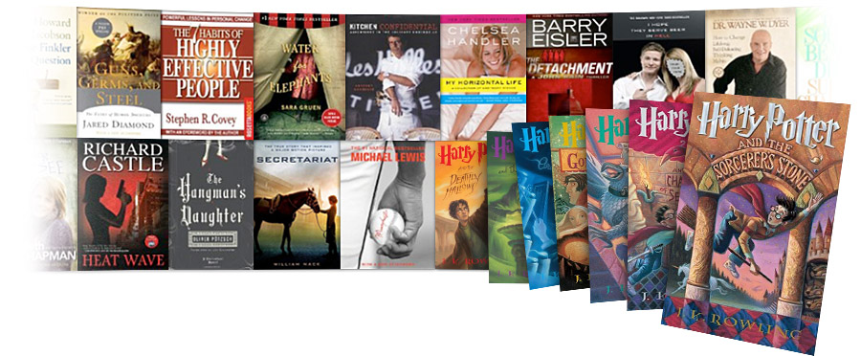
Amazon Even Competes with Libraries
Amazon Lending Library
  Kindle owners get to “borrow” books
    From Amazon, not the local library
  Links to Amazon “Prime”
    It’s “free” if you pay yearly fees ($80/yr)
  Competes with publishers too
    People who borrow don’t buy

Slide 16
Amazon Takes Control
Amazon doesn’t allow you to buy other retailers’ e-books on Kindle
  Unsurprisingly, ditto for iPad, Nook, etc.
Amazon plays hardball
  Independent Publishers Group didn’t like Amazon’s contract terms
    Amazon yanked all IPG titles from Kindle, then Web
    IPG folds

Slide 17
E-books Are A Hook
And a lock (as we will talk about in detail later)
People buy e-books as part of larger purchases
You can’t just buy “an e-book”
  You have to buy “the $EBOOK-READER version” of an e-book
    This particularly sucks for libraries
    You can’t even put your Kindle purchases onto the Kindle app on your iPad
      unless Amazon does it for you
E-books lock in authors
  once you are published on a platform the incentive to stay (exclusive) is huge.

Slide 18
What’s Wrong with E-books?
Printed Books | E-Books
Cash (anonymous) | Identity (account, sign-in, persistent, subpoena-able)
You bought it? You own it! | You don’t really own those bits. Read the agreement before purchasing. Amazon and the unauthorized, disappearing e-book (Orwell’s “1984” in 2009)
You borrowed it from a library? Those records are protected. | Companies can give out your e-book borrowing records at will (commercial and governmental)
No license restricting your use (upcoming: Kirtsaeng and used markets). | Restrictive end-user licenses apply.
Libraries determine lending policies. | E-book maker or seller determines lending policies.

Slide 19
E-Books Really Suck
Printed Books | E-Books
Known, non-proprietary format. | Secret format, readable only by approved software.
Scanning and copying for private use is allowed (blind readers). | DRM prevents copying, and blocks reading for sight-impaired people.
Nobody can legally destroy your book. | Companies may destroy (their) books, or go out of business and stop support.
Copyright laws (open, debated, public representatives, Copyright Office) govern behavior. | Corporate agreements (private, love it or leave) govern behavior.
Have a thriving used marketplace for people with low incomes, out-of-print, etc. | Seen a used e-book lately? (And you may never – more at the end.)
Thanks to Richard Stallman of the Free Software Foundation for the original inspiration for these comparisons.

Slide 20
What was Kirtsaeng?
And why does it matter that we won?
Formally Kirtsaeng v. John Wiley & Sons, Inc.
  On appeal to SCOTUS from 2nd Circuit
    Arguments Oct, 2012, decision (reversal) March 2013
Wiley wanted the court to draw a boundary around the US
  stuff made inside vs. stuff made outside

Slide 21
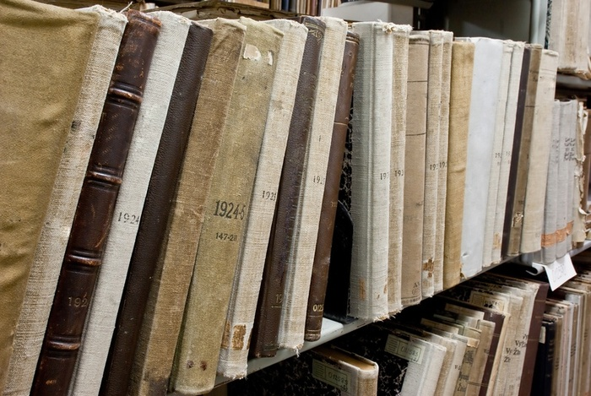
This Would Have Hurt, A Lot
Hands up time:
  Who comes from a library that takes book donations from individuals?
  Who comes from an archive (whose contents include private materials)?
ALA amicus brief
estimated 20-40 million
foreign volumes
in US libraries.

Slide 22
Legally Speaking
Kirtsaeng was a challenge to “first sale” doctrine.
  About 105 year-old notion
  It’s (lawfully) mine, so I can do with it what I want.
“First sale” means the copyright holder’s ownership rights are “exhausted” with the first sale.
  They still control copying (to some degree) and derivative works
  But not the act of selling or giving

Slide 23
First-Sale Rights
If I have a book (that I got legally) then
  I can re-sell it
  I can pass it on to my children
  I can donate it to a library
  I can lend it (as a library or as a person) to others
Bottom line: without first-sale rights libraries as we know them would be in a tougher place.

Slide 24
The Used-Stuff Marketplace
First-sale also applies to other copyrightable media
  Games & Console cartridges
  Music & movie CDs and DVDs
  (some) computer software
  Manuals, textbooks
  etc
But not e-books; see licensing restrictions above
  Used e-object marketplace is {nonexistent, a mess}
    Choose one or both

Slide 25
What Happened in this Case?
Kirtsaeng (the person)
  Bought textbooks (legally) overseas
    Cheaper
  Resold them on E-bay
John Wiley & Sons (the textbook publisher)
  Sued to stop him
  You can see how they might be unhappy about this
    Students buying from Kirtsaeng are not buying in school bookstores
2nd Circuit held: you cannot bring stuff made overseas into the US and have first-sale rights to it

Slide 26
Supreme Court Reversed
6-3 (surprising considering 4-4 last time)
The Court – in an utterly brilliant opinion by Justice Breyer, a minor classic of the “here are all the reasons why my arguments are better than yours” school of opinion-writing – rejected Wiley’s argument and refused to impose the geographical restriction Wiley sought.
David Post, at Volokh Conspiracy
Really felt like they “got it” this time
This may matter if ReDigi makes it to the Court
  Talk about ReDigi at the end

Slide 27
Back to E-Books (circa 2009)
Amazon sells lots of Kindles
And lots of e-books
At $9.99
  Which is below cost
  Also well below hardcover price for almost everything

Slide 28
Publishers Hate This
Rebates to publishers are based on retail price, not wholesale
  Amazon takes a real loss
  Publishers claim a loss
    Interesting question: what is the cost of an e-book?
    If you can figure this out you probably win some prize
      Publishers won’t say
    Logically, e-books ought to cost (way the hell) less (than paper books)
      There’s not a lot of logic in the e-book business, sorry
    Self-published e-books are an argument for costing way less

Slide 29
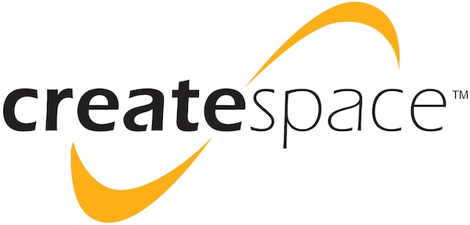
Razors, Blades, and Hooks
Cheap e-books drive Kindle sales
Amazon takes dominant position in e-book market
CreateSpace also plays a role
  Self-publishing matters (I think)
  Self-publishing & e-books
  are ham and eggs
Amazon looks to be dominating self-publishing
  Cutting out traditional publishers again
  At this point, publishers have to do something

Slide 30
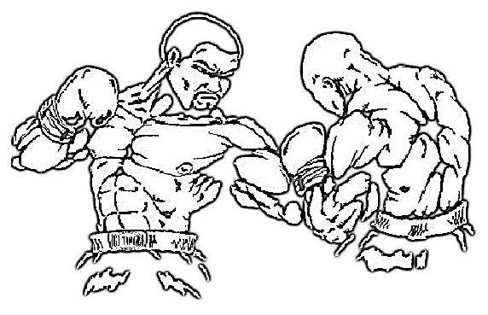


Amazon vs. Macmillan
A.k.a. “Authors getting screwed” time
30 Jan 2010: Macmillan proposes new terms for e-book sales.
Amazon says “No”. Remember how Amazon ‘negotiated’ with IPG?

Slide 31
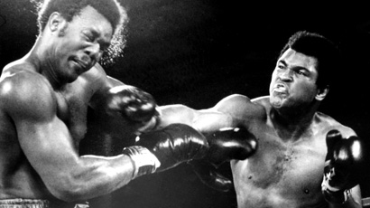
4 Feb 2010: Amazon pulls Macmillan titles from Kindle sales lists & new book link lists
5 Feb 2010: SFFWA (and others) remove Amazon links from Web sites
Authors blog/tweet/FB their desire actually to sell books (imagine that)
6 Feb 2010: Amazon capitulates! Agency pricing begins.

Slide 32

Everyone Gets On Board
Overnight, e-book prices jump 30%
People complain, but pay up anyway
Big five publishers (HarperCollins, Hachette Book Group, Macmillan, Penguin and Simon & Schuster) all switch to agency pricing
  At more or less the same time
And Apple announces iPad,
with e-books
  Having most favored nation pricing
  Using publishers logos in promotion

Slide 33
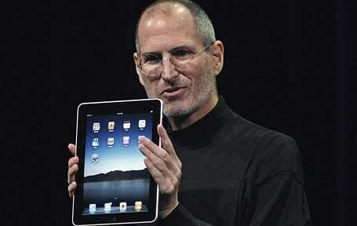
DoJ Does Not Believe in Coincidence
Remember the term “collusion”?
  Remember what it can do to otherwise-legal acts
Two days after iPad launch, Steve Jobs confidently predicts Amazon’s (much-hated) $9.99 pricing is “about to end”
  It’s almost like he was daring the DoJ to come after them.

Slide 34

DoJ Takes the Dare
4 Apr 2012: DoJ files suit
  Naming Big 5 publishers and Apple
  Accused of collusion to use agency pricing to force prices up
Three publishers would rather switch than fight
  HarperCollins, Hachette and Simon & Schuster settle
December 2012: Penguin & Random House merge, settle
  leaving one
8 Feb 2013: Macmillan capitulates

Slide 35

DoJ Settlement
Or, The Amazon Wish-List
  No more agency pricing
  Retailers can discount, and publishers eat it too
  No more MFN agreements
  In-device purchases controlled by device maker are legal
    Recall Kindles require Amazon purchases

Slide 36
How People Line Up
Big publishers: hated it!
Apple: hated it, but going to copy every Amazon bad practice anyway
Indie authors: like it
  They want to be able to set their own pricing
    Which CreateSpace lets them do, so long as Amazon gets its pound of flesh
Organized professional authors (Author’s Guild, SFFWA): hated it!

Slide 37
IMO: The Real Problem Was Missed
Amazon is a monopsony
  E-book publishers have to sell through them (through their devices)
Jumping into bed with Apple (iPad) isn’t better
  Kindle dominates now, but just wait
  Frying pan, fire anyone?
  Apple already copying Amazon restrictive practices
    And adding its own
      Incompatible formats
      Exclusive licensing, including rejects

Slide 38
What DoJ Should Be Investigating
(but won’t because they’re all ex-Cartel)
DRM (Digital Rights Management) which is mostly just encryption
  The true heart of the problem
  Someone else puts a lock on ‘your’ stuff
    And this helps you… how?
  You’re not allowed to remove this lock
    Legally, but it’s easy to do, so lots of people do it
      (we’ll come back to this in a moment)

Slide 39
What’s Actually Wrong
DRM enforces e-book terms and restrictions
DRM is the real monopoly power here
DRM is approximately the worst thing ever for libraries
  DRM hurts legitimate use
  Generally has no effect on copying
  DRM stops dumb people and impatient people

Slide 40

Meet a (DRM) Criminal
Rupert Goodwins
  Editor for ZDNet UK
  Self-published novelist
    On Amazon
  Former hardware & software engineer

Slide 41
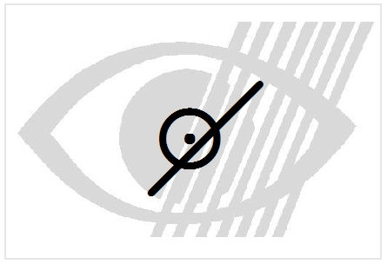
Rupert Goodwins Breaks DRM
Rupert Goodwins is slowly going blind
  Like lots of us
Rupert Goodwins loves to read
  Like lots of us
Technology exists to help Rupert Goodwins (scanners, etc)
  But not in the presence of e-book DRM
  E-book publishers won’t let you use unauthorized software, remember
So in order to read his e-books, Rupert Goodwins has to break DRM
  And thus, is a criminal
  Like lots of us

Slide 42

Macmillan’s Gambit
24 April 2012: Macmillan announces that its Tor/Forge e-book titles will go DRM-free
  This is HUGE. Free the books, free the readers (the people) and the libraries
Without DRM
  You can buy Macmillan titles from anywhere
  And read them everywhere
  Bye-bye monopoly; bye-bye monopsony
Memo to Amazon: Kiss my bits!

Slide 43
Why This Can Work
Tor/Forge titles and readers are a particular set
  Highly educated
  Highly motivated
    Follow authors
    Buy complete series
  Vocal
  Lots of genre (generally SF & Fantasy)
  Very net-savvy, connected, recommendation-sensitive
Even so Macmillan’s 2012 numbers were unconvincing

Slide 44
Keep in Mind
Getting rid of DRM isn’t the end of e-book suckage
  But it’s a damned fine start
So, how’s it working so far?

Slide 45

A Little Perspective
In 2012, Kindle market share dropped 15% month over month
iPad share is grew at about the same rate
E-book sales up over 150% month over month
Print book sales slumped
  Retail outlets closed
Indie publishing grew
Currently in a kind of limbo
A new marketplace waiting to be born

Slide 46
A Last Word on Hardware
Hands up time (I promise this is the last one)
  How many people own a point-and-shoot camera?
  How many people own a smartphone?
If you raised your hand for smartphone, why didn’t you raise it for point-and-shoot?
  Your point-and-shoot camera is named “Android” or “iPhone”

Slide 47
Peak E-Reader is Now
In the very near future your e-book reader will be named “Galaxy” or “iPad”
We are currently seeing ‘peak’ reader
Dedicated e-reader advantages:
  Screen resolution/quality (E-Ink)
  Price

Slide 48
Therefore
Two recommendations for librarians:
  Buy DRM-free titles as much as possible
    Consider independent source like Humble E-Book Bundle (http://www.humblebundle.com/)
      Eight (DRM-free) e-books, three charities, name your own price
  Buy pads, not e-readers

Slide 49
Afterword: Tiptoeing into the Used Marketplace
Or, “Oh, gods, here comes Amazon again”
  (where’s my Jaws theme music?)
February 2013 Amazon announces a patent
  Technically, “a personal data store”
  Practically, “store your used digital objects here”
  Oh and let us re-sell them for you!

Slide 50
Authors Wail and Gnash Teeth
John Scalzi tells people he’d rather they pirated his stuff than buy used from Amazon
  Remember, (professional) authors hate all things Amazon
If he (they) aren’t getting money from people’s reading of e-books then nobody should
  Anyone see a problem with that?
Later he backpedals a little, saying it’s still OK with him if people just read his e-books
  Like, say, from their local library
  He still hasn’t explained why used e-books are so much worse than used (physical) books

Slide 51
Redigi
October 2011, start-up company
  “enabling on-line sale of used music”
  Trust me, there’s no difference between a digital media file and an e-book
Careful use of technology to try and ensure only one copy of the file ever exists
Capitol Records wails, gnashes teeth, sues
April 1, 2013, Capitol gets summary judgment
  Not the end of the story, probably

Slide 52
Why Not?
Judge bought Capitol’s argument that multiple copies would exist
  If so, no first sale, no Kirtsaeng umbrella
That conclusion can be challenged
Technology is flexible (see Aereo)
  Someone else will try this
  Otherwise, why would Amazon announce its patent?

Slide 53
Libraries Care About Used Goods (I Think)
Donated items, Resold items
  Buy & shelve
  Selling off excess stock
Redigi Probably won’t have the impact of Kirtsaeng, at least not yet
  Remember how immature e-books still are
Keep your eyes on the ball
  The story of e-books isn’t the technology; it’s what people do with the tech

Slide 54
That’s All Folks
Thank you so much for your patience
Find me online
  http://copyfight.corante.com
  awexelblat@gmail.com
  @awexelblat
  And circle “Alan Wexelblat” on Google+
    Ask to be in the blog circle there

