Slide 1
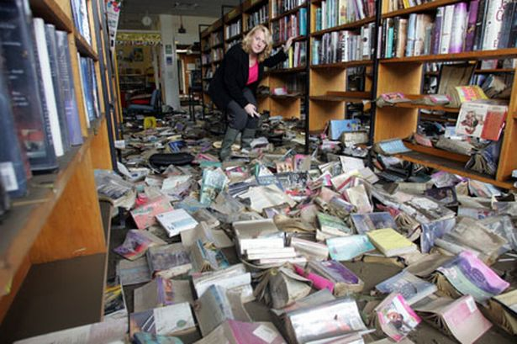
How to Create an Emergency Disaster Plan for Your Library
Notes:
Image from the Morpeth Public Library, Northumberland, England flood in September 2008 that caused an estimated £500,000 in damage.

Slide 2
Why do you need an emergency disaster plan?
The unexpected does and will happen.
It is time sensitive.
It is better to have a plan in place that you might never use than to get caught in an emergency situation without a plan.
Having a plan in place can save you money and recovery time.

Slide 3
You might need to convince someone why a plan is necessary.
Stress the irreplaceable materials in your collection that you could lose if not prepared.
Counter the “it can’t/won’t happen to us” attitude with real life examples.
The bottom line is almost always money. Be prepared to make the case that if you have a plan in place you will save valuable time and money in the event of an emergency.

Slide 4
The potential cost?
Keep in mind - One crate of wet books (10-12 books at most) costs around $200 to freeze dry with higher prices for special materials such as photographs. Weigh this against the cost of replacements (materials + staff time to process).

Slide 5
How to get started
Detailed floor plan of each level of your building. Include room numbers/room names.
Decide which of you staff are needed in an emergency situation. This may change based on the type of emergency.
If you don’t know, find out if your workplace has an emergency communications notification plan or phone tree.

Slide 6
How to get started, cont.
Compile a list of phone numbers of your staff who will help in an emergency.
Compile a list of phone numbers for your university or city that you would need in case of an emergency, such as facilities, maintenance, communications.

Slide 7
How to get started, cont.
Decide who in your organization needs to have this information. Better to have numerous copies around your library, as well as one at your home, to have on hand in case it is needed.
Keep paper and electronic copies of you plan.

Slide 8

How to get started, cont.
You should consider a training session with pertinent (or all) staff once you have your emergency plan in place.

Slide 9
Making your plan
Develop your list of priorities for a potential recovery.
Creating a priority list will be time consuming but is worth it. It is a one-time thing with updates needed routinely but the updates take much less time.

Slide 10

Making your plan, cont.
When developing your priorities list, consider all formats.
Make a map of your collection areas separate from your floor plans or as detailed portions of your floor plans.

Slide 11
Making your plan, cont.
If you have a special/treasure collection, you may want to make an item level list, but overall you can't and shouldn't create an item by item list. Instead think in terms of groups, such as call number classifications or particular collections.

Slide 12

Making your plan, cont.
Do you have vital records that you need such as those relating to your building operation and HR, legal documents, contracts, financial records? = Consider making digital copies in addition to your print records.

Slide 13
Making your plan, cont.
When creating your priority list keep in mind that some materials you own are much easier to replace than others such as recent publications and best sellers.
Keep in mind some formats are much easier to replace than others.

Slide 14
Making your plan, cont.
Ask yourself - do you have materials that are very rare or have a high monetary value or are considered very important to your community? High priority.
What are your collection priorities? Scholarly works? Local authors/faculty authors? Particular subjects? Other?

Slide 15

Making your plan, cont.
Do you keep a shelf list or card catalog? Remember those in your priority list as well.
Where do you prioritize materials on loan? Your ILLs, consortium books, etc.

Slide 16
Making your plan, cont.
Divide your priorities into High, Medium, and Low for each collection or area.
High = highest use collections, vital records with no backup copy, materials you cannot replace, anything critical to operating your library.

Slide 17
Making your plan, cont.
Medium = important materials that could be replaced if necessary, but the cost of their replacement could exceed the cost of their salvage.
Low = materials you can easily replace in their original or other (acceptable) format.

Slide 18
Making your plan, cont.
When deciding which category to use, keep in mind the format and how that would impact salvaging, for example, journal and yearbooks with coated papers that have begun to stick after getting wet may not be recoverable or may not have a high value to your collection.

Slide 19
Types of emergencies
Your plan should include how you will handle the following: fire, flood, medical emergencies, criminal activity, chemical spills, power failure, suspicious packages, collections theft or vandalism, bomb threat, weather/storm damage (earthquake, tornado, hurricane, etc.).

Slide 20

Other considerations
Make sure all emergency exits are clearly marked in your building.
Personal safety is of the utmost importance! Do not attempt to deal with an emergency or salvage materials if it puts your safety at risk.

Slide 21
Other considerations, cont.
Does your library have a plan in place to evacuate staff and patrons in case of an emergency?
Do you have a place for staff to meet outside the building after an evacuation?
Do you have more than one route to take depending on where the emergency situation is taking place?

Slide 22
Other considerations, cont.
Does your library have a public address system? Consider, is the emergency one in which you would want to use that system or would it cause panic?
Does your library have its own security? Or do you have building or campus security? Same with facilities departments.

Slide 23
Other considerations, cont.
Consider: is it safe to have staff walk around and physically evacuate the building? (Make plans for both a yes and now answer to this question.)
Find out if any member(s) of your staff are trained in first aid, CPR, or have any medical training.

Slide 24
Other considerations, cont.
Should you have a disaster recovery company on retainer? Can you afford it? Can you afford not to? Do you have other infrastructure in place that could handle recovery?
Find out what resources are available to you and your library based on where you work (to decided about a disaster recovery company).

Slide 25
Prevention tips
Know the ideal temperature and humidity in your building (if you have them).
Maximize air flow in your space to prevent mold growth.
If at all possible, keep materials off the floor (if you are low on space, consider placing materials at a higher level).

Slide 26

Prevention tips, cont.
If at all possible, do not store materials near sources of water such as heating pipes, bathrooms, or places where water could get into your building.

Slide 27
Prevention tips, cont.
Keep power strips off the floor.
Maintain your HVAC system.
Routinely test your fire/smoke detectors and other sensors as well as your fire extinguishers. Make sure fire extinguishers are easily accessible and not expired.

Slide 28
Prevention tip, cont.
If you have a building manager, consider a yearly inspection of the buildings’ roof, windows, foundation, HVAC, and utilities systems.
Make sure to regularly reread and update your plan (such as new phone numbers, new staff, recent important acquisitions).

Slide 29

Prevention-Preparation-Response-Recovery!

Slide 30
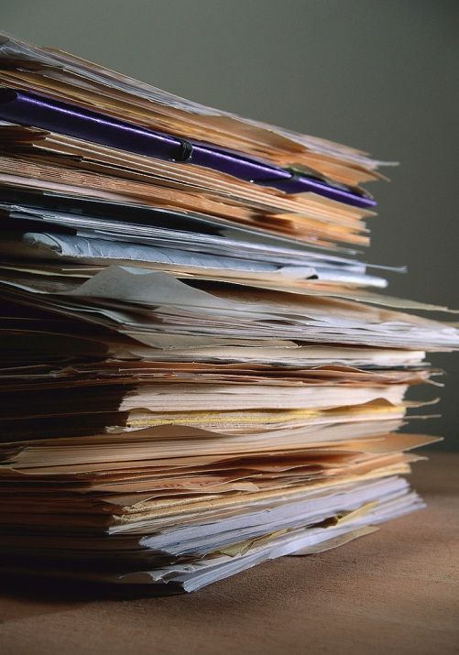
Forms
Recommended supplies (Full and small kits).
Priority List for Recovery.
Checklist of Risks and Procedures (Appendix).

Slide 31
Recommended supplies, full kit
Bags, plastic, small (boxes)
Bags, trash, large, black (boxes)
Buckets, 3 and 5 gallon
Crates, milk
Dehumidifiers
Drop cloths, 2 mil 10’ x 20’, and 9’ x 12’
Extension cords, heavy duty and rolling 100’
Fans, box, desktop oscillating, standing, whirlwind
Flashlights

Slide 32
Recommended supplies, full kit, cont.
Gloves, late and vinyl
Hammer
Heater, portable
Hats, hard
Knives, utility
Labels, Avery self-adhesive, multiple colors
Ladder, 6’
Markers, permanent, multiple colors
Masks, dust

Slide 33
Recommended supplies, full kit, cont.
Paper towels
Pliers, locking 5” and 7”
Plug converters
Power strips, surge suppressors
Scissors
Screwdrivers, assorted sizes
Sorbent wipers (rolls)
Sponges
Tape, duct and masking
Tool box

Slide 34

Recommended supplies, full kit, cont.
Twine (rolls)
Vacuum, wet/dry
Water diverters
Wrap, plastic (dowels)
Wrench, adjustable

Slide 35
Recommended supplies, small kit
2-cell flashlights and batteries – power safe flashlights rechargeable (quantity 2)
3 gallon pail – plastic (quantity 1)
Absorbent pads (quantity 1 pack)
1-ply paper towels (quantity 3 bundles)
Masking tape (quantity 2 rolls)
Pair of scissors
Plastic bags – large and medium (quantity 5 boxes of each)
Sponges (quantity 3)
Twine (quantity 1 ball)

Slide 36
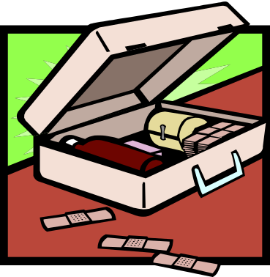

Recommended supplies you likely already have
Wheeled buckets with detachable wringers
Eye protection
Dust masks
Plastic gloves
First Aid kit with antiseptic
Hand sanitizer
Book trucks/carts

Slide 37
Priority List for Recovery
Call Number Range: This column should include the call number range in question.
Location in Building: In order to assist salvage, provide a brief description of location. For example, First Floor, Southwest Corner, or Room 182, Third Range.
Describe Materials: Briefly describe type of materials: bound serials, monographs, special collections, miscellaneous, maps, folios, etc.
Ranking: 1, 2, or 3, with one being the highest priority (with 1= Highest).
Call Number Range | Location in Building | Describe Materials | Ranking

Slide 38
Appendix
Checklist of Risks and Procedures Related to Library Buildings
Location of the Building or Library Portion of Building
Climate (outdoor)
o Extremes or sudden changes in temperature and relative humidity
o Heavy or prolonged rain or snow
o Severe storms
Floods due to proximity of large bodies of water
Earthquakes or volcanic actions
Soil: unsatisfactory base of sand, clay or gravel, requiring deep foundation on solid rock
Hazardous materials or structures in close proximity
o Flammable materials or buildings
o Harmful gases
o Radioactive materials

Slide 39
Checklist of Risks and Procedures Related to Library Buildings, cont.
History of demonstrations, riots, terrorism, or war
Vibrations from motor vehicles, trains, or planes
Foliage in close proximity
o Brush or forest fires
o Roots and falling branches
Access routes for emergency and evacuation vehicles
Distance to fire hydrants and fire station

Slide 40
Checklist of Risks and Procedures Related to Library Buildings, cont.
Design
Egress routes: inadequate, complicated or easily blocked
Flat roofs, skylights, roof access doors, internal roof drains, unsealed spaces under roofs
Framing
o Wood: flammable unless protected with fireproof plaster or gypsum
board
o Steel: not fire resistant unless covered with concrete
o Reinforced concrete: fire resistant

Slide 41
Checklist of Risks and Procedures Related to Library Buildings, cont.
Walls
o Insulation insufficient to resist fire and cold
o Fire walls too few to contain fired
o Load-bearing walls: inflexible for renovating
o Surfaces hard to clean, especially in cases of stains and graffiti
Windows and doors
o Water or air leaks, or frame seepage
o Storm, vandal and burglar resistance
o Self-closing devices lacking for fire, security
o Locks inadequate for safety and security
o Open for ventilation: need vs. risk

Slide 42
Checklist of Risks and Procedures Related to Library Buildings, cont.
Floors
o Fire resistance
+ Enclosed spaces insufficiently insulated
+ Gaps permitting vertical drafts
o Strength insufficient to support book stacks, especially compact
shelving
o Not smooth enough for efficient cleaning
o Carpeted floors in areas near Library materials

Slide 43
Checklist of Risks and Procedures Related to Library Buildings, cont.
Water/Moisture Issues
o Poor drainage
o Slow stabilization of relative humidity after flooding
o Pipes and water fixtures near Library materials
+ Leaks
+ Condensation due to insufficient insulation
+ Freezing and bursting
+ Insufficient insulation
+ Proximity to outer walls

Slide 44
Checklist of Risks and Procedures Related to Library Buildings, cont.
o Clogs, backups, and other failures
o Below sewer level, requiring sewage to be pumped upward
o Drains lacking automatic backwater valves
o Toilet stalls lacking shelves and hooks to keep Library materials off floor
Environmental management
o Circulation of fire, smoke, fumes, heat, humidity, dust
o Zoning inadequate
o Fans not connected to fire control system
o Multi-stage particulate filtration system lacking
o Galvanized metal ducts with automatic fire dampers lacking

Slide 45
Checklist of Risks and Procedures Related to Library Buildings, cont.
o Heat and humidity controls
+ Lacking or inadequate
+ Too complex to be effective
o “Bad” gaps, e.g. under doorways
o “Good” gaps, e.g. under and behind equipment, for efficient cleaning
o Lighting insufficient or difficult to maintain: indoor and outdoor
o Green plants needed to give off oxygen and absorb harmful impurities
Landscaping
o Access paths
+ Too indirect or too close to building
+ Insufficiently graded, fenced, etc. to keep users on track

Slide 46
Checklist of Risks and Procedures Related to Library Buildings, cont.
o Loose rocks, bricks, tables, benches, etc.
Book return facilities
o Free standing, outdoor: lower risk if not close to building
o Slots in building wall: higher risk, requiring:
+ Termination in enclosed space
+ Drain and automatic fire suppression
Space allocation
o Too complicated for effective security
o Limited visibility
o Isolated nooks, hideaways, offices

Slide 47
Checklist of Risks and Procedures Related to Library Buildings, cont.
o Unsecured crawl spaces
o Staff areas
+ Too easily accessible to patrons
+ Too small or complex for effective operations
o Areas inappropriate for Library materials
+ Floors, but reduce risk with 6” high wooden pallets
+ Close to walls
o Closer than 2’ to inside walls
o Closer than 12’ to outside walls

Slide 48
Checklist of Risks and Procedures Related to Library Buildings, cont.
+ Close to windows
o Light and water damage
o Theft
+ Close to physical plant operations: fire risk
+ Close to hazardous materials
+ Attics and basements
o Dampness from lack of insulation
o Inadequate heating and cooling
o Leaks and infestations

Slide 49
Checklist of Risks and Procedures Related to Library Buildings, cont.
Flammable building materials and furnishings
o Paints and varnishes, especially on wooden surfaces
o Polystyrene or polyurethane foam insulation
o Low density fiberboard and acoustic ceiling tiles
o Carpets and drapes
Building code violations
Repairs, Renovations, Construction
Increased risk of injury or damage from:
o Fire, water, machinery, vibrations, dust, dirt, theft, vandalism

Slide 50
Checklist of Risks and Procedures Related to Library Buildings, cont.
Regulations, procedures and protective measures
o Emergency evacuation
o Extra precautions
+ Fire detection and suppression
+ Ventilation, security, supplies, cleaning
o Relocation of Library collections, or:
o Sealing them effectively from construction areas
Contractual liability for injury or damage
Inspections

Slide 51
Checklist of Risks and Procedures Related to Library Buildings, cont.
Communication among all members of construction and Library staff
o Established plans and procedures
o Daily, weekly, monthly revisions
Maintenance and Inspections: Regular and Documented
Egress routes
Roofs, eaves troughs, downspouts, doors, windows, window wells, foundations
Plumbing, including pipes, joints, fixtures and drains
Central alarm system for remote detection of fire, water, unauthorized intrusion

Slide 52
Checklist of Risks and Procedures Related to Library Buildings, cont.
Water detection system
Electrical system, appliances and lighting
Fire detection and suppression system
o Smoke detectors and sprinkles
o Fire doors and extinguishers
o Water pressure for fire fighting
Heating, cooling and ventilation systems
o Inspect for mold
o Clean ducts, vents, heat-exchange coils, drip pans
o Change air filters
o Maintain air circulation

Slide 53
Checklist of Risks and Procedures Related to Library Buildings, cont.
Access controls
o Surveillance cameras, mirrors, motion detectors, switches, alarms, locks
+ Ease of use
+ Serviceability
+ Security of keys and key cards
o Windows and doors alarmed for exit and no entry
Plans
o Disaster prevention and emergency response plans
o Building plans and drawings, with duplicates stored offsite
+ Structural
+ Service access locations
+ Master switches
+ Standpipes and valves

Slide 54
Checklist of Risks and Procedures Related to Library Buildings, cont.
Emergency back-up services
Emergency equipment for first-aid, fire and flood control
Offsite storage of rare, fragile or irreplaceable materials and vital records
Book return drops
Pest control
Housekeeping
o Trash and garbage
o Dust, including dust from brittle paper
o Cleaning of rooms, floors, carpets, drapes
+ Additional security if Library is closed

Slide 55
Checklist of Risks and Procedures Related to Library Buildings, cont.
o Use and storage of hazardous materials
+ Flammables
+ Toxic cleaning agents
+ Other janitorial supplies
Library security staff
o Training
o Visibility

Slide 56
Checklist of Risks and Procedures Related to Library Buildings, cont.
Procedures
o Emergencies
o Posted policies and emergency service numbers
o Opening and closing the Library
o Interior and exterior Library patrols
o User identification and registration
o Requests for repairs or maintenance
o Communication of onsite and offsite incidents of theft, vandalsim, arson

Slide 57
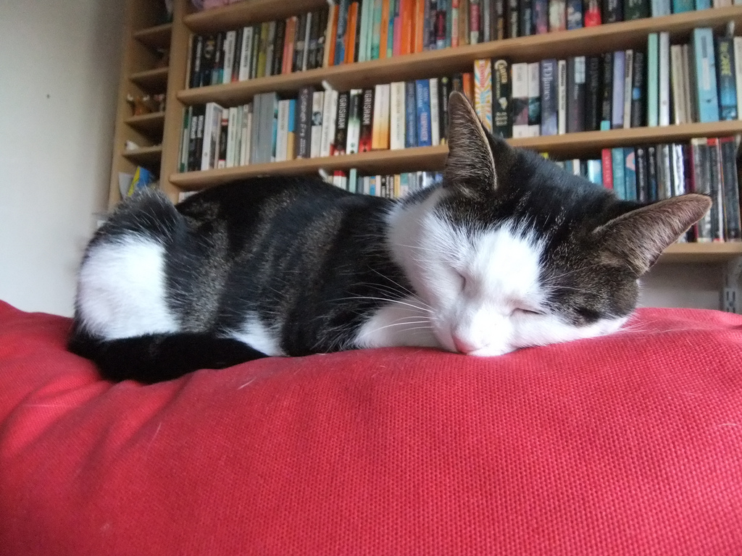
Obligatory cat photo for librarians.

