Slide 1

CTW’s Shared DDA Program
Joe Frawley • Todd Falkowski • Aaron Sandoval
NETSL Annual Conference 2015

Slide 2
Outline
Todd: Intro. To CTW & Background of DDA
Joe: Current DDA Program Explanation
Aaron: Wesleyan Workflow
Todd: Trinity Workflow
Joe: Conn. Workflow
Aaron: Cautions & Summary

Slide 3
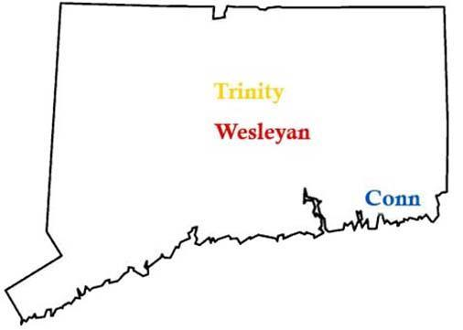

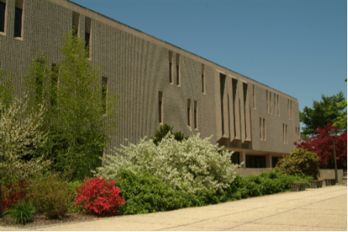
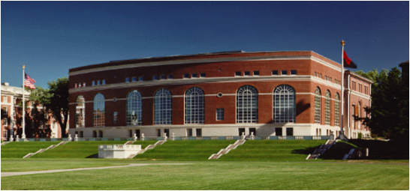
The CTW Library Consortium
Trinity College
Connecticut College
Wesleyan University
Notes:
But first, some background on CTW:
We are three small liberal arts schools:
Connecticut College in New London, Trinity College in Hartford, and Wesleyan University in Middletown.
We have a combined FTE of 7,400 – mostly undergraduates.
Trinity and Wesleyan have graduate programs which account for ~300 FTE.
The Consortium was established in 1987
to share the costs of an online library catalog
and to share our physical collections via a daily delivery service.
We currently use ExLibris Voyager as our catalog and
FedEx delivers CTW patron requests (almost daily).
The libraries are in the process of exploring various discovery tools –
As a group, VuFind will become our (more user-friendly) replacement to Voyager’s cross-search of the 3 catalogs.
Individually, each library is doing its own exploration of discovery layers.
But the libraries have worked together on several other projects recently.

Slide 4



Connecticut College
FTE: ~1875
Trinity College
FTE: ~2200
Wesleyan University
FTE: ~3000
Libraries have a history of sharing resources
Reciprocal lending system
Shared ILS and eResource purchases
Notes:
CTW’s combined FTE is ~ 7000 undergraduate students;
Trinity and Wesleyan’s Graduate programs - account for ~450 FTE
History of shared collection development –
Selectors use GOBItween to see what colleagues have purchased and avoid duplication if possible.
The libraries have shared an ILS since the mid-80s;
When a resource is of interest to everyone, we try to negotiate consortial pricing with the vendor.
The libraries experimented with YBP auto-ship plans but canceled them
Wesleyan: has an Art Title auto-ship/ approval plan with Worldwide; annual allocation = approx. $12K
In essence, our DDA program is our auto-ship plan – it guarantees students & faculty will have access to titles that weren’t firm-ordered.

Slide 5

A Story About
Budget Realities
& Vying Expenditures
Leading to
A New
Collection Development
Model

Slide 6
Why DDA & STLs are Important to CTW
Assessment of Library within Institution
Budget & Staffing Issues
Research & Teaching more Multi-Disciplinary
Collection Development >> Collection Services
Unique Content vs. Format Preferences
Vying Expenditures: Monographs vs.
Serials & eResources
Notes:
This list represents why DDA and STLs are important to the CTW consortium.
Some are also being experienced by the my co-presenters’ institutions/consortia, but some are unique to CTW.
In the next few slides, I’ll cover some Realities and Considerations for the CTW libraries
– these should provide some context for each of these

Slide 7
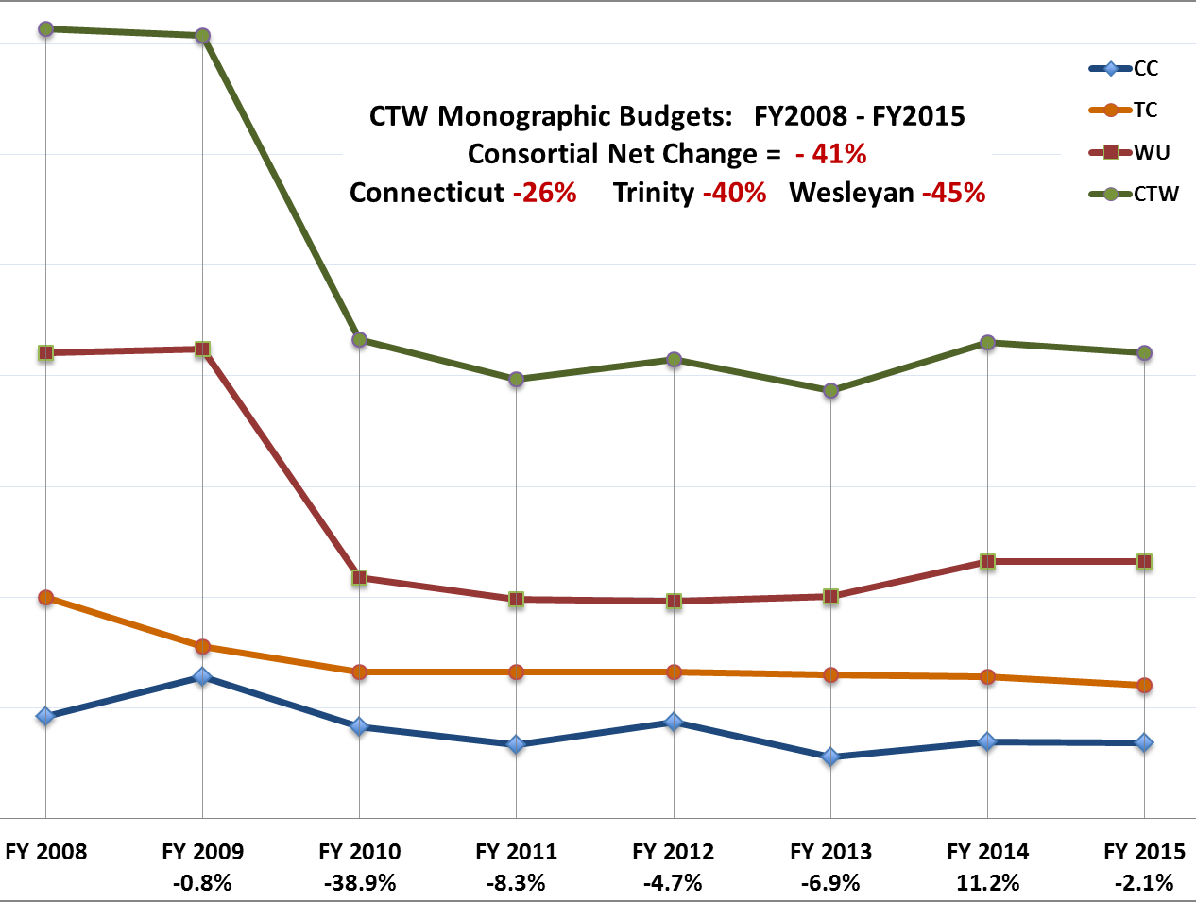
Notes:
Budgets: Despite steady tuition increases, the libraries’ monographic budgets have not increased accordingly.
Overall, our budgets are 41% lower than in AY 2008
More stable but lower budgets now prevail

Slide 8
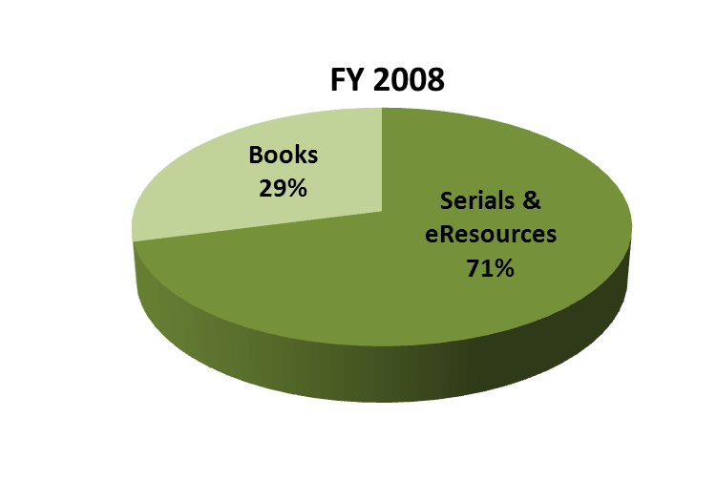
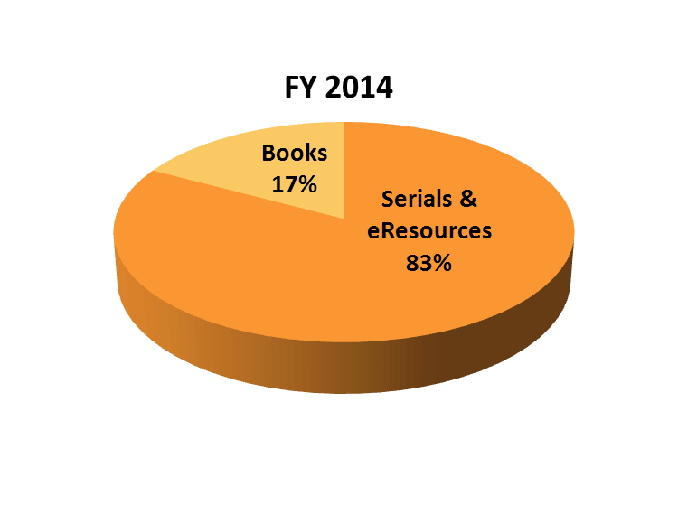
CTW’s Acquisition Budgets:
Monographs vs. Serials/eResources
Notes:
The continuous, rising costs of Serials & eResources,
-- demand an ever growing slice of CTW’s acquisition pie.
The slice for Books has decreased by 12% since FY 2008
CTW’s Monographic Budgets have dropped 41% overall –
Not only due to budget cuts,
but also to re-allocations to help pay for Serials & eResources
Recent discussions with journal vendors indicate they expect journal prices to continue rising at a minimum of 3% per year.
Are pricing practices discussed across the divisions of a publishing house? What’s the potential impact on the entire company?
In CTW’s case – flat budgets = cut backs or cancellations

Slide 9
CTW’s DDA Program
YBP /EBL
Sept 2012 – Feb 2014: Pilot project, testing
Mar 2014 – Official start date
Collection: 15,000+ titles; $200 price cap
Deletions: publisher withdrawals, overlap w/ EBSCO and ebrary
Shared Pool of Titles but Individual Purchases
Individual LibCentral admin accounts & STL settings
Notes:
We started a new DDA program for several reasons:
Try the STL model: decrease likelihood that we’d purchase titles with insignificant use (one page views)
Integration with YBP/GOBI
Allowed selectors add titles of their choosing to the DDA pool.
After a year, only 2000 titles had been added by selectors, we opted to try YBP’s automation and DDA profile.
This was a good move in terms of the collection size and overall quality of titles being offering.
We’ve triggered a few gasp-worthy STL fees
$94.50 for a 7 day loan vs. same title $19 - only 2 months before
But NO complaints about average STL fees
from Sept 2012 – May 2014: $13.88 for a 7 day loan
But things have changed…

Slide 10

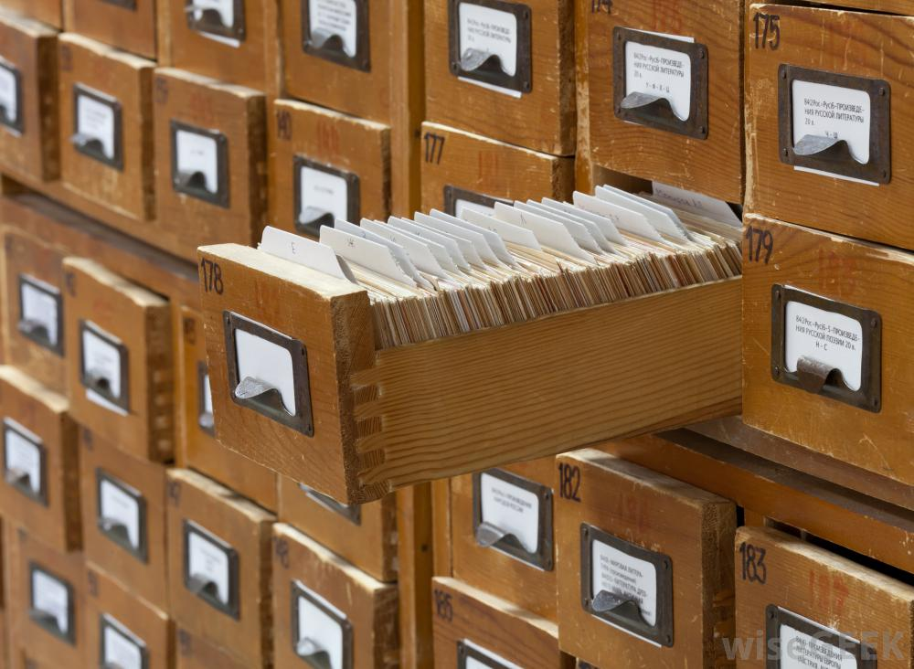
What is DDA?
EBL’s Complete Database:
~600,000
Titles
Available
CTW’s
Profile:
Pub. Date
Price
Publisher
Limits
Pool of Discovery Records:
~15,000 for CTW
Notes:
An exclusively electronic library Acquisitions model commonly called:
Demand Driven Acquisitons (DDA) or
Patron Driven Acquisitions (PDA)
Basic concept is that the library gains access to an increased volume of material, but only pay for what is actually used.
Library selectors establish a profile that governs which types of materials the library will receive (e.g. date, price, publisher limits).
The platform generates a pool of MARC discovery records based on the content profile which are then loaded into the library catalog waiting for patrons to discover and interact with them.

Slide 11

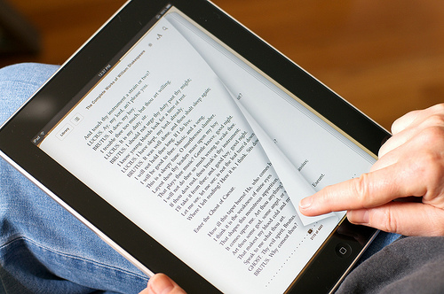



What is DDA?
STL
STL
STL
Notes:
Extended interaction triggers a short term loan (STL), for which there is a charge; varies by publisher.

Slide 12



For Each Library:
Purchased Titles
=
NonLinear
Lending
Unlimited simultaneous users, up to 325 loans per year
Autopurchase
Notes:
A certain number of loans (set by participating library) triggers an auto-purchase of the eBook.
NonLinear Lending: Per copy purchased, 325 loan instances per year, renewing each year.
Heavy concurrent use could exhaust those loan instances in a shorter period of time.

Slide 13



Notes:
will give overview how program is set up between EBL, YPB and our consortium.
later we will each present local workflows and individual issues we have encountered
Two things SPECIAL about CTW setup
1.
share pool not purchases -- each triggers own
2.
three sep. databases
VuFind layer = consortial catalog → individual catalogs
is reason why workflows vary

Slide 14
EBL-DDA Program Parameters
Short Term Loan Triggers same across CTW
5 min. free browse time in unpurchased title, continued use triggers STL
Print/download/copy will also trigger
Auto-Purchase Triggers individually determined
Trinity 2 STLs, auto-purchase on 3rd use
Conn & Wesleyan: 3 STLs, auto-purchase on 4th use
Notes:
starting with EBL --1st role = manage triggers (short term loans and auto-purchases)
STL triggers
*Same across CTW
*Browse over 5 min.
*Any printing, downloading or copying
Auto-purchase triggers
*individually set
*Trinity = 2 STLs, with auto-purchase on 3rd use
*Conn + Wesleyan = 3 STLs, with auto-purchase on 4th use

Slide 15
STL price caps individually determined
by percentage OR price
Mediated option
Email sent to library staff when STL is above threshold
Patron must wait until STL approved
Trinity at $40; Wesleyan at $50
STL Bypass Option – Conn College only
STL above threshold → autopurchase / no mediation
  for Conn, 35% of list price
Bypasses STL, title is purchased immediately
Notes:
EBL also provides options for cost control → STL price caps
Loans vary by publisher, some $$$. Price caps help prevent $$$ loans accumulating.
Two options
* mediated option = if STL above pricepoint, email sent → staff may approve, deny, or purchase
Trinity = $40 -- Wesleyan= $50
Disadvantage → patron wait
*STL Bypass Option
STL above a pricepoint, purchase immediately triggered
currently CC only = 35% of list price

Slide 16
Record De-Duplication
EBL de-duplicates against Ebrary Academic Complete &
EBSCO eBook Academic Collection - North America
CTW uploads holdings list 2 or 3 times per year
EBL generates delete file for catalogers
No charge for loans or purchases of titles duplicated in Ebrary
(Ebrary & EBL both owned by Proquest)
Notes:
EBL →record deduplication service
de-duplicates against our Ebrary A.C. & EBSCO eBook subscriptions
(to which all 3 CTW libraries subscribe)
We upload holdings 2 or 3 times per year.
EBL matches against DDA pool → generates delete file sent to catalogers
They reimburse charges to EBL titles also in Ebrary A.C.
since both Ebrary & EBL are now Proquest entities.

Slide 17



Discovery Records
(other options . . . )
Notes:
Both EBL and YBP provide their own discovery records
(records for unpurchased titles)
There are other options – we’ve each chosen a different approach
Will discuss later

Slide 18
Discovery records
Profile management
GOBI ordering system
Invoices
Notes:
Turning to YBP (in addition to providing discovery records)
1. Manage the DDA profile
2. Provide special tools within the GOBI ordering system
4. Manage invoicing & payments

Slide 19
YBP DDA Content Profile
Subject Parameters
LC classes/subclasses supporting CTW curricula at including
Non-Subject Parameters
    University presses & a select list of academic publishers
    Published 2008 or later
    English language
    Exclude certain types of materials:
    Textbooks, manuals, reprints,
    abridgements, numbered series,
    professional materials, etc.
    $200 price cap
Notes:
In beginning, CollDev. Librs met to determine a content profile - support curricula of all 3 schools
-Subject parms were established based on LC classes & subclasses, incl. interdisciplinary topics
- included university presses & a select list of academic publishers
- Chose date parm publ. 2008-
- English language only
- Exclude certain publ. types not amenable to ebooks
- mediate auto-purchases over $200
*Publishers →List prices often increased by publisher over time. May enter pool below $200 but later raise above.
→ Aaron will discuss this issue more later

Slide 20
YBP Invoices
YBP invoices individual libraries directly for STLs and auto-purchases
Invoices paid out of individual libraries’ budgets / accounts
Separate invoices for STLs & purchases;
both paid from same YBP subaccount
Notes:
YBP manages invoicing and payments
YBP invoices libraries individually
NOT paid from a consortial account
--paid out of individual libraries’ budgets & accounts
YBP separates STLs and purchases onto diff. invoices
--both paid from same YBP subaccount

Slide 21
GOBI Ordering System - Special Tools for Consortial DDA
GOBI is the ordering platform for YBP
Allows selectors to see if a title is in the CTW DDA pool, via GOBItween link
Provides option to manually add to
DDA pool - for titles outside our profile
Notes:
finally, YBP → special tools thru GOBI online ordering system.
1.
DDA data in GOBItween interface
When title added (discovery record) →Library History: “EBL DDA Record Sent”
--tells selectors record active in DDA pool.
2.
Provision for ordering outside of profile

Slide 22
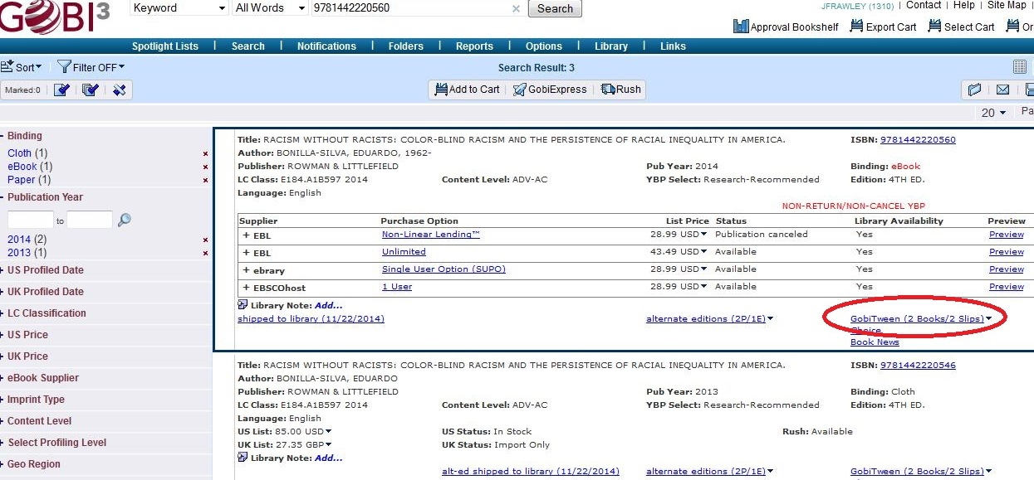
GobiTween Link
Notes:
Screenshot of GOBI ordering system, with GOBItween link.

Slide 23
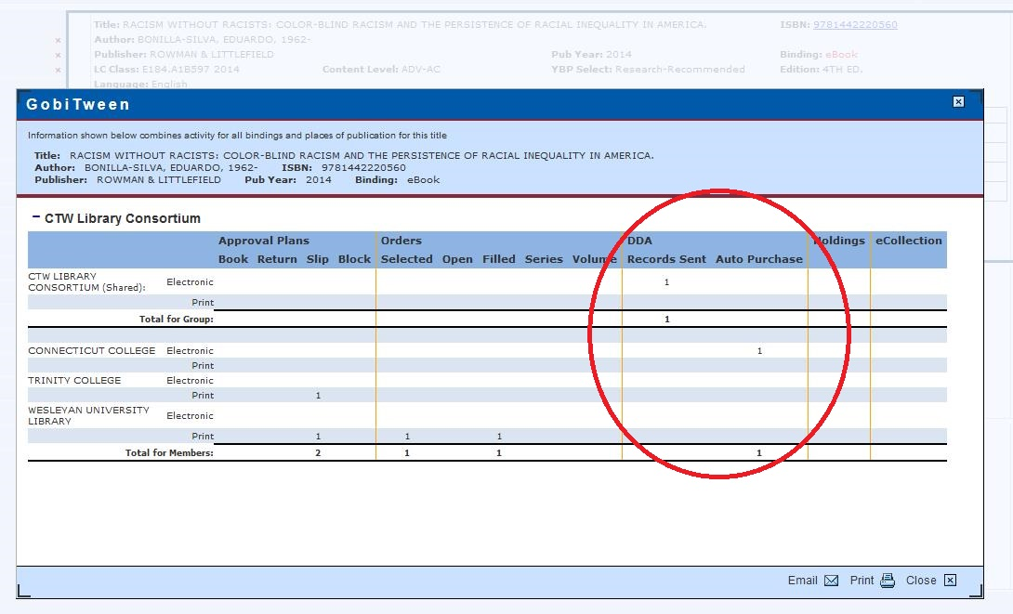
GobiTween Item Details
Notes:
GOBItween detail screen, indicating DDA record sent.

Slide 24
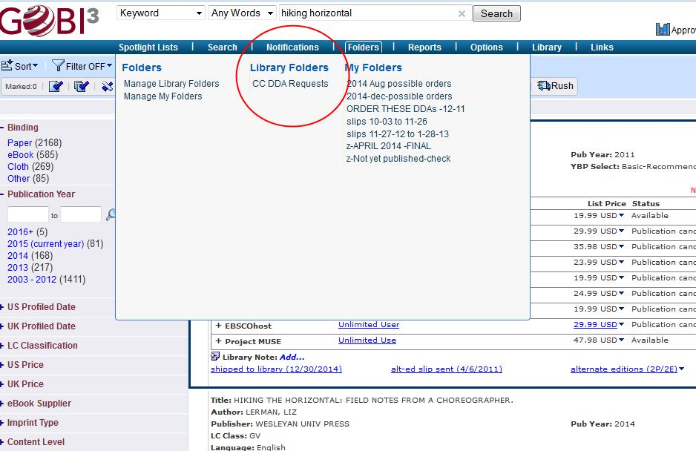
Titles outside profile may be added manually.

Slide 25
Discussion of Workflows

Slide 26

DDA Plan (Evolving) Workflow
Searching for the path of least resistance…

Slide 27

Expanded DDA Plan in place for approximately a year
DDA Plan a misnomer?
Really functions as a STL
(Short-term loan) plan
Majority of activity & costs for Wesleyan
DDA purchases: 26 Costs: $1,793
STL instances: 514 Costs: $8,721

Slide 28
DDA Bibliographic Record Management
Wesleyan currently utilizes YBP for:
1) primary selection tool (Gobi), representing our local holdings
2) large majority of our print orders
3) bibliographic records for print material (PromptCat)
4) marking / stamping / security-stripping
5) our consortial purchasing data (including DDA plan)
Straightforward decision to also utilize YBP for supplied ebooks:
6) Discovery DDA records
7) DDA purchase bibliographic records
8) Firm order ebook bibliographic records

Slide 29
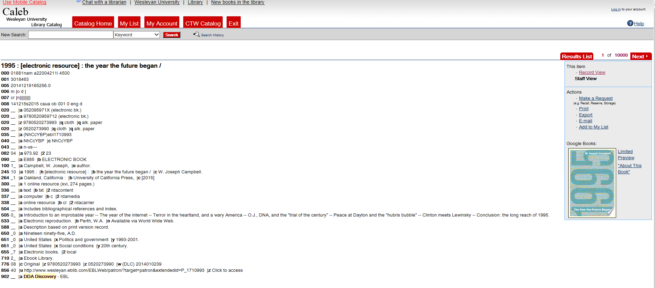
DDA Discovery records from YBP
manually loaded into Voyager ILS
Weekly files, minimal edits

Slide 30
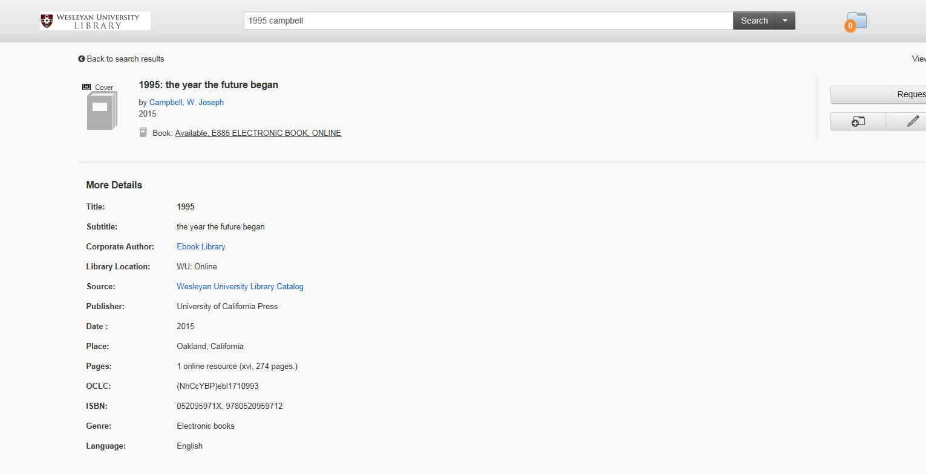
Wesleyan utilizes Summon
from Serials Solutions for
a discovery layer, OneSearch
Library still acclimating,
continued reliance on
traditional ILS

Slide 31
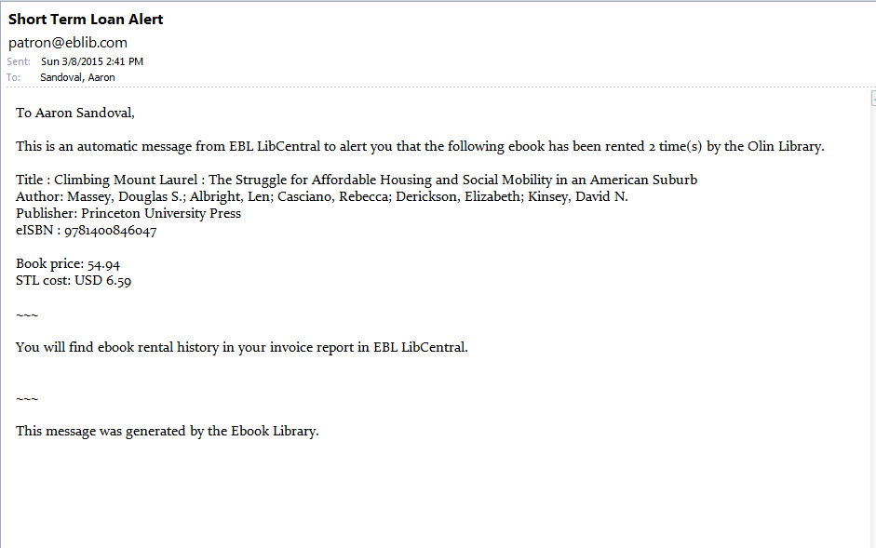
Patron triggers STL
EBL sends notification the same day
Helpful for keeping tabs on overall DDA plan activity

Slide 32
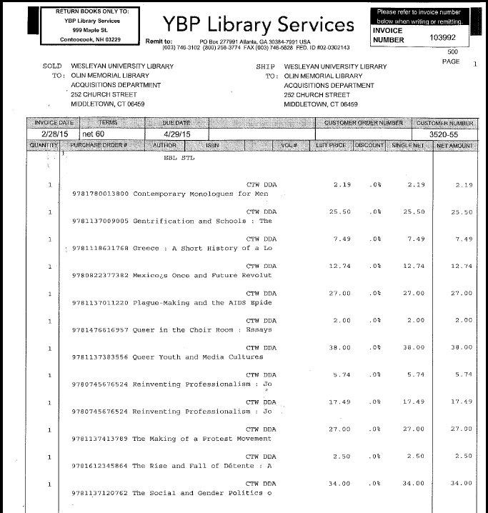
STL invoices billed weekly by YBP
Already paid via our deposit account
Manually entered into ILS (Voyager)
Entered only as invoices with service charges (no purchase orders created)
One fund for both STLs & DDA purchases
ISBNs are noted

Slide 33
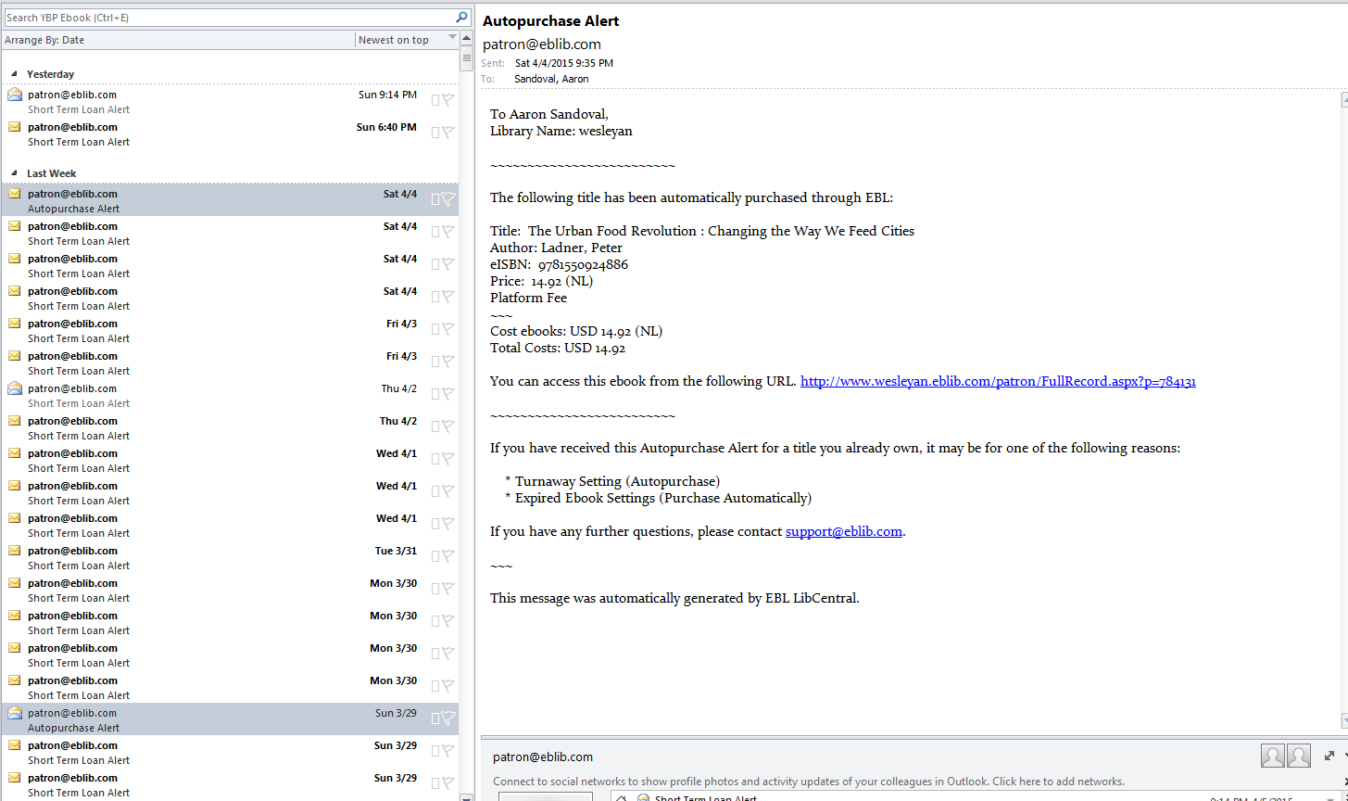
Short Term Loans vs. DDA Autopurchases

Slide 34
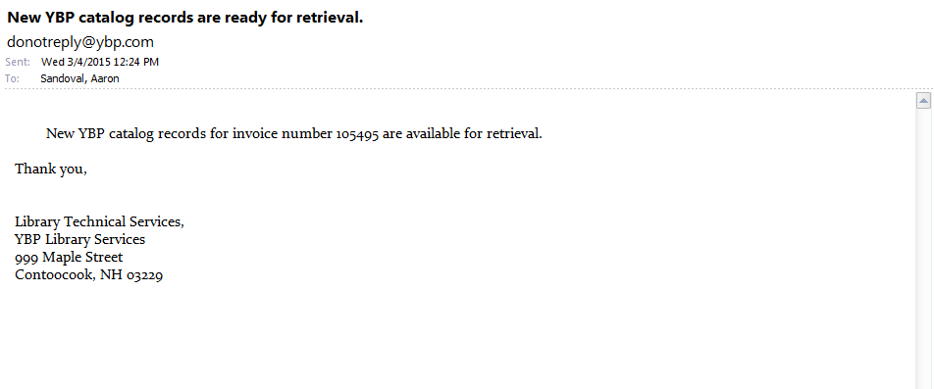
New bibliographic record available within a week from YBP, containing local data
Discovery DDA record still functions in the interim
Notice of availability from YBP, manually pick up via FTP
Manually import, overlaying Discovery record
Manually create purchase order(s) & invoice for payment

Slide 35
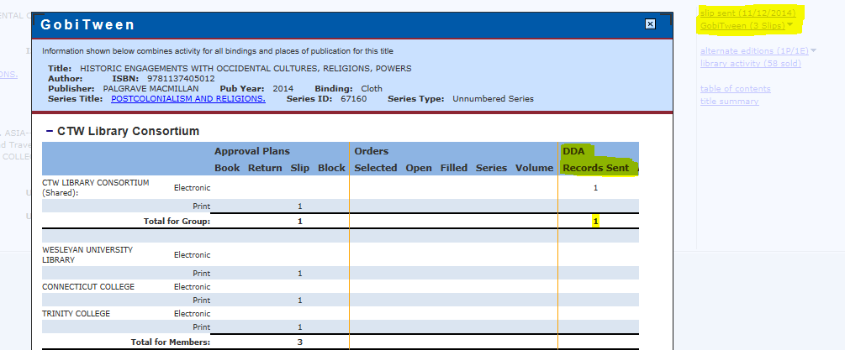
Possible improvements from YBP…
1. EDI for STL invoices & DDA Purchases….Please!
2. More transparent DDA data in Gobi

Slide 36
Changes in Wesleyan’s DDA workflow over the past year:
Are locally edited Discovery records more efficient for DDA purchases? Do we really need 2nd new bib records from YBP?
Automate cataloging loads for DDA purchases
Automate purchase order creation for DDA purchases
Still manually enter invoice records for both DDA purchases & STLs, also delete original DDA Discovery records
Currently exploring EBL metadata uploads directly into our OneSearch discovery layer (Serials Solutions’ Summon)
  Not currently a viable substitute for bibliographic records in our ILS
  Would enhance discoverability by patrons
  Our future workflow?

Slide 37

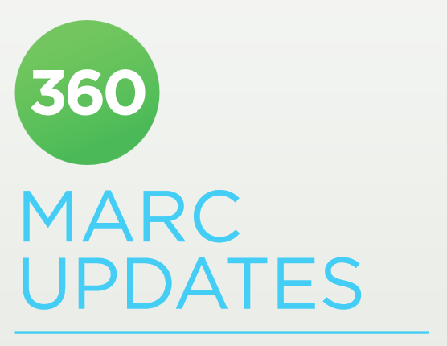

DDA Tech Services Workflow managed with:

Slide 38
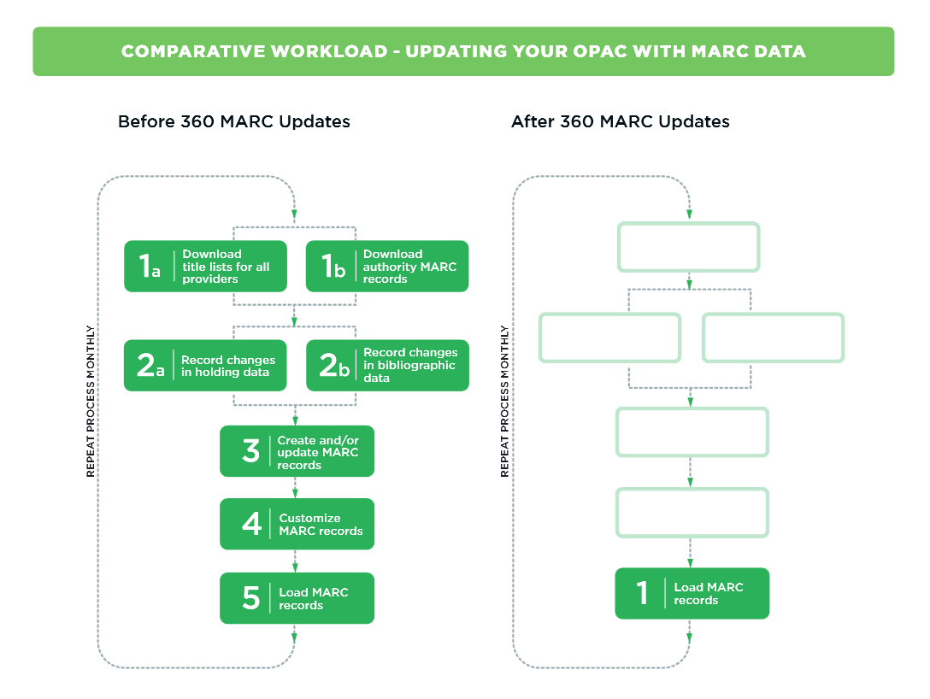

Slide 39
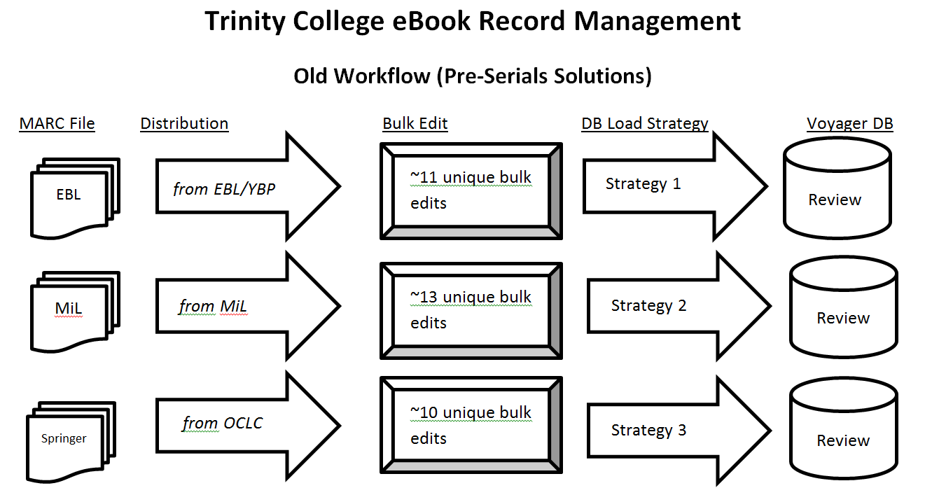

Slide 40
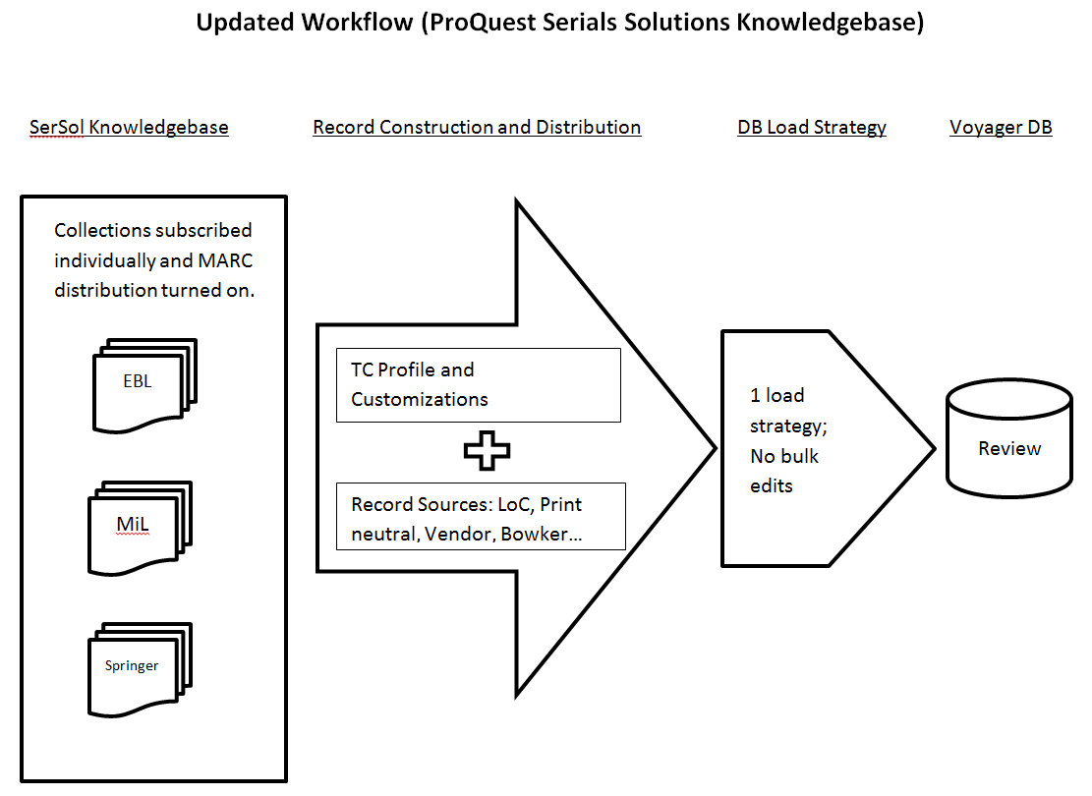
Notes:
Strengths of the SerSol Platform
Creates a single stream of records from multiple collections/subscriptions.
Merges access points into one MARC record for title overlap across collections.
Library can set record customizations and distribution frequency.
Some collection updates are completely automated as providers feed updates into KB.

Slide 41
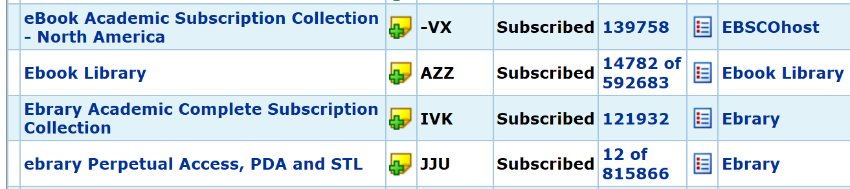
Example of an Ideal Scenario
Ebrary Academic Complete Subscription
The library has access to the complete list of titles in the collection.
Firm order/Perpetual Access titles are also fully automated in a parallel track.

Slide 42

Reality of the EBL Collection
CTW’s
Profile:
Pub. Date
Price
Publisher
Limits
Subset of Collection
AUTOMATION
Notes:
Selection profiles narrow the title access to a subset of the full collection on offer.
Discovery record pool is very fluid and constantly fluctuating in record count.
To date, there is no viable automation or direct feed from EBL database to SerSol platform. Partially due to our consortial setup.

Slide 43

Wiping the Slate Clean • Biweekly

Slide 44
Trinity’s Solution for EBL
Developed a manual strategy that utilizes the SerSol Offline Date and Status Editor (ODSE).
CSV template files are populated then uploaded to SerSol KB for bulk operations.

Slide 45


EBL through SerSol KB
http://trincoll.eblib.com/patron/FullRecord.aspx?p=1118497
Visible Titles
Discovery &
Purchased
Modify Syntax
CSV File w/ Title Metadata
Notes:
Biweekly, check the EBL LibCentral databse to retrieve the most up-to-date title list of all “Visible” titles: discovery and purchased.
Download a CSV file populated with metadata.
The direct URL for each eBook will become the match point in the SerSol KB since it contains a unique book ID #.
http://trincoll.eblib.com/patron/FullRecord.aspx?p=1118497
Modify the URL into a syntax the Serials Solutions’ matching algorithms will recognize.

Slide 46

EBL through SerSol KB
Title | ISBN | Status | URL
* |  | Subscribed | …p=1118497
* |  | Subscribed | …p=1134566
* |  | Subscribed | …p=1246884
* |  | Subscribed | …p=1798233
* |  | Subscribed | …p=1658797
* |  | Subscribed | …p=7899543
Notes:
Modify the URL into a syntax the Serials Solutions’ matching algorithms will recognize.
Populate the SerSol ODSE template with the modified URLs and switch all other data elements (e.g. title, ISBN) to neutral values.
In the SerSol KB deselect all currently active titles then upload the ODSE file to the server for processing.

Slide 47
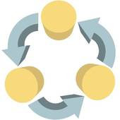
DDA Tech Services Workflow
Notes:
Will discuss CC’s approach to DDA management.
notice workflows at each library have taken different turn. -→
Because (reiterating)
-3 separate catalogs
-auto-purchases not shared consortially - each school triggers its own purchases
– means we are each free to develop our own procedures.

Slide 48
DDA Record Management
Options For Discovery Records
EBL records → Poor quality
YBP records → Better
OCLC Collection Manager records → Generally good quality
+ additional benefits
Notes:
For discovery records – we had a few options:
EBL = unacceptable quality
examples:
-improperly formatted content notes + subject fields
-problems w/ 520 field → summaries often cut off mid-word/sentence
2) YBP = “acceptable quality” -- have issues (mentioned prev.):
they are converted print records with 533 fields
no OCLC #’s
- require manual customization
3) Other options exist – Todd talked about one (360)
We chose to channel records thru OCLC Collection Manager
CM uses records from WorldCat
Recs generally good quality + additional benefits which I will discuss next

Slide 49

EBL
OCLC
Conn College
  Benefits of Collection Manager
  Free with OCLC Cataloging subscription
  Single source and workflow for records
    Single workflow for DDA & subscription record management
    Can set the same customizations and delivery frequency
  Merges duplicates with subscription collections (Ebrary, EBSCO)
Notes:
CM free with cataloging subscription = easy to experiment with
To start → asked EBL deliver weekly feed to OCLC KB
After: KB now knows which titles= discovery pool and =purchased collection
We are also using CM for Ebrary and EBSCO subscr. = opens up a variety of benefits.
single workflow for DDA & subscr. ebook collections - adds/updates/deletes processed together
Single record for title overlap
where same in EBL, Ebrary & EBSCO = single rec w/ multiple URLs
This has reduced duplicate & triplicate recs, which was a big concern for public services
We also reorder 856 fields → EBL displays below any others
try to steer patrons away from DDA link when in other collections

Slide 50
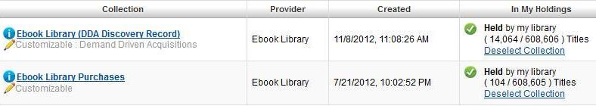
Two collections in the Knowledge Base:
1. Unpurchased books (discovery records)
2. EBL purchases
Notes:
(mentioned) CC= two EBL collections in KB -- discovery recs and purchases
can see recs OCLC thinks we should have anytime.
also tools to manually add / remove titles from KB collections
Our current configuration:
Discovery recs monthly, merged file
Purchased recs: weekly
CC now uses CM for all DDA rec mgmnt, with one exception:
large delete files issued by EBL manually processed ASAP

Slide 51
Things to be aware of
Pros outweigh cons… but,
Slightly delayed updates
Worldcat problems = Your problems (though most often found and corrected)
No separate delete file for merged OCLC #’s
  Need a process to handle merges
Notes:
things to be aware of (pros outweigh the cons, but):
*Keep the delay in record changes in mind:
-slight lag time btwn EBL update and KB to process
(may be off by a few weeks)
*Recs susceptible to any problems in WorldCat,
e.g, dups for same title, or other cataloging problems.
-when corrected in, re-sent as in Update file
*Lastly, when dup recs merged in WorldCat, invalid records not sent in delete file
- need to run a separate process (MarcEdit & Access) → find 035$z’s in merged recs & batch delete

Slide 52
Connecticut College DDA Workflow
1. Cataloger: Loads discovery records via Collection Mgr (monthly)
2. Patron: Discovers and interacts with ebook, triggers STL
3. EBL: Emails “Short Term Loan alert”
4. YBP: Sends paper invoice for STLs (weekly)
5. Acq: - Receives invoice & processes (YBP deposit account)
  - Creates Voyager P.O., attaches Voyager invoice/line item
  to discovery record
  [Repeat above until purchase is triggered]
Notes:
I’ll close this section with something of a workflow sequence for Connecticut College DDA.
1. Cataloger: Loads discovery records via OCLC Collection Manager (monthly)
2. Patron: Discovers catalog record and interacts with ebook, triggering STL
Due to our price cap, if STL >=35% list price, title is auto-purchased
3. EBL: Emails “Short Term Loan alert” each time an STL is triggered
4. YBP: Sends paper invoice for STL charges (sent weekly)
5. Acq: - Receives invoice & processes for payment → YBP deposit account
- Creates PO in Voyager; attaches invoice & line item to the discovery record for each STL
(later we will create a separate P.O. once a title has been purchased)
--These steps repeat until auto-purchase is triggered --

Slide 53
Connecticut College DDA Workflow (cont.)
6. Patron: Interacts with ebook final time, triggering purchase
7. EBL: -Emails notification of purchase –"Autopurchase Alert“
-Sends update to OCLC KB for purchased record
8. Cataloger: -Retrieves purchased record from Collection Mgr
-Overlays discovery record
9. YBP: Issues invoice for purchase price of item(s)
10. Acq: -Processes invoice for payment
  -Locates Bib record and attaches P.O. with invoice(s)
Notes:
6. Patron: Interacts with ebook final time, triggering purchase
7. EBL: Emails notification of purchase –"Autopurchase Alert"
8. Cataloger: Retrieves a record from the EBL purchased collection in Collection Manager / overlays the discovery record
9. YBP: Issues invoice for purchase price of item(s)
10. Acq: -Processes invoice for payment
-Creates new PO, and attaches to purchased record

Slide 54
For more information on DDA record management via
OCLC Collection Manager
“Options for implementing your Demand Driven Acquisitions
program using the WorldCat knowledge base”
OCLC Documentation
http://bit.ly/1BO9tzB
“OCLC's Next-Generation Metadata Management”
Presentation @ ALA Annual, Chicago, 2013
http://bit.ly/1GoY5cc
“You Have a DDA E-book Plan, Now How Do You Manage It?”
Presentation @ Charleston Conference, 2013
http://slidesha.re/1aennzf
Notes:
This slide is provided if any of you want to learn more about Collection Manager and the OCLC Knowldege Base, and specifically how they can help with DDA.

Slide 55
CTW’s DDA plan
first year
challenges & responses
Changing publisher policies
Changing vendor landscape
New tools
Need for thorough review & analysis
Options for expansion

Slide 56
STL price increases from various publishers
June 2014 - ongoing
Publisher EBL Short-term Loan Changes
Name of publisher | Current 1- day STL | New 1- day STL | Current 7- day STL | New 7- day STL | Current 14-day STL | New 14- day STL | Current 28-day STL | New 28- day STL
Oxford UP | 15% | 25% | 20% | 40% | 25% | 50% | 30% | 70&
Emerald | 5% | 20% | 10% | 30% | 15% | 40% | 20% | 50%
Royal Society of Chemistry | 5% | 35% | 10% | 45% | 15% | 55% | 20% | 65%
Louisiana State University | 15% | 30% | 20% | 40% | 25% | 45% | 30% | 50%
NYU Press | 5% | 25% | 10% | 45% | 15% | 55% | 20% | 70%
Cambridge UP | 15% | 30% | 20% | 60% | 25% | 60% | 30% | 60%
World Scientific | 5% | 40% | 10% | 50% | 15% | 65% | 20% | 75%
John Benjamins | 15% | 25% | 20% | 35% | 25% | pending | 30% | pending
Kogan Page | 5% | 25% | 10% | 45% | 15% | 80% | 20% | 80%
McFarland & Co. | 5% | 50% | 10% | 75% | 15% | 100 | 20% | 100

Slide 57
CTW OPTIONS
1. Remove/halt worst offenders
CTW tried this with Cambridge UP, then added their titles back into DDA pool. Reluctance to alter our publisher profile.
2. Mediation
If we’re going to say no, why are titles discoverable?
If we’re going to say yes, why give ourselves extra work and delay access?
3. Automatic purchases (by STL %, @particular price point)
4. Change parameters of plan (buy on 1st, 2nd, or 3rd use)

Slide 58
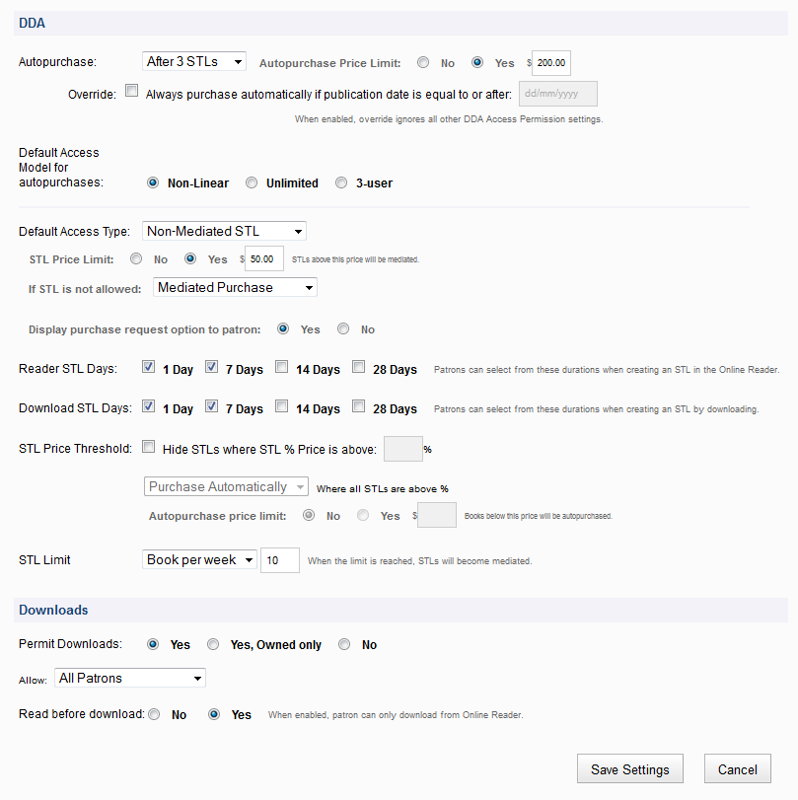
E
B
L
C
U
S
T
O
M
I
S
A
T
I
O
N

Slide 59


Other evolving publisher reactions to STL / DDA
One year embargo of STLs for new titles:
CTW currently omitting Wiley’s newest content, including it after the embargo
Five year embargo of both STL & DDA for new titles
More to come?

Slide 60



Changing vendor landscape
Improving tools
EBL- Ebrary merger
LibCentral released 2014
New Ebrary reader 2014
Integrated platform expected 2015
Our biggest concern: Non-linear lending model & its relative price
Ebsco purchase of YBP
Possible effects on DDA terms down the line?
Notes:
It is worth noting the considerable change in the vendor landscape, from the time of our DDA expansion profile arrangement, EBL merged with Ebrary, one of the other major ebook providers we considered for DDA plan.

Slide 61
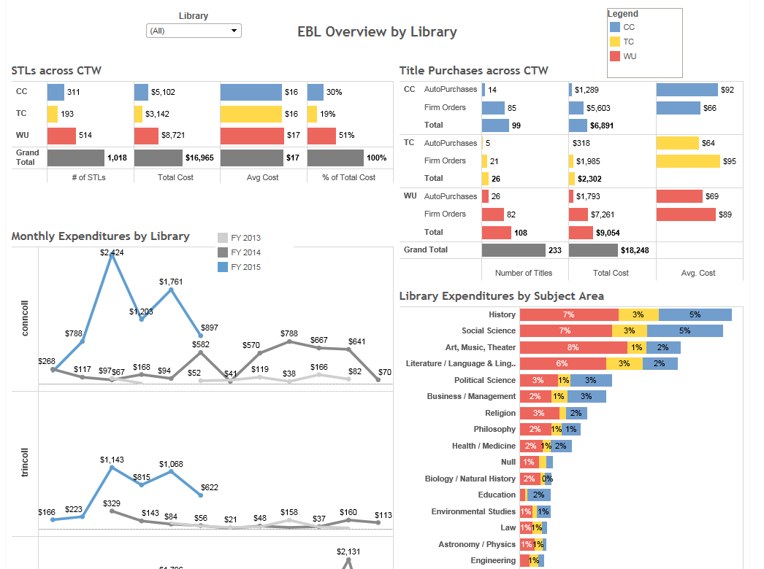

Slide 62
The future of the CTW DDA plan
Systematic review of plan in Summer 2015
utilizing Tableau & LibCentral
Ongoing desire for high quality monographic content
not available through current plan
Open to multiple or expanded DDA plans

Slide 63

THANK YOU!
Contact us with questions & suggestions:
Todd Falkowski Todd.Falkowski@trincoll.edu
Joseph Frawley jfrawley@conncoll.edu
Aaron Sandoval asandoval01@wesleyan.edu

