Slide 1

Digitization:
What you Need to Know About Outsourcing
NETSL Conference
April 10, 2015
Caitlyn Lam
Yale University
Tom McMurdo,
Vermont Department of Libraries

Slide 2
Basic questions:
How big is this project? Will it be a one time project or will it be ongoing?
Who is paying for the project and what are their expectations?
Are there rigid specs for the project?
Can you meet those specs if you do the project in house?
Do you have enough money for the necessary staff and equipment to do the project yourself?
If you purchase equipment, how long before it becomes outdated?
How much time do you have?

Slide 3
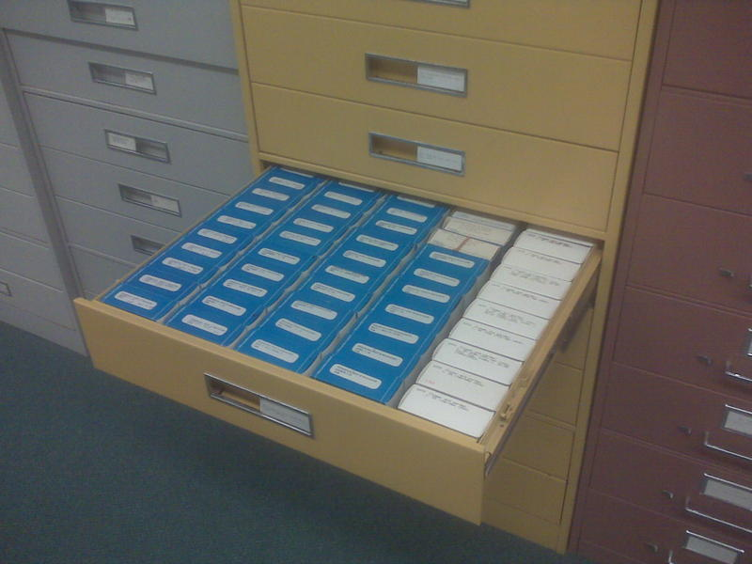
How big is this project? Will it be a one-time project or will it be ongoing?
Naturally, the volume of material to digitize will have a strong influence on your decision making about outsourcing. If you have a multi-year project, that may offset some of the costs of doing a project in house.

Slide 4

Who is paying for the project and what are their expectations?
If this is a grant-funded project, grant funders are usually pretty specific about what they want to see. Read the grant and understand what is needed.
If this is a project that is controlled fully by your institution, that can lessen the burden on your for reporting purposes, but don’t sacrifice quality. Look at accepted specs for imaging the materials you are working with.

Slide 5
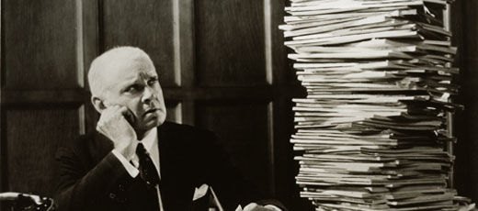
Are there rigid specs for the project?
Can you meet those specs if you do the project in house?
My primary experience is with the National Digital Newspaper Program (NDNP). This project requires high production volume and rigid specifications that limits the field of vendors to a select few.
Even if your project does not have a prescriptive set of specifications, chances are that you will want to follow some standard for your work.
Do you have the know-how in your organization to meet those specs? If not, do you have the money to hire someone who does?

Slide 6
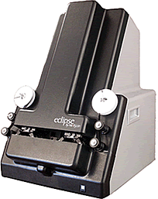
And, speaking of money, Do you have enough money for the necessary staff and equipment to do the project yourself?
Scanners and other imaging equipment can be expensive
Do you have someone on staff who understands metadata? NDNP uses METS/MODS.
How will you gather and encode metadata?
Imaging is an art as much as a science. Do you have expertise with he source materials and do you have the knowledge to understand what a “good” digitized image should look like?
Mistakes can be expensive. In large volume scanning projects, an ongoing mistake can mean not meeting spec. With an outside vendor, much of that risk falls to the vendor. Are you comfortable taking on that risk if you work in-house?
A NextScan ribbon microfilm scanner
like this costs
about $75,000

Slide 7
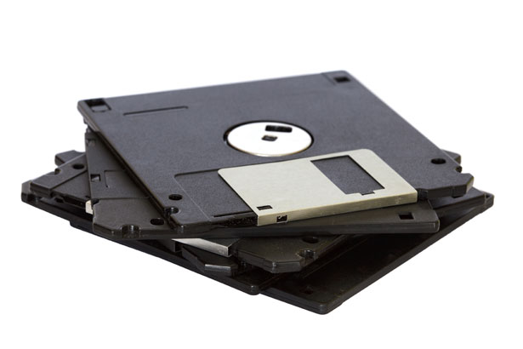
If you purchase equipment, how long before it becomes outdated?
When the next generation of imaging equipment for your materials comes out, will you have money for it? What is your institutional commitment to the project?
More importantly, will you be able to replace equipment when it becomes obsolete?
Is your volume high enough to justify the purchase of scanning equipment?

Slide 8
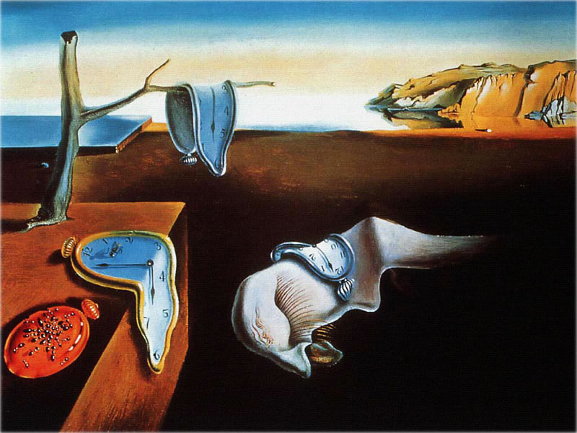
How much time do you have?
If you have time to research and purchase equipment, advertise positions and hire staff, then you may have the option of doing work in-house.
If you need to scan 50,000 photos and attach metadata to them in the next 6 months, you may not have the option of doing the work in-house.

Slide 9
Let’s take a look at these questions as they relate to vendors:
How big is this project? Will it be a one-time project or will it be ongoing?
  It is important to select a vendor that can work with projects that match your size and scope. Small shops can be a great fit for small projects. Research the vendor and require references from similar clients. See samples of their work so that you can compare apples to apples when making your selection. Don’t let cost be the only factor.
Who is paying for this project and what are their expectations? Are there rigid specs for the project?
  If you are part of a federal grant program, as I was with the NEH-funded NDNP, then the vendors you solicit may already know the specs of your project. If you are using voluntary national specs, the vendor should already be familiar with these as well.

Slide 10
Let’s take a look at these questions as they relate to vendors:
Can you meet those specs if you do the project in-house?
  A good, reputable vendor should be able to hit any specs that you bring them, provided that those specs are in the realm of what is accepted in the industry.
Do you have enough money for the necessary staff and equipment to do the project yourself?
  The up front investment in equipment and the ongoing cost of project staff can be prohibitive for an in-house project. The cost of working with a vendor is almost always going to be much lower—at first.

Slide 11
Let’s take a look at these questions as they relate to vendors:
If you purchase equipment, how long before it becomes outdated?
  A good, reputable vendor will maintain equipment that will never be obsolete.
How much time do you have?
  Depending on the bureaucracy at your institution, it may take several weeks to several months to sign a contract with a vendor. In some cases, you may be able to work with a vendor fairly quickly and be in production within weeks. There should be little or no learning curve for a vendor for your project. There may be a steep learning curve for you, staff that you hire, or existing staff.

Slide 12

A list of some of the pros and cons of outsourcing.
Business Cat

Slide 13
Pros of outsourcing:
Getting a project going is much easier. Instead of having to know how to do everything—imaging, metadata, file structure, quality assurance—you only have to know enough to evaluate the work you receive.
That means that your expertise can grow with the project without taking the risk of costly mistakes at the outset.
Lower initial cost. Without having to buy equipment and possibly hire people who know how to operate the equipment, the up front cost of getting a digitization project going is much lower.
Time. Because of the up front investment required for an in-house project, it can take a good while to get started. With a vendor, the only thing holding you back in evaluation of vendors and the time that it takes to execute a contract—if that’s even necessary.

Slide 14
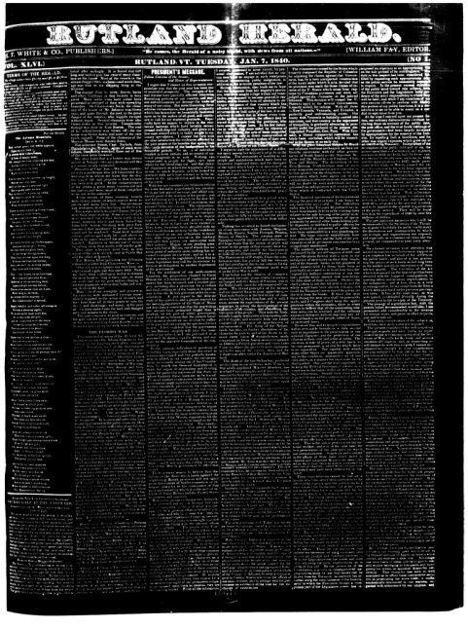
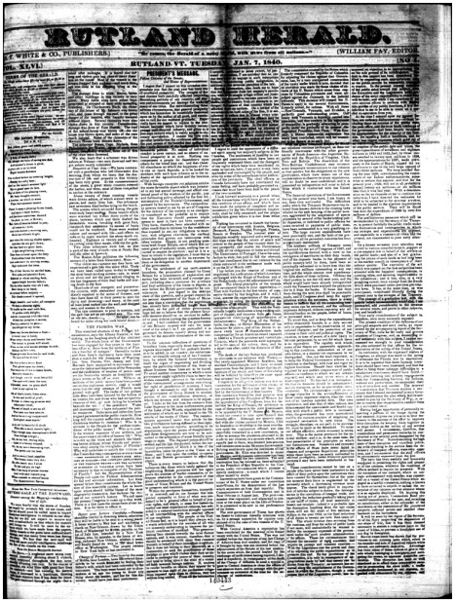
Pros of outsourcing:
A reputable vendor has probably worked with materials of the type for your project before and may be familiar with your specs already.
A digitization vendor should be able to work with you on a timeline and can help clarify expected outcomes.
A knowledgeable vendor can help troubleshoot problems as they arise, and should be good at working with damaged or brittle materials. A knowledgeable vendor should also be able to tell you what the best image is from a difficult source material.

Slide 15
Cons of outsourcing:
No vendor will have as much interest in your materials as you do. Your project may be your passion, but for most vendors it is just another job.
If you outsource, you will not develop the same level of hands-on expertise had you done the work in-house.
Vendors sometimes subcontract with other vendors overseas. This means that the vendor is now the middleman between you and the people doing some portion of your work. Vendors are not always the best for delivering your specific desires to a third party. See the first point above. Often metadata work is farmed out in this way.
Though startup costs are lower, for a multiyear project, you may pay a vendor as much as you would for equipment to perform the work.

Slide 16
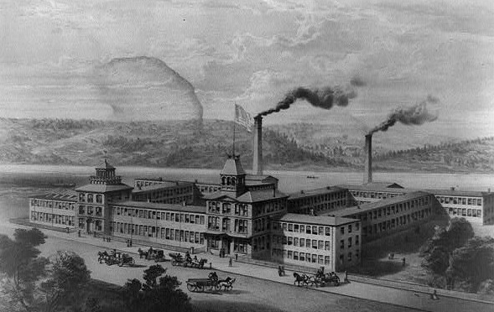
Cons of outsourcing:
Because you are not developing expertise doing the work yourself, at the end of a project it can feel like you spent a good sum of money, but are still at square one if another project comes up. Outsourcing tends to lead to more outsourcing.

Slide 17


Hybrid models:
This doesn’t have to be an exclusive choice. It may be possible to do some of the work in house and contract some of it to a vendor.
Depending on the type and scope of your project, you may be able to take a role in production.
At both the California Digital Newspaper Collection and the Vermont Digital Newspaper Project, we became part of the vendor’s workflow. This can be very beneficial because mistakes get caught before the files are completed. This can also mean a significantly lower cost.

Slide 18
General tips for working with digitization vendors:
As previously mentioned, choose the right vendor for your project. Get samples of work that is as much like yours as possible. Ask for references and check with other customers who are similar to you.
If you don’t already know, learn enough to have a good grasp of what you are getting back from the vendor. Understand your metadata schema and how the data you give to the vendor fits into that schema.
Know about file types and resolution.
Know your source material. You cannot evaluate the work you receive from a digitization vendor if you do not understand your analog materials.

Slide 19
General tips for working with digitization vendors:
Inspect their work and provide feedback. Give specific feedback that shows that you are inspecting their work. At the beginning, that should be a high percentage of what you get from them. As you progress and get consistent satisfactory results, you can reduce the percentage you inspect. This should settle at around 10%.
Even the best vendors have a tendency to settle for “good enough.” If you are giving them specific feedback you will get better work. Often, a vendor just needs to know that someone is paying attention. If their work disappears into a vacuum, it is natural to let things go.
Some vendors will fight you about quality. That is why it is critical to have a working understanding of the digitization process and a thorough knowledge of your materials. Digital artifacts and carelessness in the digitization process can look like weaknesses in the source materials. Know which is which.

Slide 20
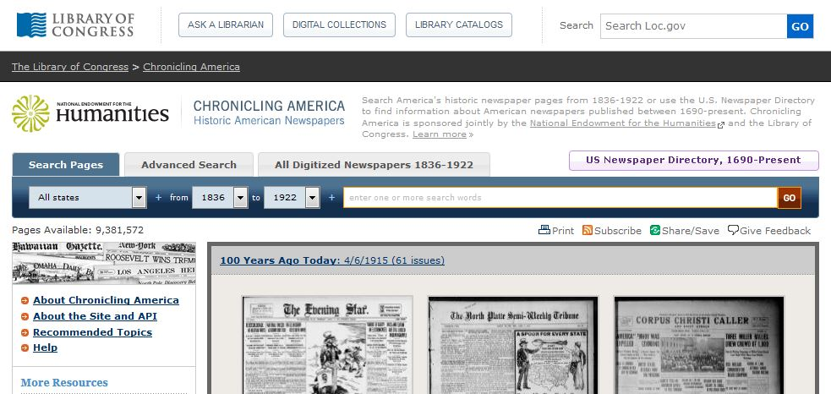
General tips for working with digitization vendors:
In my experience, digitization vendors want what you want: the best product that can be delivered. Developing a comfortable rapport with vendors can mean that they will go the extra mile for you to get the best quality images. Praise good work and provide constructive criticism.

