Slide 1
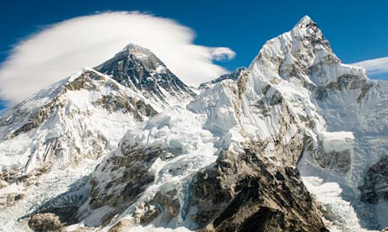
The 7 Practices
for Highly Effective Librarians in the 21st Century
José-Marie Griffiths, Ph.D.
NETSL Annual Conference
Friday, April 10, 2015
College of the Holy Cross, Worcester, MA

Slide 2
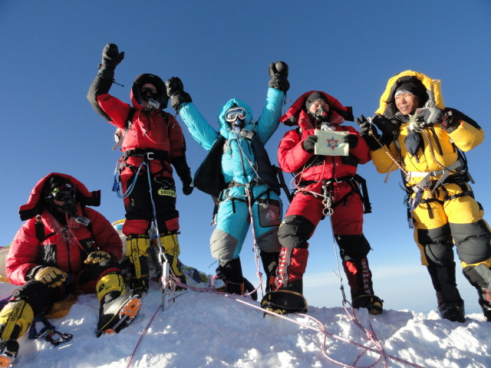
The 7 Practices for Highly Effective Librarians in the 21st Century:
Reaching Your Potential

Slide 3
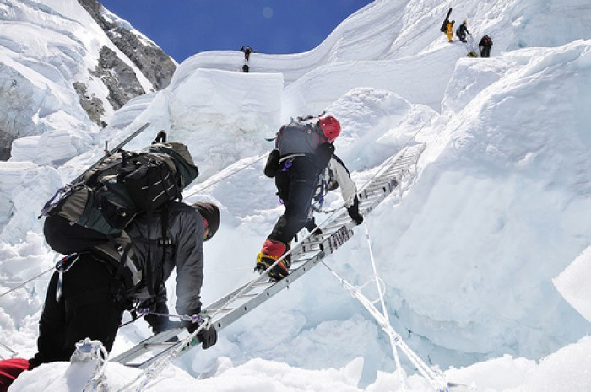
Being a successful librarian today has a lot of similarities to mountain climbing

Slide 4

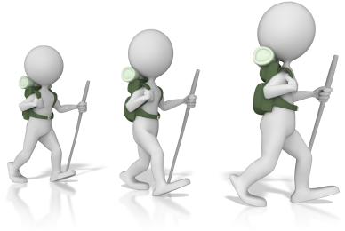
The 7 Practices for Highly Effective Librarians in the 21st Century
SUCCESS!
PRACTICE
7
PRACTICE
6
PRACTICE
5
PRACTICE
4
PRACTICE
3
PRACTICE
2
PRACTICE
1

Slide 5
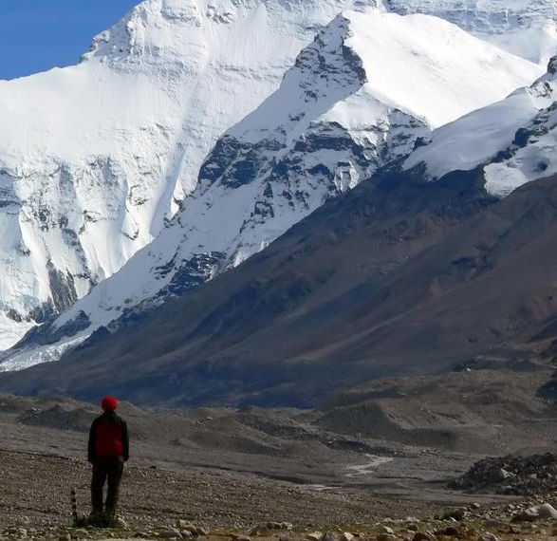
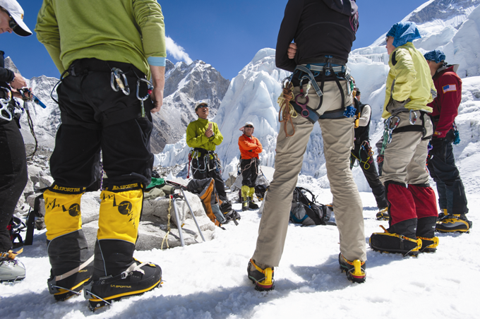
Need to make sure we are focusing on the right things…
…and more time focused on the climbers with whom they are working.
Everest climbing experts always say that the best sherpas spend less time focused on the mountain…

Slide 6

The importance of focus and perspective
PRACTICE
1: Understand Your Expertise
We are in the knowledge business
not the information business
We need to understand the difference between:
focusing our efforts on content management versus focusing our efforts on knowing
We need a focus on knowledge management and a focus on developing, encouraging and sustaining a culture of knowing
managing something that is static to managing something that is alive, emerging, interactive.

Slide 7
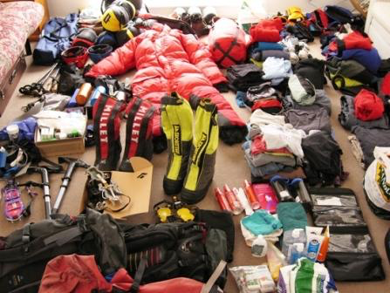
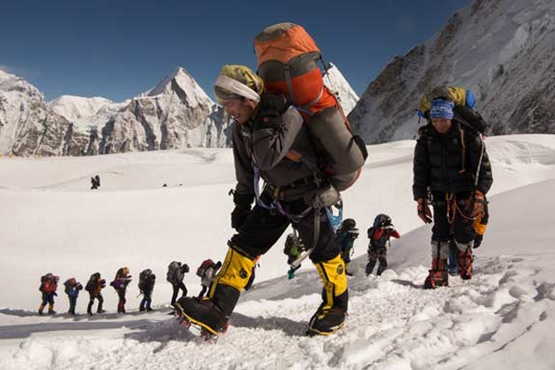
Need to understand what it takes to scale mountains…
“All the newest technologies and top-rated equipment won’t get you to the top of Everest – and back down…
…only a skilled and seasoned sherpa guide can do that.”

Slide 8
Librarians typically don’t understand their value…
PRACTICE
2
Know Your Value
The guide is always more important than the equipment…
Librarians model the classic servant leader
Need to understand how expertise can be applied and used, what it’s worth
Librarians add tremendous value by helping people hone in on their search, understand the qualification of resources
Adds value to the individual, the community, the organization
Understand Your Expertise

Slide 9
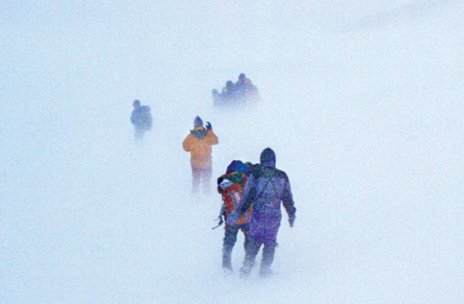
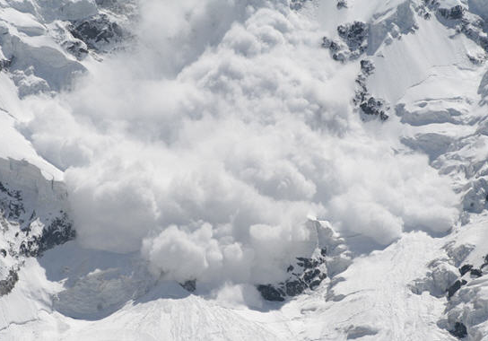
Need to understand environmental factors…
“The best guides are constantly monitoring what is happening on and around the mountain…
…the weather, how the season has been, who’s ahead, who’s behind, how avalanches have reconfigured the side of the mountain – you have to be aware of all of it.”

Slide 10
Your world is bigger than what is in front of your desk…
Have to make sure you have the right goal – to not only get up the mountain but also to get back down…
PRACTICE
3
See The
Big Picture
Need to understand the part you play in an institution - how you assist the institution accomplish its mission
Step out of the library, look at where the institution is going – what is happening to your user base – what is success for them
Make sure you have the right goal – need a sustainable approach
Know
Your
Value
Understand Your Expertise

Slide 11
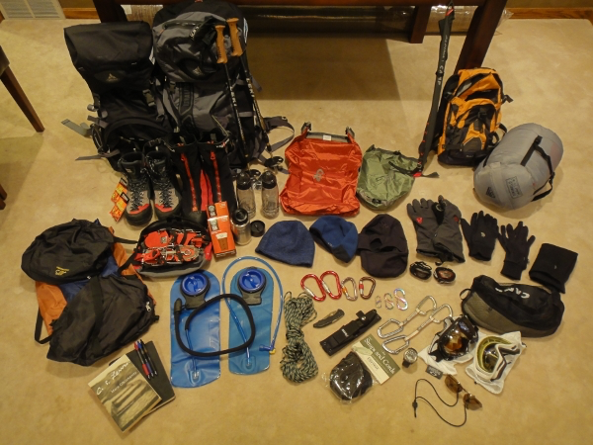
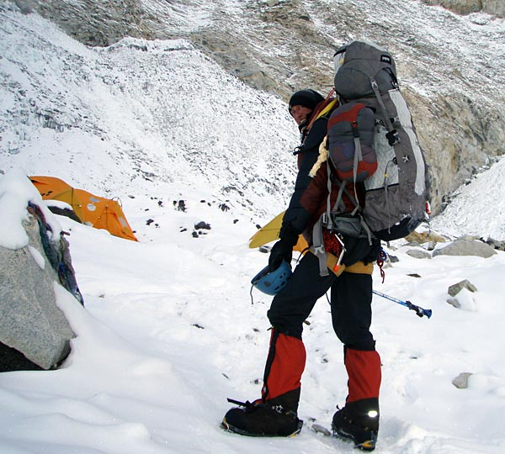
Good guides know their equipment...
“You have to know how to skillfully use every piece of equipment you have…
…and you learn how to use everything you have with you in multiple different ways – you’d love to have exactly the right tool for every situation, but you can only carry so much in your pack.”

Slide 12
Know your tools and push their functionality…
PRACTICE
4
Embrace Technology
Apply and push the technology
Work with the tech providers
Anticipate what your user community might need
Take the technology you have and extend it, enhance it to do something more than it might have originally been intended to do
See The
Big Picture
Know
Your
Value
Understand Your Expertise

Slide 13
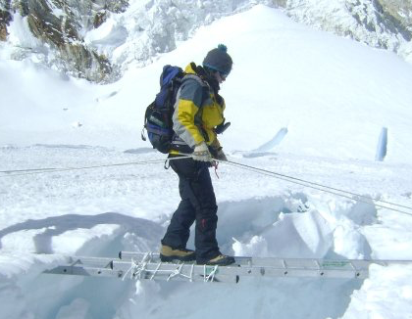
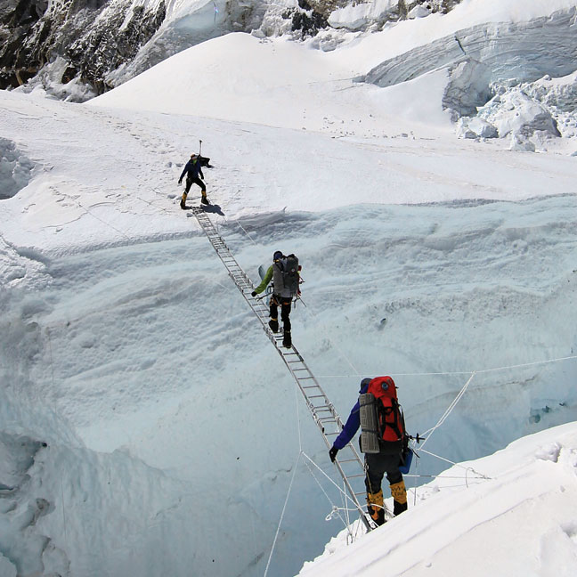
Teaching and training is the first order of business…
“Experienced guides spend a lot of time at Base Camp in a supportive environment teaching and practicing the skills the climbers will need on the mountain…
…so when they get to the harder, more difficult parts of the climb their climbers have the skills that now make the difference between life and death. ”

Slide 14
Have to teach to the changes…
PRACTICE
5
Learn How To Teach and Learn
Librarians have to be the TRANSLATORS to multiple audiences of the changes in knowledge availability and delivery…
Teaching and training is a big part of library roles today because of:
changes in resources available
changes in technology
changes in how information is created, captured and delivered
Embrace Technology
See The
Big Picture
Know
Your
Value
Understand Your Expertise

Slide 15
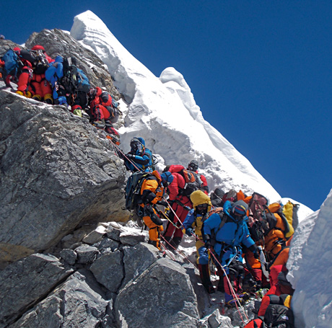
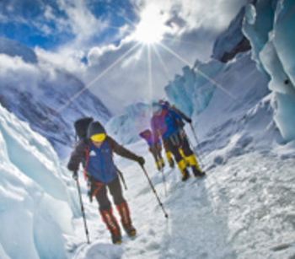
The past is not always the best guide for the future…
“Trudging nose to butt up the ropes that had been fixed to the steep slope, [my sherpa] and I were wedged between strangers above us and below us…. Above me were more than a hundred slow-moving climbers…
…the lead Sherpa of our team and I unclipped from the lines, swerved out into open ice, and began soloing—for experienced mountaineers, a safer option.”

Slide 16
Forward motion requires creativity and innovation…
Sometimes the way to get your climbers to the top is NOT path you’ve followed in the past or everyone else you know is taking…
PRACTICE
6
Get Out Of Your Comfort Zone
Learn How To Teach and Learn
Embrace Technology
See The
Big Picture
Engage with the organizations and people important to your institution
Get out of the library – in your community become a true advocate for your organization and help others see how the library can help people’s success
Represent the institution – build relationships for your institution
Know
Your
Value
Understand Your Expertise

Slide 17
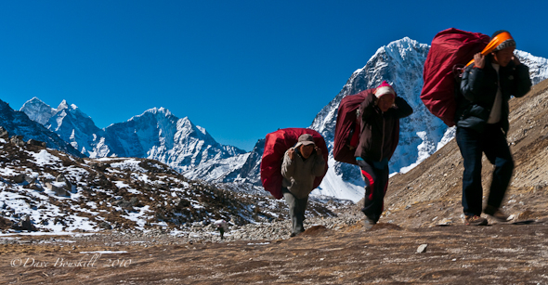
We can make the climb better for everyone…
“The sherpas are the ones who make the climb to the summit possible. They are the ones who take up all the equipment, set up all the ladders [across the crevasses] and the ropes, and guide climbers across the ever shifting face of the mountain. They pay it forward – often with their lives – every day so that people can experience Everest. Without them, scaling Everest is unimaginable.”

Slide 18
Look for opportunities to help with the climb…
Contribute now….and pay it forward as well…
PRACTICE
7
Make Contributions
Get Out Of Your Comfort Zone
Learn How To Teach and Learn
Embrace Technology
See The
Big Picture
Know
Your
Value
Look for opportunities both internally and externally to your organization
Stewardship model of leadership – what is your real purpose?
Understand Your Expertise

Slide 19
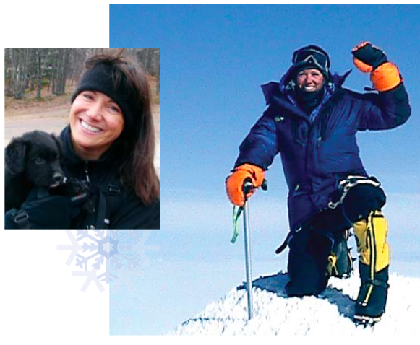
Inspiration from the top of the mountain…
Lori Schneider – mountain climber
Moved beyond a diagnosis of Multiple Sclerosis to become a world-renowned climber.
Has done all Seven Summit climbs (the highest peaks on each of the world’s seven continents), including Mount Everest in 2009
“How can a mountain better prepare us for life? At 29,035 feet, there is a lot to learn. The most important lessons are equally as relevant on icy slopes as they are in conquering our everyday work and life challenges.”

Slide 20
Ordinary people can achieve extraordinary things, if we just set our mind to it. It’s all about taking a leap of faith in your life and going for the gusto!
2. Believe in yourself and don’t be afraid to take a risk. You don’t have to be the strongest, or the smartest, or the best to succeed. You just have to get out there and do it. The success is in the journey.
3. Pack a light life pack. Let go off all the unnecessary things in life that weigh you down. That extra emotional baggage called guilt, regret or worry only serve to make your life pack heavier, making each step more difficult. Dump the “what if’s” from your life pack and leave the burden behind.

Slide 21
Inspiration from the top of the mountain…
4. Take your challenges one step at a time. On Everest, we took one step then seven breaths, one step then seven breaths. Break tasks down into smaller steps so you have the strength to make it all the way to the top.
5. Rely on your “life sherpas” to help you along the way. On Everest, we had Sherpas to help lighten our loads. They strapped on our life-giving oxygen, so we could climb safely. They guided our way in the dark, as we inched blindly toward the summit. Rely on the strength of the people in your life who care about you, when your own strength is not enough.
6. Realize that your limitations and barriers are often self-imposed. When you are able to move beyond them, they no longer define who you are.
7. Challenge yourself and climb beyond your limits.

Slide 22
“It is not the mountain we conquer, but ourselves.” — Sir Edmund Hillary

Slide 23
José-Marie Griffiths, Ph.D.
Bryant University
Smithfield, R.I.
josemarie@gmail.com

