Slide 1

Library Collections Review in the Digital Age: Collaborate, Disseminate and Eliminate
A Case Study from Kresge Library
at Dartmouth College

Slide 2

Kresge Library Collections Review Step-by-Step
The more user-friendly version is in your hand-out

Slide 3
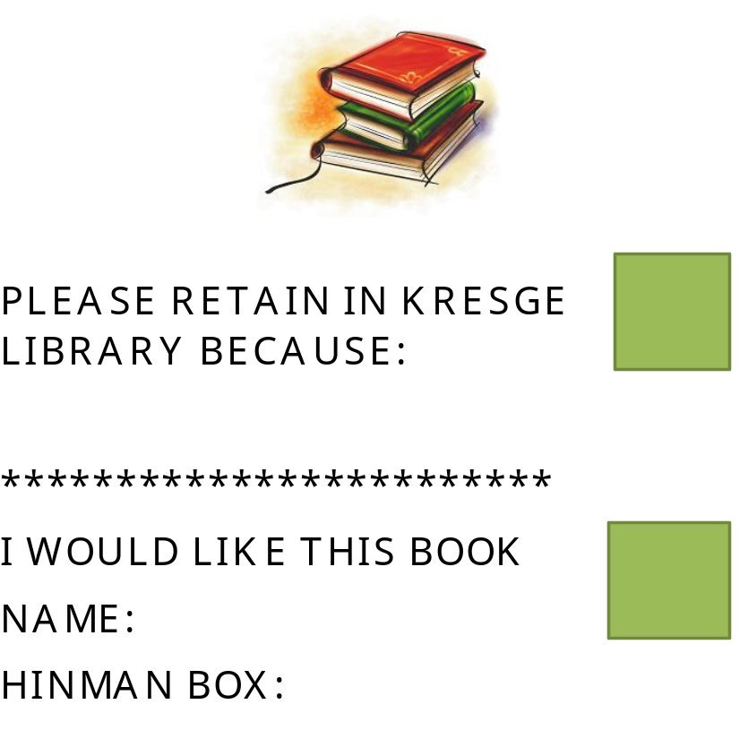
Kresge Patron Decision Slips

Slide 4
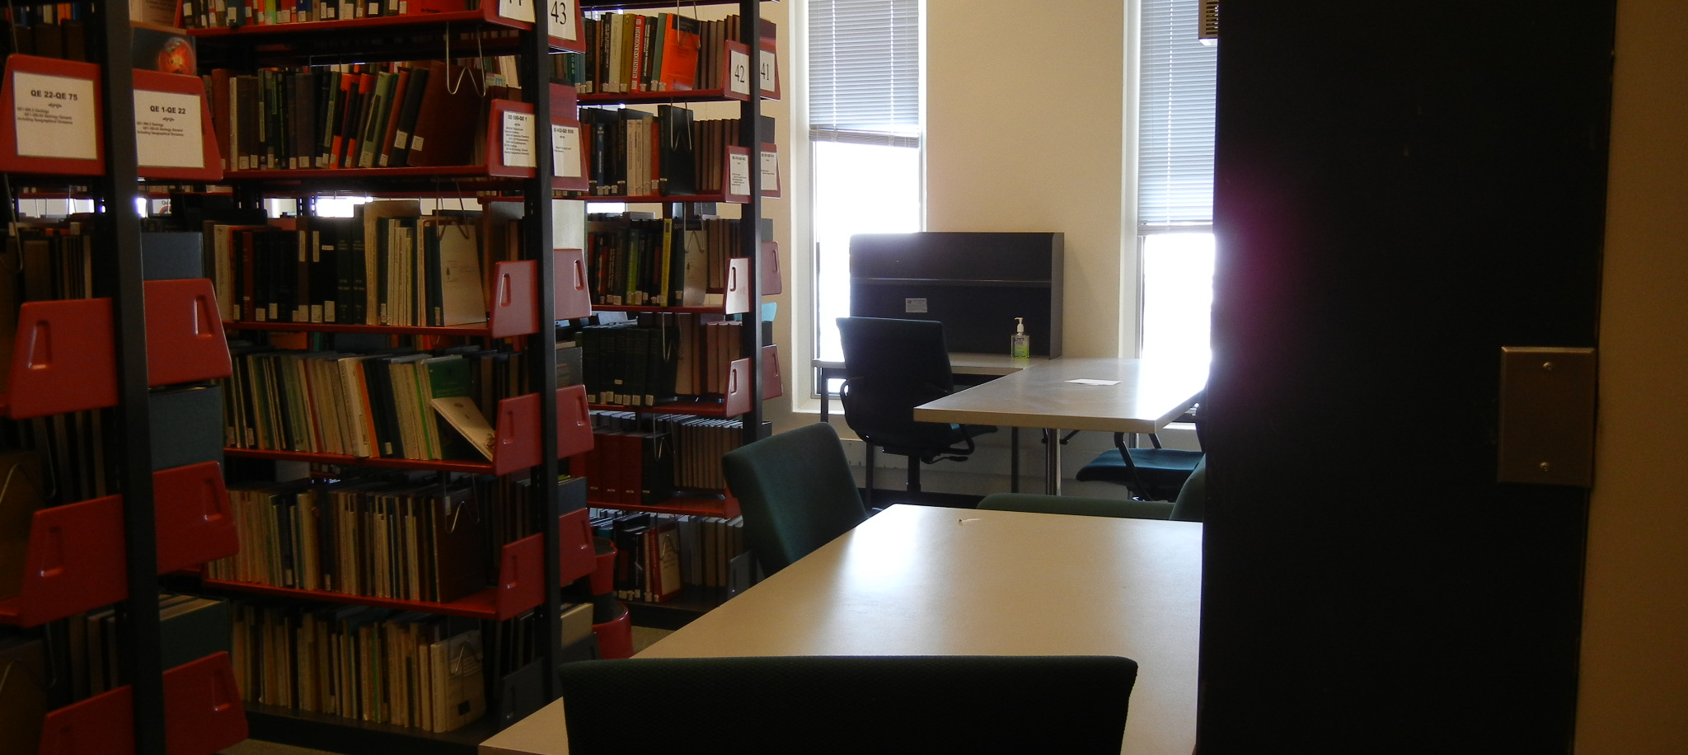
Back Corner of Kresge Monograph Stacks during Intersession
The Study Carrels and tables are quite popular, in spite of the tight spaces.
Our goal is to add more as we reduce our print collection in the coming years.

