Slide 1
Building and Rebuilding the Perseus Catalog
Alison Babeu
Digital Librarian
Perseus Digital Library

Slide 2
What I said I would talk about
This session will discuss the iterative and ongoing development of the metadata and interface for the Perseus Catalog with a particular focus on the collaborative work and relationship between the digital librarian, the head software developer and the digital library analyst (read developer with a different title) that went into getting the catalog online in 2013.
First conceived of in 2005, with continuous data creation ongoing, the Perseus Catalog has suffered through various attempts at making its data accessible and searchable including a painful eXist experiment, a short lived eXtensible Catalog implementation, and its current instantiation using Blacklight.
This talk will explore a number of aspects of the Perseus Catalog’s journey towards the light, including 1) the creation of MODS and MADS data and attempts to move towards linked data; 2) the utilization of Canonical Text Services as an overarching architecture; 3) the challenges of picking and then implementing an open source catalog system that could exploit the richness of the XML data; 4) the importance and challenges of making all bibliographic data and source code open and well documented; 5) the challenges and opportunities of building relationships between “traditional” and new professional roles created in a digital library by the need to move from closed data and services to an open collaborative environment.

Slide 3
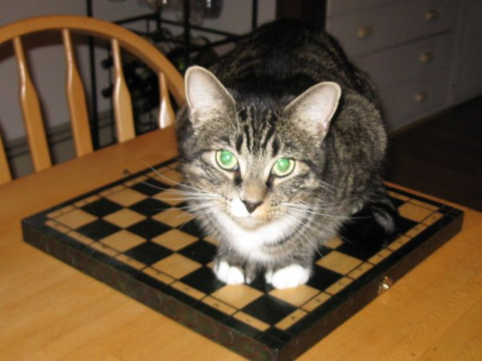
Putting the cat into Catalog
Milo!

Slide 4
So What I’m Going to Try and Cram In Here
Brief overview of the Perseus Catalog, its history and development.
My experience of changing metadata practices and data creation in the brave new world of data sharing and linked data (with a little bit about standards).
A bit about the challenges of using XML for library data and relying on open source tools to exploit it.
The rewards of open metadata and code creation, but oh the documentation.
“New” roles and “new” relationships discovered along the way through increased collaboration.

Slide 5
Perseus Digital Library Overview
The Perseus Digital Library:
  A collection of resources for the study of the humanities.
  A research project offering experimental tools and data testbeds.
  A content provider that maintains a publicly accessible, actively curated set of collections, tools and legacy data.

Slide 6
Perseus Overview-2
Audience includes researchers, scholars, students, instructors, citizen scholars and the general public.
The flagship collection features primary language texts (Ancient Greek, Latin, Arabic, et al.), morphological tools, translations, secondary sources, images and supporting materials.

Slide 7
Perseus Background-1
Planning for the Perseus Project began in 1985 with the first publication, a single CD-Rom, published in 1992. Perseus moved online in 1994. Current version introduced in 2005.
Initially a collection of resources on the Greco-Roman world; subsequent initiatives expanded the collection to other areas of the humanities.

Slide 8
Perseus Background-2
Currently in transition from closed, traditional style of publication to a collaborative and open-access model.
Perseus, and its various elements and collections (such as the Perseus Catalog!), have been funded by a series of public and private grants, in combination with the support of Tufts University.
Perseus hosts several research initiatives and has worldwide collaborators. Prof. Crane has a joint appointment at the University of Leipzig.

Slide 9
What We Hoped for in the Perseus Catalog
Broad purpose is to provide systematic catalog access to at least one open access edition of every Greek and Latin author (extant and fragmentary) from antiquity to around 600 A.D.
Scope of the Perseus Catalog has changed over its 10 year lifespan from classical finding aid to core component of both Perseus and related project infrastructures.

Slide 10
The Participants
Bridget Almas—Senior software developer
Alison Babeu—Digital librarian
Lisa Cerrato—Managing editor
Greg Crane—Editor in Chief (cameo appearances)
Anna Krohn—Digital library analyst

Slide 11
The Challenges
Get almost 7 years of legacy bibliographic and authority metadata online in a usable format through a suitable interface.
Make that data openly available as linked data or at least linkable data.
Transition from previously closed workflows to a new open and collaborative environment.
Document the whole process and work together with as little bloodshed as possible.

Slide 12
Perseus Catalog Timeline-1
2005: First experimental catalog online for Perseus Digital Library deployed using FRBR “model”.
2006-2008: Beginning creation of metadata for current catalog
2008: White paper released regarding current state of the Perseus catalog data and future plans.
2008-2011: Metadata creation expands to support growing bibliography of public domain editions of classical authors.
2011-2012: Discussions begin between senior software developer and digital librarian as to how to get the catalog data online.
2011-2012: eXtensible Catalog implementation tested.
2012: Discussions continue between digital librarian and senior software developer on need for different solution.
Late 2012: White paper 2.0 tries to outline catalog data and interface needs

Slide 13
Perseus Catalog Timeline-2
Late 2012: Digital library analyst hired to oversee the development and assist in programming for the beta release of the Perseus Catalog.
January 2013: Blacklight chosen for implementation.
Spring 2013: Continuous meetings to discuss interface, user needs, and documentation requirements.
Summer 2013: Metadata and code are made available on GitHub.
2013-Present: Ongoing updates to existing catalog data, creation of new catalog data, maintenance of catalog code, user support for the online catalog.
2015: Release of wikis on how to create new data for the catalog and on the GitHub catalog_data repository
June 2013: Blacklight implementation of Perseus Catalog released.
Spring 2013: Testing of data conversion processes, creation of Perseus Catalog blog to host initial documentation and user guide.

Slide 14
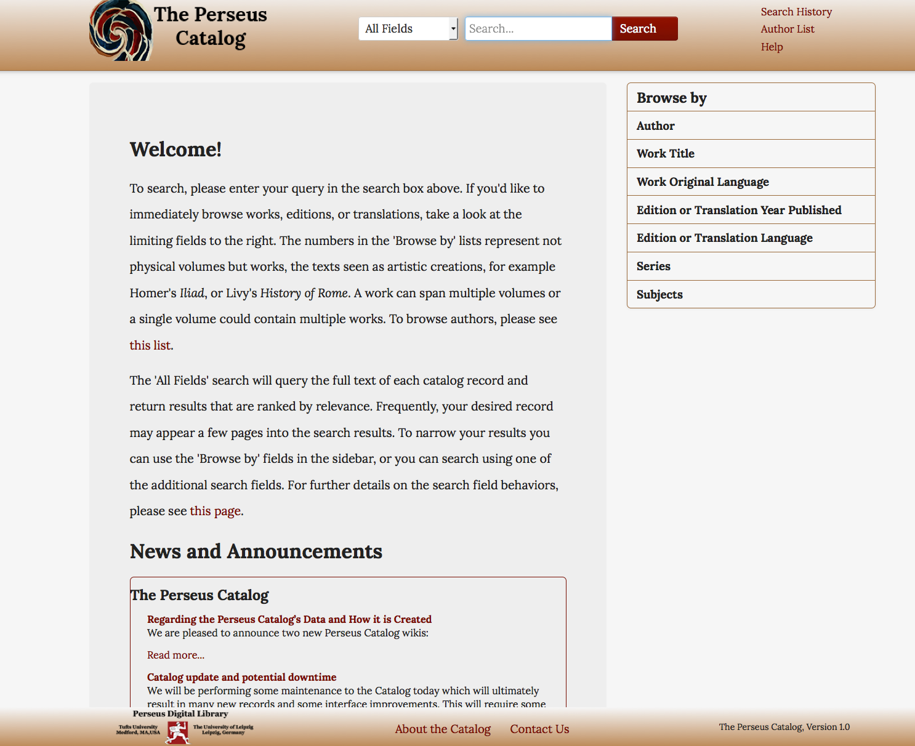

Slide 15
The Library Standards
FRBR—Or the idea rather than the standard behind it all).
MODS—basis for all catalog records in the Perseus Catalog.
MADS—basis for all authority records in the Perseus Catalog.
Notes:
Or What makes it all work!

Slide 16
The Digital Classics Standards
Developed through the work of the Homer Multitext Project:
Canonical Text Services Protocol (CTS)-Network service to identify and retrieve text fragments using canonical references expressed by CTS-URNs.
CITE Architecture-Collections, Indexes, Texts and Extensions-Network service to support discovery and retrieval of texts or collection of objects
CTS-URNs-Part of the CTS and CITE Architecture, provide “permanent canonical references” to retrieve texts or text fragments

Slide 17
CTS Terminology-Or Why Am I Telling You All This?
CTS defines a number of key concepts utilized by the Perseus Catalog for its data architecture-
  Textgroups-Way of grouping texts, used for authors of literary texts or corpus collections-require unique identifiers.
  Works-As with the FRBR model-a distinct intellectual creation.
  Editions/Translations-In Perseus Catalog indicates a particular published version of a work (somewhat equivalent to the FRBR expression).

Slide 18
Work Identifiers and Catalog Records
How it all fits together in the Perseus Catalog:
  Perseus Catalog makes use of the CTS-URN format
  Utilizes work identifiers from several classical canons (Thesaurus Linguae Graecae, Packard Humanities Institute) when available
  Uses these to create both version identifiers and canonical URIs for editions in the catalog.

Slide 19
Say What?
  An example to illustrate:
  urn:cts:greekLit:tlg0012.tlg001.perseus-grc1
    greekLit Domain for the text
    tlg0012 is the textgroup identifier for Homer, defined as author 0012 in the TLG Canon
    tlg001 is the work identifier for the Iliad assigned by the TLG
    perseus-grc1 stands for the 1920 OCT edition of this work edited by Thomas Allen that is available in the PDL.

Slide 20
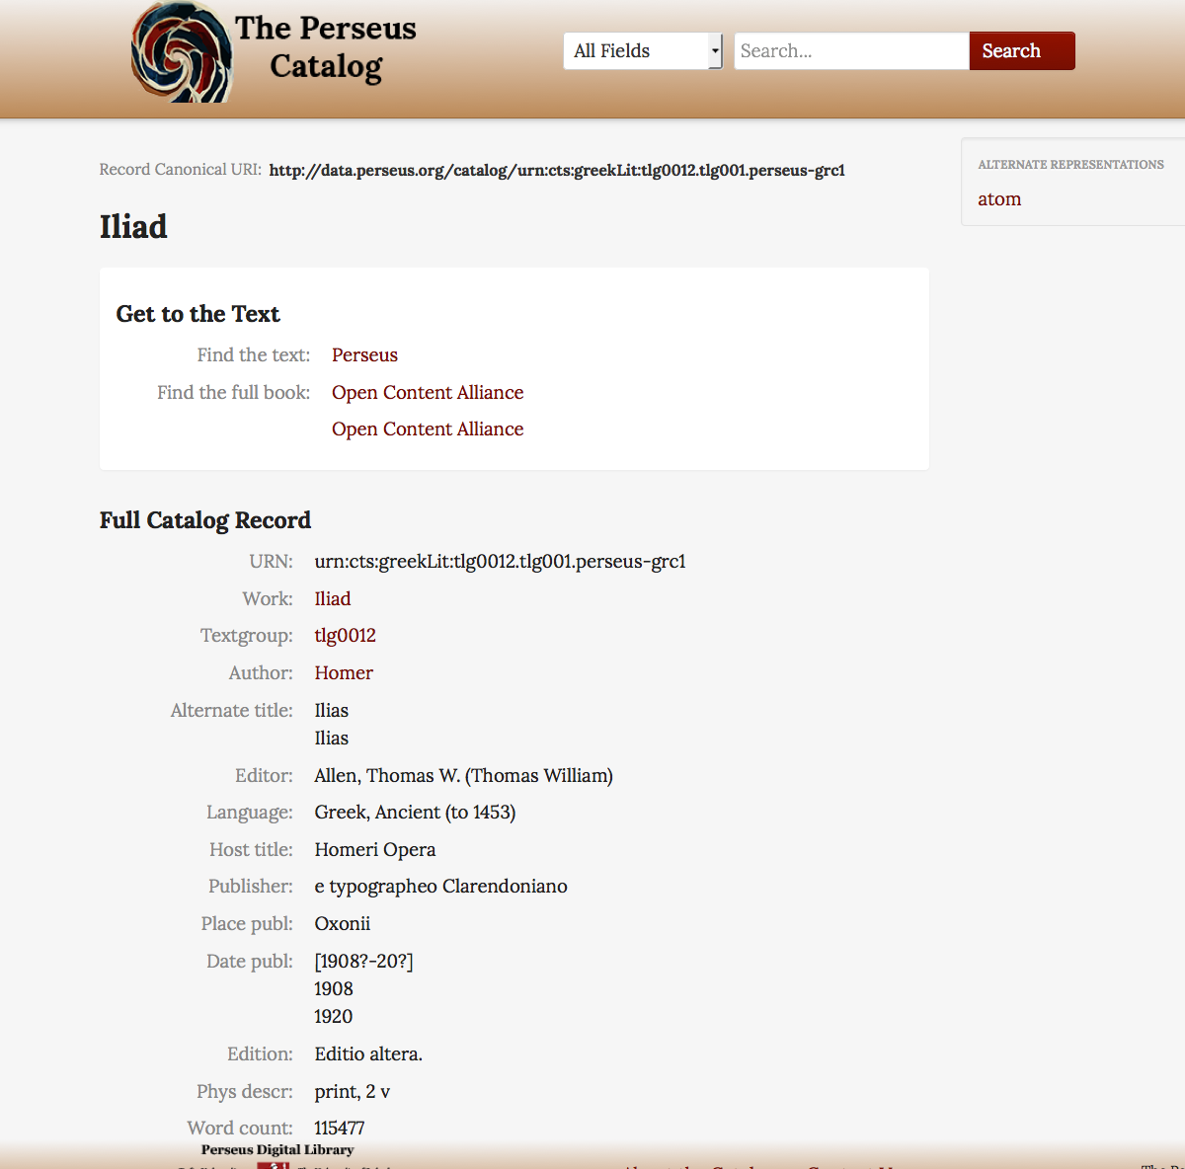

Slide 21
Linked Data & the Perseus Catalog
Plan to make all data available as linked data, current roadmap plans to:
  Release all the data as RDF triples, via common serialization formats such as RDF/XML and or JSON-LD.
  Add RDF-A attributes to the HTML displays of the Perseus catalog.
All data is currently available in both ATOM and HTML formats.
Canonical URIs are used to name all Textgroups, Works, Editions and Translations:
  Viewable in the current interface using the following syntax:
  http://data.perseus.org/catalog/<record id>[/format].

Slide 22
Changing Metadata Creation Processes
  Metadata creation processes for the Perseus Catalog have always been evolving along with library world in general.
  Library data creation practices constantly changing over last decade:
    Linked data
    Open bibliographic data sharing
    User contributed metadata
    Open source library systems
    Etc!

Slide 23
Metadata Creation for the Perseus Catalog
  Initial data creation process in mid-2000s involved:
    Downloading MODS records by querying LC web service using SRU.
    Converting MARCXML records when could find them to MADS using XSLT.
    Ultimately MODS and MADS XML templates created to support quicker creation of records when no existing data could be found:
      Templates are also available in GitHub for our potential data partners.

Slide 24
Library Linked Data to the Rescue
  Between 2008-2009, LC began offering a number of linked data services:
    LCCN permalinks- First created in Feb 2008-eventually could directly download MODS records from these persistent URLs.
    Linked Data Service-could download MADS records directly from LCNAF authority record pages that had permanent URIs.
  Expansion of Virtual International Authority File :
    Ability to download a MARCXML record from each authority record
    VIAF also includes authority records from the Perseus Catalog!

Slide 25
So What’s Different Now?
General transition from closed to open environments for data creation:
  Metadata for Perseus Catalog moved from closed CVS to public GitHub repository.
  All metadata can be downloaded individually or in its entirety.
  All potential new data for the catalog also becomes publicly viewable once it is created, pushed to a GitHub repository catalog_pending.

Slide 26
Anything Else?
  New levels of transparency and openness in communication and metadata editing processes:
    Registered GitHub users can post issues with the data/and or questions directly within the repository.
    Perseus project and partner staff open issues to assist in tracking of problems and resolution.
    Mixed blessing in that some issues/questions don’t always seem well suited to a public system.

Slide 27
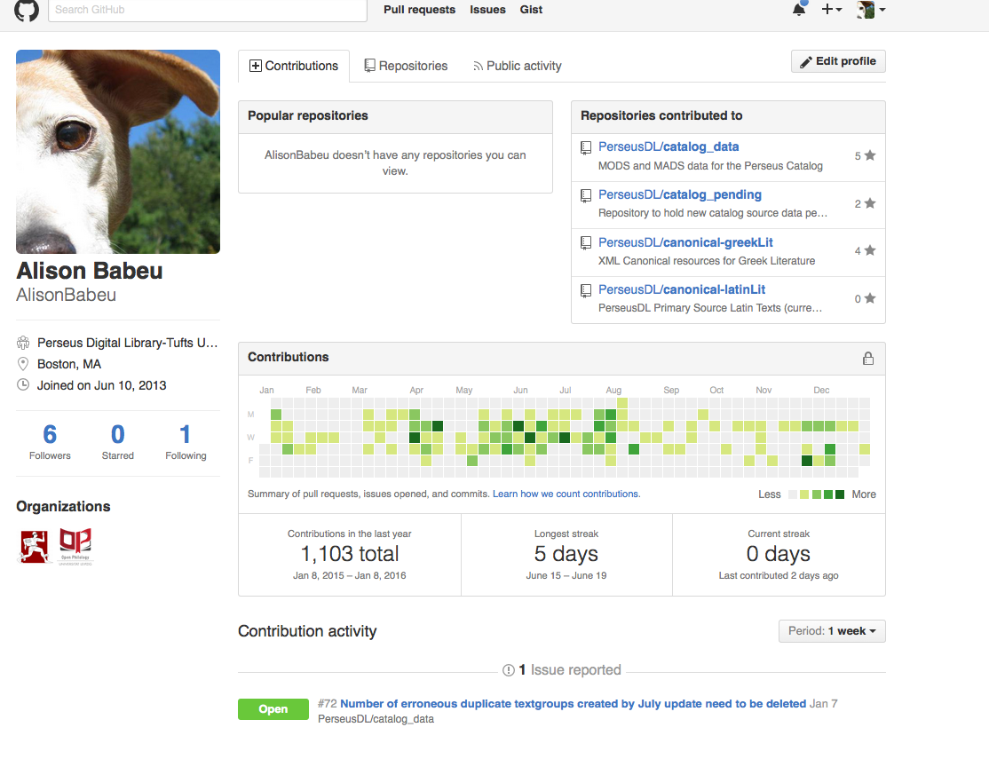
Learning to Love Avatars and Cope with more Public Professional Identities
Or can you see that I really love my pets?

Slide 28
Picking a “platform” for the Perseus Catalog
Needed an open source system that could be adapted.
Number of open source library systems- most provide support for MARC or Dublin Core, but not MODS.
Native XML database- requires significant technical expertise and interface development.
Metadata for the Perseus Catalog is very granular:
  Thousands of deeply hierarchical XML records to be indexed with work level metadata.
  Large number of fields needed to be both displayed and searchable.

Slide 29
Interfacing the Catalog
eXistdb-(2005)
  Open source noSQL database built off of XML technology.
  Native XML database.
eXtensible Catalog (2011-2012)
  Open source set of software components including a Drupal Toolkit and Metadata Services toolkit.
  Metadata Services toolkit supports XC interface to present “FRBRIzed, faceted navigation across a range of library resources.”
  Support for Dublin Core and MARCXML but not MODS.
Project Blacklight (2013-present)
  Open source project using Ruby on Rails.
  Provides discovery interface for Solr indexes.
  Allows powerful indexing of XML data and various facets for searching/browsing.

Slide 30
Agile or not so Agile Development Cycles (My Librarian Perspective)
Biggest development challenge-Perseus Catalog’s definition and scope has changed multiple times during this process:
  Initial vision as classical text discovery tool
  Became key part of PDL workflow both for flagship digital library and to support new data creation and tracking (Open Greek and Latin)
  Collaborative data publication seeking active outside contributions.

Slide 31
Agile or not so Agile Development Cycles-My Librarian Perspective (2)
Challenges of limited resources and a small if dedicated team.
Agile development approach led to continuous and effective but sometimes at least for my part exhaustive communication.
Approach did lead to true collaboration rather than just pretend cooperation.
Required both a willingness to speak one’s mind and to learn how to use new tools and workflows (it’s just the command line, nothing to be afraid of).

Slide 32
Now for the Software Developer’s Perspective
Sustainability challenges to this approach-had to custom program for pre-existing workflows rather than developing more out of the box solution:
  Downside-Led to some idiosyncratic code that is not so easily maintained (and no funding).
  Upside-Support existing MODS/MADS data creation workflow-keep data management separate from presentation layer.

Slide 33
On The Need for Documentation
Openness can be a beautiful thing but often leads to more participation, more questions, and well, more work, requiring:
  MORE DOCUMENTATION!
Previous experience in writing database guides (in a former life as a reference librarian) but little writing extensive documentation.
Utilized Tufts instantiation of Wordpress to support: The Perseus Catalog Blog

Slide 34
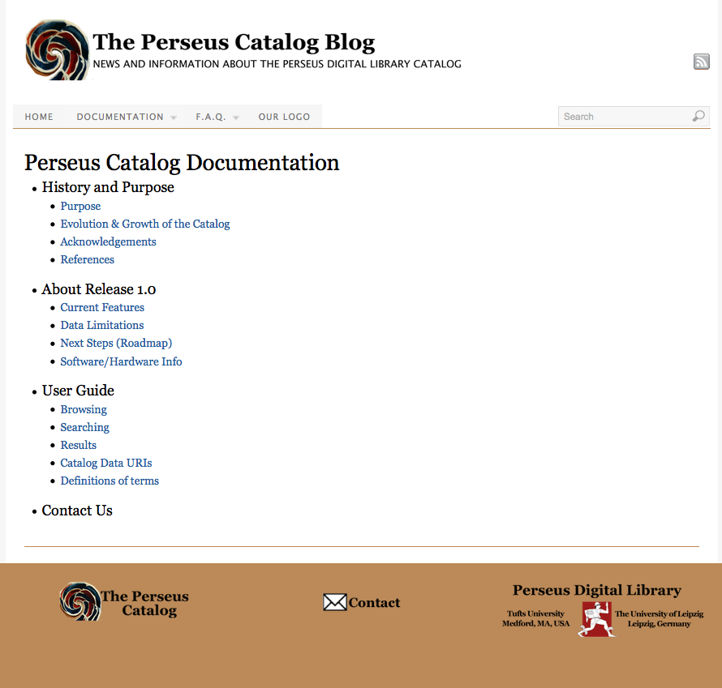

Slide 35
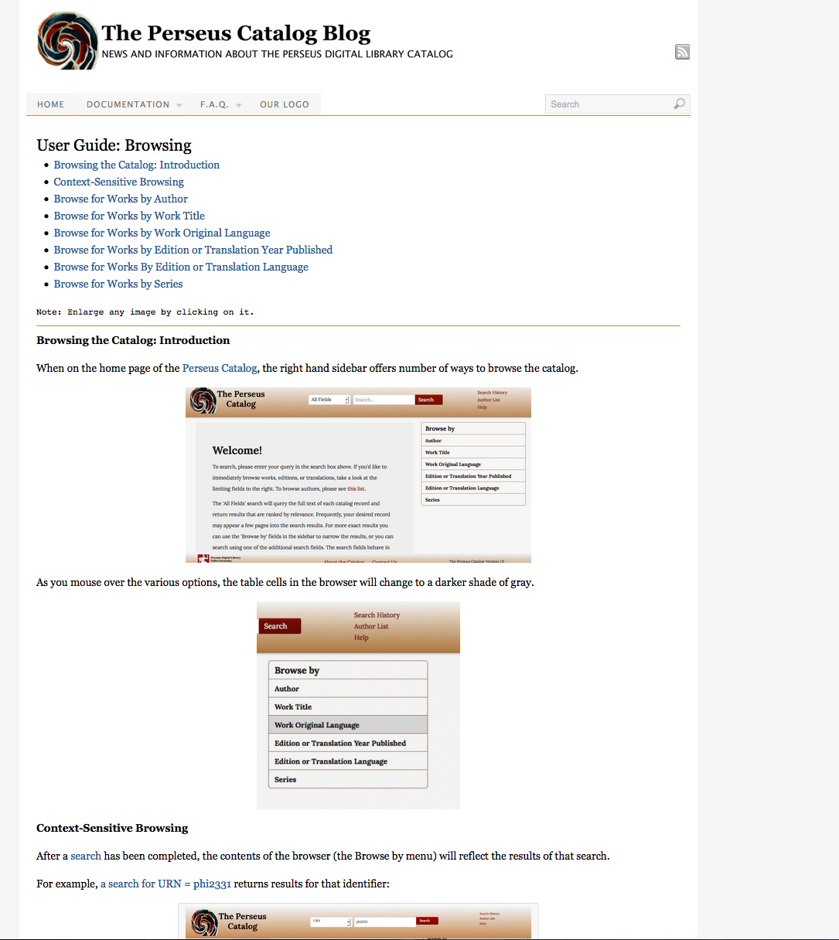

Slide 36
And then more documentation
As Perseus Catalog moved beyond information gateway to collaborative data publication, documentation needs shifted again.
This time to the creation of GitHub wikis and flowcharts:
  Documentation wiki with step by step details on how to create new data for the catalog.
  Documentation on data found in the Perseus Catalog and how to edit it.
  Flowchart of data creation process.

Slide 37
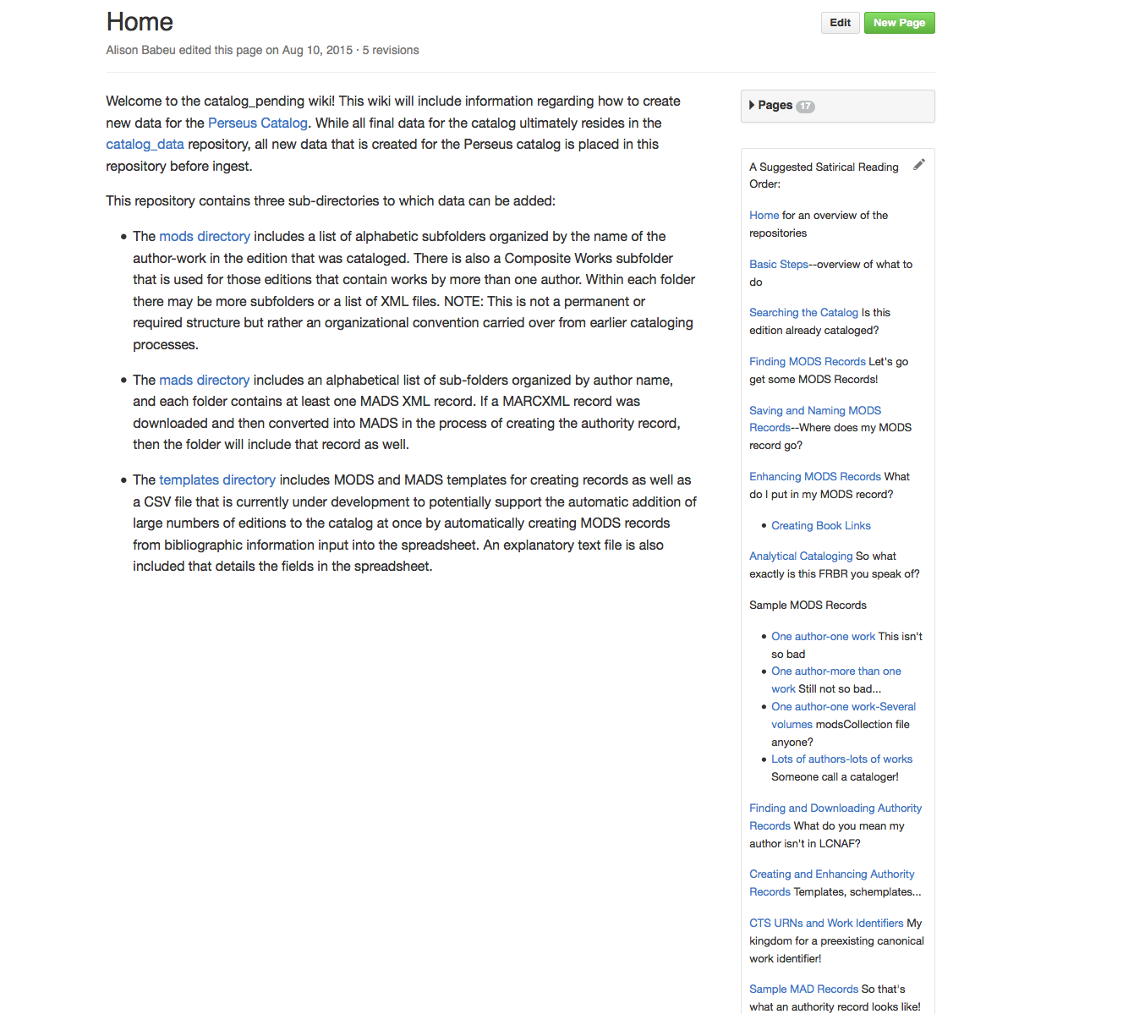

Slide 38
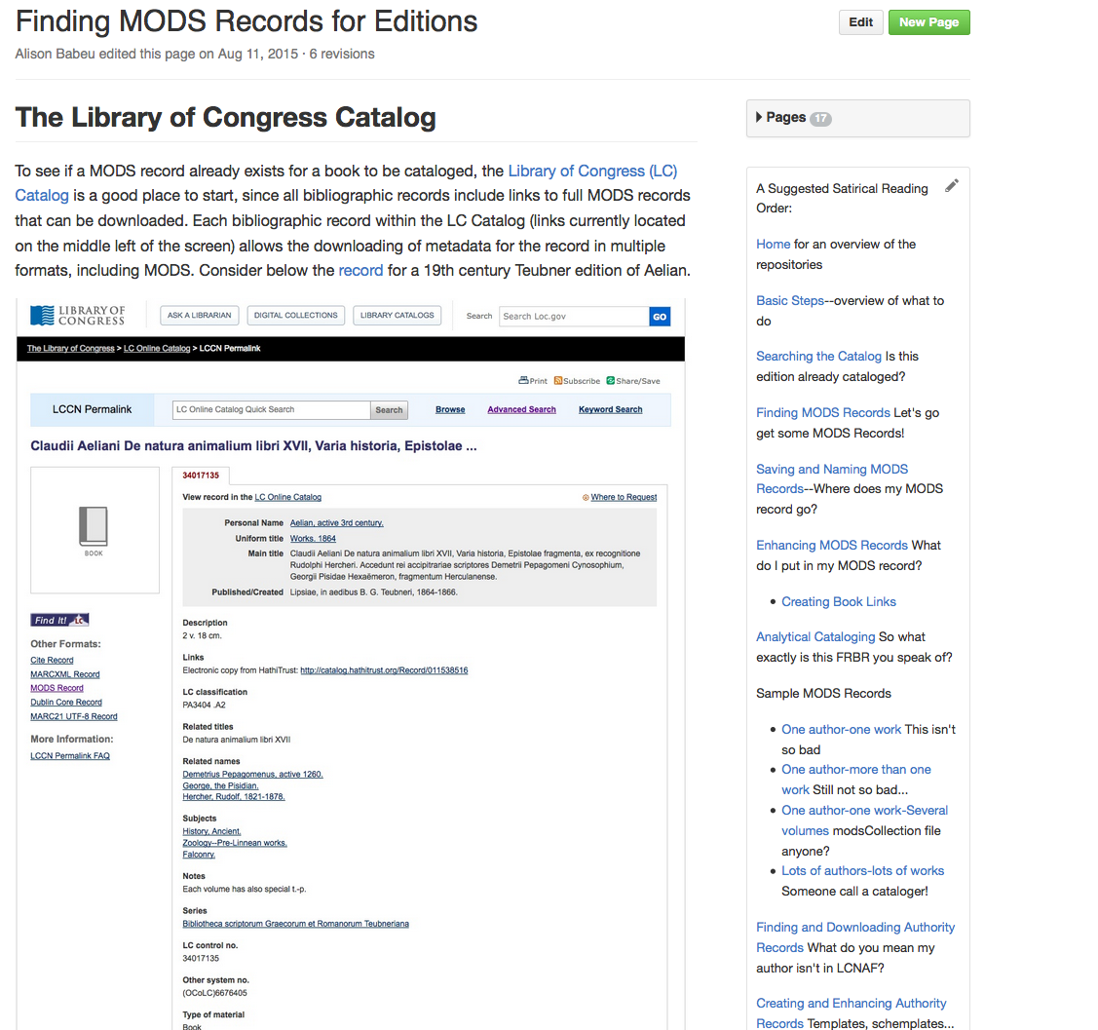

Slide 39
Even more documentation (for the code this time!)
For the eXtensible catalog implementation:
  Overview documentation for the first beta “Catalog of Ancient Greek and Latin Primary Sources”
  Documentation on previous SIP creation process
Documentation for the current Perseus Catalog:
  For the Blacklight instantiation
  For the current Catalog Update Process

Slide 40
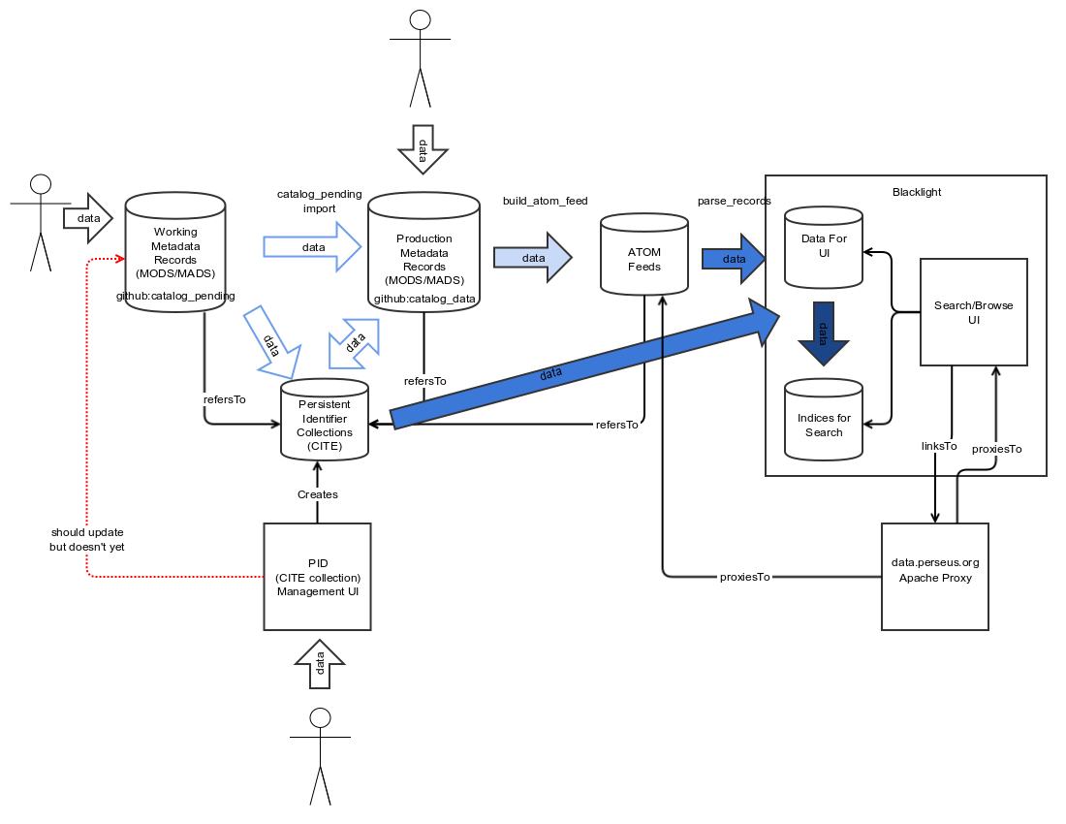
A Software Developer’s Flowchart
Simple, Direct, Elegant

Slide 41
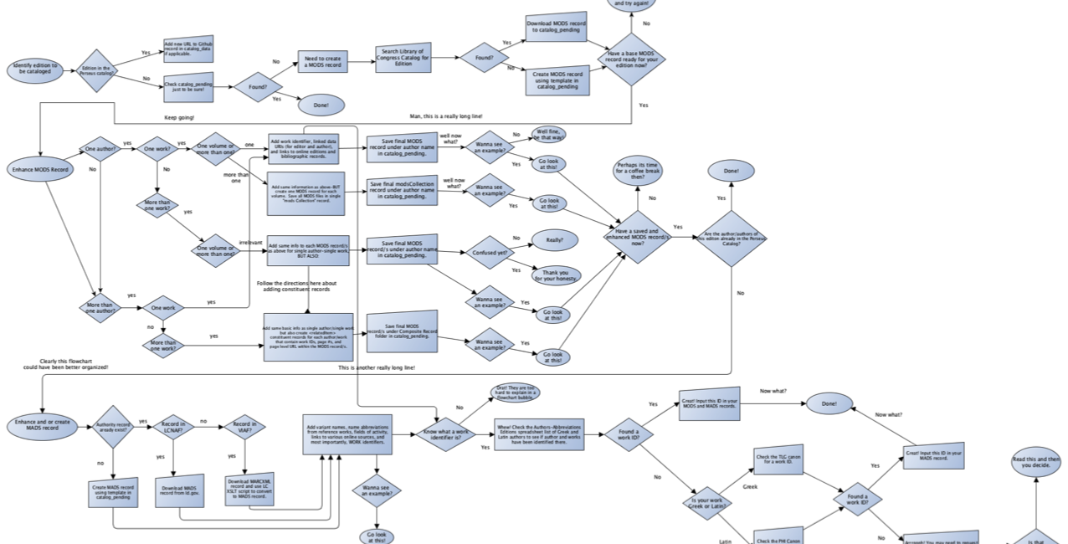
My First Ever Flowchart

Slide 42
Evolving Roles as A Librarian
From cataloger/metadata specialist/digital librarian to junior aspiring programmer/quality tester.
  Don’t have to be a developer, librarian’s understanding of underlying data and how it was structured was essential part of successful data enhancement and support for reuse.
  One set of roles do not replace the other-they coexist and in many ways have long co-existed.
    None of this work is entirely “new”—standards evolve, interfaces adapt, tools/programs that need to be learned change quickly.
    Determining what data requires expensive manual creation and enhancement vs. what can best be done programmatically has long been an important part of library work.

Slide 43
“New” Partnerships and Collaborative Teams
Developing the ability to succinctly and clearly describe what you do so others on your team (and beyond) can utilize your data or reproduce your workflows (e.g. documentation) is HARD but not IMPOSSIBLE.
Learning to be part of project team and process where you frequently report on work-in-progress and continuously release incomplete/imperfect data results is a (mostly) rewarding experience and an interesting change of perspective.

Slide 44
Future Plans/Challenges
Support user contributions in different formats:
  Make data corrections to existing catalog data.
  Add new metadata such as links to new online editions, etc.
  Uploading of large scale bibliographies using CSV template.
Challenges of using GitHub as final collaborative data repository: fork, branch, shared access?
Need for long term solutions regarding our reliance on CTS-URNs:
  Versions need unique work identifiers, BUT many works being cataloged have no work IDs in any canon
  This has made it impossible to include secondary works in the Perseus Catalog
  Number of other scalability and expansion problems

Slide 45
Definitions
CTS- Canonical Text Services Protocol- a specification that “defines a network service for identifying texts and for retrieving fragments of texts by canonical reference expressed as CTS-URNs”
  Textgroups- Used by CTS to describe “traditional, convenient groupings of texts such as ‘authors’ for literary works, or corpus collections for epigraphic or papyrological texts”
CITE Architecture- a “framework for scholarly reference to the unique cultural phenomena that humanists study.”
CTS-URNs- “A collection of CTS compliant URNs.” Part of the CTS and CITE Architecture, these URNs “provide the permanent canonical references” on which CTS relies “to identify or retrieve passages of text.”
FRBR- Functional Requirements for Bibliographic Records
  Works-As with the FRBR model- “a distinct intellectual or artistic creation”
  Editions/Translations-In the Perseus Catalog, this indicates a particular published version of a work (somewhat equivalent to the FRBR expression
MODS-Metadata Objection Description Standard-XML schema designed by the Library of Congress (LC) for bibliographic metadata-.
MADS-Metadata Authority Description Standard-LC XML Schema for an authority metadata element set.

Slide 46
Further Reading And References
Almas, Bridget, Babeu, Alison, and Anna Krohn. (2014). “Linked Data in the Perseus Digital Library.” ISAW Papers 7.3
Babeu, Alison. (2008). “Building a FRBR-Inspired Catalog: The Perseus Digital Library Experience” White Paper submitted to Mellon Foundation.
Crane, Gregory, Almas, Bridget, Babeu, Alison et al. (2014). “Cataloging for a Billion Word Library of Greek and Latin.” Proceedings of DaTECh 2014 (Madrid, Spain).
Mimno, David, Gregory Crane, Alison Jones. (2005). “Hierarchical Catalog Records: Implementing a FRBR Catalog.” D-Lib Magazine, 11 (10).
Perseus Catalog Blog-http://sites.tufts.edu/perseuscatalog/

