Slide 1

Adventures in Mutual Metadata:
Creating a Shared Zine Catalog
Netanel Ganin, Metadata Coordinator, Brandeis University
Rhonda Kauffman, Bibliographic Metadata Associate, MIT
Honor Moody, Cataloger, Schlesinger Library, Harvard University
NETSL 2016

Slide 2
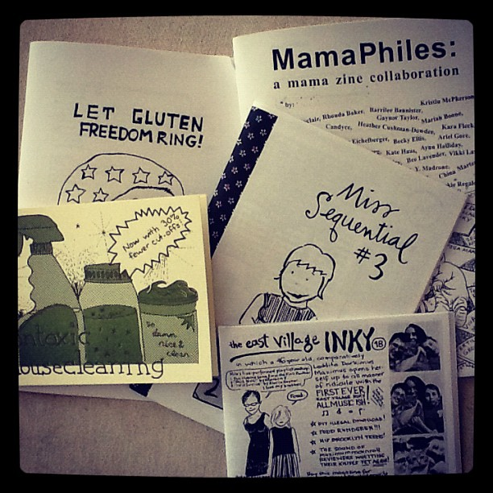
What are Zines?
Derived from fan magazine - is an independently- or self-published booklet
Usually photocopied, DIY
Available from “distros,” info shops, or directly from zinesters; sometimes traded for other zines
May or may not have recognizable chief source of information
Monograph and/or serial?
Notes:
What do we talk about when we talk about zines? Zines are ephemeral, self-published, usually photocopied, available through the author themselves or local bookstores or special zine distributors.
They follow no publishing rules, and not have any recognizable chief source of information.

Slide 3
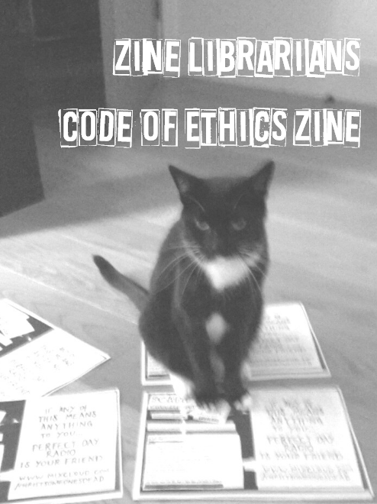
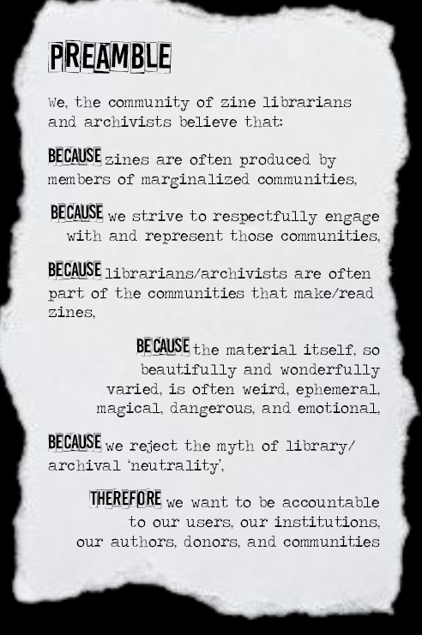
Why zines?
http://zinelibraries.info/wordpress/wp-content/uploads/2015/11/EthicsZine-rev-20151105.pdf
Notes:
Why is it important to acquire and catalog these things? Zines capture the authentic voice of individuals of (often) underrepresented groups, provide rare primary resource materials for researchers, and diversify library collections. Cataloging zines provides access.
Zine collections in more traditional libraries are often started by motivated individuals outside of technical services, sometimes without access to catalogers or traditional metadata creation. So, they end up becoming accidental catalogers using whatever ad hoc system is available to them to provide access to the collections. Their choice of cataloging system can vary depending on background, training and knowledge, resulting in zines cataloged into spreadsheets, database software like access or filemaker, or finding aids, and directly into OCLC.

Slide 4

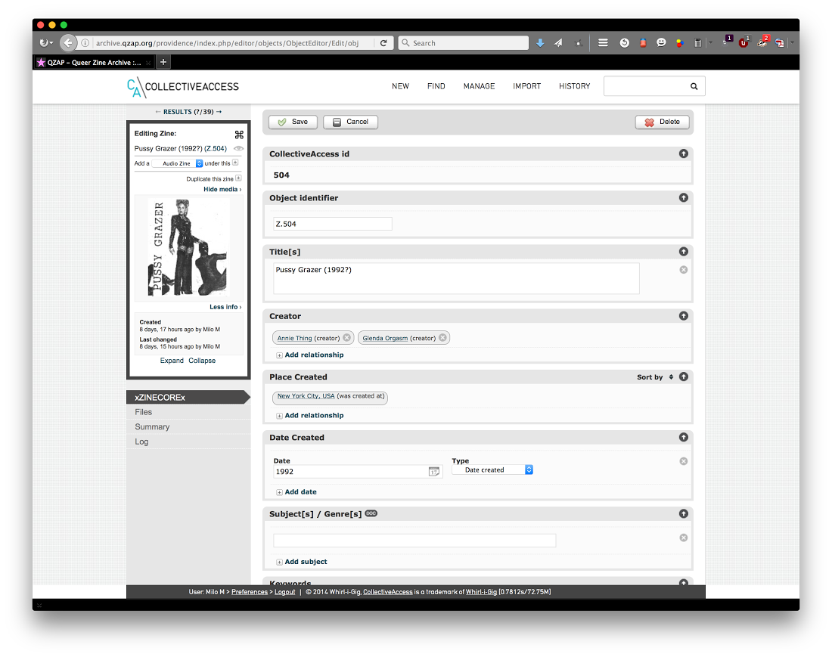
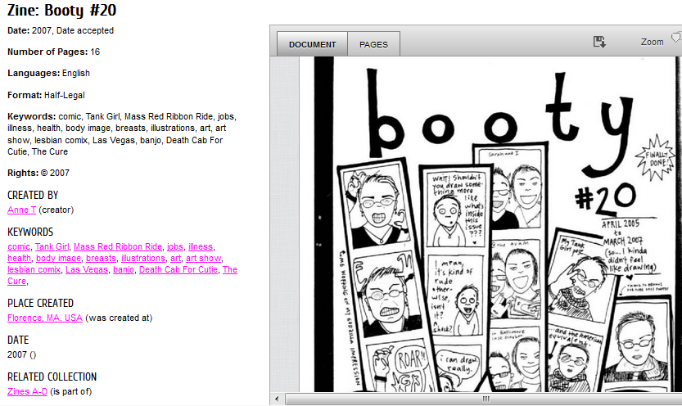
Notes:
All kinds of libraries collect zines: public, academic, archives, info shops, and DIY libraries made entirely of zines. Even libraries with traditional library catalogs don’t always catalog their zines in them.
QZAP (Queer Zine Archive Project) uses Collective Access for its catalog, a free and open-source catalog system created for museums and archives.

Slide 5
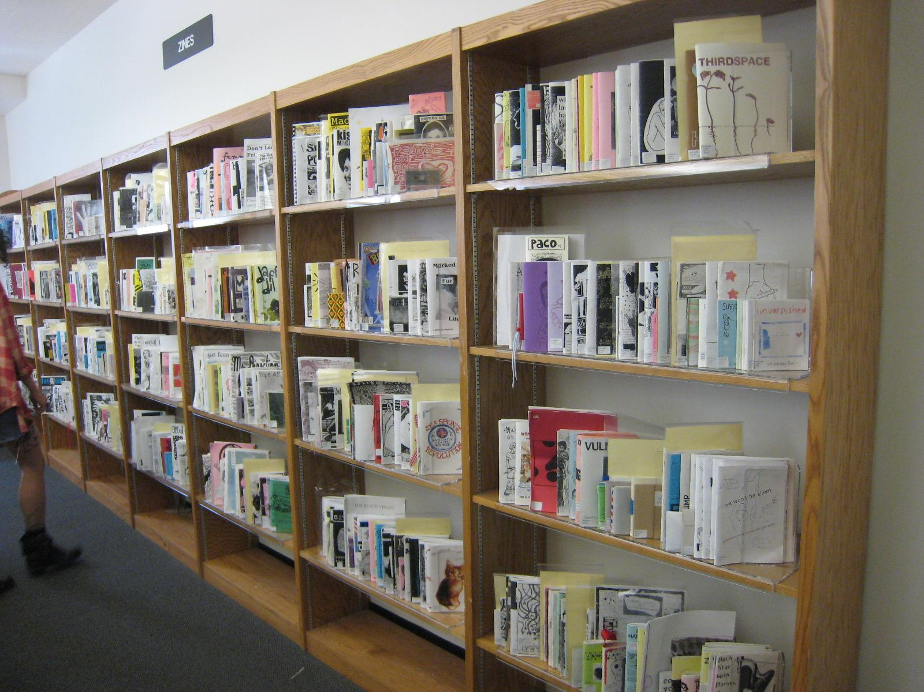
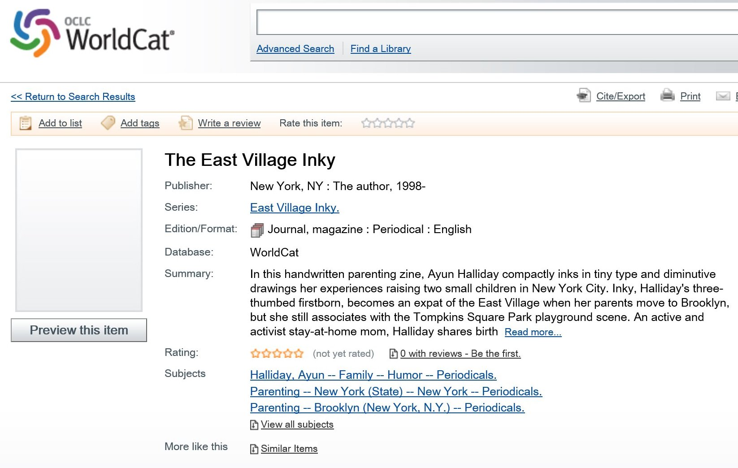
Barnard Zine Library
(photo credit: flickr @klg19)
Notes:
The big guns catalog directly into OCLC, adhering to modern cataloging rules.

Slide 6
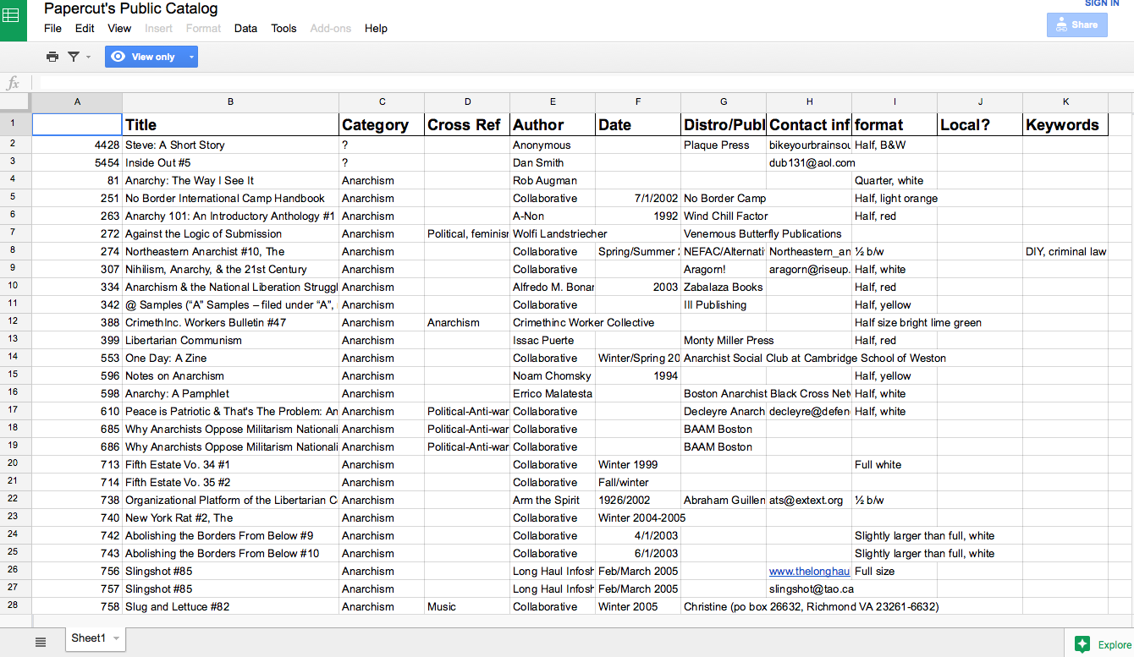
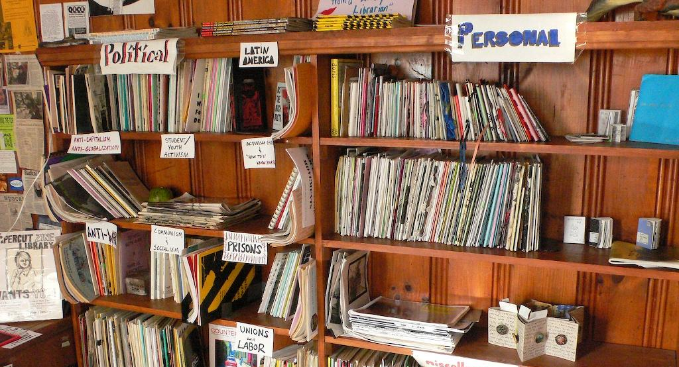
Papercut Zine Library
(photo credit: flickr @gruntzooki
Notes:
Papercut Zine Library -- A stand alone zine lending library staffed by volunteers uses an EXCEL SPREADSHEET for its catalog. And uses Local terms for their elements -- not LCSH.
Our goal is to create a central location for zine metadata. Why can’t we just use OCLC/Worldcat? Some of these places don’t want to be in OCLC because they don’t want to use LCSH because of its lack of inclusive subject headings. Or, even if they could afford OCLC subscription, they wouldn’t want to be part of something that isn’t open source and community-driven; they want to maintain control, and manage their own ingest/outgest of metadata.

Slide 7
Zine Librarians Interest Group
The Zine Libraries Interest Group is a collective of people interested in all aspects of zine libraries.
2011: xZINECOREx metadata schema developed during the Zine Librarian (Un)Conference in Milwaukee
2014: Zine librarians, archivists, metadata specialists and developers form Zine Union Catalog sub group.
Notes:
The first Zine Librarian (un)Conference (ZL(u)C) was held at ZAPP (The Zine Archive Publishing Project) in Seattle, WA in March of 2009.
Largest take-away from the weekend was the desire for a Union Catalog for zines, a catalog containing
bibliographic records that indicate locations of materials in more than one library or in several units of one library.
Want an online system, to share information about the zines in our various collections, including which library has which zines.
July of 2011. Another Union Catalog discussion, and the idea was fleshed out a bit more that the Union Catalog would be like World Cat, but open source

Slide 8

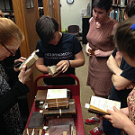

Functional Requirements of the
Zine Union Catalog
Users
Catalogers
Systems
photo credit: Flickr @ james_lumb
photo credit: Flickr @ 97741188@N04
photo credit: Flickr @ biscuitsmlp
Notes:
New from the beginning that we wanted to leverage the power of linked open data for both iterative enhancement of the metadata and to display of community appropriate headings
Two different groups which have two different sets of needs
Users, described as those seeking zines, and/or the zinesters themselves
search, browse, and view records
facet search results - by all xZINECOREx fields
see what library has a particular item, and have links to library
The catalogers are those who are inputting the zine metadata and may indeed be the zinesters themselves
analyze usage of catalog
view any revision history
set up a holding library profile
add "holdings" to records
query the database, export reports
create, edit, import, and export records (both single records and in batches)
upload & store images
System requirements refer to those things which were identified as needs/wants by the catalogers
System
matching algorithm to ident duplicates
templates for producing records
identify broken URLs

Slide 9
Where are we now?
Assessment of existing data storage and access options
We love xZINECOREx, but realistically, Dublin Core is the way to go
  Might have xZINECOREx element descriptions with DC schema
Notes:
After we identified our functional requirements we’ve begun comparing existing tools that may serve our needs. These are:
Koha, Collective Access, Omeka, Hydra, Mukurtu, Zinewiki, Kuali’s Open Library Environment, Islandora
Although xZINECOREx is mapped closely enough to Dublin Core as to make conversion (mostly) lossless -- sticking with an internationally supported standard is still better (and more efficient) than encouraging the use of a new ontology.

Slide 10
Where do we go next?
Github address https://github.com/MiloQZAP/xZINECOREx
zinelibraries.info http://zinelibraries.info/zine-union-catalog/
ZL(u)C 2016
  The 2016 Zine Librarian (un)Conference will be held July 29-30th in Boston, Massachusetts at Simmons College.

