Slide 1



THE STATE OF TECHNICAL SERVICES IN PUBLIC LIBRARIES:
CASE OF LIBRARY CONNECTION LIBRARIES
Presenters:
Judy Njoroge, System Librarian for Bibliographic Services, Library Connection, Inc.
Jessica Palmer, Technology and Technical Services Manager, Avon Public Library, Avon CT
Dorothy Russell, Collection Management/Reference Librarian, Lucy Robbins Welles Library, Newington CT

Slide 2
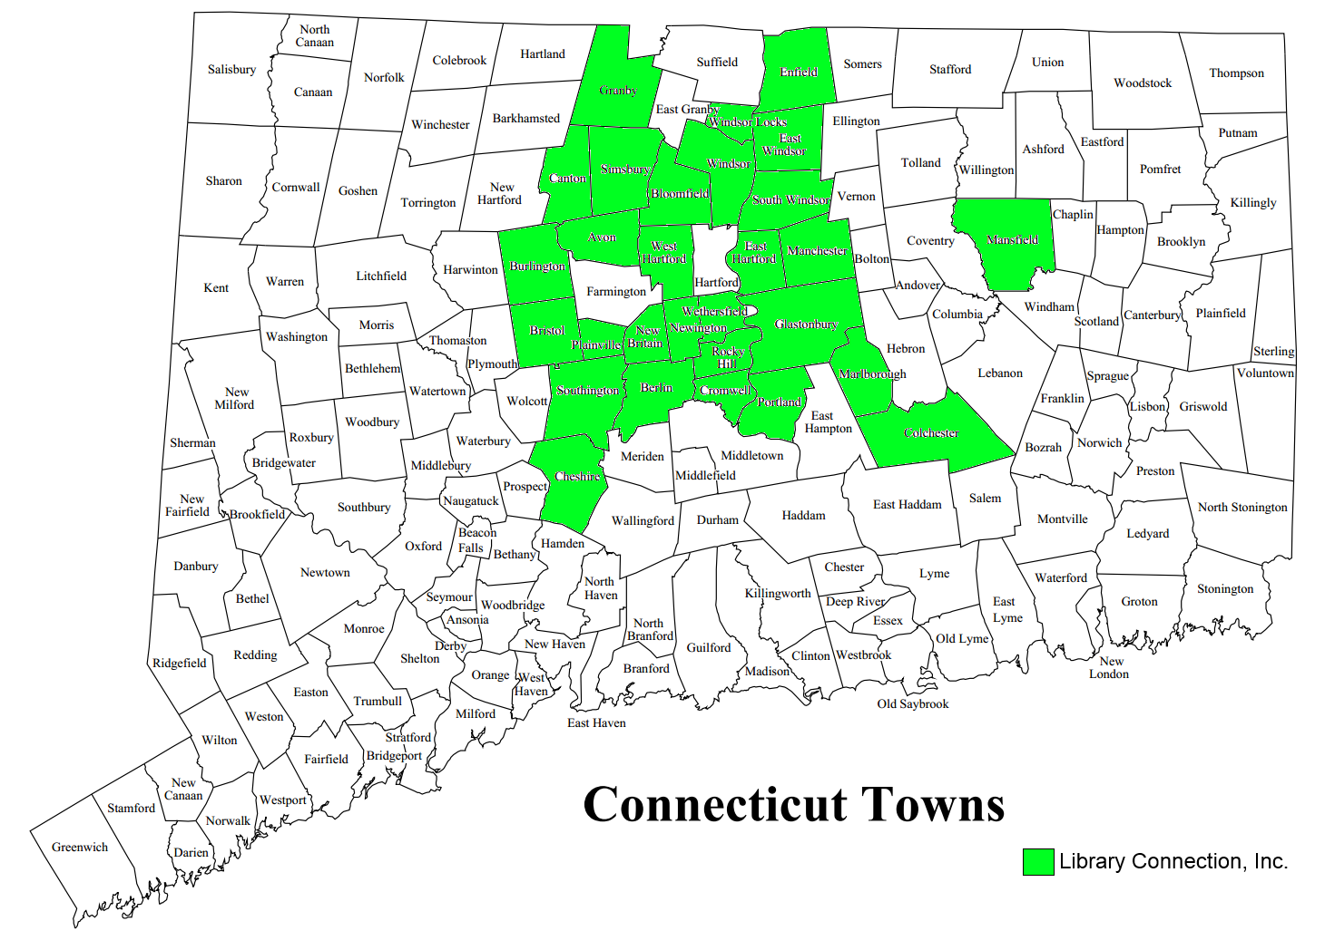

Slide 3
Library Connection, Inc. (LCI)
A consortium of 29 public libraries and 1 academic library in Northern CT.
Based on 2014/2015 CT State statistics, most LCI libraries can be categorized as medium to larger based on factors like population and print collection size.
Only 7 libraries were below 2015 state median population of 13, 129.
Only 4 libraries were below 2015 state median print collection of 55,419.
Notes:
Reference: Connecticut State Library. (2016). Connecticut Public Libraries: A statistical profile, July 2014 – June 2015. Retrieved from http://libguides.ctstatelibrary.org/ld.php?content_id=17803291

Slide 4
Technical services functions carried out by the consortia Main office
Maintenance of the ILS (Sierra and Encore)
Cataloging
Database maintenance
Vendor Liaison
Training
Notes:
Maintenance of the ILS (Sierra and Encore):
Monitor system status
Works with libraries and ILS provider to troubleshoot and resolve problems
Recommend enhancements
Run periodic reports
Cataloging:
Batch processing
Original and copy cataloging
Loading and maintaining shared Electronic resources
Database maintenance:
Deduping – Records from different vendors don’t always have similar match points match (stand-alone libraries may not have to deal with this)
RDA conversion
Authority control
Regular Cleanups
Help libraries with projects that require advanced system permissions
Vendor Liaison:
Setting up MARC Download and Edifact ordering
Work with vendors to set up authentication e.g. through SIP2 for access to databases, integration e.g. Overdrive
Set up third party software and hardware e.g. self-check machines, receipt printers
Training:
Use of ILS features
Cataloging procedures e.g. loading electronic resources
We do our best to help our libraries with whatever needs or questions within the constraints of time and staff resources.

Slide 5

Presence of a Technical Services Department or Equivalent
What’s in a name?
1 has no official name or structure “We exist in the shadows, like ninjas but with sensible shoes and cardigans.”
Notes:
72.22% - Yes
11.11% - No
16.67% - have an equivalent
In 2 libraries it is called Collection Management
1 has no official name or structure
The two libraries that don’t have a technical services department stated that the technical services functions are performed by:
Reference librarians and library assistants
Children's Librarian and Adult Services Librarian

Slide 6
Functions
Comment: “The weight of the Library rests on our shoulders”
Notes:
18.75% - Selection
37.50% - Acquisition (all do standard ordering from vendor websites and downloading MARC records – 2 libraries use full acquisitions function in ILS, EDIFACT ordering and invoicing and maintenance of library funds in the ILS—Most payments done by Towns)
100%- Cataloging (mainly copy cataloging only 3 libraries perform original cataloging)
100% - Processing (spine labeling, security strips, ownership stamps, covering, etc.; some libraries purchase some items with spine labels, Milo jackets)
37.50% Maintenance of technology resources (some do this for the library and the town)

Slide 7
Staffing
Staffing Levels
People with Degrees
Between 20 - 175 weekly hours dedicated to technical services
Notes:
In the course of my work at LCI I have interacted with an awesome group of people most found themselves in the profession because of their love of books, libraries and serving people and others have grown to love them after the fact. They do a lot with very little and they are making it work! So what are the numbers here?
Answers ranged from
0 to 3 Full-time
0 to 5 Part-time
0 to 7 Volunteers
A March 29th, 2016 article by the BBC “Libraries lose a quarter of staff as hundreds close” stated that between 2010 and 2016, “Almost 8,000 jobs in UK libraries have disappeared in six years, about a quarter of the overall total ... Over the same period, some 15,500 volunteers have been recruited and 343 libraries have closed, leading to fears over the future of the profession. “
Between 20 - 175 hours dedicated to technical services
Qualifications
1-4 MLS
1-4 Bachelors
0-2 Library Technicians
1 Other
Reference: BBC (March 29, 2016). Libraries lose a quarter of staff as hundreds close. Retrieved from http://www.bbc.com/news/uk-england-35707956

Slide 8
Challenges and Solutions
Time/Money
Space
Staff knowledge, experience & training

Slide 9
Time & Money
Budgets: staff hours, supplies & materials
    Advocate for your department
Time: too little, too much, never just right
    Streamline workflows
    Less time allocated to other departments

Slide 10
Space
Not enough
    Rearrange
    Renovate?!
Noisy & chaotic
    Add a door
Undesirable location
    Renovate?!
    Open the door

Slide 11
Staff Knowledge, Experience & Training
New staff with little experience
      Train them!
Staff uncomfortable with information technology
      Train them!
      Cross training
Odd-ball cataloging issues
      Patience & creativity
New tasks
      Provide training!
  ***Support professional development opportunities***

Slide 12
What’s changed?
Technology
New ways of thinking
Notes:
Survey question: What has changed in Technical Services since you started in the field?
Answers were like a timeline of TS history over the past 30-40 years
Can be broken into these 2 parts
Technology- using a broad definition of all the tools we use for our jobs (computers, cataloging rules, materials/process for label processing)
The easy part.
Technology and tools change. It is disruptive, but with training and support, you become familiar with it until it becomes second nature.
New ways of thinking
The hard part.
You have to take a big step back to see changes.
In changes as a result of technology, you can’t always predict what the changes are
Need to reexamine what you have been doing, which means examining assumptions that you may not realize that you have.
Card catalog to computer: workflow was learned much faster than understanding how it affected record sharing or how staff time is used. How computers have changed searching and what people need or don’t need in catalog records is an even bigger change.
The good news: We can assume technology with keep changing, so we can plan for that with training and support when something new rolls out. We’ve done this before. Then we can focus on recognizing and responding to the big changes in how we think.

Slide 13

“We exist in the shadows,
like ninjas but with
sensible shoes and cardigans.”
-Survey response
Notes:
Going back to this quote…
Tech Services is the invisible department in the library.
We operate behind the scenes and few understand what we really do.
Survey responses: There was a sense that Tech Services exists in it’s own little world, sometimes along with a frustration at being invisible or not respected.
I want to use this as a starting point for what we can do moving forward

Slide 14
Ninja Tech Services Strategies
  Know what your mission is
  Do not scale the roof if the front door is unlocked
  Use unconventional methods to add the element of surprise
  Know when it’s time to come out of the shadows
Notes:
Survey responses:
More technology- either incorporated into traditional tech services functions or by adding IT role to TS
Tech services becoming more tightly entwined with the rest of the library through TS staff on public desks, sharing of e-resource management
“Know what your mission is”
Set goals based on the big picture
Look at not just tech services, but its larger role in the library’s mission and initiatives.
When you’ve identified a problem in TS, look at how it relates to other issues elsewhere in the library. Is there a bigger solution to solve multiple problems at once?
Example: implementing Acquisitions in ILS
“Do not scale the roof if the front door is unlocked”
Red flag: “Because we’ve always done it this way” can lead to some crazy convoluted workflows
Find the bottlenecks in your workflow. What part of the process is slowing everything else down? How do you change it?
When you decide to make changes, use big picture goals to help simplify
“Use unconventional methods to add the element of surprise”
Ideas are everywhere. We need to find them and share them.
Sharing brings in a fresh perspective, whether you are lending your perspective to someone else or whether you are bringing in new outside ideas
Inside the library: freely exchanging ideas between departments
Example: sharing advanced search techniques in catalog
Outside the library: learning from other libraries at NETSL. Star ideas you want to bring back in your notes.
“Know when it’s time to come out of the shadows”
Survey quote: “I don't know what the future of the TS department is at my library. What I do know now is that it is an essential part of any library, and it's role should be just as important as Circulation and Reference. Just because we aren't the public face of the library doesn't mean we shouldn't be forgotten. “
Communication ties in closely with other strategies.
Example: fixing an inefficient, shared space in TS
Be aware of the role that tech services plays in the library and also how we add value to the library (the big picture goals)
Recognize that getting new books in patrons hands is a priority
Fix your workflow as best you can (direct path)
Streamline to make it as efficient as possible, recognize that having to clear a shared space and set up again is still a problem
Gather ideas (unconventional methods)
Look at alternatives: preprocessing from vendors
Talk to other departments who share workspace and how this impedes their work too
Gather design and organization ideas from other libraries, magazines, etc.
Use them all to advocate for what you need (communicate)
Use what you know and what you have done to pitch a new space to the director, board, town, etc.

Slide 15
Brainstorming
In a group, pick a problem and brainstorm
30 solutions (or more, if you can) in 2 minutes
Training staff
Cramped space
Unpredictable workflow
Getting respect from the rest of the library
Notes:
Audience interaction time!
Brainstorm as many ideas as you can think of. Why 30? Because it’s hard! Out of the box ideas often appear after you’ve thought of the obvious solutions.
Share favorite ideas with the group.
Questions?

Slide 16

Take the survey: https://www.surveymonkey.com/r/G7V5Y56
See the results: https://www.surveymonkey.com/results/SM-WRX7QTDS/
Contact us:
Judy Njoroge System Librarian for Bibliographic Services Library Connection, Inc. jnjoroge@libraryconnection.info | Dorothy Russell Collection Management/ Reference Librarian Lucy Robbins Welles Library drussell@newingtonct.gov | Jessica Palmer Technology and Technical Services Librarian Avon Free Public Library jpalmer@avonctlibrary.info

