Slide 1
Linked Data
NETSL 2016
what you need to know to understand, produce, and work with Linked Data
Robert Chavez, PhD.
Senior Content Solutions Architect, NEJMGroup

Slide 2
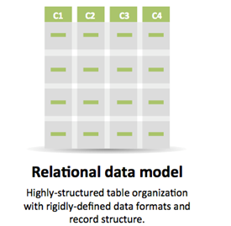
Relational Data
prevalent since 1970s
uses defined data schemas
organizes records into tables
record attributes and fields organized into columns
Standard query language: SQL
Intuitive: spreadsheets, anyone?

Slide 3
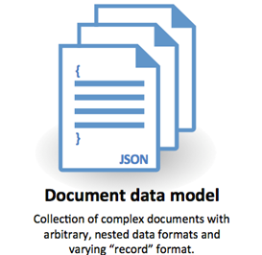
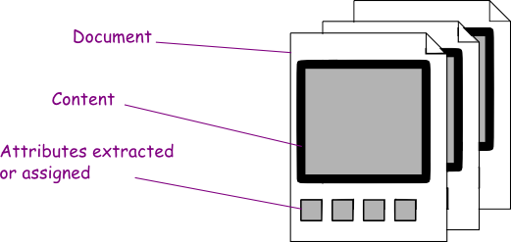
Document Data
prevalent with the advent of the internet
many diverse ‘document’ models (images, unstructured text, XML, JSON, etc.)
can have a schema or not: no pre-defined data model
very easy to scale
no single standard query language (although, XQuery)
works well with REST services

Slide 4
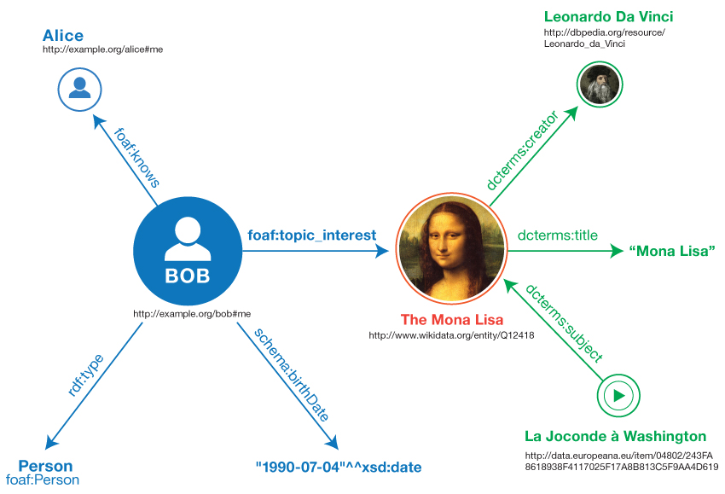
Graph Data
a relatively recent occurrence: 2000s
schema-less, simple data model
allows dynamic properties
allows nodes to be arbitrarily linked
Not strictly built for the Semantic Web. RDF datastores are a type of graph database.

Slide 5
Why graph data? … evolution
Relational model shortcomings:
Identifiers internal (relational)
Can be difficult to work with complex data (relational)
Little schema flexibility (relational)
Document model shortcomings:
Poor for interconnected data (relational + document)
Queries mainly limited to keys and indexed values (document)

Slide 6
Infrastructure Evolution
System and Web infrastructure has evolved along with our needs and expectations:
Software As A Service (SAAS)
Cloud Computing
Application Program Interfaces (APIs)
Service and Application focused
Modular architectures and micro-services replace monoliths
More and more internet-centric

Slide 7
Information Evolution
The way we think about information (data), the way we find and use that information (data) has evolved:
The Web: a place for exploration
Web Standards:
  protocols, methods and ways to explore
  data and reference formats
Interconnectivity: we expect it
Information: active use and re-use of data
Realization: different users (working with the same data) have different needs
Notes:
API: In computer programming, an application programming interface is a set of routines, protocols, and tools for building software and applications.

Slide 8
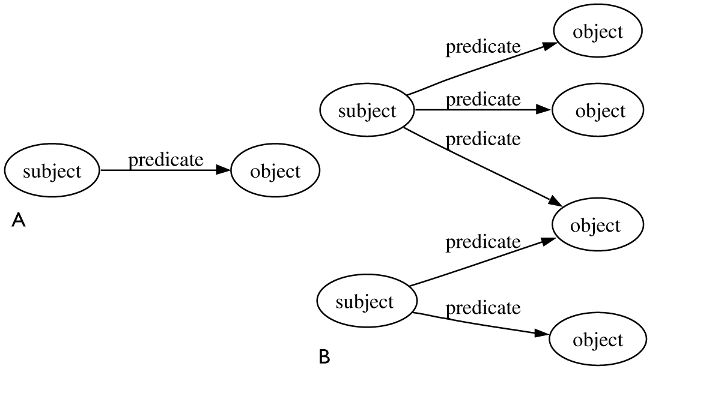
Wait. What about Linked Data?
styled after a graph data
Resource Description Framework (RDF) = Semantic Data
describes and models information about resources,
as granular as you want to be
describes complex relationships in a way that you, your query language, and other technologies can easily understand.
human and machine readable

Slide 9
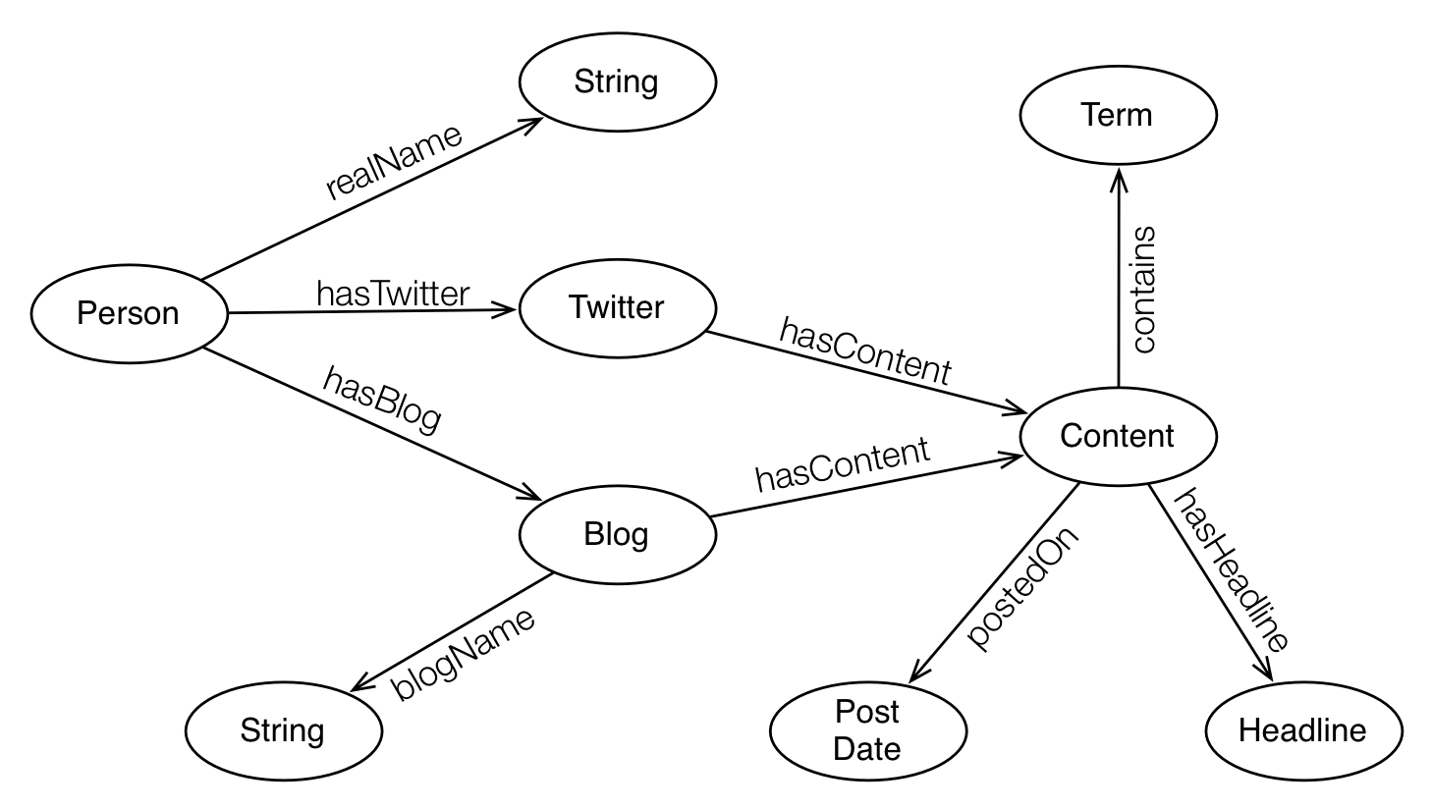
Linked Data? Semantic Web?
Linked Data is Semantic Data
organizes information into three part chunks of data, with a subject, a predicate, and an object. (Triples)
built on the architecture of the Web (facilitates sharing of data on a global scale)
Standard query and access protocol (SPARQL Protocol)
The Four Principles

Slide 10
The Four Principles
Use URIs as names for things
Use HTTP URIs so that people can look up those names
When someone looks up a URI, provide useful information using the standards (RDF, SPARQL)
    RDF: making statements and forming sentences
    SPARQL: querying data and discovering relationships
Include links to other URIs, so that they can discover more things

Slide 11
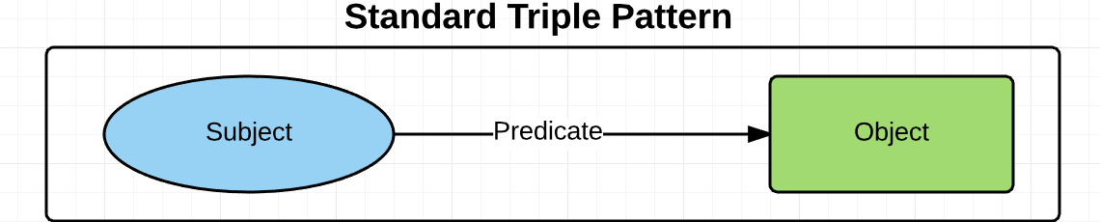
RDF in 2 minutes (or maybe 4)
Subject | Predicate | Object
Michelle Mello | Contributed to | Prevalence and Characteristics of Physicians Prone to Malpractice Claims

Slide 12
RDF in 2 minutes (or maybe 4)
Subject (IRI) | Predicate (IRI) | Object (IRI/Literal)
http://nejm.org/author/123456 | http://purl.org/dc/elements/1.1/contributor | Prevalence and Characteristics of Physicians Prone to Malpractice Claims
http://nejm.org/author/123456 | dc:contributor | Prevalence and Characteristics of Physicians Prone to Malpractice Claims
http://nejm.org/author/123456 | dc:contributor | https://doi.org/10.1056/NEJMsa1506137

Slide 13
Linked Data in 2 minutes
Subject (IRI) | Predicate (IRI) | Object (IRI/Literal)
http://nejm.org/author/123456 | dc:contributor | https://doi.org/10.1056/NEJMsa1506137
Subject (IRI) | Predicate (IRI) | Object (IRI/Literal)
https://doi.org/10.1056/NEJMsa1506137 | dc:title | Prevalence and Characteristics of Physicians Prone to Malpractice Claims
Subject (IRI) | Predicate (IRI) | Object (IRI/Literal)
https://doi.org/10.1056/NEJMsa1313308 | schema:hasPart | https://doi.org/10.1056/NEJMsa1506137

Slide 14
How do I create triples? What do I need?
RDF data: can be created in multiple ways (manual and automated methods)
  aggregation from other sources
    (DBPedia, Getty, Library of Congress, British Library, Europeana, National Library of Medicine, Linked Jazz, OCLC -- WorldCat, Dewey Decimal Classification, etc.)
  conversion of local data
  newly minted data
RDF Tools:
  RDF Converters, OpenRefine, LODRefine, Catmandu, TopBraid
  Linked University: converting legacy data to RDF
  See:
    http://linkeduniversities.org/lu/index.php/tools/
    http://semanticweb.org/wiki/Tools.html
    https://github.com/timrdf/csv2rdf4lod-automation/wiki/Alternative-Tabular-to-RDF-converters
Notes:
Christina Harlow: http://journal.code4lib.org/articles/11013
LODRefine:
LODRefine is actually OpenRefine with integrated extensions that make transition from tabular data to Linked Data a bit easier.
Integrated extensions are:
RDF extension
DBpedia extension
Crowdsourcing extension
Stats extension

Slide 15
How do I create triples? What do I need?
Web server: to handle HTTP services, triplestore, SPARQL Endpoints, Gateways, APIs, etc.
  Linux/Windows server
  AWS, Azure
  Hosted solutions: Open Knowledge Systems DataHub
  See:
    https://datahub.io
    https://okfn.org
    http://ckan.org
A Triplestore: for triple storage and management Open Source and Paid options (including platform and integration)
    Apache Jena/TDB, Apache Marmotta, MarkLogic, Ontotext, Sesame, Virtuoso,
    See: https://www.w3.org/wiki/LargeTripleStores
SPARQL: for querying your (and other) triplestores
  Open Source and paid toolkits, clients, etc.

Slide 16
Fine. But, why bother?
Problem 1: disambiguate and unify identification schemas
  Search: http://viaf.org/viaf/21883573/#Mello,_Michelle_M.
    (not an Alfred Hitchcock problem)
    http://viaf.org/viaf/49226917/#Hitchcock,_Alfred,_1899-1980
  VIAF Record: http://viaf.org/viaf/21883573
  Library of Congress Record:http://id.loc.gov/authorities/names/no2005104784.html
Problem 2: enrich metadata, enhance discoverability
  MeSH: https://id.nlm.nih.gov/mesh/D000071243.html

Slide 17
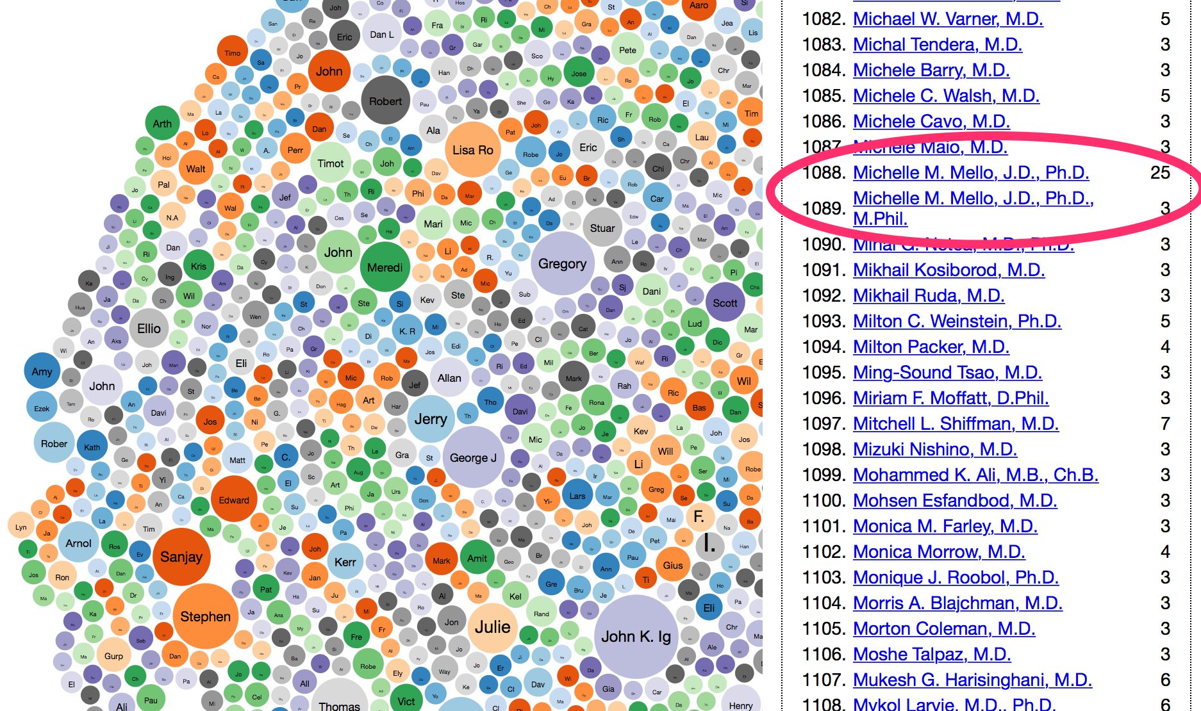
Solving problems with LD: example 1

Slide 18
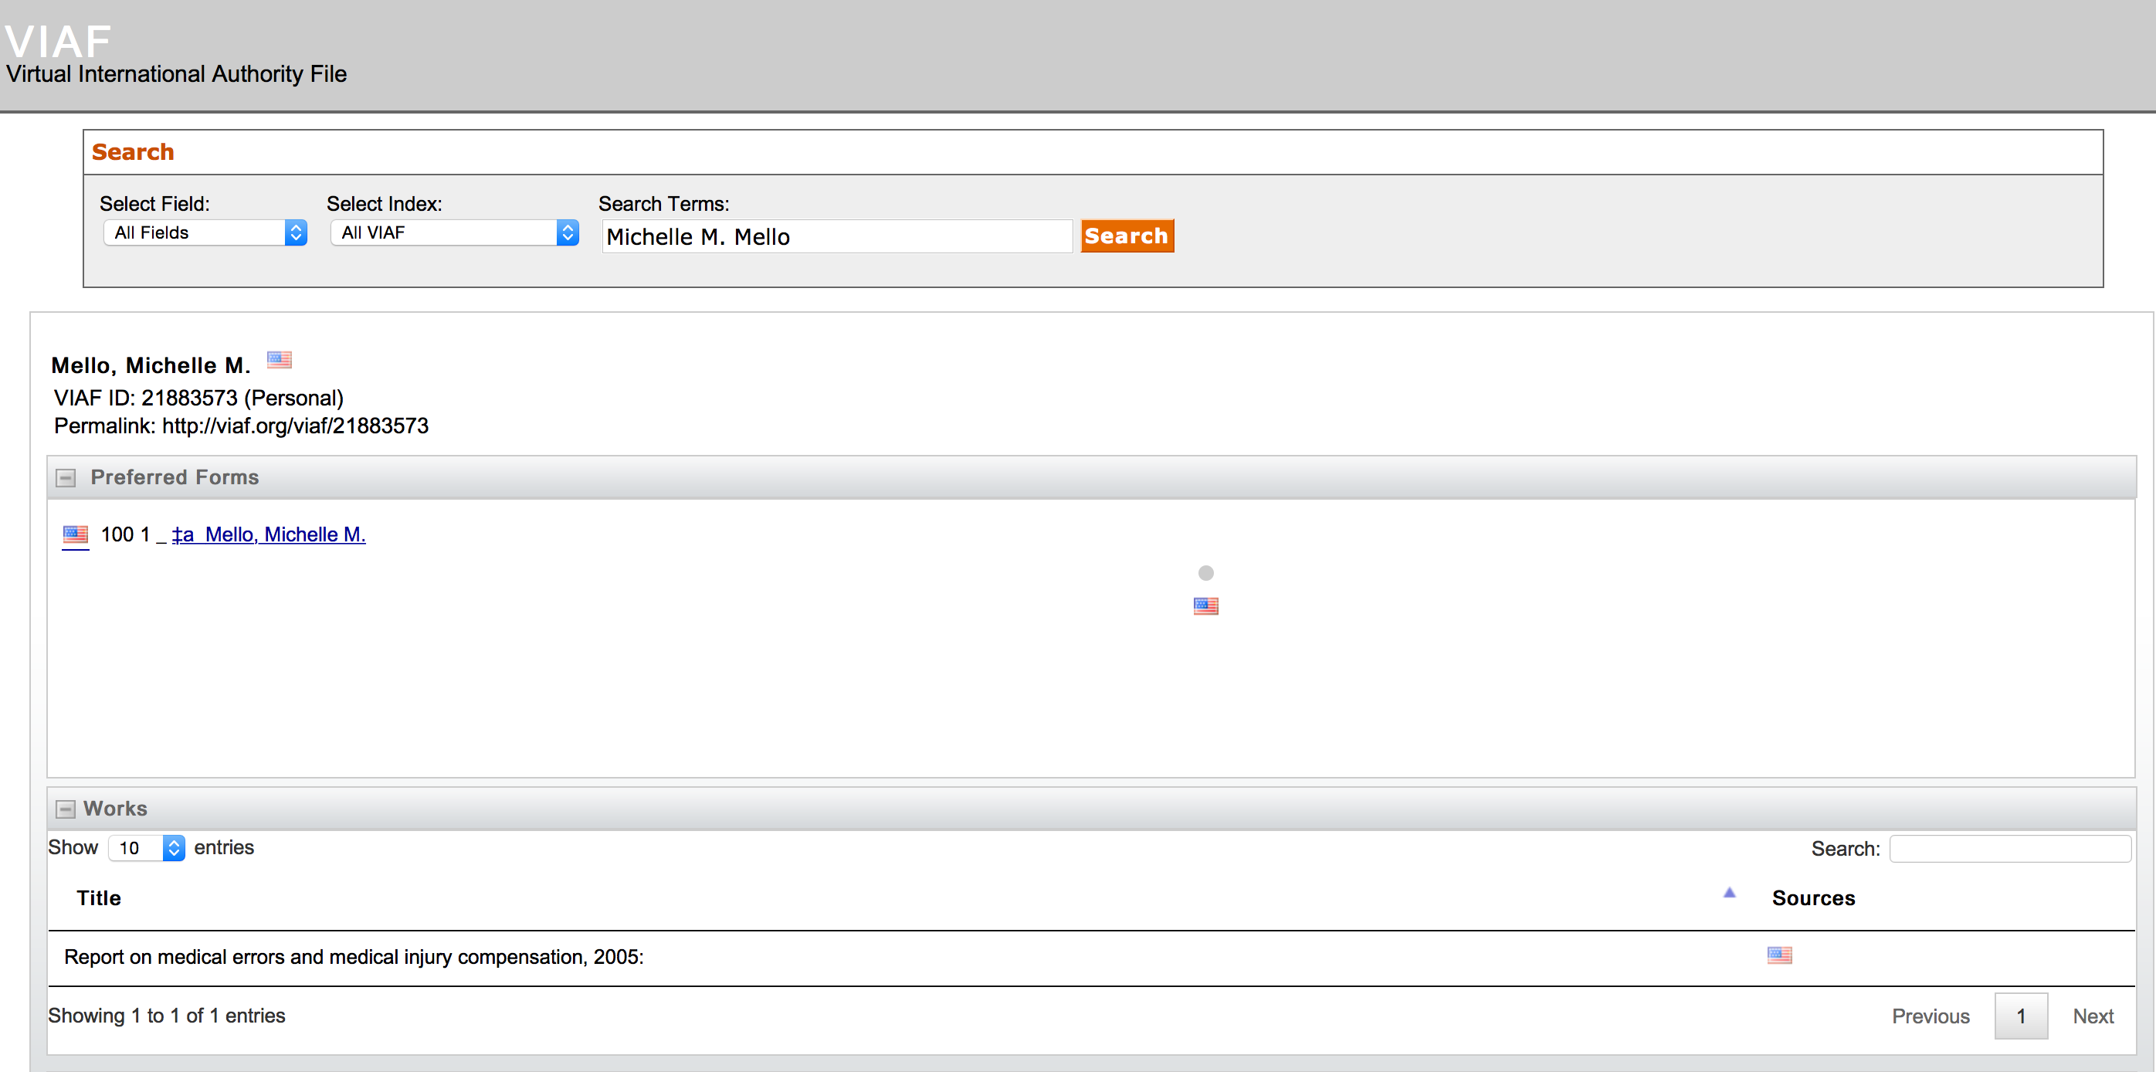
Solving problems with LD: example 1
VIAF: http://viaf.org/viaf/21883573

Slide 19
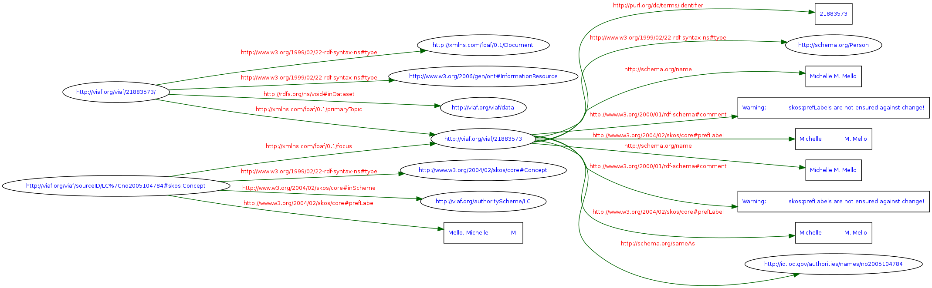
Solving problems with LD: example 1

Slide 20
Solving problems with LD: example 1
NEJM Triple:
<http://nejm.org/author/123456> <owl:sameAs> <http://viaf.org/viaf/21883573>
VIAF Triples:
<http://viaf.org/viaf/21883573> <http://www.w3.org/1999/02/22-rdf-syntax-ns#type> <http://xmlns.com/foaf/0.1/Document> . <http://viaf.org/viaf/21883573/> <http://www.w3.org/1999/02/22-rdf-syntax-ns#type> <http://www.w3.org/2006/gen/ont#InformationResource> .
<http://viaf.org/viaf/21883573> <http://rdfs.org/ns/void#inDataset> <http://viaf.org/viaf/data> .
<http://viaf.org/viaf/21883573> <http://xmlns.com/foaf/0.1/primaryTopic> <http://viaf.org/viaf/21883573> .
<http://viaf.org/viaf/21883573> <http://purl.org/dc/terms/identifier> "21883573" .
<http://viaf.org/viaf/21883573> <http://www.w3.org/1999/02/22-rdf-syntax-ns#type> <http://schema.org/Person> .
<http://viaf.org/viaf/21883573> <http://schema.org/name> "Michelle M. Mello"@en-US .
<http://viaf.org/viaf/21883573> <http://www.w3.org/2000/01/rdf-schema#comment> "Warning: skos:prefLabels are not ensured against change!"@en .
<http://viaf.org/viaf/21883573> <http://www.w3.org/2004/02/skos/core#prefLabel> "Michelle\n M. Mello"@en-US .
<http://viaf.org/viaf/21883573> <http://schema.org/sameAs> <http://id.loc.gov/authorities/names/no2005104784> .
<http://viaf.org/viaf/sourceID/LC%7Cno2005104784#skos:Concept> <http://www.w3.org/1999/02/22-rdf-syntax-ns#type> <http://www.w3.org/2004/02/skos/core#Concept> .
<http://viaf.org/viaf/sourceID/LC%7Cno2005104784#skos:Concept> <http://www.w3.org/2004/02/skos/core#inScheme> <http://viaf.org/authorityScheme/LC> .
<http://viaf.org/viaf/sourceID/LC%7Cno2005104784#skos:Concept> <http://www.w3.org/2004/02/skos/core#prefLabel> "Mello, Michelle M." .
<http://viaf.org/viaf/sourceID/LC%7Cno2005104784#skos:Concept> <http://xmlns.com/foaf/0.1/focus> <http://viaf.org/viaf/21883573> .

Slide 21
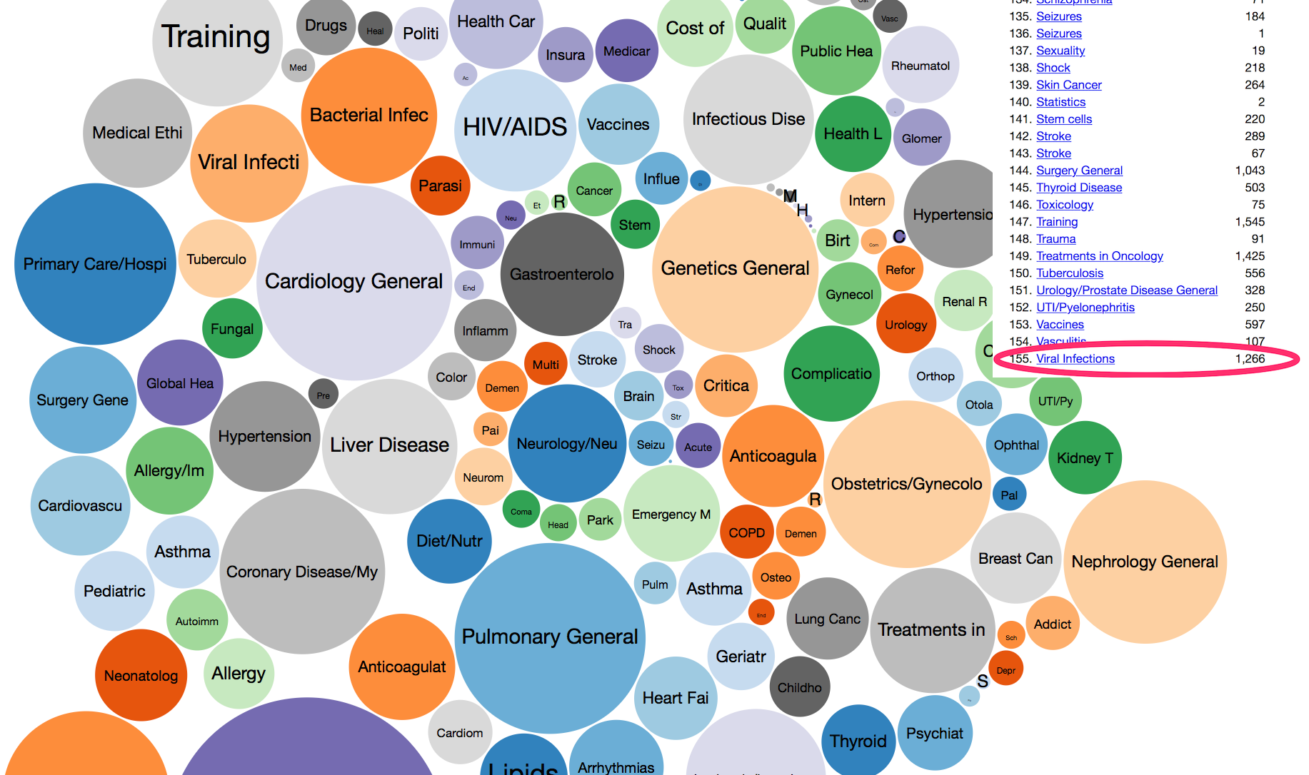
Solving problems with LD: example 2

Slide 22
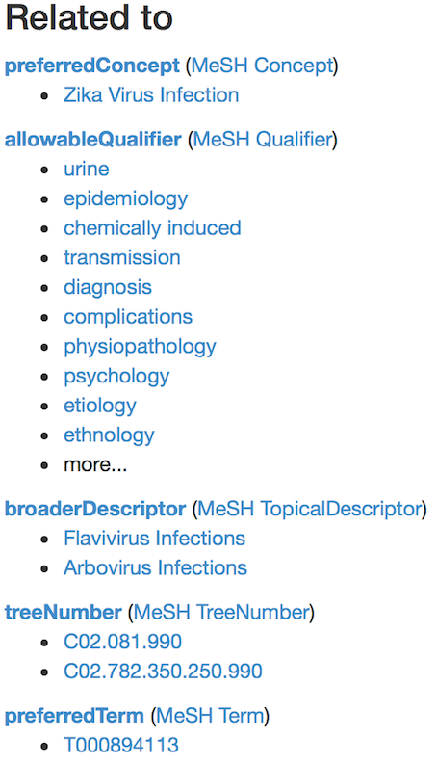
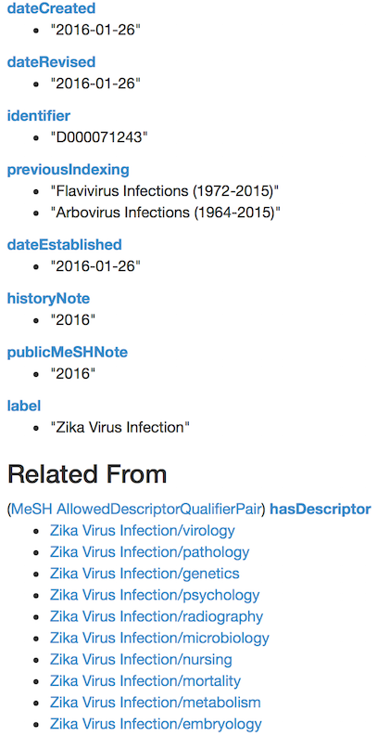
Solving problems with LD: example 2

Slide 23
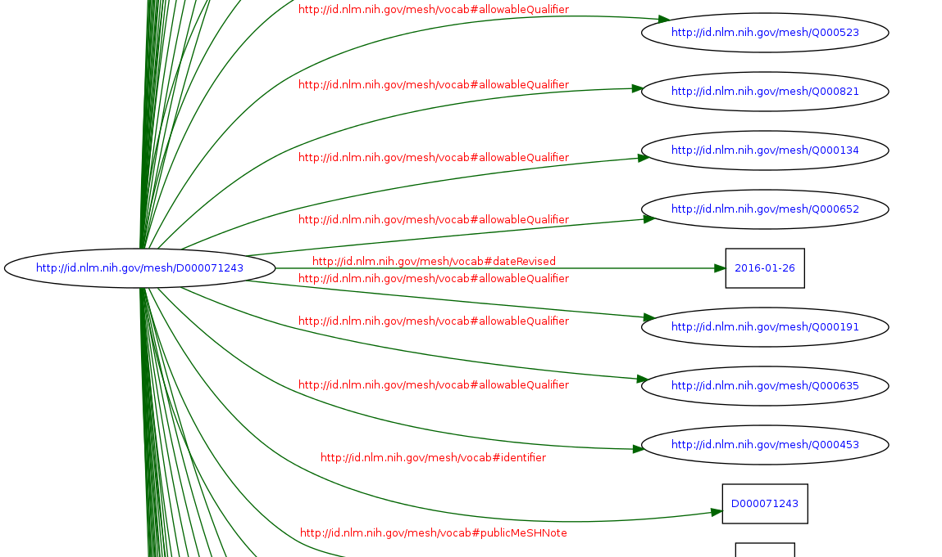
Solving problems with LD: example 2

Slide 24
Solving problems with LD: example 2
<http://id.nlm.nih.gov/mesh/D000071243> <http://www.w3.org/2000/01/rdf-schema#label> "Zika Virus Infection"@en .
<http://id.nlm.nih.gov/mesh/D000071243> <http://id.nlm.nih.gov/mesh/vocab#treeNumber> <http://id.nlm.nih.gov/mesh/C02.081.990> .
<http://id.nlm.nih.gov/mesh/D000071243> <http://id.nlm.nih.gov/mesh/vocab#treeNumber> <http://id.nlm.nih.gov/mesh/C02.782.350.250.990> .
<http://id.nlm.nih.gov/mesh/D000071243> <http://id.nlm.nih.gov/mesh/vocab#broaderDescriptor> <http://id.nlm.nih.gov/mesh/D001102> .
<http://id.nlm.nih.gov/mesh/D000071243> <http://id.nlm.nih.gov/mesh/vocab#broaderDescriptor> <http://id.nlm.nih.gov/mesh/D018177> .
<http://id.nlm.nih.gov/mesh/D000071243> <http://id.nlm.nih.gov/mesh/vocab#dateEstablished> "2016-01-26"^^<http://www.w3.org/2001/XMLSchema#date> .
<http://id.nlm.nih.gov/mesh/D000071243> <http://id.nlm.nih.gov/mesh/vocab#preferredTerm> <http://id.nlm.nih.gov/mesh/T000894113> .
<http://id.nlm.nih.gov/mesh/D000071243> <http://id.nlm.nih.gov/mesh/vocab#historyNote> "2016"@en .
<http://id.nlm.nih.gov/mesh/D000071243> <http://id.nlm.nih.gov/mesh/vocab#dateCreated> "2016-01-26"^^<http://www.w3.org/2001/XMLSchema#date> .
<http://id.nlm.nih.gov/mesh/D000071243> <http://id.nlm.nih.gov/mesh/vocab#dateRevised> "2016-01-26"^^<http://www.w3.org/2001/XMLSchema#date> .
<http://id.nlm.nih.gov/mesh/D000071243> <http://id.nlm.nih.gov/mesh/vocab#identifier> "D000071243" .
<http://id.nlm.nih.gov/mesh/D000071243> <http://id.nlm.nih.gov/mesh/vocab#publicMeSHNote> "2016"@en .
<http://id.nlm.nih.gov/mesh/D000071243> <http://id.nlm.nih.gov/mesh/vocab#previousIndexing> "Flavivirus\u00A0Infections\u00A0(1972-2015)"@en .
<http://id.nlm.nih.gov/mesh/D000071243> <http://id.nlm.nih.gov/mesh/vocab#previousIndexing> "Arbovirus\u00A0Infections\u00A0(1964-2015)"@en .

Slide 25
Silos: connect, don’t break
This is the proverbial data silo
Datasets = catalogs of things
    of collections
    of articles
    of rights
    of formats
    of contributors
    of subjects
    of types
We can categorized all these by using controlled vocabularies and taxonomies (i.e. create domain models)
We can establish relationships between all these (i.e. create ontologies)

Slide 26
Silos: connect, don’t break
How we store and organize our data and define our data models matters
Linking data allows us and our audience to access and query our data from any single point
Because these datasets are linked, a single query can retrieve articles in a given journal, by a given contributor, on a given subject

Slide 27
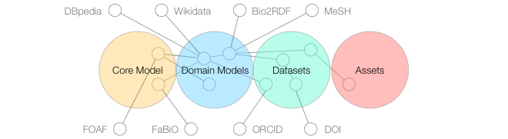
Connect to (and share with) the wider world
Solid well defined data in our Silo
Modeled as Linked Data
Enables connectivity to other datasets data models on the Web
Graphic from Nature.com

Slide 28
Further Reading…
Linked Data for Libraries (LD4L)
  https://www.ld4l.org
Common Ground: Exploring Compatibilities Between the Linked Data Models of the Library of Congress and OCLC
  http://www.oclc.org/research/publications/2015/oclcresearch-loc-linked-data-2015.html
Linked Data in Libraries: Status and Future Direction
  http://www.infotoday.com/cilmag/nov15/Hastings--Linked-Data-in-Libraries.shtml
A Linked Data Landscape
  http://americanlibrariesmagazine.org/2016/01/04/linked-data-landscape/
Notes:
http://experiment.worldcat.org/entity/work/data/312338454

