Slide 1
Building the Reef: Adding onto the CORAL ERMS
By Louisa Choy and Erin Wentz on behalf of Fenway Libraries Online

Slide 2
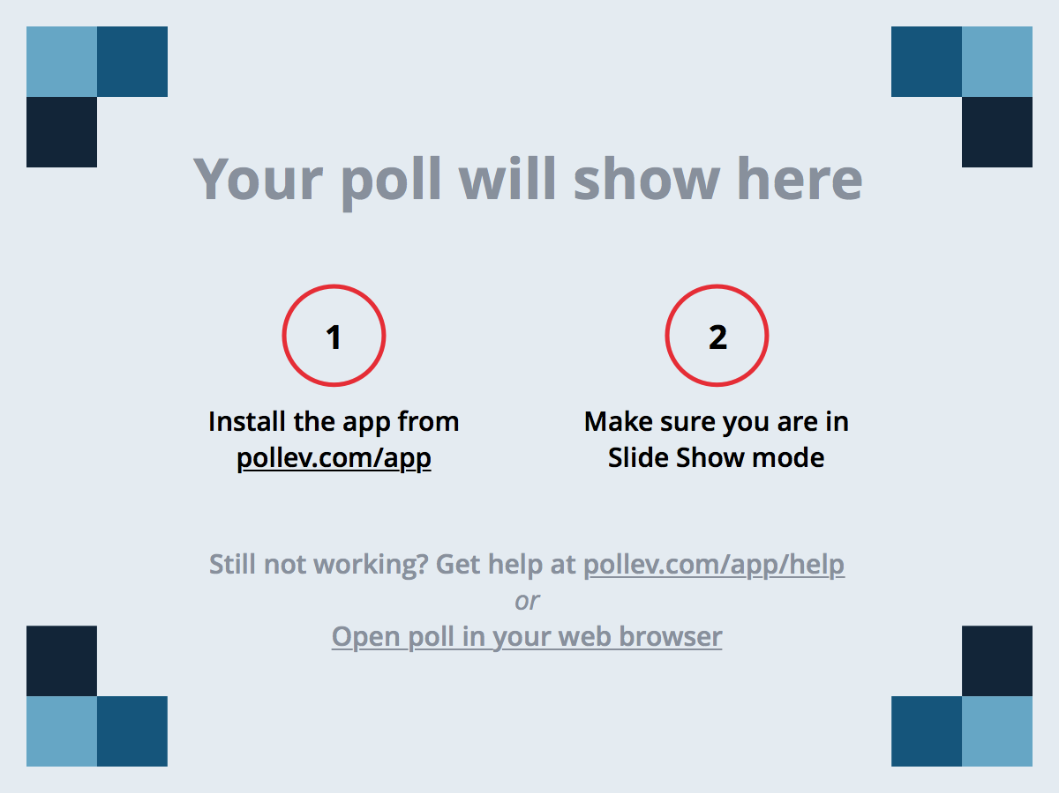
Notes:
Poll Title: What is the first thing you think of when you hear the term ERMS (Electronic Resources Management System)?
https://www.polleverywhere.com/free_text_polls/QX9C29FpVEZpPk3

Slide 3
Notes:
Poll Title: Does your library use an ERMS?
https://www.polleverywhere.com/multiple_choice_polls/9uMzkgVAkPMekve

Slide 4
Notes:
Poll Title: Do you use any software that you wish you could change in some way?
https://www.polleverywhere.com/multiple_choice_polls/bTVHdzIMSqtbSlx

Slide 5
Who Are We (FLO)?
Fenway Libraries Online Member Libraries
Emerson College
Emmanuel College
Lesley University
Massachusetts College of Art and Design
MCPHS University (Massachusetts College of Pharmacy and Health Sciences)
Museum of Fine Arts / School of the Museum of Fine Arts
New England College of Optometry
New England Conservatory
Wentworth Institute of Technology
Wheelock College
Notes:
Fenway Libraries Online (FLO) is a consortium of 10 academic and special libraries in the Boston, MA area. Member libraries specialize in different disciplines, though there is some overlap.

Slide 6
Who Are We (Project)?
Project Members
Kelly Drake, (formerly) FLO Office
Louisa Choy, Wheelock College
Ann Glannon, Wheelock College
Cathy Tuohy, Emmanuel College
Kathleen Berry, (formerly) Wentworth Institute of Technology
Marilyn Geller, (formerly) Lesley University
Erin Wentz, MCPHS University
Developer:
Paul Hoffman, FLO Office
Other Contributors
Adam Shire, (formerly) FLO Office
Allyson Harper-Nixon, (formerly) Wheelock College
Walter Stine, FLO Office
Notes:
Individuals from several FLO libraries participated in the project we will be describing today. Under the leadership of Kelly Drake, the project members developed the specification and performed beta testing. The developer transformed the specification into actual code. Some people started as project members, but were unable to continue. The FLO Director played an advisory role.

Slide 7

What is CORAL?
Tubattaha- lighthouse- table coral in red by q phia. Used under CC BY 2.0 licensing. Resized.
Notes:
Some of you may know it as the fish that are involved in building CORAL reefs by secreting calcium carbonate like in this slide. But for us at FLO, its primary meaning is very different.

Slide 8
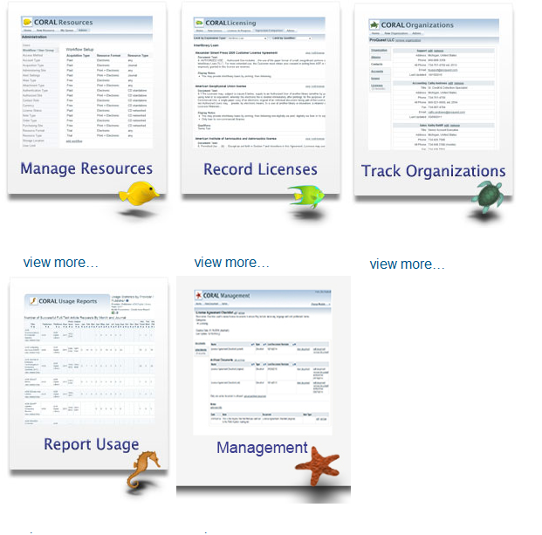
What is CORAL?
an Electronic Resources Management System.
Comprised of several modules, it tracks all information related to the entire lifecycle of an e-resource.
Screenshot of the CORAL website, showing CORAL’s 5 modules. See http://coral-erm.org/modules/.
Notes:
CORAL, short for Centralized Online Resources Acquisitions and Licensing, is an Electronic Resources Management System created by the University of Notre Dame. Comprised of several modules, it tracks all information related to the entire lifecycle of an e-resource.

Slide 9

An Open Source System
CORAL is open source.
Source code of the software is open and freely available to the public.
https://opensource.org/osd
Support available
  No vendor support
  Support comes from the community of users
Notes:
What sets CORAL apart from popular vendor products like EBSCO’s ERM Essentials and Serials Solutions 360 Resource Manager is that it is not a vendor product. It is an open source software.
Open source can be defined by the literal meaning of the term: the source code of the software is open and freely accessible to the public. There is a longer, more detailed list of criteria on the Open Source Initiative website (linked in the slide) that more clearly defines open source software by the spirit in which open source software should exist: that by gaining access to the source code, users can improve upon it and share those improvements, allowing for the rapid evolution of software. And that is what makes open source so powerful and attractive.
Since open source software is freely distributed, almost all of them do not have the backing of a vendor – so no training webinars or dedicated support staff – though for the more popular software, there are certainly a 3rd party companies out there who make it a business to sell support services. For open source software, the support is provided by the community of users, who come together with an interest in helping others use the software, in improving the software, and in encouraging others to join in the software’s community, thereby expanding that community. And our presentation today is about how we became a part of the community of CORAL users.
Image: https://opensource.org/logo-usage-guidelines

Slide 10
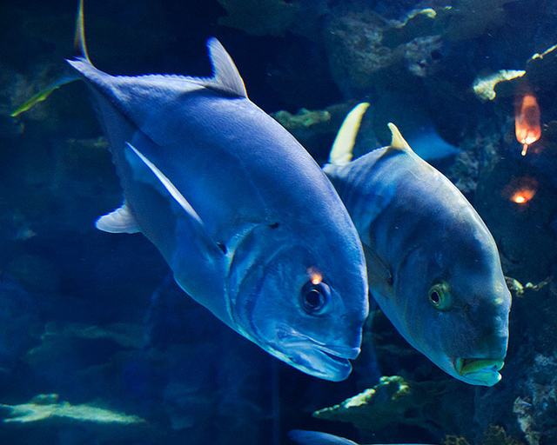
Getting Started
Deciding how to implement CORAL
Filling in the blanks (types of organizations, resources, etc.)
Renaming pre-built options
Creating best practices for the consortium
Discussing what CORAL did not do well
I Don’t Know, What Do You Think It Is? By Mike Fisher. Used under CC BY 2.0 licensing. Resized.
Notes:
The early participants and the consortium’s office worked out a local plan for the consortium. They decided everything from which modules to use to what local names for different pieces of information should be. CORAL was designed as a set of interactive modules. Each module could work as a standalone system or could work as part of a larger system. Institutions could download and install as many or as few modules as they wanted. We decided to implement only 3 of the modules: Organizations, Resources, and Licensing. Through many dialogues, the early adopters determined how to customize and implement these modules for member libraries’ needs. The Out-of-the-box version of CORAL includes options for different pieces of information, such as different types of resources, but allows the institution to expand or override those options as needed. After examining the early participants’ resources, the consortium revised those settings accordingly. They added extra types of some pieces of information (eg. Zombie as an organization type) and renamed existing ones (changed “vendor” to “vendor (seller)” to clarify). In the process, they developed best practices for the consortium. They recorded all of these decisions in shared Google Docs files.
The group also uncovered areas where CORAL could be improved. They asked “What is missing?”, “What could work better?,” and “What causes problems?”

Slide 11

Using CORAL
Phased implementation
Teaching other members
Becoming familiar with CORAL
Joining the CORAL community
Polyps by Brett Levin. Used under CC BY 2.0 licensing. Resized. Cropped.
Notes:
The consortium implemented CORAL in a few rounds over a couple of years. A few libraries at a time started using it. People from the earlier rounds trained people from the later rounds. Through using the system and teaching each other how to use it, we became familiar with how it worked and what its limitations were. Each member library participated in the CORAL community for a different amount of time, but we had accumulated a fair bit of collective knowledge of the system by the time we started thinking about contributing back to the CORAL community.

Slide 12
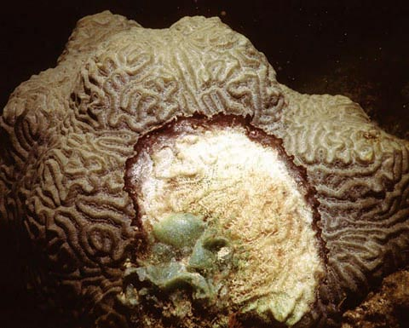
Why Get Involved?
Self preservation
Desire for vibrant community
Existing collaborative model
Opportunities to customize / improve CORAL
Experience with Open Source
Photo of brain coral with black band disease by Andy Bruckner of the NOAA. http://oceanservice.noaa.gov/education/kits/corals/media/supp_coral10a.html
In the Public Domain
Notes:
Overall, the consortium was pleased with CORAL. It helped us organize the many pieces of information about our subscriptions. Consortium members had some concerns, however, and wanted to get involved to address those concerns.
Members were concerned that CORAL might not continue to exist – or might not continue to exist as a unified whole. The discussion list had low participation. It was unclear how the steering committee functioned or what they did. Development seemed haphazard – it was not clear which projects were being worked on or what procedures a group needed to follow to contribute to the development.
As members already knew from being part of a consortium of 10 small academic and special libraries with widely differing specialties, internal cultures, and needs, working as part of a community has real benefits. Members can draw on each others’ expertise, ask each other questions, and bounce ideas off one another. Sharing common systems also reduces the amount of work each individual organization needs to do. The community aspect of CORAL was one of its draws and the consortium wished to keep the community going.
As I mentioned earlier, early participants noticed things they wished CORAL could do or would do differently. These changes ranged from tiny inconveniences to larger projects. The consortium saw ways to make the system work better and wanted to take advantage of the opportunity to improve the system.
Having used other open source systems in the past, the consortium had established a level of comfort with using open source systems and was ready to move from being users to being active contributors.

Slide 13
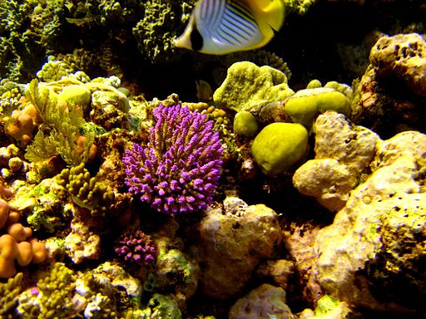
Building the Cost History and Cost Reporting Enhancement
Reef 2183 by LCDR Eric Johnson, NOAA Corps. From NOAA Photo Library. Used under CC BY 2.0 licensing. Resized.

Slide 14
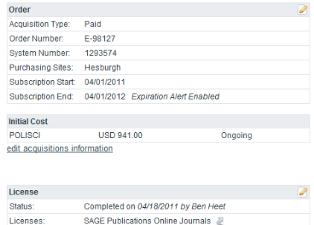
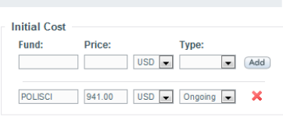
An Identified Need
FLO members who have adopted CORAL wanted a way to manage and review a resource’s cost information over successive renewals.
Notes:
So why this project? We felt that the out-of-the-box Cost History did not quite meet our needs. As you can see, the Resources module allows users to input start and end dates, and cost information, for one subscription cycle at a time for any given Resource. However, it does not encompass the full lifespan of the Resource, and thus does not effectively track changes over time. We tried to hack it by appending fiscal year information to the fund field, but that still did not give us a clear picture of subscription start and end dates, nor did it allow us to include important cost details like whether the cost was determined by the Carnegie Classification or FTE.
We also wanted a way to pull that information out into a report. The only reporting features available in CORAL were an export of all resources and stored Usage Statistics reports.
The University of Notre Dame who created CORAL and so graciously shared it with the public actually had a separate system for managing such information, so this feature was not included in CORAL as there was no need for it on their part.
Managing and reviewing a resource’s cost information over successive renewals is an integral part of what we do in e-resource management and we wanted it in this system which has become the go-to for all ERM info.

Slide 15
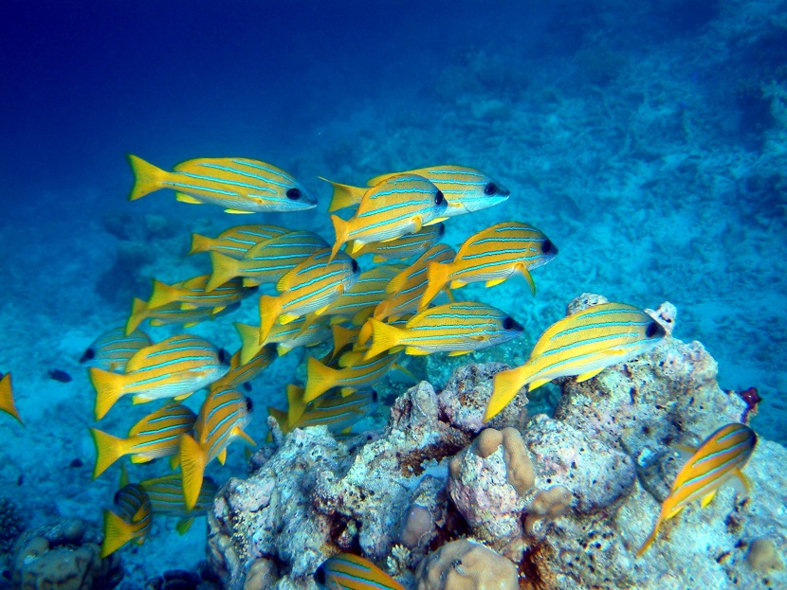
A Community Request
Members of the CORAL Discussion Listserv had voiced similar concerns over the Cost History portion of CORAL and an expanded Cost History feature was of high interest.
Snap of Snapper! by Jim and Becca Wicks. Used under CC BY 2.0 licensing. Resized.
Notes:
And it wasn’t just us. When we had implemented CORAL, we had joined the CORAL Discussion Listserv. We noticed that other users had questions about the limitations of the Cost History feature and there was a very strong interest for an expanded Cost History feature. Our FLO CORAL Development Committee (FCDC) was excited to do something that would benefit both us and the larger community. We determined that out of all the potential enhancements we were interested in doing with CORAL, it would be one that was moderately difficult to carry out, but would have a large impact.

Slide 16
Partnerships
Mellon Foundation
FLO Members
LYRASIS
FLO Office
All CORAL Users
FCDC
Trial Team
Consortium Luxembourg
CORAL Steering Committee
BibLibre
Notes:
Implementing CORAL and developing the enhancement required many levels of community and partnership. You will hear more about how each group contributed later in the presentation.
Trial Team – Selected CORAL and helped train other FLO members.
FLO CORAL Development Committee (FCDC) – Led the enhancement process.
FLO Office – Supported Trial Team and FCDC. The FCDC leader was from the FLO office.
Other FLO Members – Provided input and feedback.
Consortium Luxembourg – Drafted a specification FCDC built on.
CORAL Steering Committee – Guided and reviewed the enhancement development. Shared Consortium Luxembourg’s draft. Acted as a bridge between us as developers and the wider CORAL community of users.
Wider CORAL User Community – Provided feedback.
BibLibre – Responded to the RFP. Made suggestions.
LYRASIS – In exchange for a case study, provided funding used to cover developer’s fees.
Andrew W. Mellon Foundation – Funded LYRASIS’s proposal, indirectly funding the development fees.

Slide 17

Resources & Funding
Enthused consortium office
In-house expertise & resources
Member libraries willing to participate.
LYRASIS Case Study
Coral Reef, Florida by Jerry Reid, U.S. Fish and Wildlife Service and uploaded by eutrophication&hypoxia. Used under CC BY 2.0 licensing. Resized.
https://discuss.foss4lib.org/case-study/flo
Notes:
When we had selected CORAL, we examined our organizational capacity (both at FLO and the member libraries’) to support open source and to support potential developments (whether it be coding it ourselves or hiring someone else to do it). We had even develop rubrics examining this.
While CORAL was free and we’re not dropping a huge chunk of change into a vendor’s pockets for an ERM for each interested member’s libraries, there was a hidden cost in labor and setup – think of all the time involved in consensus-building, decision-making, self-directed training, installing, and looking at ways the system can be enhanced. When we had taken into consideration the cost saved on not using a vendor product (which would have required to buy several instances of the product) and compare that with the cost spent in labor, setup, and maintenance and took into account how well the software would serve our particular needs and the value added in exploring open source, the our choice was ultimately an economical one.
It freed us to pursue paying someone to create an enhancement according to a specification that we, the FLO CORAL Development Committee, leveraging our enthusiasm and in-house expertise and resources, would develop. By in-house expertise, I refer to not only to coding, but the collective experiences and expertise in managing e-resources across our different libraries.
Erin also discovered that LYRASIS was looking for libraries who have adopted open source software to share their stories. At the time, LYRASIS was expanding their role in encouraging libraries to explore and adopt open source. They had put out a call for proposal looking for case studies and we answered it. We wanted to share our story and LYRASIS was paying the selected libraries to develop their case studies. The case study is available on the Foss4Lib website. Foss4Lib is a website launched by LYRASIS to provide decision support tools for libraries about open source software. While today’s presentation is focused on enhancing an open source product, you can read about how we came to adopt CORAL and get a copy of the rubrics we used to make our decision.
It was fortuitous that both FLO (and I’m talking about both the consortium office and the member libraries) and LYRASIS’s explorations of open source aligned at the same time. It seems fitting that our interest and exploration of open source led to an open source project which we were able to write a case study about, which then led to funding that help support our exploration of open source.

Slide 18
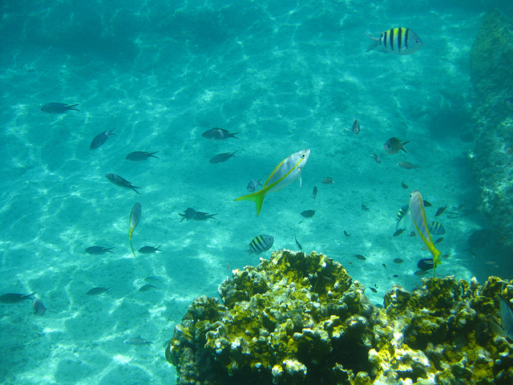
Developing the Specification:
Getting Started
Notified the CORAL Steering Committee and inquired about the process of getting our enhancement into the master code.
Consortium Luxembourg specification
Great Sturrup Cay Snorkeling by brownpau. Used under CC BY 2.0 licensing. Resized.
Notes:
We got started in November 2013. A small team called the FLO Coral Development Committee was formed – led by Kelly Drake, our fearless leader and FLO Systems Librarian. It also involved representatives from several of the member libraries who were actively using CORAL. As the first step in the project, Kelly notified the CORAL Steering Committee via Benjamin Heet, the E-Resources Librarian at NCSU, of our plan to develop a Cost History Enhancement and Reporting feature for CORAL and inquired about the process for getting code included in the software. The Steering Committee oversees the code base. Ben confirmed that the cost history functionality was in demand and forwarded a copy of a Cost History Specification that had been written by Consortium Luxembourg, a group of libraries in Luxembourg who were actively using CORAL for their ERMS. They had shared their specification with the Steering Committee, but no one had taken up the project. We reviewed it and incorporated many elements in our specification, but modified it to fit our needs more closely.

Slide 19
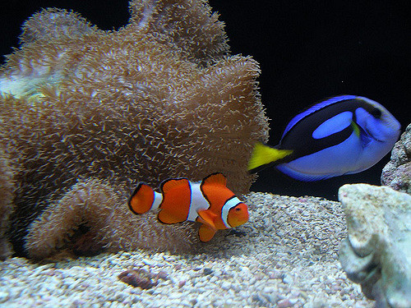
Developing the Specification: Drafting It
4 iterative cycles of specification development and negotiations between November 2013 and February 2014.
P3200101 by Sawyer Pangborn. Used under CC BY-NC-ND 2.0 licensing. Resized.
Notes:
FCDC went through 4 iterative cycles of specification development and negotiations over a 4 month period- we communicated through emails and in-person discussion. Kelly Drake, the FLO systems librarian, led the way in providing mockups and wireframes while the committee provided feedback, clarification, and alternative directions.
Image: https://www.flickr.com/photos/abandonedhero/2348425823/
Uploader: Sawyer Pangborn
CC BY-NC-ND 2.0, https://creativecommons.org/licenses/by-nc-nd/2.0/

Slide 20
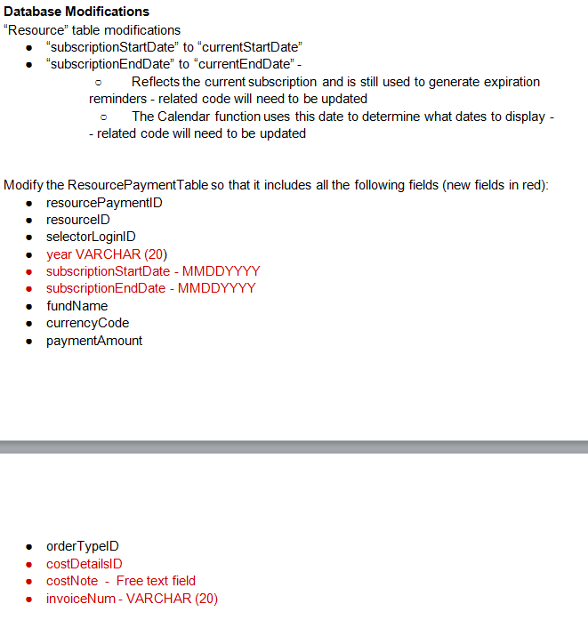
The Specification
Overview
Configuration Modifications
Database Modifications
Notes:
I’m going to take a break in our story to show you a snippet of our specification. It was posted on the CORAL listserv and we don’t have it linked publicly anywhere, so feel free to let us know if you would like a copy of it and we can send it to you. The screenshots are of the final specification after we’ve made additional changes in response to community feedback.
It is important that we’re specific and explicit about the kinds of changes we want. Developers are typically not users, at least not hard-core users, of the software. A specification should help bridge that divide.
In our final specification, we included the following pieces of information:
-An overview of what we’re trying to accomplish with the Resource Cost History and Reporting Enhancement
-Configuration modifications in the software’s initialization file. We originally didn’t have this. It was added after we decided that the enhancements would be optional features that users can turn on and off.
-Specific database modifications. We’re talking about creating new fields in the database tables and modifying existing ones. In the slide is a snippet. As you can see, we’re renaming the existing subscriptionStartDate field to currentStartDate and using subscriptionStartDate as a new field for the cost history table and we noted that any code related to the renamed currentStartDate field will have to be updated.

Slide 21
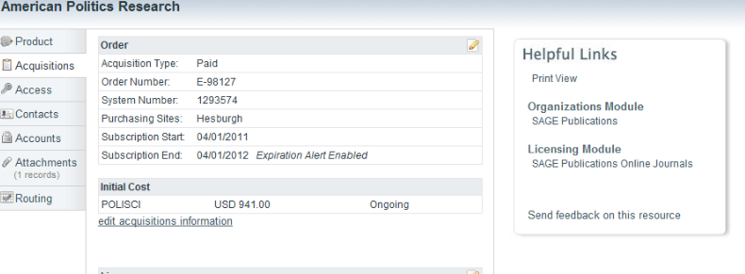
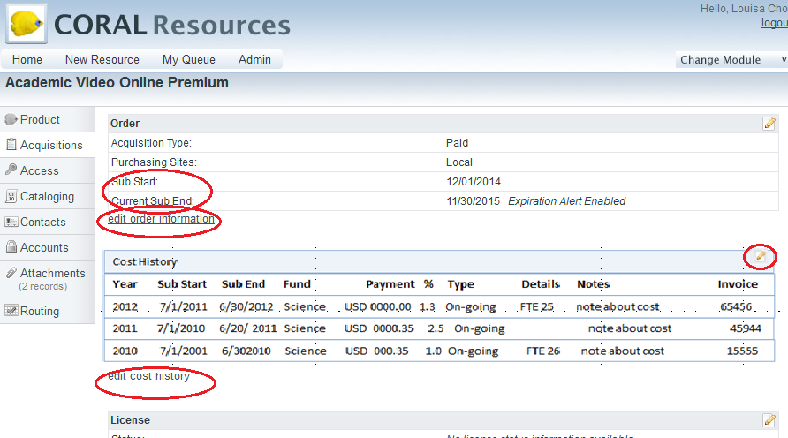
The Specification
Original
Proposed
User Interface Modifications
Notes:
Change labels – Subscription End → Current Sub End.
Add “edit acquisitions information” link under Order box
Add “edit cost information” link under the Cost History Box; link to “Edit Acquisitions Details”
Add edit button to the uppper right hand corner of the Cost History table and where that button will link to (“Edit Cost History”)
If Enhanced Cost History enabled, helpful links box on the right will disappear to make room.
A table containing the following fields:
Year:
Sub Start:
Sub End:
Fund:
Payment:
Currency:
% Inc* (which we got rid of)
Type:
Cost Details:
Note:
Invoice:

Slide 22
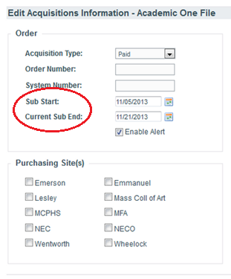
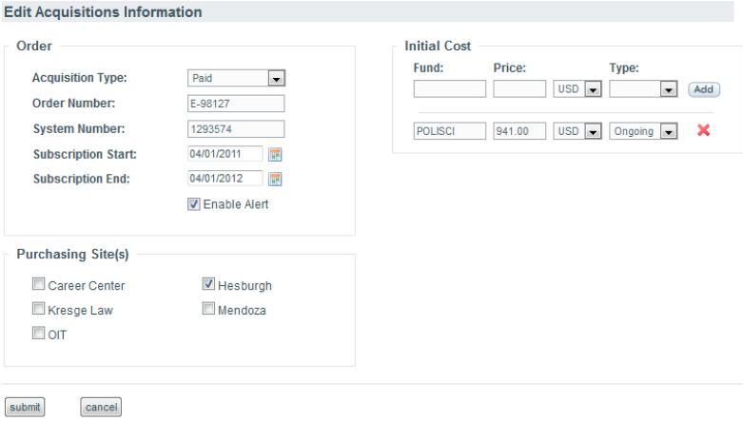
The Specification
Editing Window Modifications: Edit Acquisitions Information
Proposed
Original
Notes:
Specified changes to the Add New Resource Window and the Edit Acquisitions Information Windows. Here is an example of changes made to the Acquisitions information Window.
As you can see, similar to the database modification and user interface, we’ve renamed Subscription End to Current Sub End. We made sure to specify all the places a certain change needs to be made.
We’ve removed the initial cost section, whose information will later be put into the cost history payments table.

Slide 23
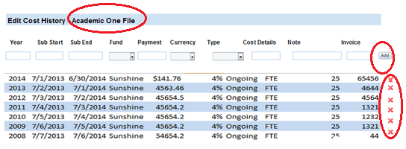
The Specification
Creation of the Edit Cost Information Window
Proposed
Notes:
With Enhanced Cost History enabled, we proposed that the edit Cost History window will look like this.
Include Resource Name in header
Cost Section - Column headers as follows:
Year:
Sub Start:
Sub End:
Fund:
Payment:
Currency:
Type:
Cost Details:
Note:
Invoice:
Add input boxes for the above fields:
year
subscriptionStart
subscriptionEnd
fundName
paymentAmount
currencyCode
orderTypeID
costDetailsID
costNote
invoiceNum
- followed by the “Add” button
Previously entered data would appear below the add line with a delete option to the right of each line. Our first iteration had missed out on little details like the add and delete buttons.

Slide 24
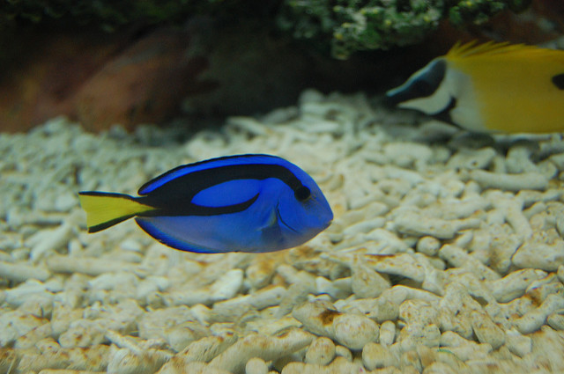
Developing the Specification: Feedback and Negotiation
Feedback from listserv and Steering Committee
Further work on specification from February 2014 through May 2014
dory, surgeon fish by kitakitts. Used under CC BY-NC 2.0 licensing. Resized.
Notes:
A few months later, When we were ready, we released it to the CORAL listserv and Steering Committee around February 2014. The feedback was positive, though there were also a number of questions, suggestions, and concerns. The Steering Committee provided feedback on parts of our specification that may cause conflict with the existing code. Getting the feedback and incorporating it took a few months.

Slide 25
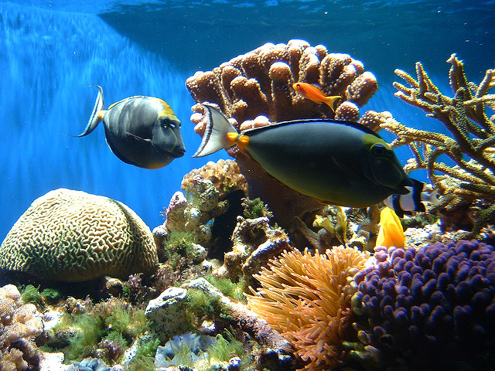
Request for Proposals
Posted finalized software specification to CORAL as a Request for Proposals
Only received one response
Eventually, went with in-house expertise.
Coral Reef by only_point_five. Used under CC BY-NC 2.0 licensing. Resized.
Notes:
We posted the specification to the listserv as a request for proposals in July. We had hoped to get several proposals, review them, and then award a contract to the developer. In the end, we only received one proposal. While it was a strong one, but we had reservations due to location (different country) and distance (several time zones away) and a slight language barrier – all of which we felt would make communication difficult.
Because of all the time it took to draft and then finalize the specification and then waiting for proposals to come in, it eventually came time for FLO’s resident programmer and Systems Librarian, Paul Hoffman, to return to the US after spending about 18 months in India during his wife’s sabbatical. He had already had experience with working on software installation, development, coding, and project planning for FLO systems and experience in working with and communicating with the FLO Community.

Slide 26

Accomplishments
Glossary
Case study + tools
(Optional) Expanded Cost History
Increased communication
More formalized processes
In-progress merging of modules
Star_red&orange by paulshaffner. Used under CC BY 2.0 licensing. Cropped and resized.
Notes:
Through this project, we accomplished many things. We developed much of what we wanted to see. We shared with the wider community. We became more involved in the CORAL community.
We contributed to the glossary on GitHub, based on a local document the consortium had developed while implementing the system.
We wrote a case study, with accompanying matrices others can use to see if open source is a good fit for them.
We developed a clear specification, with explicit information about the changes we wished to see and how the enhancement would work. We noted what type of information the system would use, what would happen when a person clicked on a specific button, and more. All of this specific detail allowed our developer to take our vision and turn it into reality.
We added most of the expanded cost history. The steering committee added our code to the master version in GitHub and shared the updated documentation with the listserv. People now have the option to use this expansion to track their costs over time and understand why those costs might be changing.
As Louisa mentioned earlier, we left off one of the features we had initially included in the specification. It would have calculated the annual resource cost increases automatically. Unfortunately, it was was not flexible enough for many users. The feature did not work well if funding for a single resource came from multiple fund codes or if a resource required multiple payments.
We also held off on the reporting portion of the specifications. Our developer noted that our specification was a bit less clear about how this portion would work than about the cost history portion. In addition, he shared that it would be easier to build in an environment where all the modules were part of a unified code base instead of being separate modules that shared information in some ways, but did not share information in other ways. Enough other people also expressed a desire for this unified code base that the Steering Committee was exploring merging the codes. We currently have a scaled-down, FLO-specific version, but the full-featured version does not exist and the scaled down version has not been shared with the wider community.
Communication in many forms has improved, in part because of a push from Kelly Drake. She and others pushed for increased communication from the steering committee, clear versioning, and formalization of development procedures.
As noted above, we and others prompted the move to a single unified codebase, rather than standalone modules. This project is currently underway.

Slide 27

Lessons Learned
Implementation can turn out differently than what is planned
Finding developers who understand and are interested in coding Library software can be difficult.
Being specific and explicit in detailing the changes you want.
Contributing to the community can take a very long time.
For a large project like this, we needed a leader to drive this project forward.
Coral by scyrene. Used under CC BY-NC-ND 2.0 licensing. Resized.
Notes:
Like Erin has mentioned, even with a massive amount of planning we did for the specification, implementation can turn out very differently especially when we’re dealing with complex ERM scenarios and an existing structure we’re trying to gracefully incorporate a new feature in.
Finding developers who understand and are interested in coding for CORAL or any open Library software can be difficult, especially with a small community that is still growing.
And speaking of developers, developers love specifics. As mentioned before, developers are not often users interacting with the software on a daily basis. We need to be able to communicate our specific needs and break down our vision into identifiable and tangible tasks in order to facilitate the implementation process. Think about what the developers are working with – Code. Developers have to be able to translate our needs into code – which is a precise set of instructions written in a language that computers can follow. And with code, small changes can involve and lead to large ramifications.
In addition to it being much more complicated to implement than we originally imagined, part of why the reporting piece didn’t go according to plan was that the specs in the reporting piece did not meet the same level of specificity as the enhancement piece. And by being specific in how you articulate the changes you want, it forces you to really think about the feasibility of implementing the feature.
We learned that contributing to the community can take a very long time. We thought once we have our very well-thought out specification written out, everyone would just say “great, go ahead and do it now”. We had to check in with the CORAL Steering Committee to make sure our enhancement does not conflict with the master code. The CORAL Steering Committee wasn’t super active at the time. They were full-time library employees who had other things to do besides work with CORAL all day, as are the librarians on this end of things, so exchanges could take days or weeks at a time. Other community members, who even though were enthused by what we’ve proposed, also had some very valid ideas regarding the Cost History enhancement, which we had to negotiate. This all took a lot more time than we expected. If we were building it for ourselves, we could move right along and do it to our own local instances. However, we wanted to build it for everyone and move the software forward. We wanted to really make an investment in the software.
Because of the unexpected length of time, it was invaluable that we had a strong leader among us – Kelly Drake- who tirelessly moved the project forward even as some of the initial exuberance waned a little as we waited for feedback. She has since retired. I don’t think we would have gotten as far as getting the enhancement into the master code if it wasn’t for her. And the CORAL Steering Committee was instrumental in helping us newbies really think through our proposed changes and the potential ramifications. When looking at open source software, having a group of designated leaders who are invested in the software and who provide encouragement and guidance for evolving it is very important.

Slide 28

Takeaways
Spirit of change and sharing
Crowdsourcing of experiences
Even if you don’t code, you can make a difference!
Ybcrf_1b by Greg Goebel. Used under CC BY-SA 2.0 licensing.
Notes:
Sometimes I do leave conference sessions feeling a little bit discouraged – these librarians are presenting this wonderful project in hopes that other librarians can take their work and implement it in their own libraries and ….my library just doesn’t have the resources and my plate is so full, I can’t possibly do anything. It’s great if you have the resources and the interest in pursuing something similar to what we did. Actually, we encourage you to, because you have the resources, and it’s for a good cause. If not, then hopefully, our presentation today will provide a glimpse into open source and the spirit of change, generosity, and collaboration that drives it.
One of our biggest takeaways and hopefully yours from this presentation is an appreciation of the sense of community involved and the crowdsourcing of experiences and time and resources. And how wonderful it is when the interests and passions of many align – actually how necessary that is when you want to get something done- and sometimes you don’t know if those interests align unless you listen and then when you can, speak up.
While our FLO community – specifically the FCDC group- developed the specifications and eventually developed the code for the enhancement, we could not have done so without the interest and input of users in the listserv and in the CORAL Steering Committee. Just by adopting it and looking at software and knowing that you or someone else out there who could afford to share a little bit of time and resources to modify it to suit your needs is empowering. For those who work in or belong in consortiums, which I’m guessing is all of you, consider crowdsourcing your collective expertise and working together and see how you can make a difference in enhancing some of your systems – whether it’s within your consortium or within the broader library community. Even if you don’t code, you can make a difference!

Slide 29
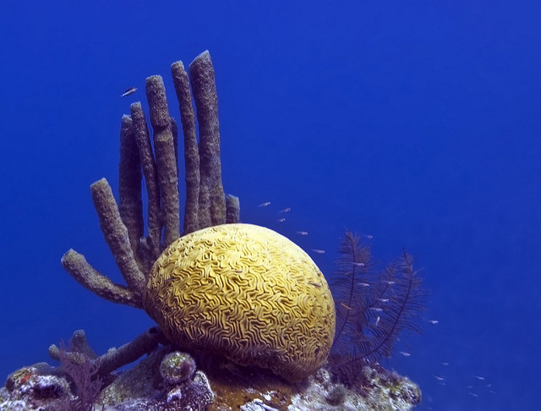
Reflection
Corals of the Great Blue Hole in Belize by Jean-Marc Kuffer. Used under CC BY 2.0 licensing. Resized and cropped..
Notes:
What, if anything, would you like to change about software, databases, or tools that you use? [Open or proprietary] How can you help make them more usable? What skills or talents do you have that might be useful – identifying things to change [idea-sharing], describing the change to be made [creating specifications], connecting others to funding, writing clear instructions [documentation], clarifying others’ instructions [editing or translating’, coding [development], testing, sharing, advocating….
[Wait a few minutes.]
Does anyone want to share what you thought of? You might find collaborators right here in this room…

Slide 30
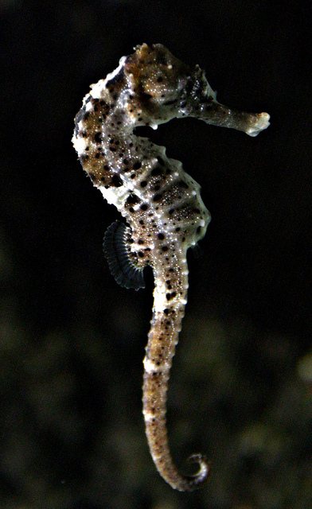
Questions
Seahorse by Misko. Used under CC BY 2.0 licensing. Resized and flipped horizontally.

Slide 31
Resources
CORAL website: http://coral-erm.org/
The CORAL listserv (and archive) https://listserv.nd.edu/cgi-bin/wa?A0=CORAL-ERM
CORAL GitHub site: https://github.com/Coral-erm
GitHub home page: https://github.com/
GitHub Training page: https://training.github.com/
Open Source Definition https://opensource.org/osd
Roles in Open Source Projects http://oss-watch.ac.uk/resources/rolesinopensource
Notes:
Learn more about CORAL, GitHub, and Open Source using these resources. Elizabeth Tatham at the University of Oxford developed a nice list of different ways to contribute to open source software. Her guide is available under CC BY-SA International 4.0 Licensing (http://creativecommons.org/licenses/by-sa/4.0/).

