Slide 1
Research in tech services
Let’s assume Cutter wasn’t perfect
Jeanette Norris
NETSL 2016
Lightning Talk

Slide 2
Taking a step back from our work
How did we get to where we are?
What is the basis of the rules that we have?
Are we serving patrons as well as we could?
Are we providing them the information they need?
What forces are driving change?
What does it mean to be user centered?

Slide 3
Using different disciplines’ methodologies
History
  Understand why we’ve made the decisions we’ve made
  Understand what as led us to our current situation
  Ask, “Why did change happen?”
Social sciences
  How do people approach research?
  How do people understand catalogs?
  Do they really just want to Google everything?
  Are they really just browsing the stacks?

Slide 4
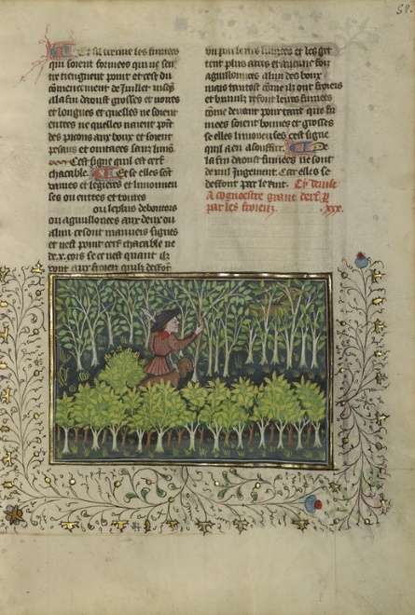
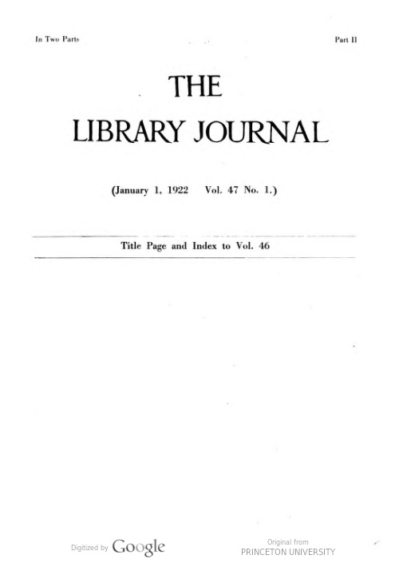
History example
Question
Data Sources
What led and affected the adoption of MARC?
  Why did libraries across the country (and the world) change their practices and adopt this expensive disruptive technology?
  Question the ubiquitous narrative that envelops tech services
Digital image courtesy of the Getty's Open Content Program

Slide 5
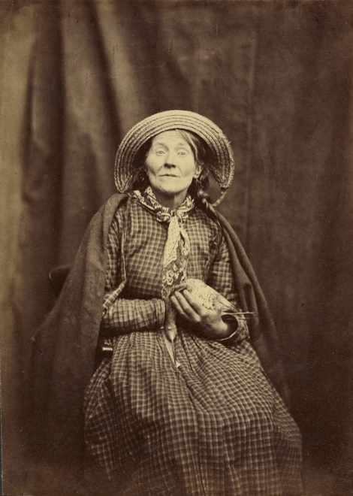
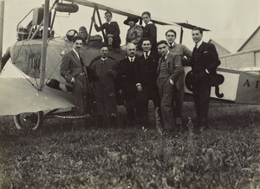
Social sciences example
Question
Data Sources
What information is our community likely to use when searching for our resources?
How do researchers act in the information landscape?
Digital images courtesy of the Getty's Open Content Program

Slide 6
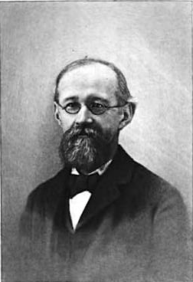
Let’s assume Cutter wasn’t perfect
Work to either prove the theoretical underpinnings of our profession, or to understand how we can improve the effectiveness of our work.
Boston Athenaeum - The Athenæum Centenary. 1907.

Slide 7
Now that I have a question…
Figure out what methodologies are best suited to your question
Read literature using those methods
Talk to colleagues
Take classes / workshops
Learn more about relevant methodologies and jump in!

Slide 8
Why?
Create knowledge that can inform what we do
Prove through research the value and vitality of tech services operations
Make decisions based on data
Develop new skills
Interact with colleagues and community in a new way

Slide 9
Want to talk through ideas with someone?
Contact me!
jeanette_norris@brown.edu

Slide 10
Image references
URLs for images in order of appearance:
http://www.getty.edu/art/collection/objects/2160/unknown-maker-a-hunter-and-a-dog-examining-a-deer's-fraying-place-french-about-1430-1440/
http://babel.hathitrust.org/cgi/pt?id=njp.32101076205101
http://www.getty.edu/art/collection/objects/45349/hugh-welch-diamond-seated-woman-with-a-bird-british-about-1855/
http://www.getty.edu/art/collection/objects/134553/fedele-azari-airplane-and-people-italian-1914-1929/
http://books.google.com/books?id=1q8ZAAAAMAAJ, Public Domain, https://commons.wikimedia.org/w/index.php?curid=8050127

