Slide 1
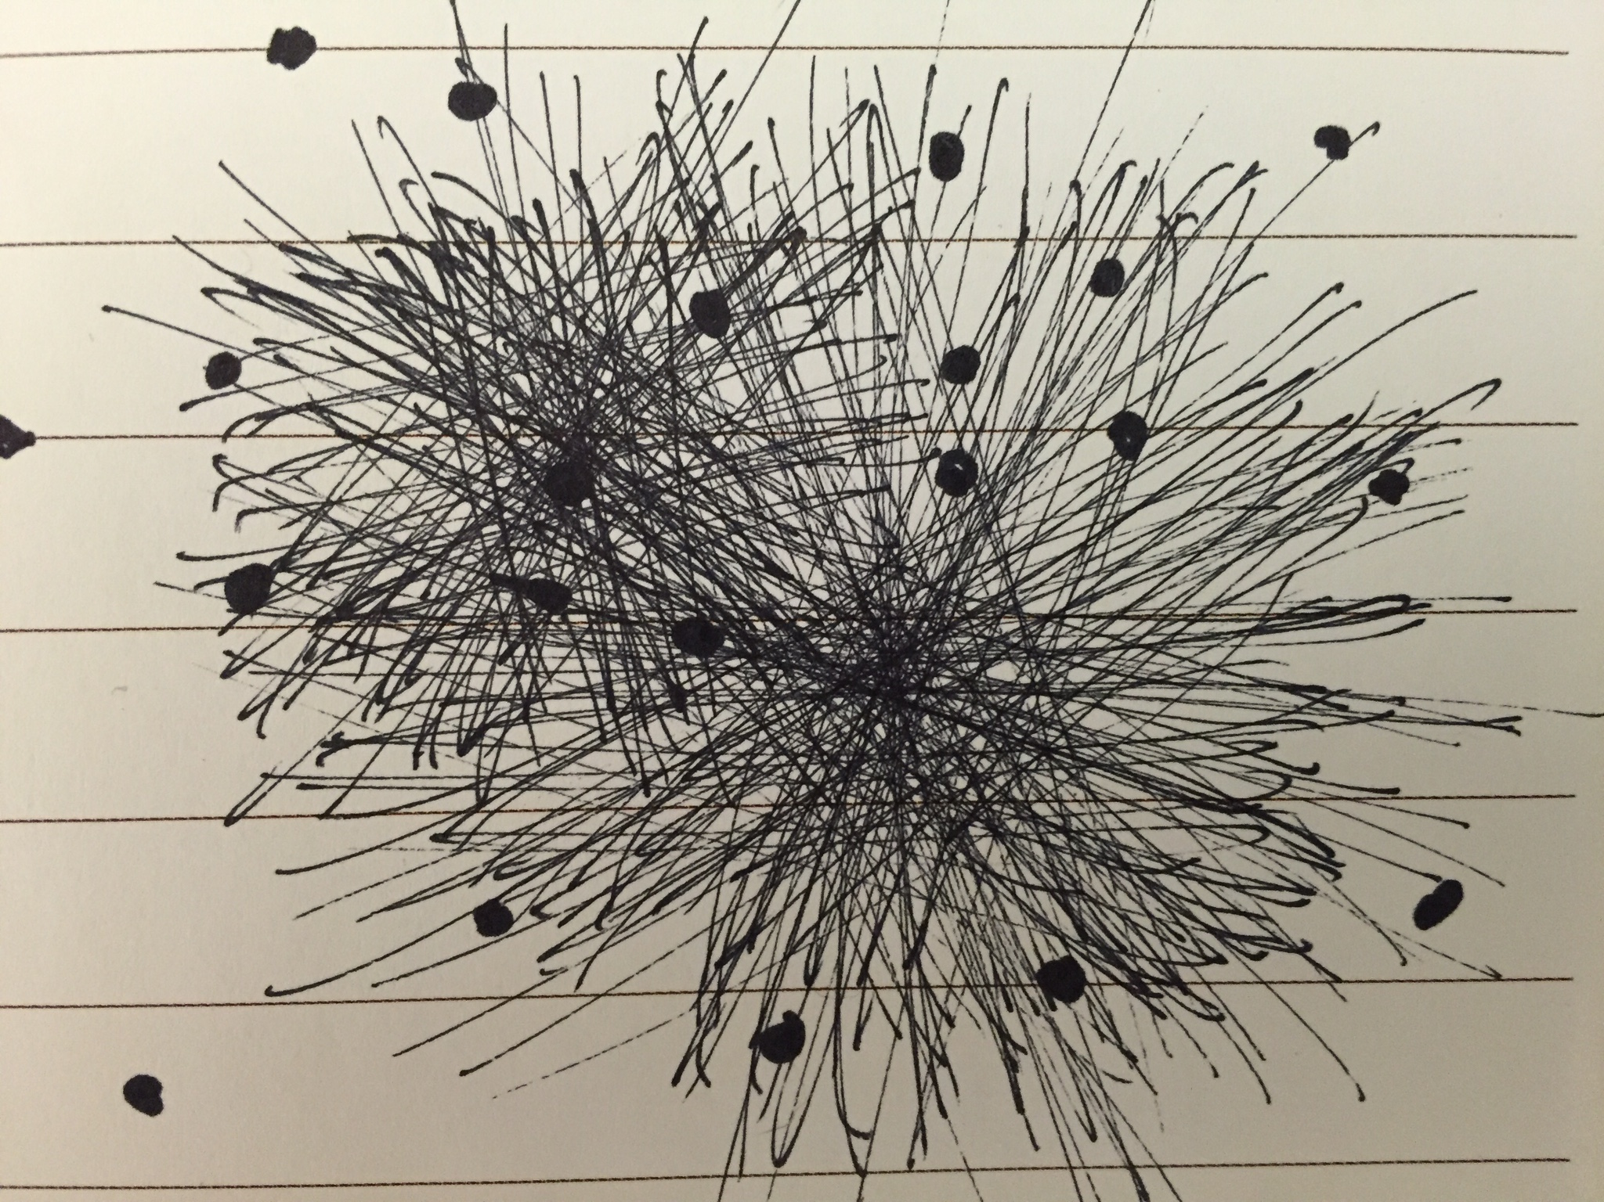
What Now?
Current Opportunities in Preparation for Linked Data in Libraries
Notes:
Description: It is often difficult for technical service staff to know the best way to experiment with linked data techniques for managing library data, or how to justify the allocation of staff resources towards such R&D projects. This is especially true when there are few (if any) library vendor products or out-of-the-box open source solutions readily available for hands-on use. This talk will draw heavily on the speaker’s work in the Linked Data for Libraries (LD4L) project and PCC URIs in MARC Task Group to advocate for a number of concrete low barrier activities to warrant staff time for experimentation and gain experience with linked data principles.
A linked data WD40 pres

Slide 2
Talk Outline
Why Linked Data?
  Why now? [State of the Union]
Skills/Activities to Get Started
  Training Opportunities
Leadership/Management
Notes:
This talk is a mashup of some ideas I’ve presented on before and then some. The basic outline is this...
Why? [Including but not limited to…]. We need clear direction when considering moving away from established workflows. It can’t be rudderless/gratitous change. It has to be deliberate.
Why now? [State of the Union] What things are happening within the library community that are breaking down the barriers for adoption.
Skills/activities that do not require production Linked Data Systems Bulk of the talk will be on activities that don’t require advanced tools.
Training Areas/Opportunities
Close with an As a manager how to go about making change within your organization/department. If you’re not a manager, I would say ask/help your supervisor to achieve some of these objectives.

Slide 3
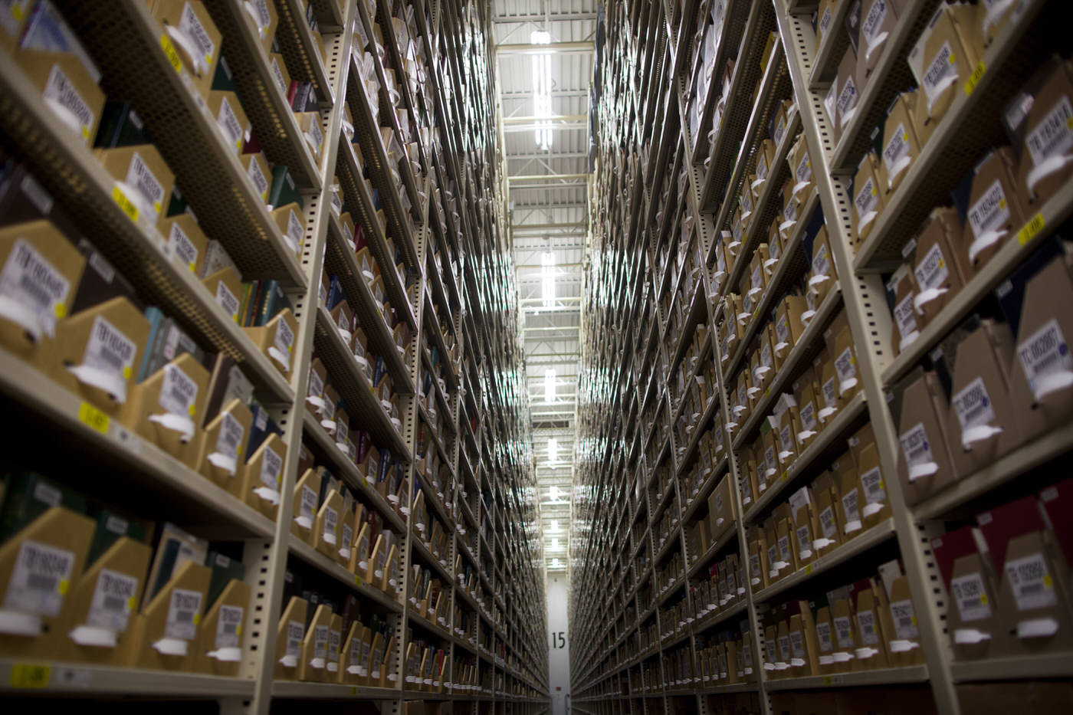
The diversity and volume of things we are asked to describe.
Photograph by Stephanie Mitchell/Harvard Public Affairs and Communications
Notes:
Libraries have always had a diverse number of content types we attempted to describe and provide access to. Just ask anyone who has had to catalog a kit in MARC. That said, we’re placing greater importance on providing access to preprints from our Institutional Repositories, images from our special collections. We’re also archiving websites we want to make available to researchers in perpetuity.
We’re also increasingly considering different external data sources, e.g. data about our theses supplied by databases administered in graduate schools, cover art from Amazon, links to HathiTrust for digital access to public domain work.
Fields of study and carriers types are growing faster than we we can account for using our current standards development practices. We need to look outside ourselves to a larger community working on some of the same issues.

Slide 4
Does Discovery
Still Happen in the Library?
“Libraries might find that a less institutionally-driven
approach to their discovery role would counter-intuitively make their contributions more relevant.”
http://www.sr.ithaka.org/blog/does-discovery-still-happen-in-the-library-roles-and-strategies-for-a-shifting-reality/
Notes:
More recently some have questioned the value of investing in single search within library websites.
This quote here suggests that maybe our efforts would be better spent developing a more distributed discovery strategy. If we build a beautiful single search discovery environment, but the majority of our determined audience doesn’t use it, is our effort wasted?
I don’t think this is an either/or proposition. We should find ways to embed discovery of our collections on the open web that leads researchers back to our catalog/services/facilities.

Slide 5
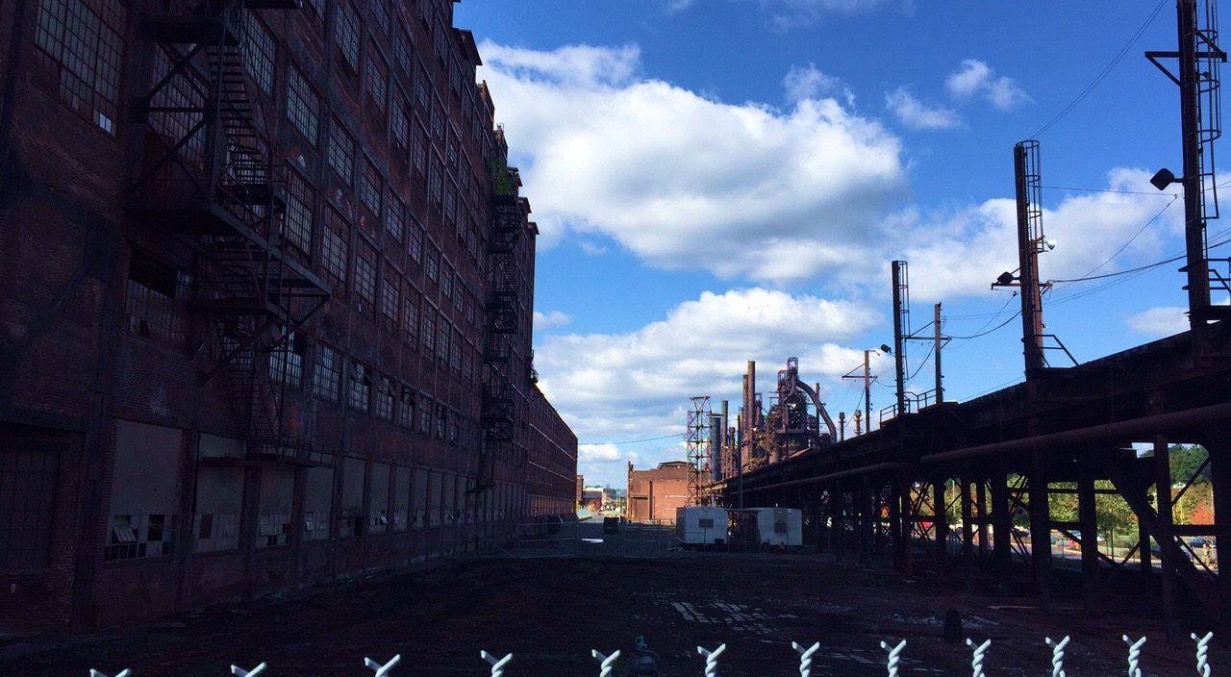
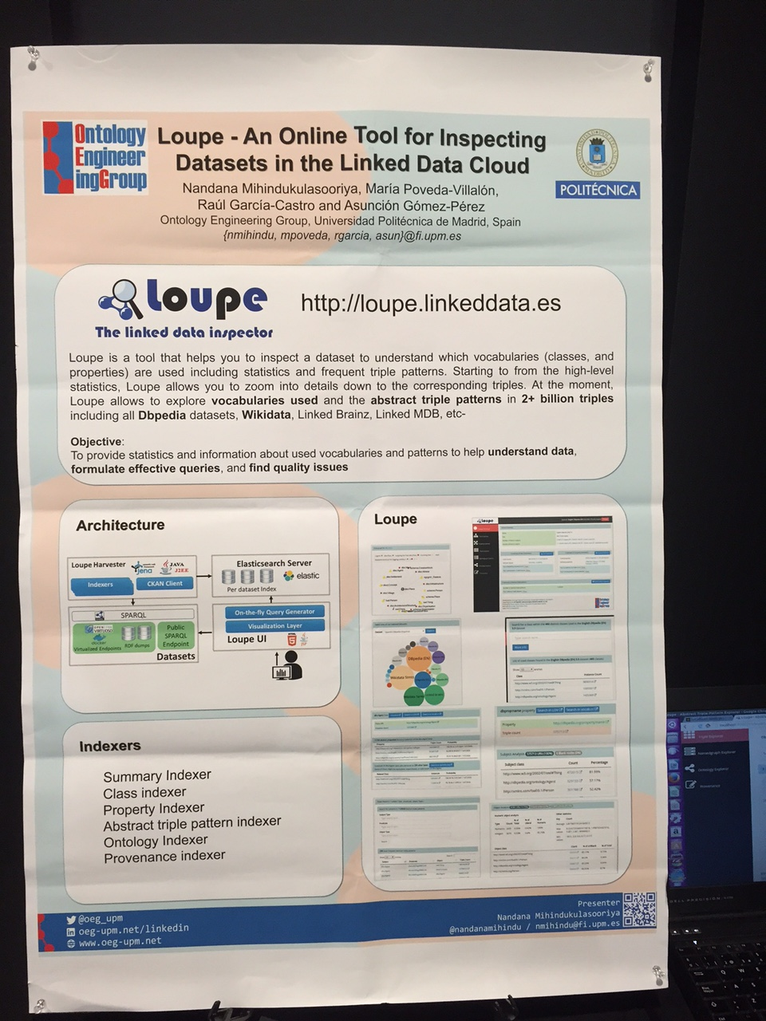
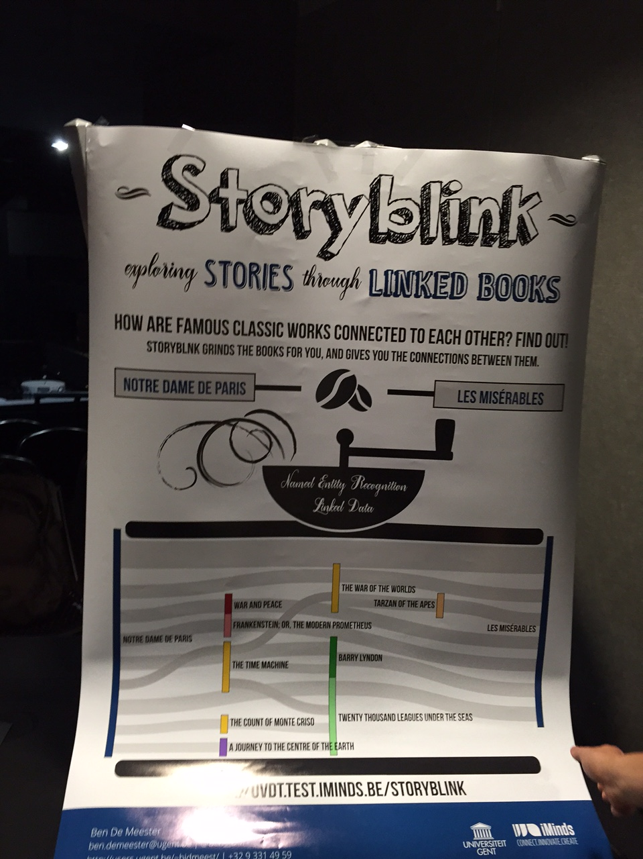
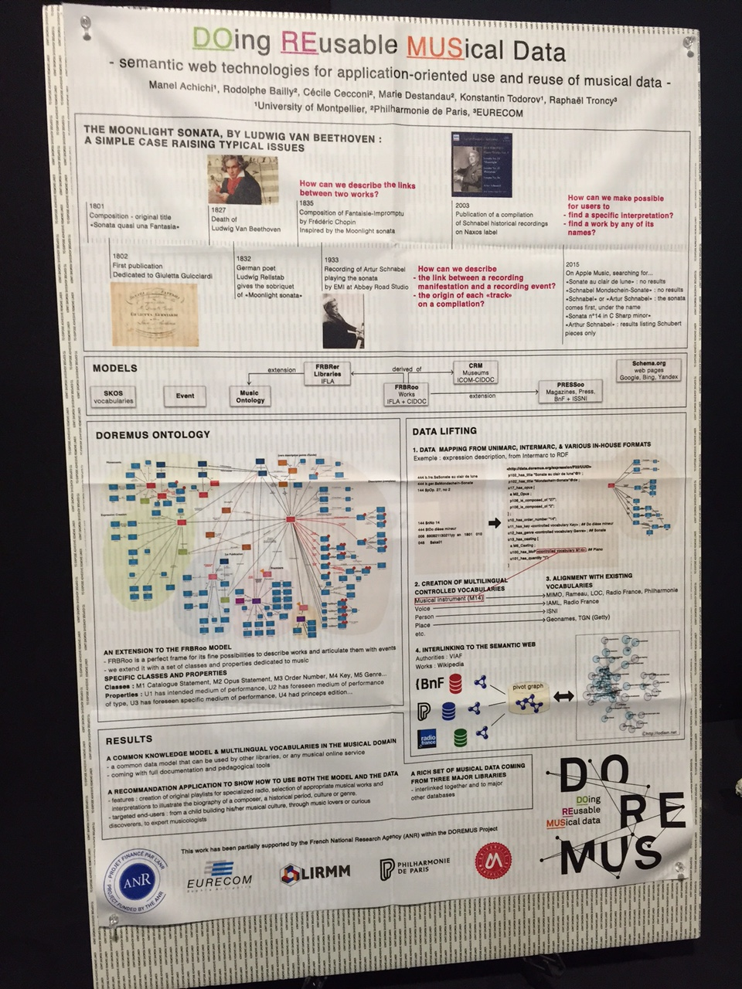
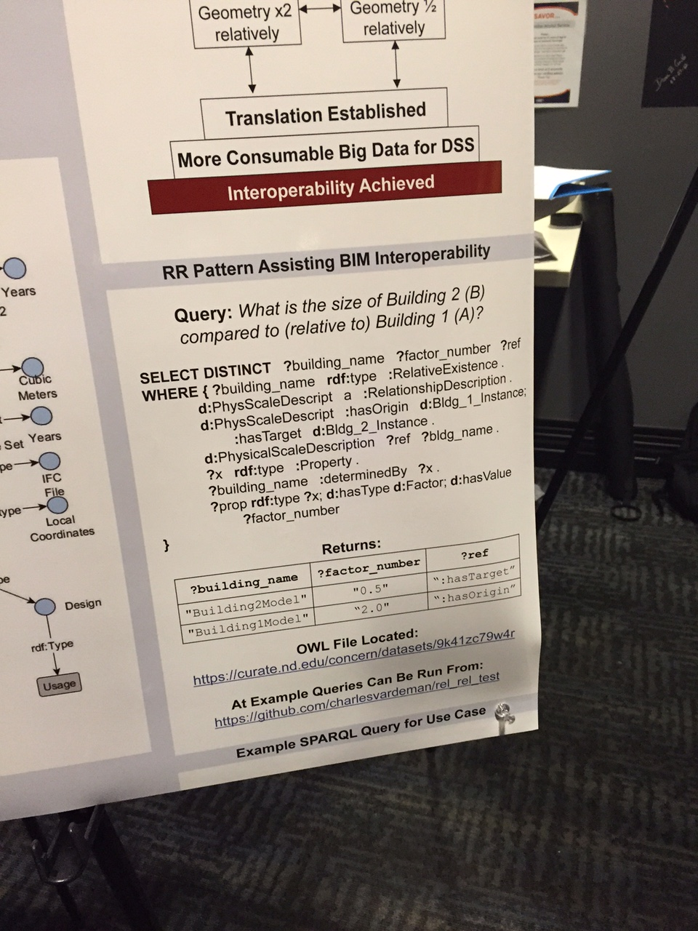
Industrial/Social Benefits of Linked Data
Notes:
Lately I’ve been thinking about the benefits of Linked Data in these two dimensions Industrial and Social. And then I went to ISWC where my instincts were only confirmed.
Libraries are a member of the information exchange economy. We no longer have the highest market share. We also have to admit that there is quality data and information resources on the web for us to take advantage of.
Industrial benefits
With more flexible frameworks and tools, we hopefully can increase our capacity for providing rich metadata for our growing collections.
Easily integrate library data using data models that are community-defined
Enhance discovery using non-library sources
Less obligated to create data redundantly for entities already described on the web as linked data
Social Benefits
Web-oriented commonly used technologies, models, and data expand options for technology partners/vendors.
We get to actively influence how new technologies and standards before they are fix.
Effectively expose our collections and data in non-library discovery environments and increase our visibility.
Our metadata can become data that exposes/informs knowledge creation.

Slide 6

Why now?
PCC URIs Task Group
LD4L and LD4P
Hydra Community and PCDM
VIVO
BIBFRAME
VRA RDF
Getty Vocabularies
…
Image credit: ctkblogdotcom.wordpress.com

Slide 7
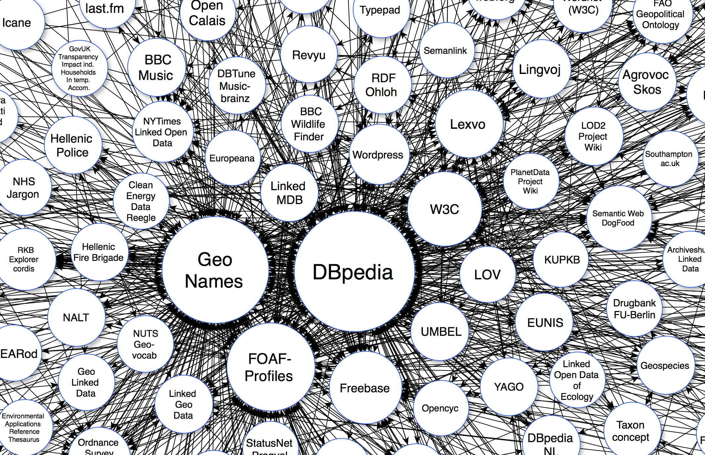
But again…
Notes:
The networked effect of our linked data efforts will be limited if there is no alignment with ontologies outside of the cultural heritage domain and/or reuse of linked data.

Slide 8

Understanding Modeling/Ontology Fundamentals
Image Credit: http://www.maciejratajski.com/work/this
Notes:
Ontology development or engineering is the act of defining within a domain the things a community wants to describe and keep information on, and the relationship between those things.
By creating RDFS and Owl ontologies, you not only define these class and properties, you begin to consider their entailments.
For instance you might have a transitive property that says Boston is part of Eastern Massachusetts, which is part of Massachusetts which is part of New England, so Boston is part of New England.
Or a Class restriction that says all brothers of fathers or mothers are the uncle of nieces or nephews, so that if a person has a father and the father has a brother, the person has an uncle.

Slide 9
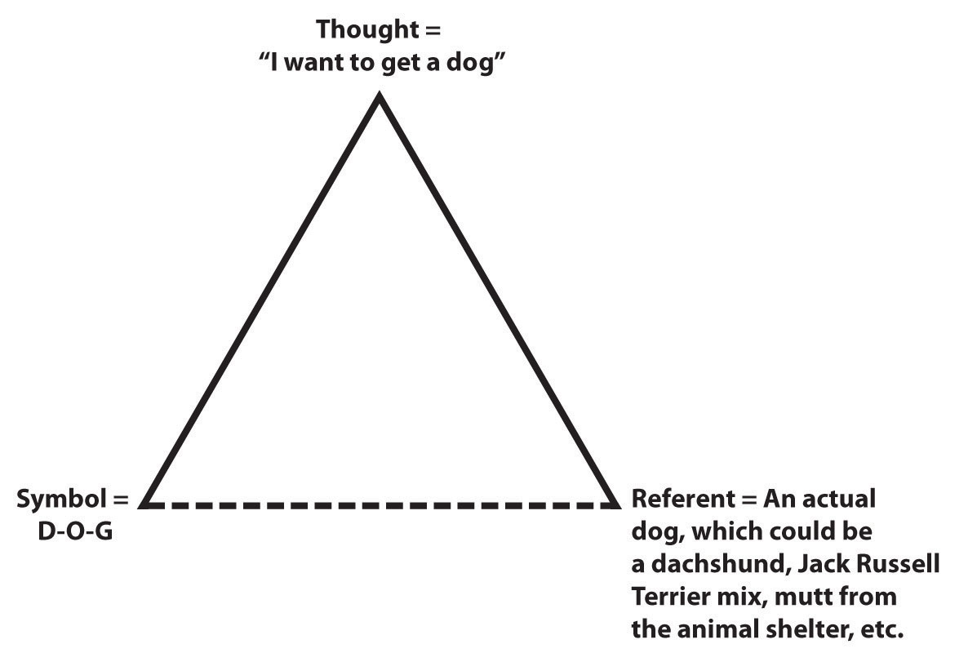
What does it all mean?
Image credit: http://catalog.flatworldknowledge.com/bookhub/reader/14959?e=jones_1.0-ch03_s01
Notes:
Source: Adapted from Ivor A. Richards and Charles K. Ogden, The Meaning of Meaning (London: Kegan, Paul, Trench, Tubner, 1923).
Entities are often described using the Meaning Triangle to explain the layers of meaning.

Slide 10
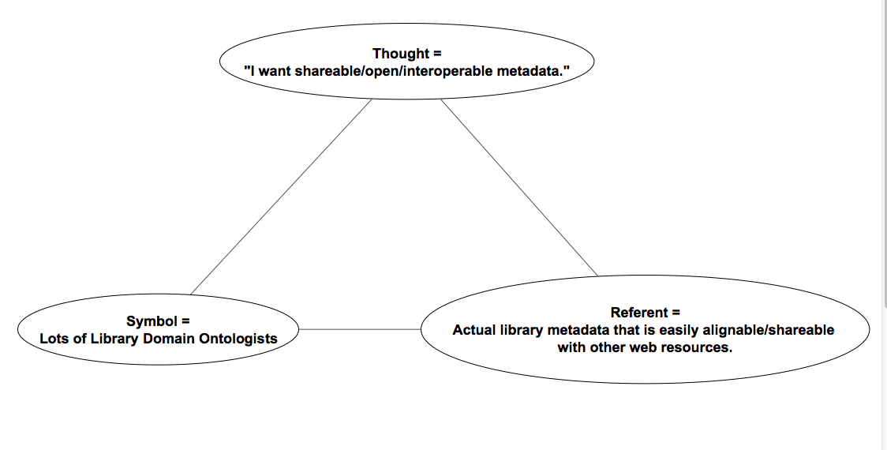
The Meaning [of My Life] Triangle
Notes:
Rather than locally/poorly defined fields, ontologies will be used. These ontologies will use/acknowledge/align with widely used ontologies and more specific domain ontologies. Ontologies are open/discoverable/explicit/machine actionable data dictionaries.
Conceding to single monolithic/watered down schema doesn’t meet researcher needs. Having a more flexible way to extend types and use more specific relationships allows us to be more expressive about library resource and give greater context while remaining interoperable.

Slide 11
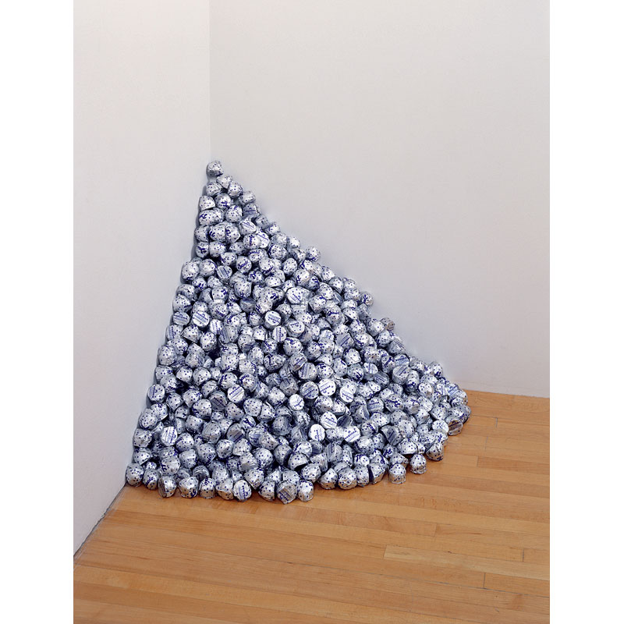
Ontology Best Practices/Process
Image Credit: http://moca.org/pc/viewArtWork.php?id=23
Notes:
There are best practices and technical standards, but there are also soft-skills required.
Skills required: creativity in modeling, community engagement
Not everyone will need to be involved modeling activities, but everyone will need to understand different entity types and relationships.
and the end game, to get our data more usable on the web and to be able to take advantage of others data.
Felix Gonzalez-Torres’s Untitled (A Corner of Baci)- a process artist who believed that “meaning is created once something can be related to personal experience.” http://moca.org/pc/viewArtWork.php?id=23 In this work, the artist invites museum goers to take a piece of candy. The museum is committed to stocking the Baci Italian kisses.

Slide 12
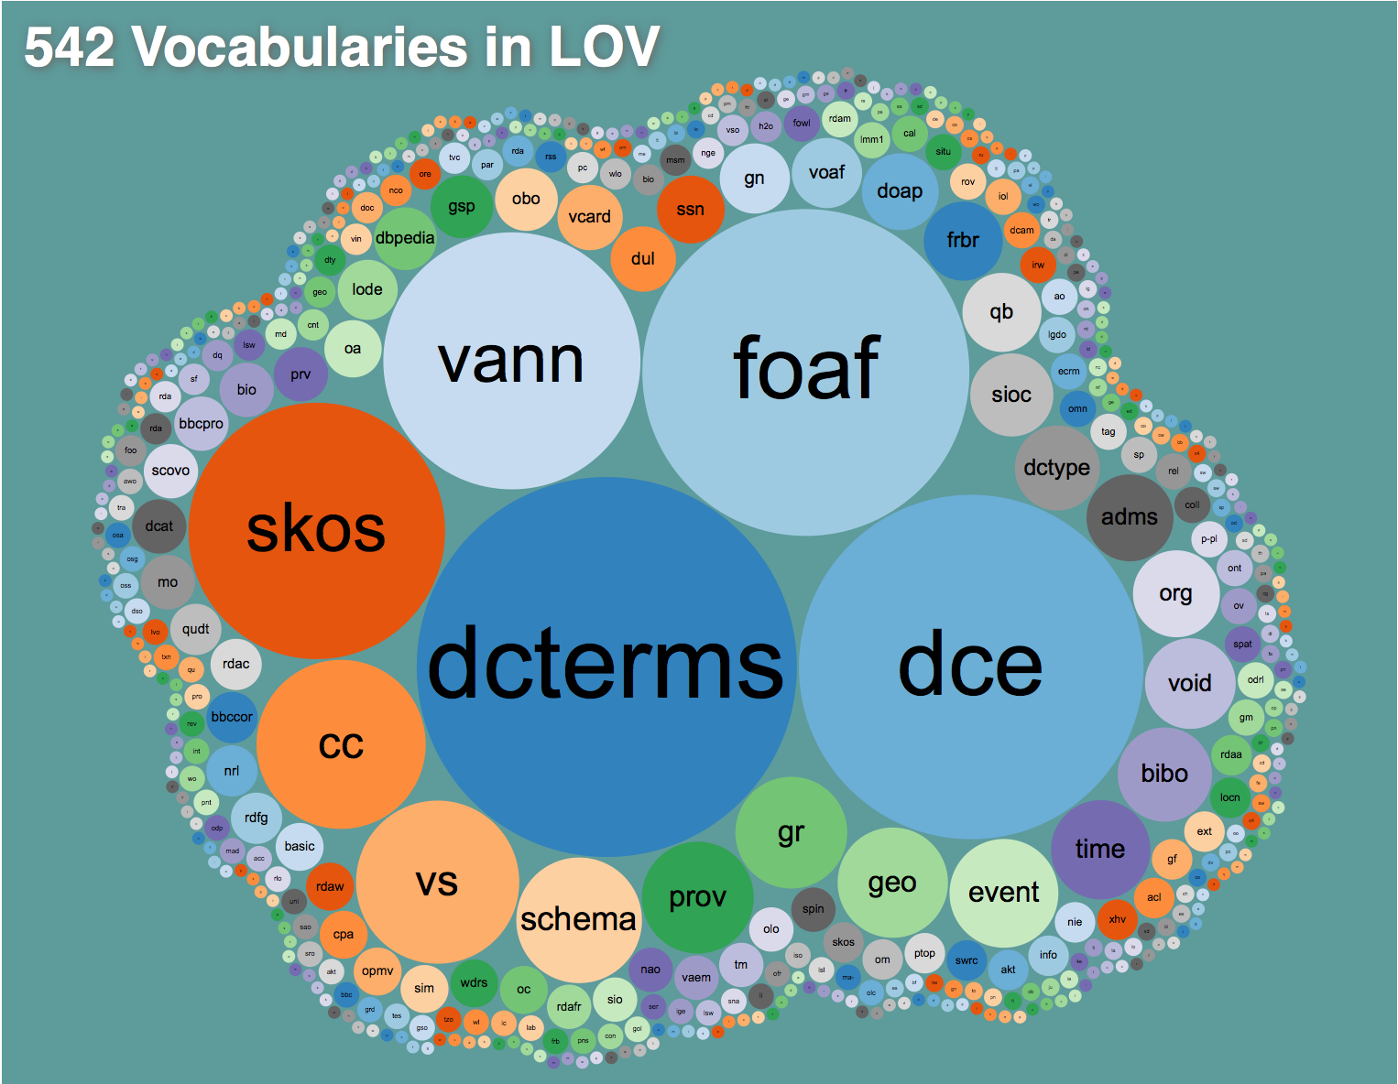
LOV: Get Familiar with Existing Ontologies
Notes:
There will be no liked data if there is no alignment amongst the different ontologies.
Linked Open Vocabularies is a great place to discovery existing ontologies. They vet the models for best practices (stable identifiers, versioning, etc.)

Slide 13
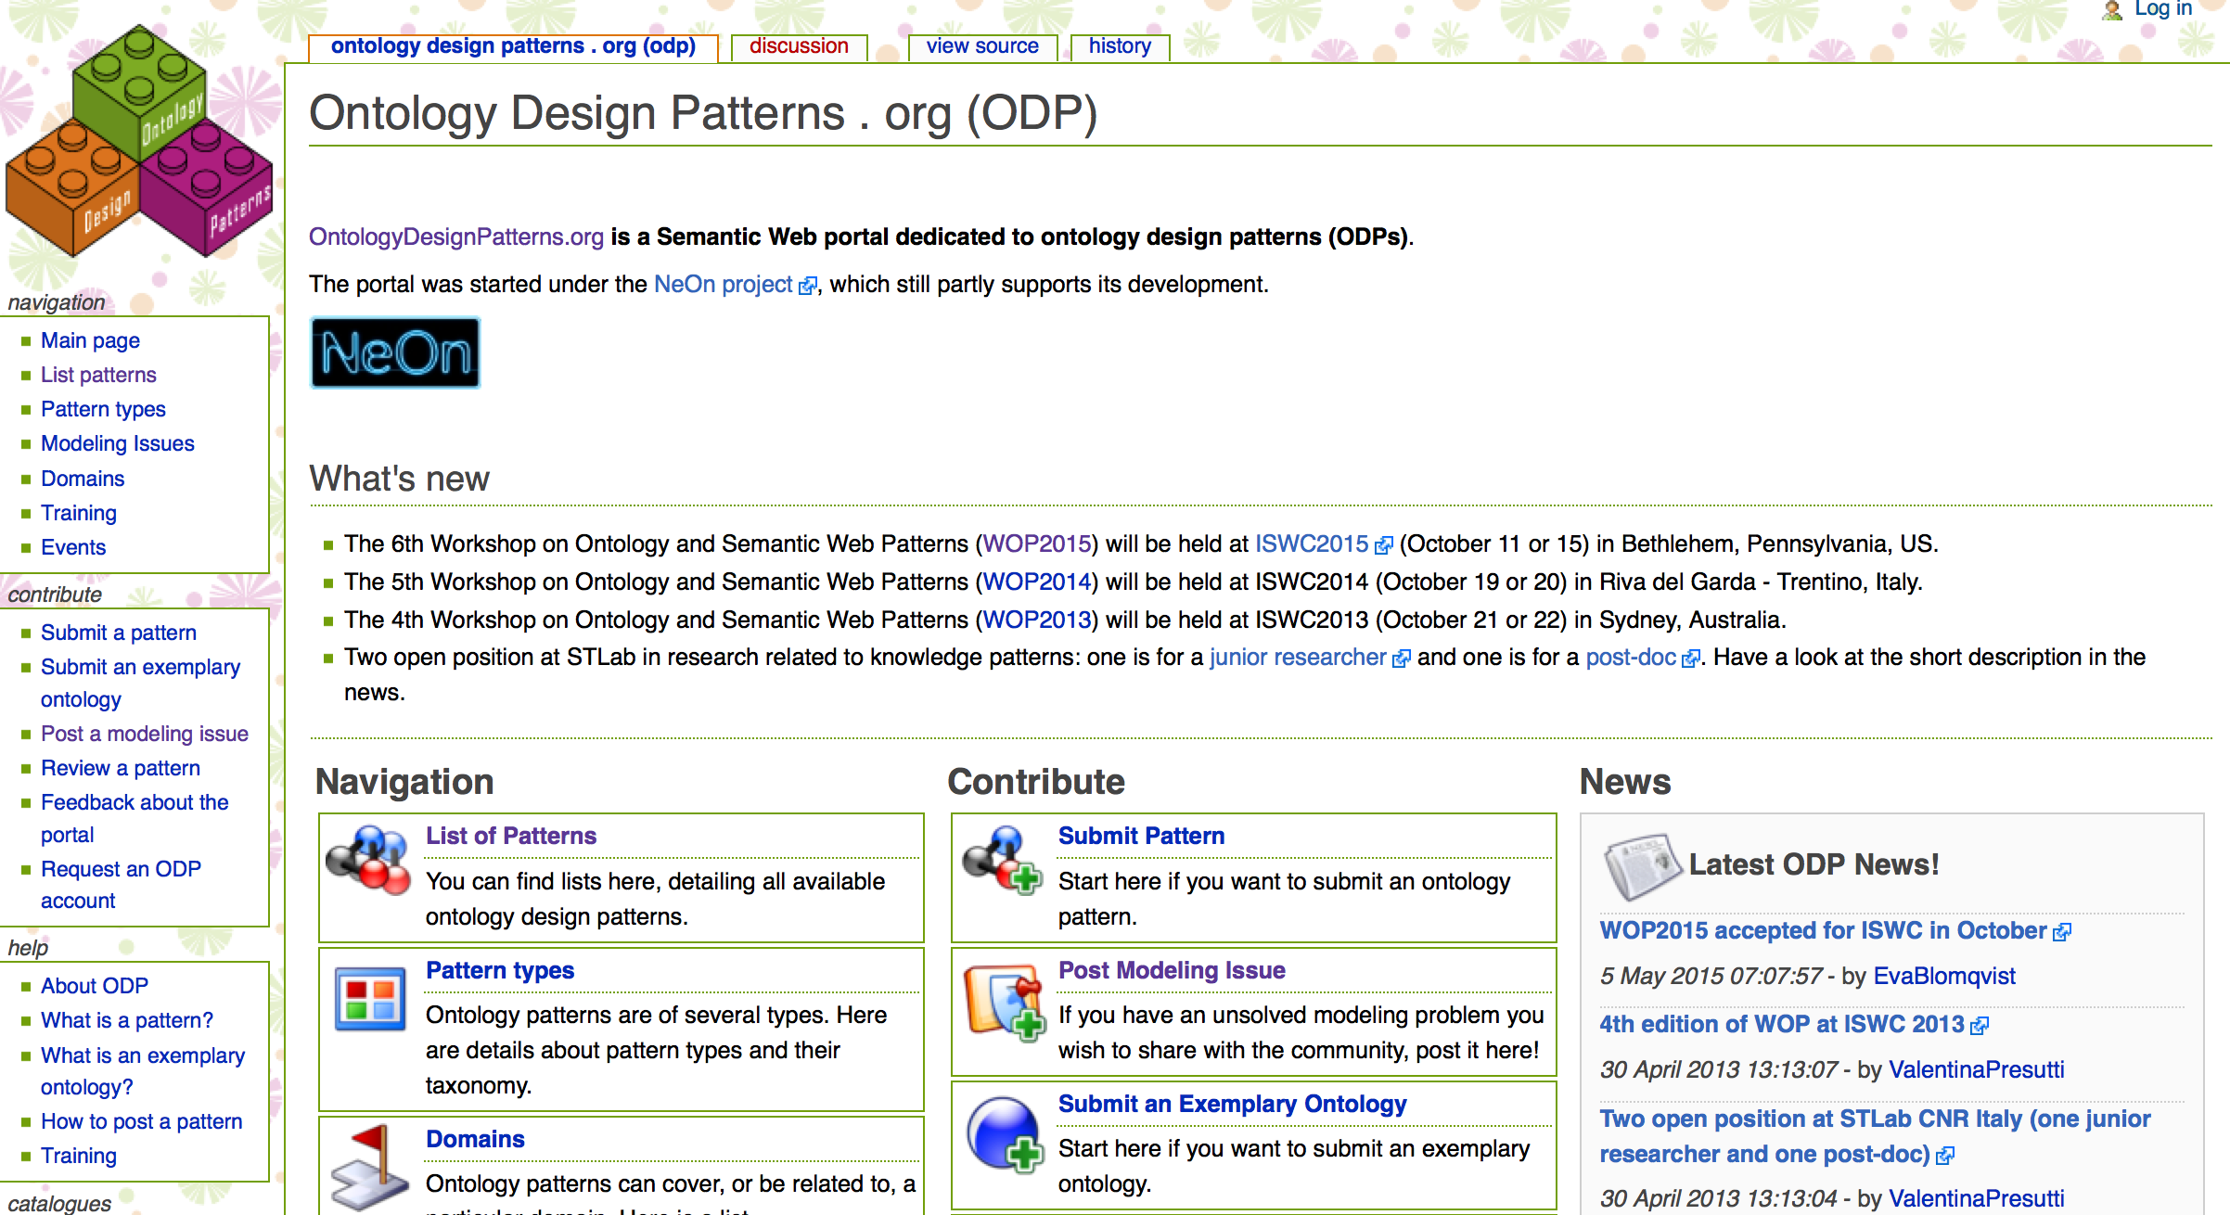
Ontology Design Patterns (ODPs)
Notes:
Consider Reuse When creating definitions.
Being overly stringent with domains and ranges inhibits their use in perfectly appropriate ways
In a “Anyone can say anything about anything” world, it’s not wrong to use a property in an unintended way, it just means that we’ll get unintended inferences
It is tempting to specify as much as possible about new terms in an ontology and lock it down with a constricting range and domain.
Only use domain and ranges, if you think it everything will always be true. Over constraining can make it difficult for others to reuse your ontology
If a property has the domain of a Person, and it is used with a Cat, then this is not an error. Instead processing systems will incorrectly infer that the Cat is also simultaneously a Person.

Slide 14
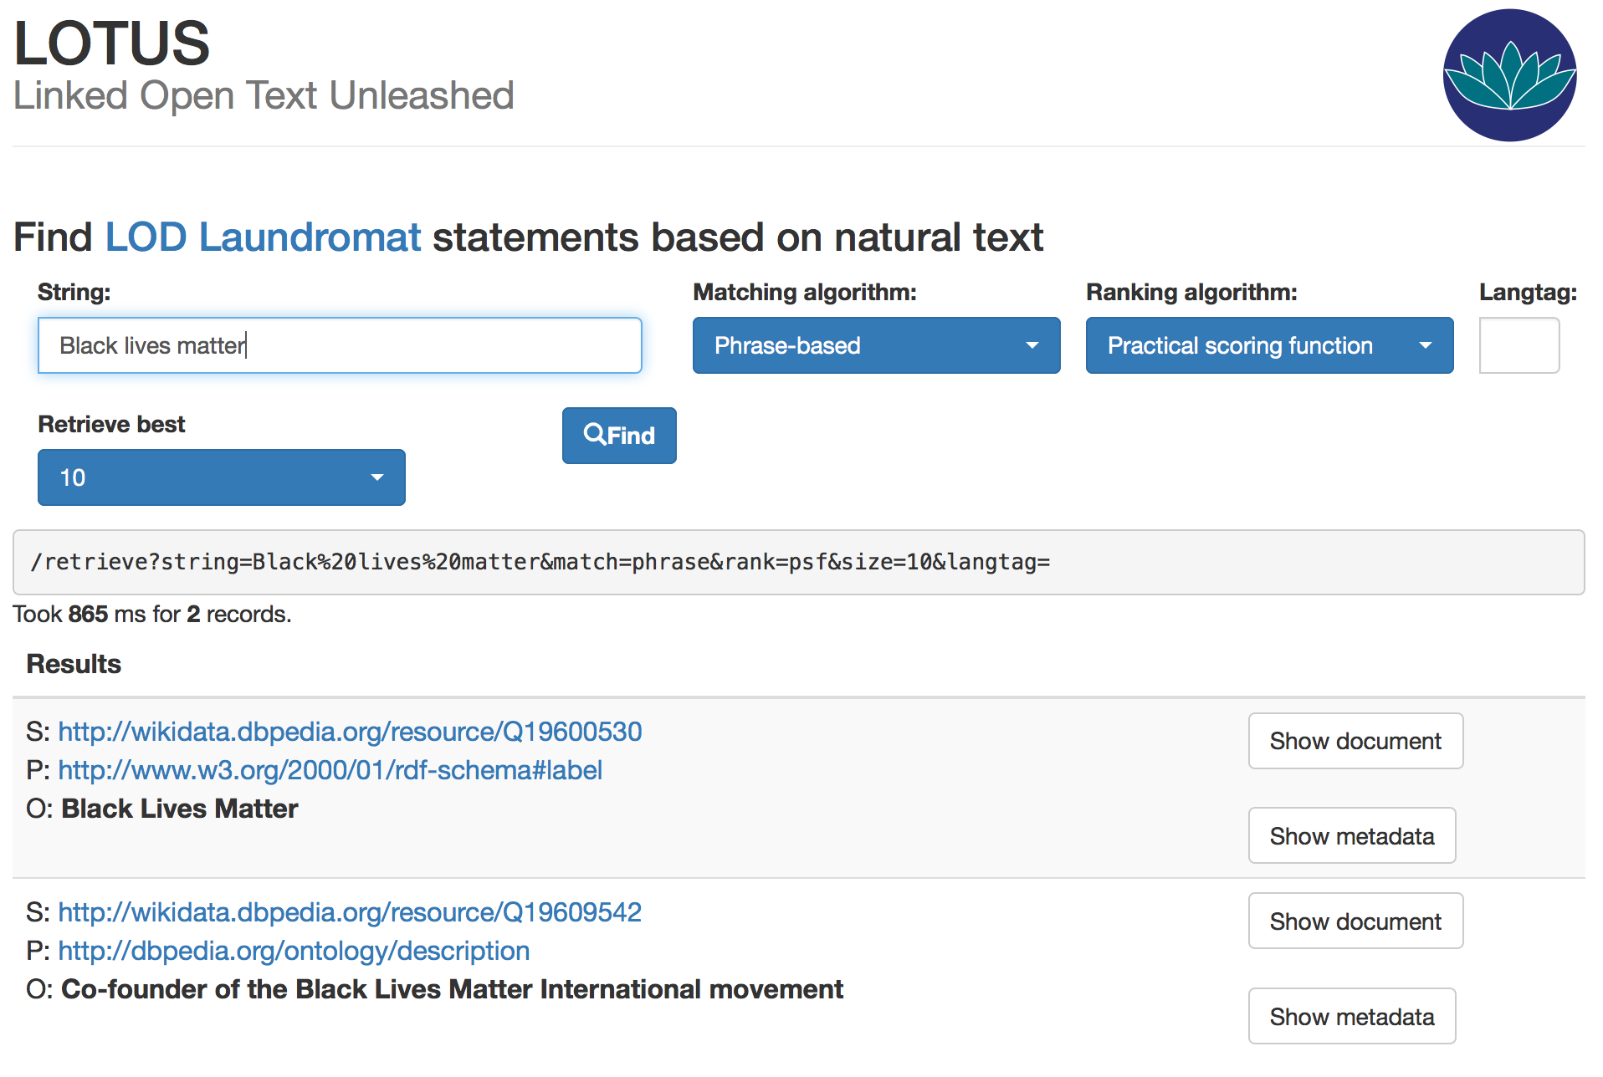
Get Familiar with Sources of Linked Data
Notes:
LOTUS is a string searching tool to discover entities described in RDF on the semantic web. Part of the Linked Open Data Laundromat product at the University of Amsterdam.
http://lodlaundromat.org/about/
LOD Laundromat
crawls the semantic web and cleans copies of the datasets. Can mostly interact with at a dataset level.
store the dirty data in the Laundry Basket
Cleans and folds in in the wardrobe.
Provides Analytics on the datasets.
More recently with a tool called Lotus began indexing the triples and can search to see if there are any rdf representations for a something on the web.

Slide 15
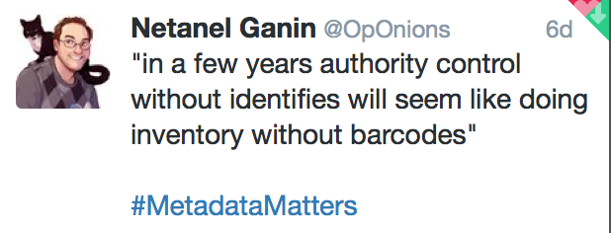
Prepare Our Data for Conversion
Normalization of Values
  Key word headings to controlled terms, etc.
Make structural changes as needed
  Break headings into atomic things (e.g. LCSH to FAST)
Entification (Adding URIs to data)
Notes:
With a model decided on…
Onto something

Slide 16
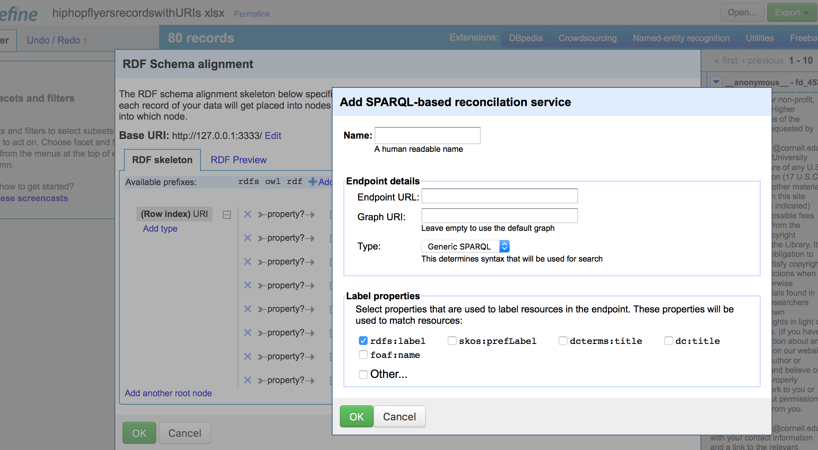
OpenRefine/LODRefine
Notes:
Next up, I want to talk about a couple tools to help with clean up and URI gathering. They aren’t the only tools or even the most appropriate for every workflow, but they give you an idea of what’s involved.
Open Refine allows you to clean up string data relatively easily and with the LOD Refine extension you can map non-RDF to RDF, and get URIs for strings.

Slide 17
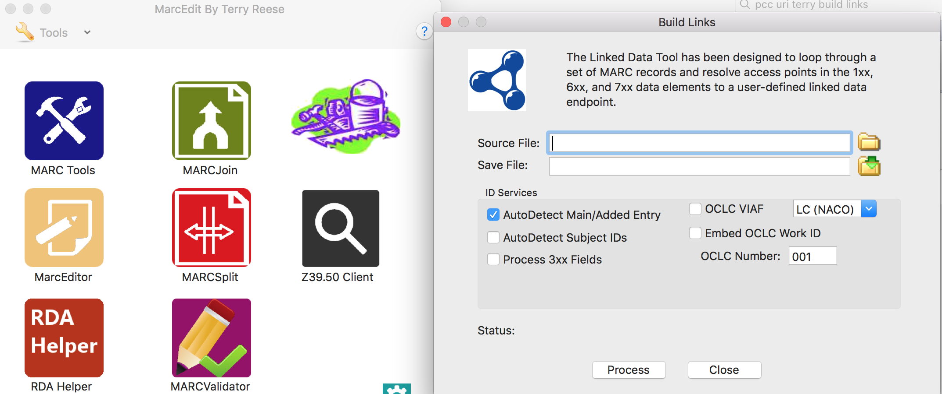
MARC Edit
Notes:
Many MARC data mungers will be familiar with MARC Edit, the reason I bring it up here is the Build Links Tool will look up URIs for 1, 6, and 7XX fields in MARC and try to bring back URIs from a data source.

Slide 18
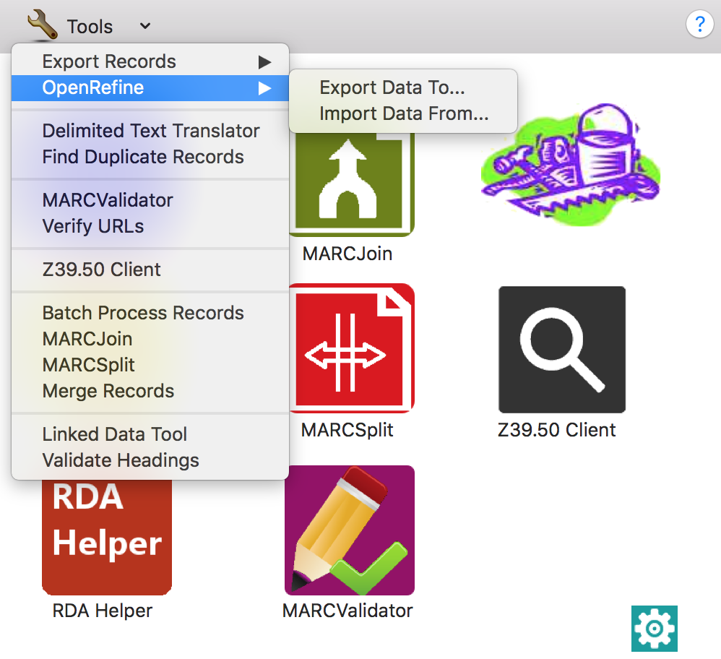
MARC Edit + Open Refine
Notes:
More recently, MARC Edit has been integrated with Open Refine so that you can pass data from one to the other to use what each is good for.

Slide 19
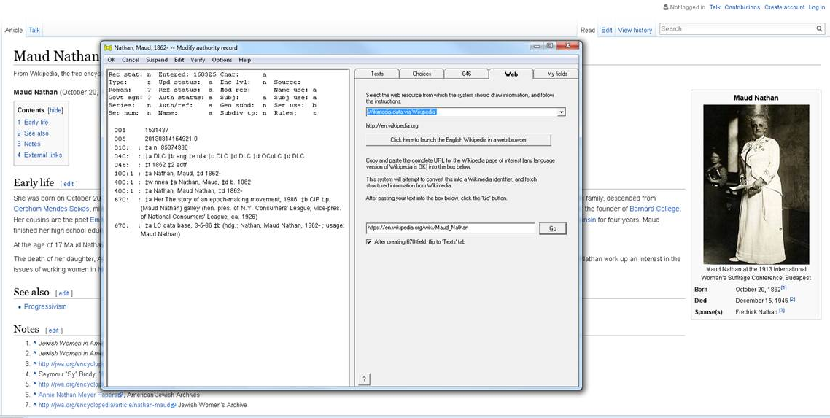
Gary Strawn’s Authority Toolkit
Image credit: Honor Moody, Schlesinger Library
Notes:
Gary Strawn (a hero in authorities circles) has been expanding his authority tool kit to be able to follow a URI and pull back linked data into Authority records.

Slide 20
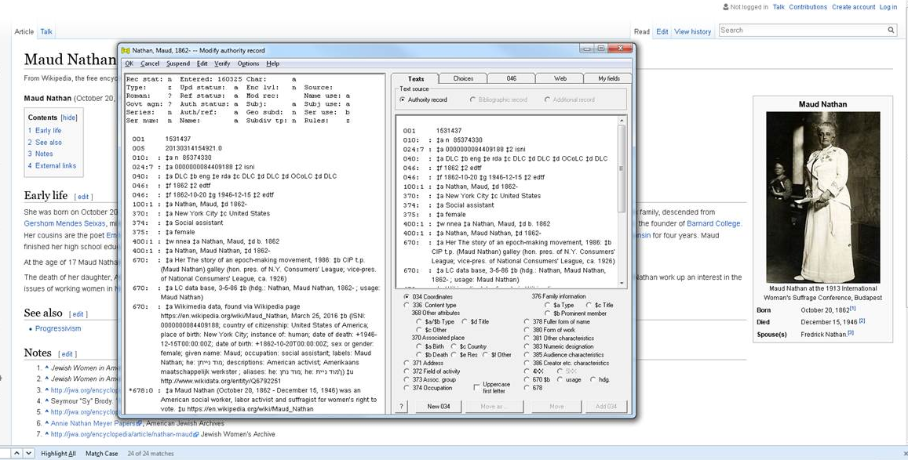
Gary Strawn’s Authority Toolkit
Image credit: Honor Moody, Schlesinger Library
Notes:
An example of the record enhanced.

Slide 21
Training Opportunities
Zepheira’s BIBFRAME training (the WHY)
Library Juice (the HOW and library context)
  Especially the Ontologies and Linked Data Course
Protégé Short Course- In depth training in OWL and ontology design through the Protégé ontology creation tool.
DIY… (SW for Working Ontologist, Twitter, Github, etc.)

Slide 22
Get Involved with Ontology Conversations
BIBFRAME List (Can be pretty testy, but there are voices of reason participating)
Protégé User List (lots of trouble shooting Protégé software, also nice ontology design conversations)
Lodlam.net,#lodlam on twitter, LODLAM Google Group

Slide 23

Start Small
Image credit: www.gillianb.com

Slide 24
Pilot: Hip Hop Flyer Metadata to RDF with links to MusicBrainz/LinkedBrainz Data
Goals
Model non-MARC metadata from Cornell Hip Hop Flyer Collection to RDF
  Test BIBFRAME for describing the flyers
  Test the use of other ontologies for describing other entities, e.g. events, venues (more on this in a moment)
Use of LinkedBrainz URIs for performers to discover relationships to other entities to discover relationships to other entities…

Slide 25
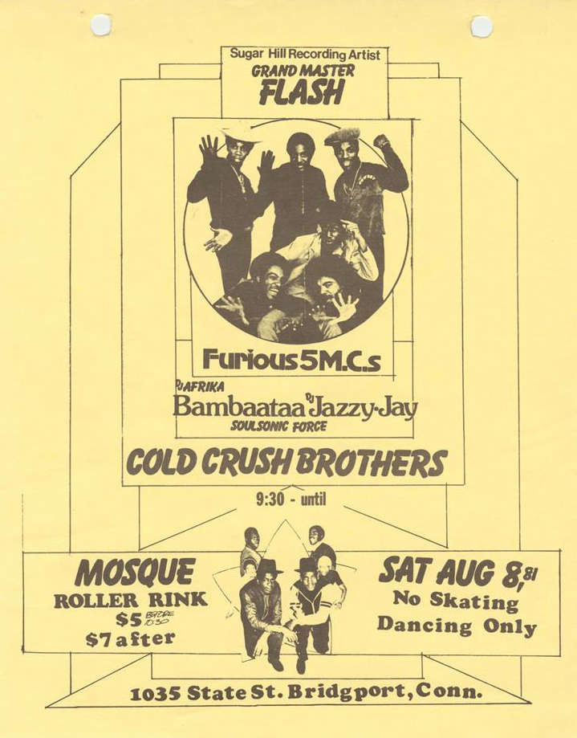
About the Hip Hop Flyers
Notes:
(494 Flyers)
Each of flyer describes an event/s
Events can have a known venue. Multiple flyers can refer to the same venue.
Each event can have anywhere from 1-20 (plus) performers
Flyer Metadata
Cataloged using ARTstor’s SharedShelf
Custom template
Uses some elements for VRA (worktype, category, start and end dates)
Customized to capture specialized metadata, graphic designer, event and venue information
Uses Getty AAT for worktypes, RefID’s.
Mostly local authorities for performers, rarely represented by LCNAF or other name authorities

Slide 26
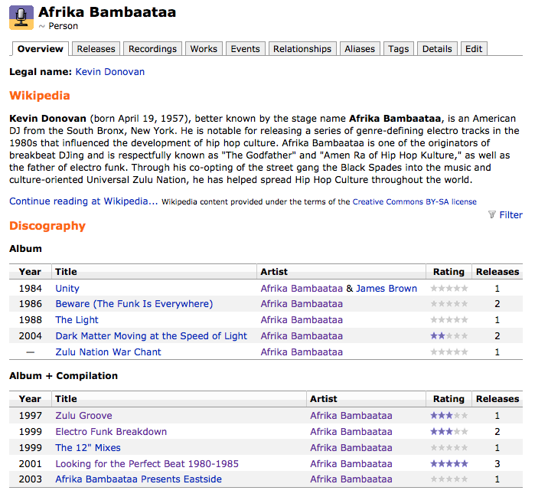
MusicBrainz
Notes:
MusicBrainz is an open music encyclopedia that collects music metadata and makes it available to the public.
Pulls in descriptions from Wikipedia
has relationships to other artists
Works they have produced
Events they were related to
All of this data is available as RDF through LinkedBrainz

Slide 27
Ontology Decisions
Describe the flyer in BIBFRAME, extend where needed
  Used Getty AAT to create bf:Work sub-classes
Describe events and related entities using MusicOntology, Event Ontology and Schema.org
Use foaf:Person’s to reflect RWO persons, with bf:Person as an associated authority

Slide 28
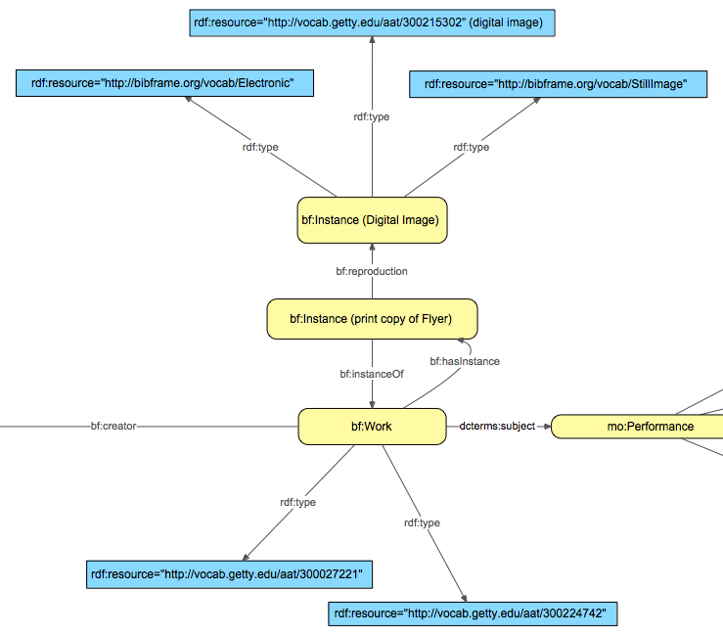
Ontology Decisions: BIBFRAME for Flyers

Slide 29
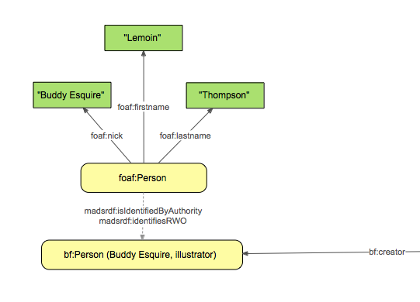
Ontology Decisions: FOAF for Persons
Notes:
Considering Schema persons as well.

Slide 30
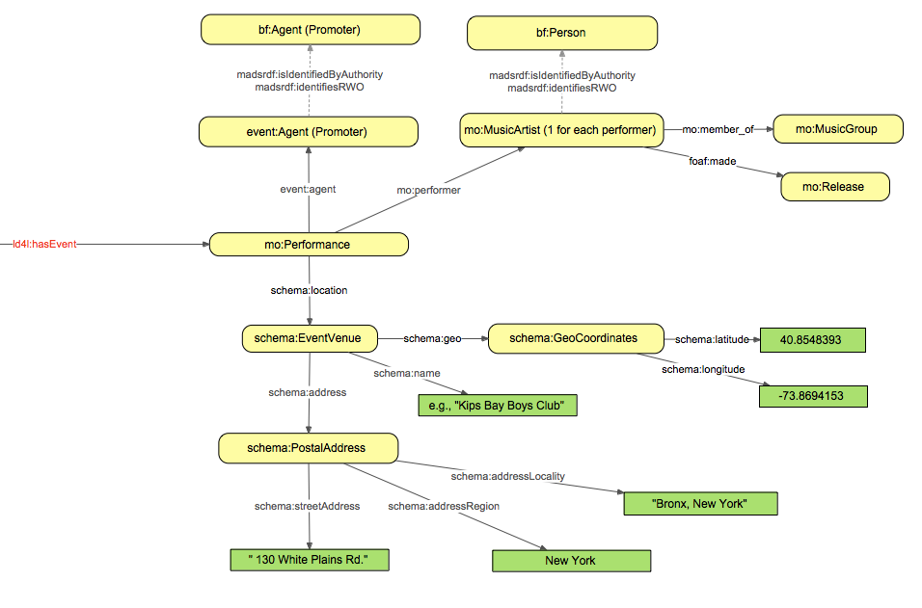
Ontology Decisions: Events and Performers

Slide 31
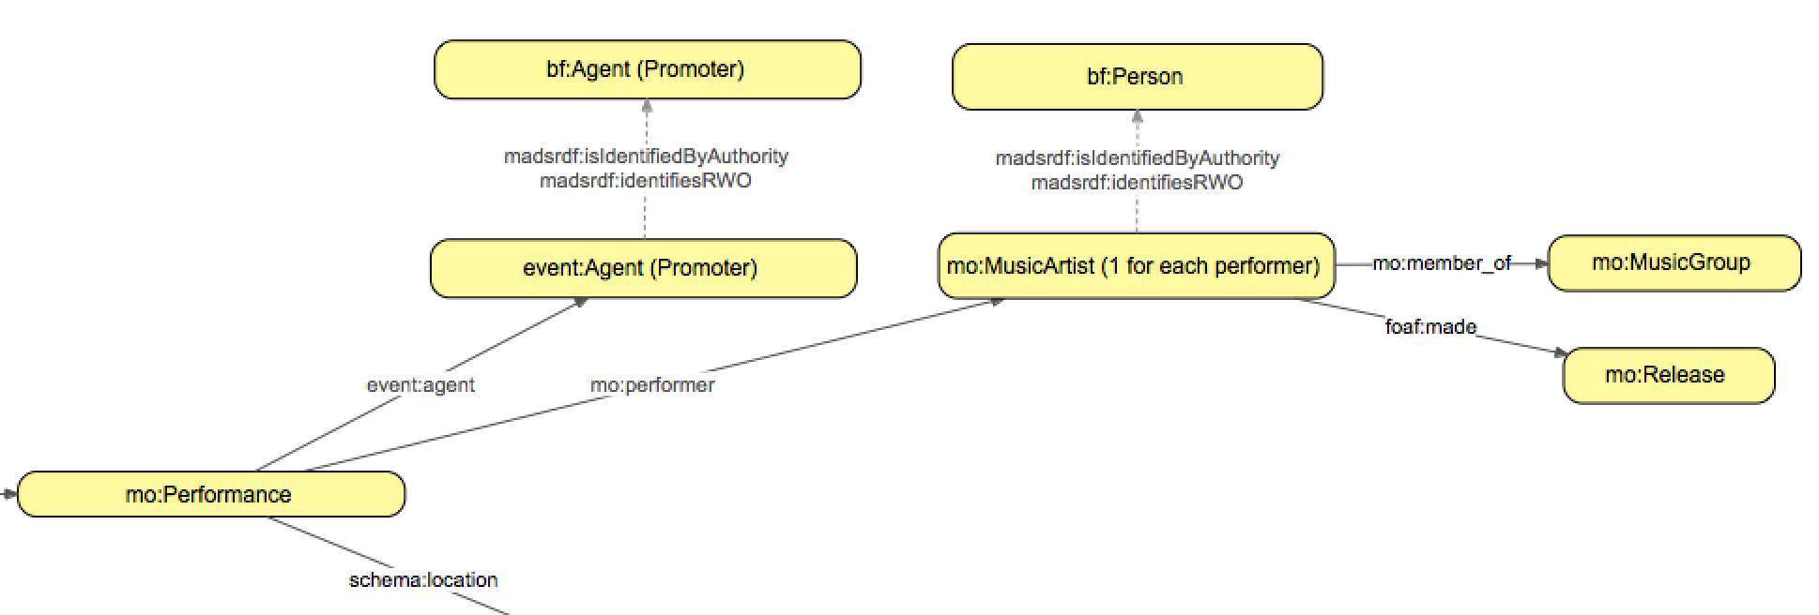
Tying this to external Graphs
When we have a MusicBrainz URI for instances of mo:MusicArtist we can query for relationships to other entities and properties of these new entities.

Slide 32
Successful LOD Needs:
Leadership
Always have answers to the Why’s on hand
  Cornell LTS and Linked Data: A Position Paper
Management
Have a staged plan
    Fund the plan (especially with staff hours)
    Consider levels of training and scaling
    Include evaluation
    Iterate
Notes:
Vision, Value, and Action

Slide 33
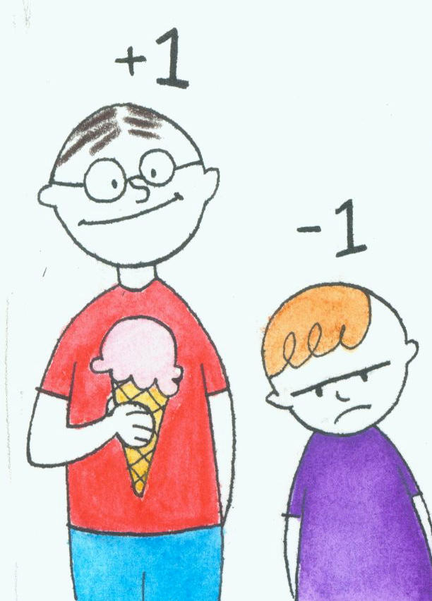
Increasing Capacity
Internal Advocacy
Parternships with other Institutions
Grants
  IMLS
  Gates
  Mellon
  Sloan
  Etc.
Image credit: www.eremedia.com
Notes:
So I’m interested in how we can increase our capacity to experiment and ultimately implement.
Human Resources are intertwined with financial resources.
How do we increase the sum in the zero-sum equation
Internal advocacy for the value of metadata
Partnerships with like-minded/complimentary institutions
Grants

Slide 34
Worst case scenario if you follow this advice…
A better articulation of the value of metadata when advocating for resources
A better understanding of new/alternative metadata techniques
A better vocabulary to discuss product development with vendors
More engaged and able workforce
Cleaner, more sustainable metadata [now]

Slide 35
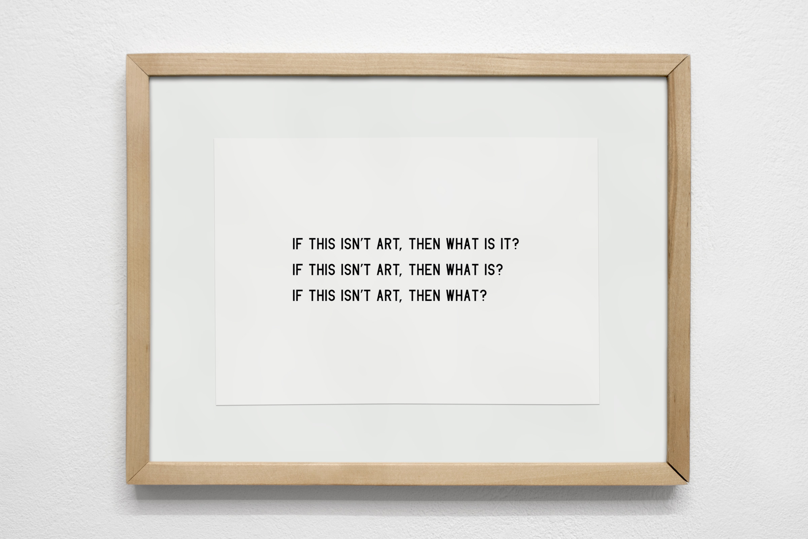
Ask Questions
Image credit: http://www.maciejratajski.com/work/what-is-art
Notes:
I’ve said this before, in different contexts, but I value learning more than self-preservation.
We need the humility to form questions, and care enough to ask them.

Slide 36
Steven Folsom
<http://id.loc.gov/authorities/names/no2015079947> mads:identifiesRWO
<http://orcid.org/0000-0003-3427-5769> .
<http://orcid.org/0000-0003-3427-5769> owl:sameAs
<http://vivo.cornell.edu/individual/sf433> ,
<http://viaf.org/viaf/316560733> ,
<http://worldcat.org/entity/person/id/2630057950> ,
@sf433 .

